Slide 1

RECITATION 9
EG1004

Slide 2
AGENDA
Resume Review Practice
Graduate School
Engineering ePortfolios
How to Give the Final Project Presentation
Lab 8 Presentations
1

Slide 3
RESUME REVIEW

Slide 4
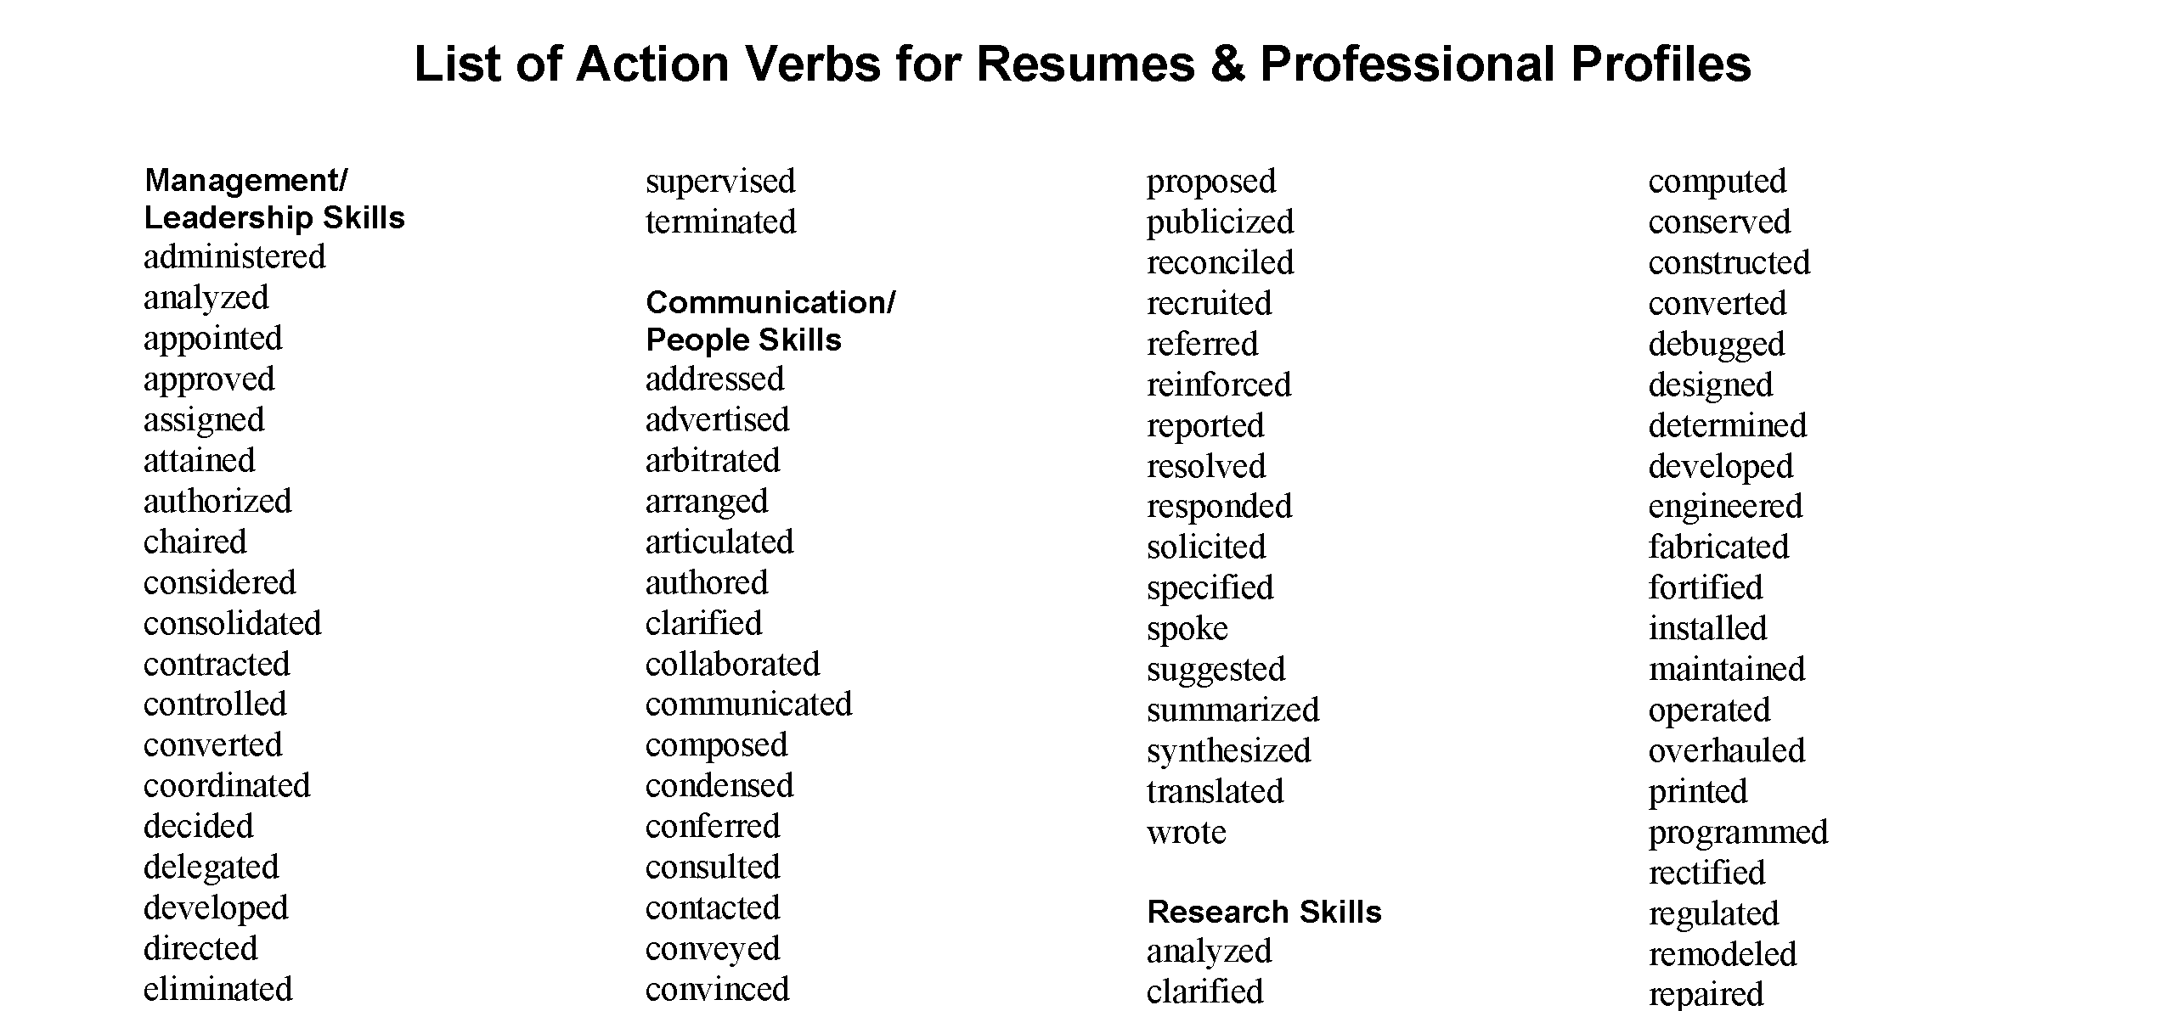
RESUME ACTION VERBS
Learn More
Figure 1: Action verbs for resumes courtesy of Washington State University
3

Slide 5
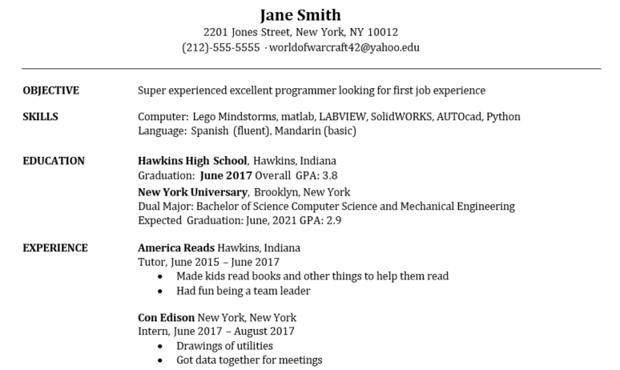
SPOT THE ERRORS
4
Notes:
Using the knowledge that you have gained today and in past recitations, what suggestions would you make to Jane to improve their resume? **Ask students to raise their hands and participate**

Slide 6
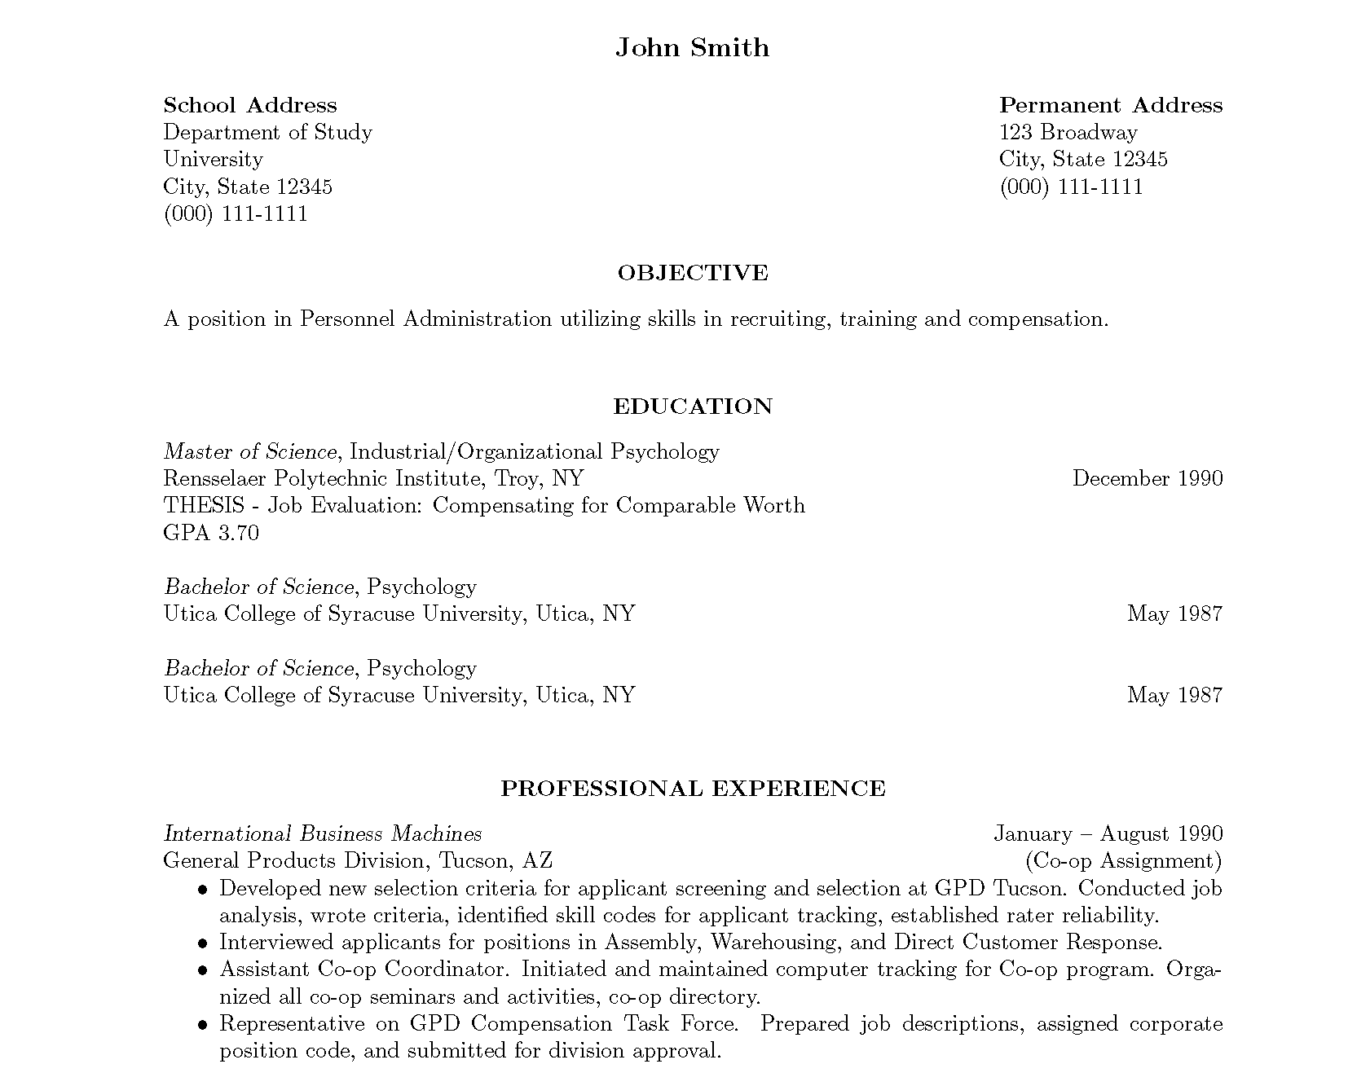
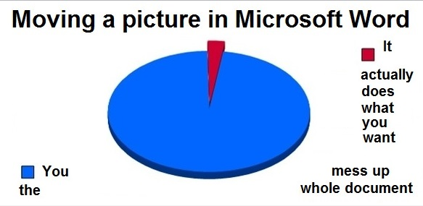
LaTeX
5
Notes:
LaTeX is a software for document preparation and is largely what is used when creating scientific papers to manage formatting. This also is a good resource for completing your resume as shown on the right instead of using Microsoft Word.

Slide 7
GRADUATE SCHOOL

Slide 8
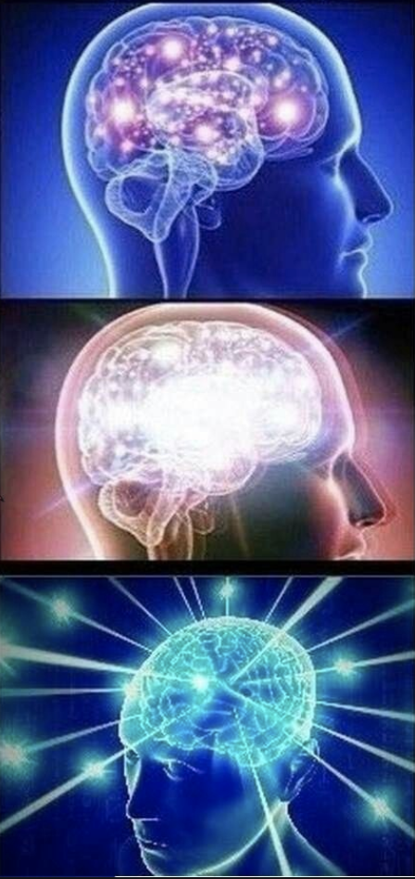
UNDERGRAD VS GRAD
Undergraduate (Design)
  Create a meal from a recipe
Masters (Analysis)
  Create a recipe for a meal
Doctoral (Modeling)
  Create a meal
Figure 2: Cognitive growth courtesy of Reddit
7

Slide 9

FINDING A PROGRAM
US News and World Report
  Skewed by funding and test scores
Talk to alumni
Visit campuses
Specialized interests
8

Slide 10
FACTORS TO CONSIDER
Do some research on the university
  Course options, research, teaching
  Professors and projects
  Student activities
Your advisor is the most important consideration
Talk to professors at NYU
Location is critical for job market
9

Slide 11

APPLYING
Prepare for the GRE
  Take several practice exams
Three recommendation letters
  Academic references better
  Connections are most important
Personal statement
10

Slide 12

OPPORTUNITIES
Graduate research assistant
Graduate teaching assistant
Fellowships
  NSF GRFP
  University fellows
  Other program specific scholarships
11

Slide 13
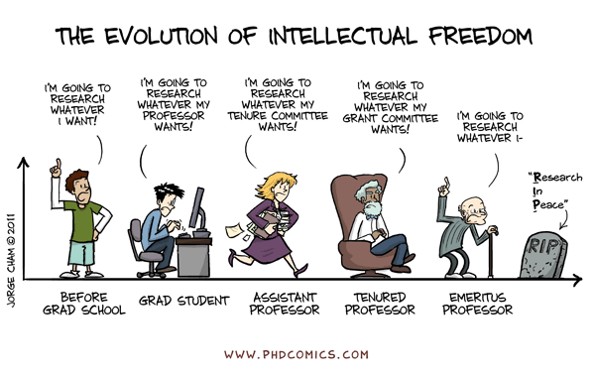
PHD HUMOR
12

Slide 14
QUESTIONS?

