Slide 1
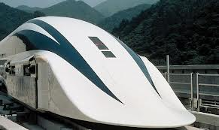
EG1003: Introduction to Engineering and Design
Magnetic Levitation Competition

Slide 2
Overview
Objective
Background Information
Rules of the Competition
Materials
Procedure
Report / Presentation
Closing

Slide 3
Objectives
Assemble a cart suspended by magnetic levitation while keeping in mind the aspects of minimal design
Reach Checkpoint A (LED 20) of the track
Reach Checkpoint B (LED 40) of the track

Slide 4
Magnetic Levitation
Magnetic levitation is a type of levitation that depends on the magnetic fields generated from electromagnets
Types of Magnetic Levitation:
Electromagnetic Suspension (EMS)
Electrodynamic Suspension (EDS)

Slide 5
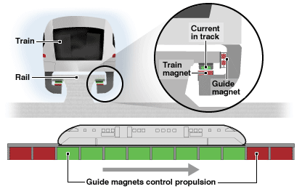
Electromagnetic Suspension (EMS)
EMS: technique inducing a current through the electromagnets using large power source
Magnetized electromagnets used to create propulsion in the Magnetic Levitation vehicles

Slide 6
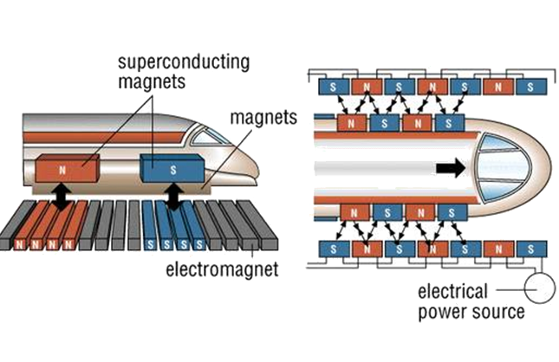
Electrodynamic Suspension (EDS)
EDS: technique of exposing superconductors to magnetic fields that vary with time
Time-varying magnetic fields operate the magnetic levitation vehicles more efficiently

Slide 7
Earnshaw’s Theorem
Earnshaw’s Theorem states levitation in a constant magnetic field is not possible
Magnetic field requires additional guidance on the sides of the track for stability (so it doesn’t derail from the track)

Slide 8
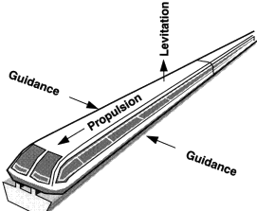
Magnetic Levitation Trains
Three main components: Guidance, Propulsion, Levitation
Propulsion and levitation are caused by electromagnets
Guidance keeps the Magnetic Levitation trains on the track

Slide 9
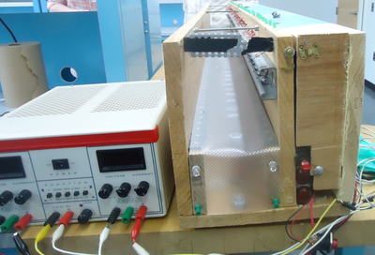
Magnetic Levitation Track
Magnetic Levitation track
LEDs and Photo resistors block using provided flag
Power Supply
Electromagnets

Slide 10
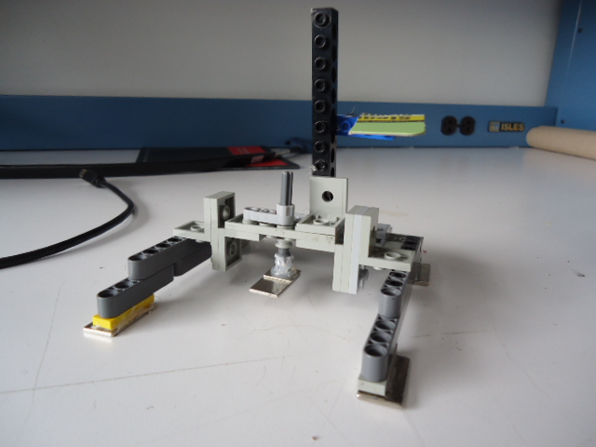
Magnetic Levitation Cart
Prototype of a Magnetic Levitation Cart
Flag
Outer Magnets
Central Magnet Type 2
Robot Arms
(Custom)

Slide 11
Competition Rules
The TA must approve your design before you are allowed to add your magnetic components
All the materials you use in your design must be purchased, and are non-refundable
The maglev cart must fit into the maglev track and must include the flag piece included in the maglev Lego kit
You may conduct up to three trials and the best ratio of the three trials will be taken
A TA must be present to oversee your trial or the results of that trial will become invalid

Slide 12
Competition Rules
All Magnetic components must be returned at the end of the experiment or your grade for this lab may be jeopardized.
Your 3 trials will be scored using this equation:

Slide 13
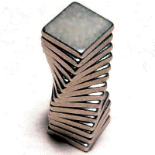
Material Price List
Center Magnet Type 1:.………………………$1.00 (max one)
Center Magnet Type 2:.………………………$1.50 (max one)
Outer Magnets (Custom):..…………………………$0.75/each
Long Magnets (3/4” x 3/8” x 1/16’’ thick):…………$0.50/each
Square Magnets (3/8’’ x 3/8’’ x 1/8’’ thick):.………$0.25/each
Bearings: …………………………………………….$0.25/each
Maglev Lego Kit:.…………………………....……...$0.00

Slide 14
Procedure
Brainstorm possible designs
Sketch design on paper
Obtain a Maglev Lego Kit after your design is approved by a TA
Assemble your design using the Maglev Lego Kit

Slide 15
Procedure
Obtain the magnetic parts from a TA
Create price list detailing your design
Conduct practice runs to optimize your design
Conduct your three trials to obtain your minimal design ratio

Slide 16
Procedure
Disassemble your cart and return all the parts to the Maglev Lego Kit
Magnetic components must be returned before leaving the room

Slide 17
Assignment: Report
Individual Lab Reports
Title page
Discussion topics in the manual
Include original data with instructor’s initials
Scan in lab notes (ask TA for assistance)
TA must initial that table and graph were completed
Include table, graph, and photo of container

Slide 18
Assignment: Presentation
Team presentation
State rules of competition
Describe your design and its concepts
Include table of class results and photo of cart
How could your current design be improved?
Refer to “Creating PowerPoint Presentations” found on EG website

Slide 19
Closing
Have all original data signed by TA
Submit all work electronically
Clean up workstations
Return all unused materials to TA

