Slide 1

HOW TO GIVE A MILESTONE PRESENTATION
EG1004 | RECITATION 4

Slide 2
AGENDA
Milestones & Benchmarks
Milestone Presentation Overview
Milestone Presentation Format
Questions
1

Slide 3
MILESTONES & BENCHMARKS
Milestones
One Milestone
Make a presentation
Update progress on semester-long design project (SLDP)
Benchmarks
One Benchmark
List of tasks to complete
Tasks are semester-long design project (SLDP) dependent
2

Slide 4
MILESTONE PRESENTATION
OVERVIEW
Timed five-minute presentation
Update on progress of SLDP
Technical project progress/update presentation
Be a bit more creative with these presentations!
3

Slide 5
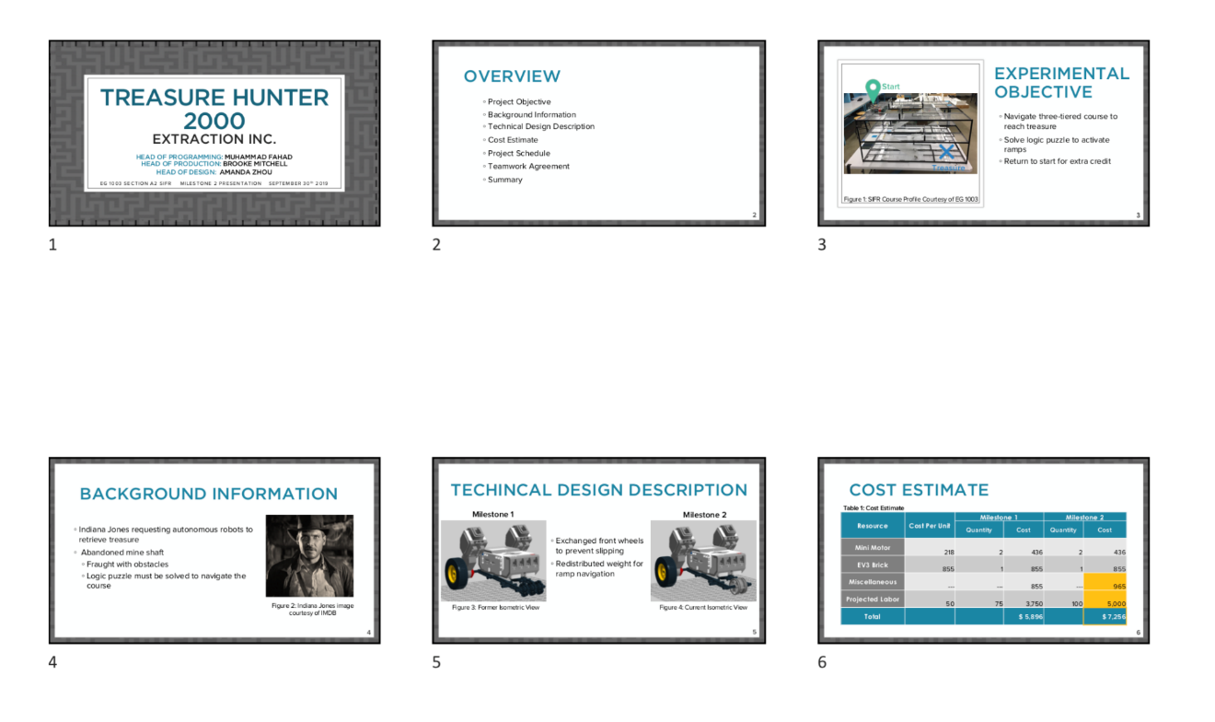
MILESTONE PRESENTATION
OVERVIEW
Submission:
Email by 11:59 PM night before recitation
Figure 1: Multiple slide view
4

Slide 6
MILESTONE PRESENTATION
FORMAT
Consistent format and order for all Milestone presentations:
Title
Agenda
Project Objective
Background Information
Technical Design Description
Summary
Title
Different format than lab presentations!
5

Slide 7

TITLE SLIDE
Product name
Company name
Group members with company titles
EG1004 section
Date
You create! Remember to be professional!
Figure 2: Title sample slide
6

Slide 8
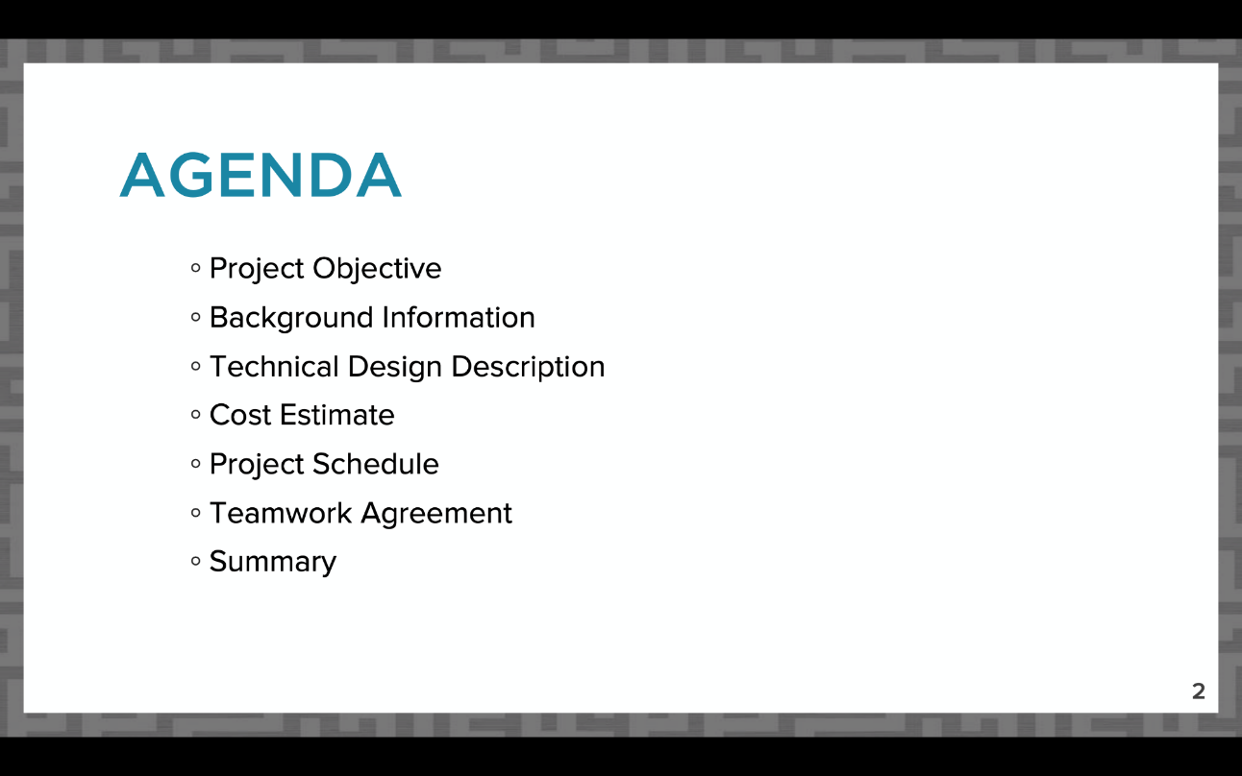
AGENDA SLIDE
Slide title “Agenda”
No need to read slide aloud during presentation
Same agenda slide/order for all Milestone presentations!
Figure 3: Agenda slide sample
7

Slide 9
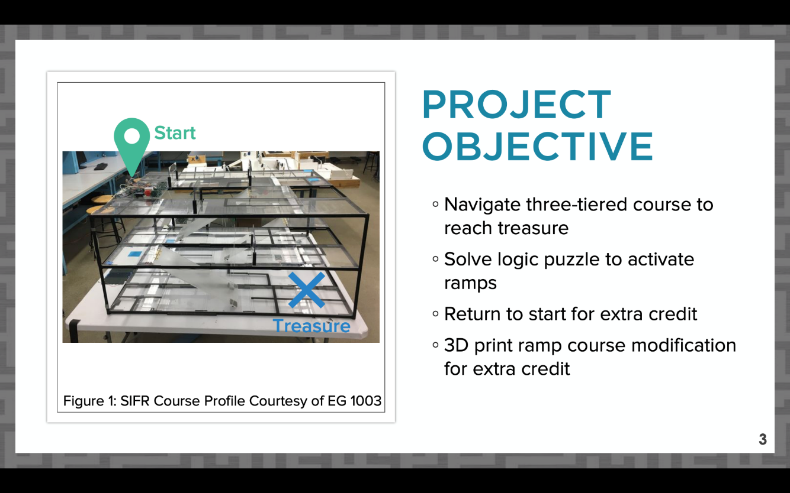
PROJECT OBJECTIVE SLIDE
Slide title “Project Objective”
What are you doing in your project?
Include overall approach
Figure 4: Project objective sample slide
8

Slide 10
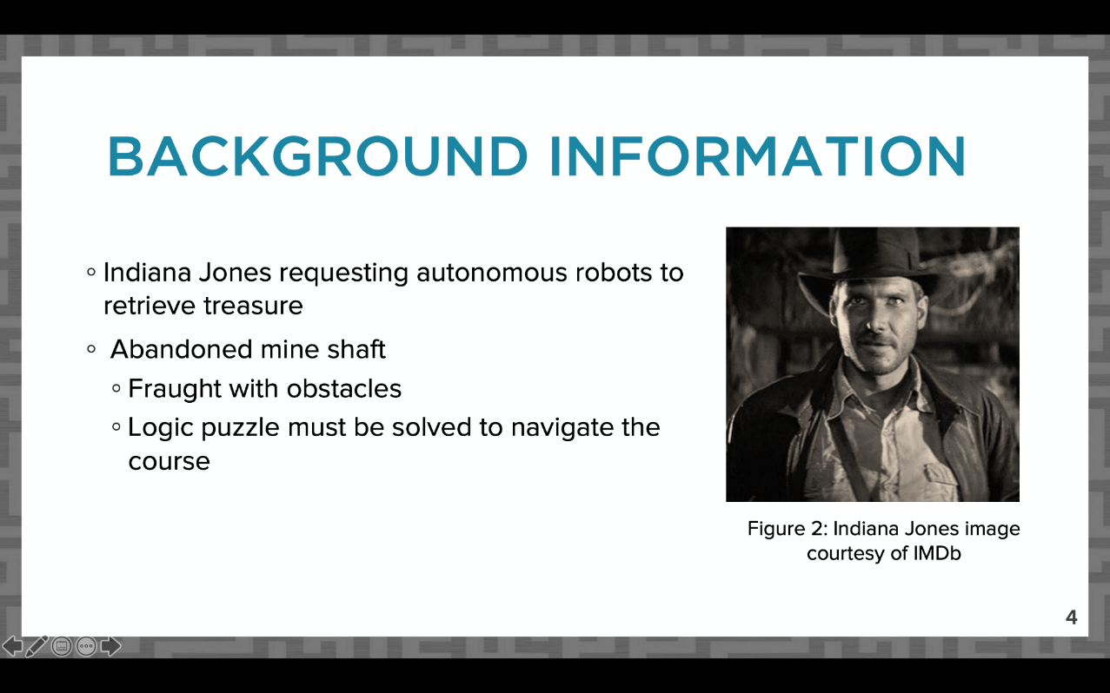
BACKGROUND INFORMATION
SLIDE
Slide title “Background Information”
Problem/Mission Statement
Why are you completing the project?
Figure 5: Background information sample slide
9

Slide 11
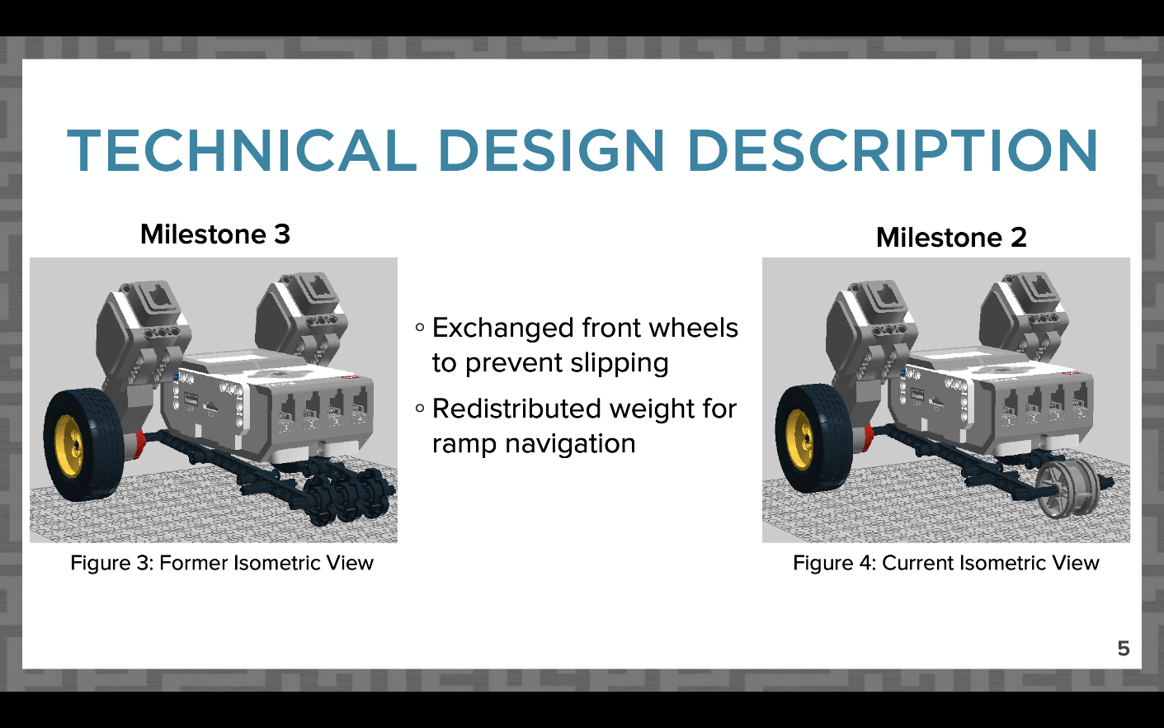
DESIGN DESCRIPTION SLIDES
Slides titled “Technical Design Description”
How does your project work?
Circuit diagram(s)
Code flowchart
For future Milestones, compare changes in design
Figure 6: Sample CAD design change comparison
10

Slide 12
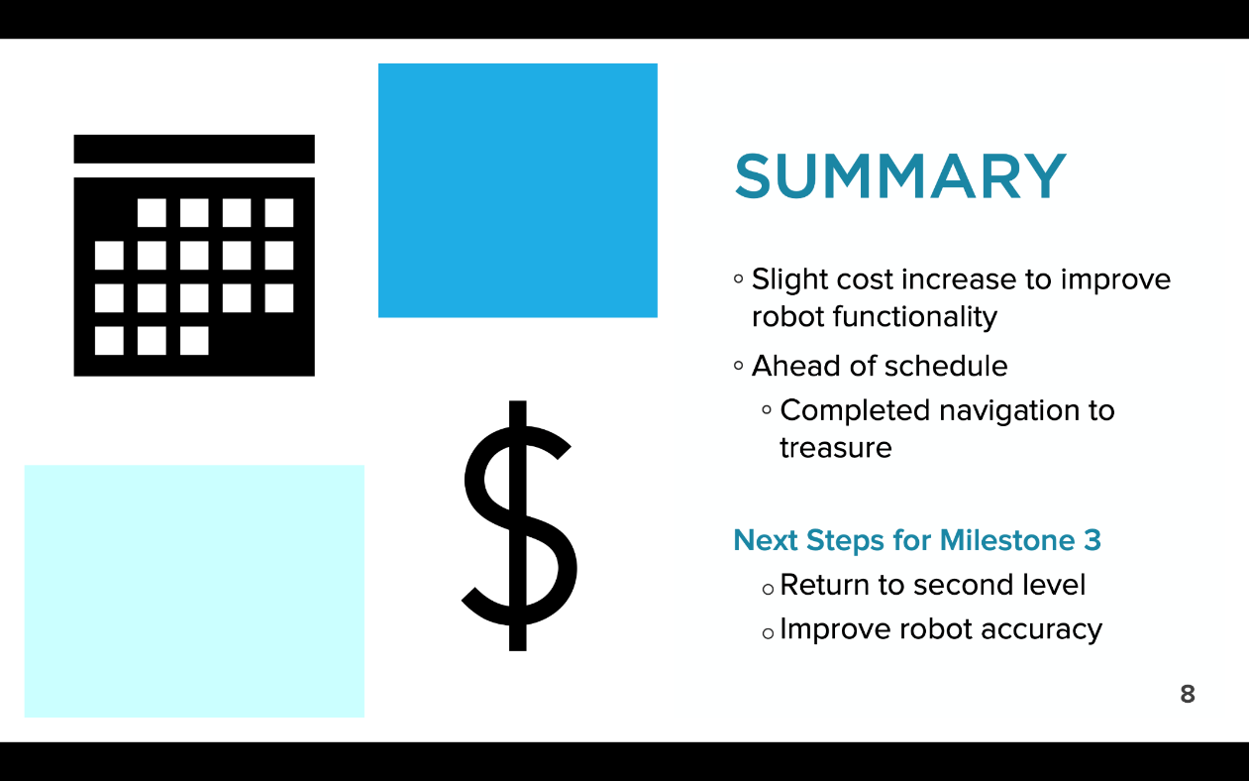
SUMMARY SLIDE
Slide title “Summary”
Overall assessment on project
Include next steps
Figure 9: Conclusion sample slide
15

Slide 13
QUESTIONS?

