Slide 1
The Timeshifter
Hour Glass, Inc.
Eve Fishinevich (Project Coordinator)
Rondell Sinanan (Head of Research)
Milestone 3
Date of Presentation: 10/99/9999
Section Z
Notes:
To replace this picture, just select and delete it. Then use the Insert Picture icon to replace it with one of your own!

Slide 2
Agenda
Project Objective
Background Information
Technical Design Description
Cost Estimate
Project Schedule
Summary

Slide 3
Projective Objective
Petitioning for the creation of the world’s first working time machine
Aiming to retrieve force field generator & saber tooth tiger
Aiming to have it run at 50 years per minute

Slide 4
Background Information
Requirements:
Retrieve one item from the past
Retrieve one item from the future
NASA is soliciting designs for a time machine to find alternate energy sources

Slide 5
Technical Design Description
Our robot uses quantum technology to warp time
Travels 50 years in 2 minutes
Faster by 1 minute since Milestone 2

Slide 6
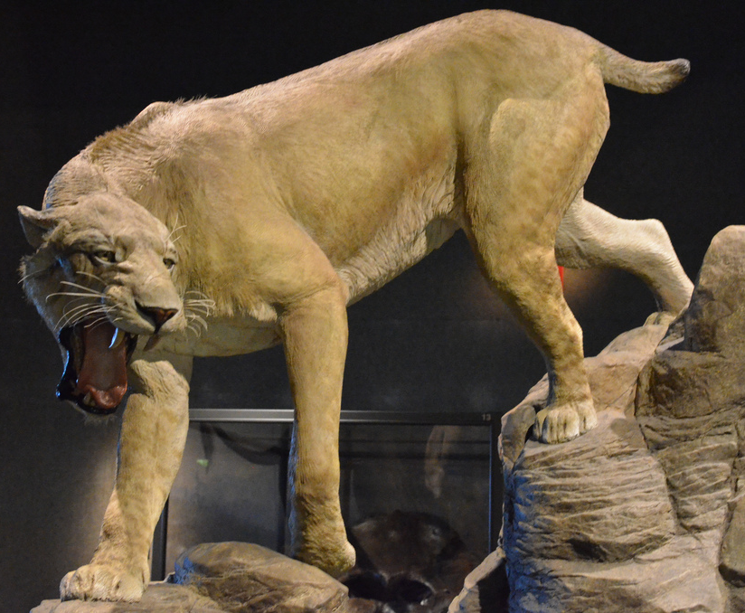
Technical Design Description
Successfully retrieved sabretooth tiger from the past
Successfully reached the future
Benchmark B
Currently working to retrieve item from the future
Notes:
https://c1.staticflickr.com/9/8199/8247829737_4209055ac9_b.jpg

Slide 7
Technical Design Description
Top View
Front View
CAD DRAWING
CAD DRAWING

Slide 8
Technical Design Description
Isometric View
Most Detailed Side View
CAD DRAWING
CAD DRAWING

Slide 9
Cost Estimate
Item/Employee | Quantity | Unit Cost | Cost
Item 1 | # | $$$ | $$$
Item 2 | # | $$$ | $$$
Item 3 | # | $$$ | $$$
Miscellaneous | # | $$$ | $$$
Labor | # | $$$ | $$$
Total | $$$
Notes:
*VERBALLY STATE THAT COST HAS NOT CHANGED (IN THIS CASE)*

Slide 10
Project Schedule
Notes:
PROGRESS LINE SHOULDN’T BE AT THE END SINCE IT’S ONLY MILESTONE 3!

Slide 11
Summary
We’re on schedule
Item from past retrieved
Machine reached the future
Working on retrieving item from the future
We’re on budget
By the Final Presentation
Have the robot retrieve item from the future (Commission)
Continue optimizing design

Slide 12
The Timeshifter
Hour Glass, Inc.
Eve Fishinevich (Project Coordinator)
Rondell Sinanan (Head of Research)
Milestone 3
Date of Presentation: 10/99/9999
Section Z
Notes:
To replace this picture, just select and delete it. Then use the Insert Picture icon to replace it with one of your own!

