Slide 1

RECITATION 11
EG1004

Slide 2
AGENDA
Engineering & Social Justice
Visualizing Data For Your Argument
1

Slide 3
ENGINEERING SOCIAL JUSTICE
Notes:
Beyond classic examples of data visualization in charts, data visualization is the core of a continuously growing snowball that allows engineers to ideate and innovate.

Slide 4
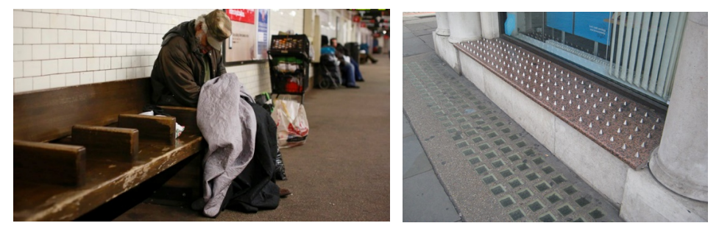
What ethical & social are there with the use of hostile architecture?
DISCUSSION QUESTION
(See handout for more details)
3
Notes:
**Give students time to discuss this question in groups and/or have a larger group discussion**

Slide 5
VISUALIZING DATA FOR
YOUR ARGUMENT
Notes:
Beyond classic examples of data visualization in charts, data visualization is the core of a continuously growing snowball that allows engineers to ideate and innovate.

Slide 6

EXPLAINING CONCEPTS
5

Slide 7
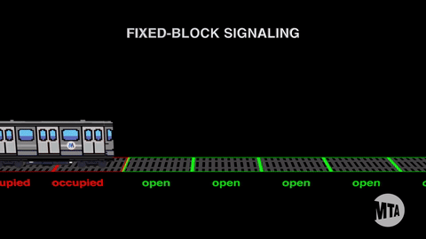
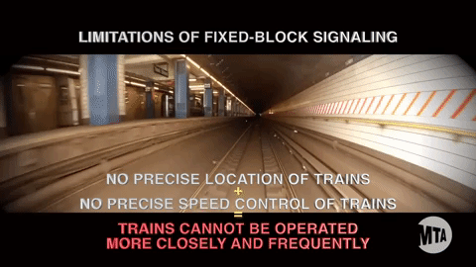
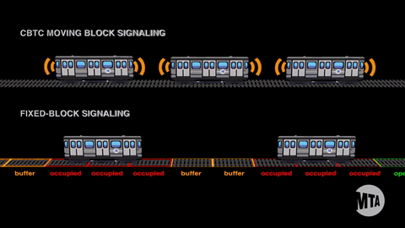
IDENTIFYING PROBLEMS
Learn More
6

Slide 8
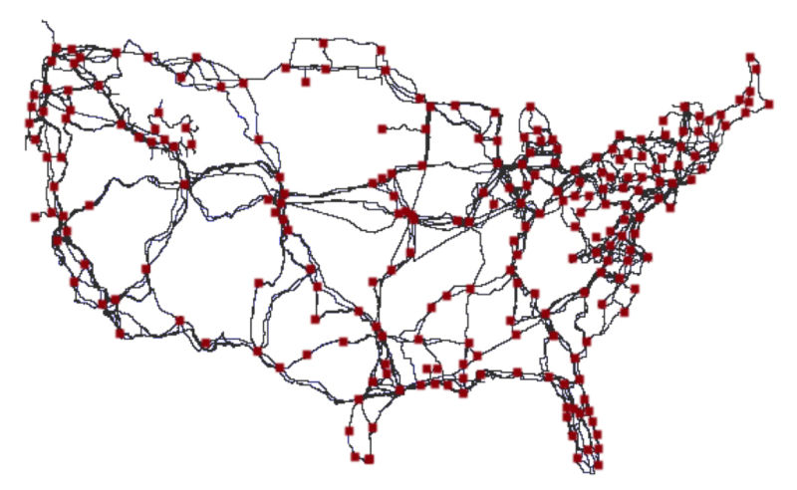
DATA COLLECTION
Figure 1: Map courtesy of Gizmodo
7
Notes:
**Ask students what they think this map shows** Answer: Major Internet Cables

Slide 9
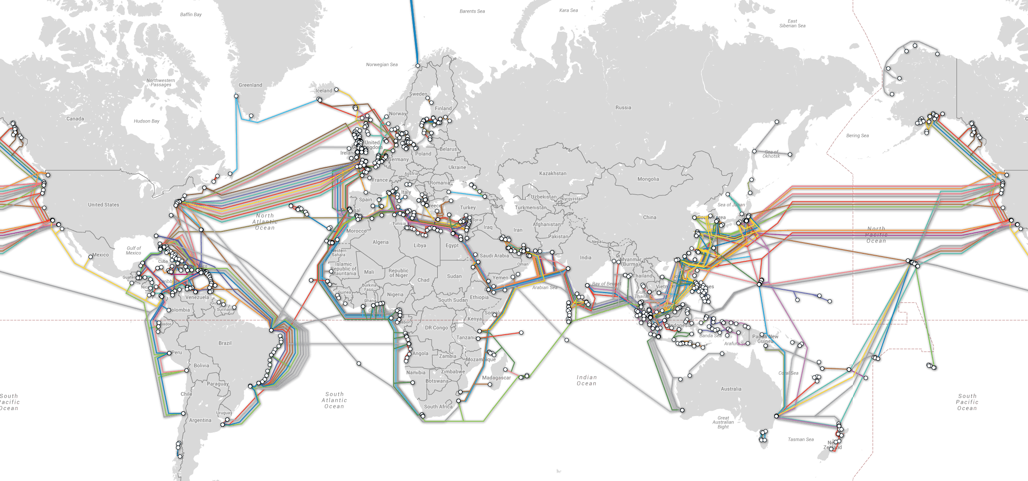
DATA MANAGEMENT
Figure 2: Map courtesy of Reddit
8
Notes:
**Ask students what they think this map shows**

Slide 10
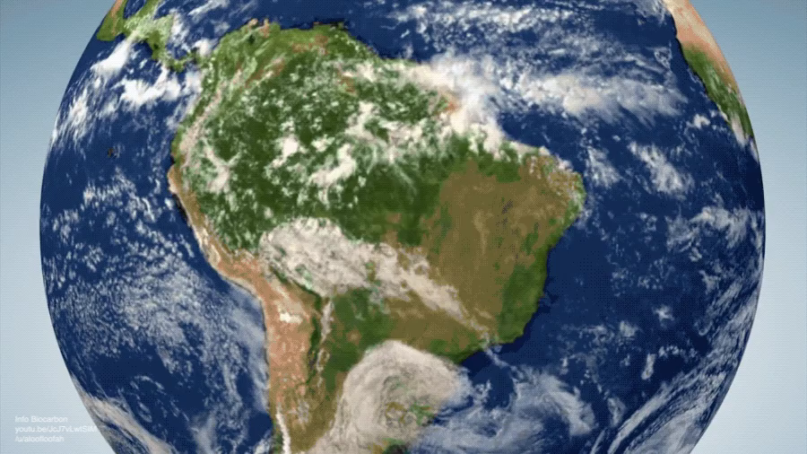
INNOVATIVE SOLUTIONS
9
Notes:
**Ask students what they think this map shows**

Slide 11
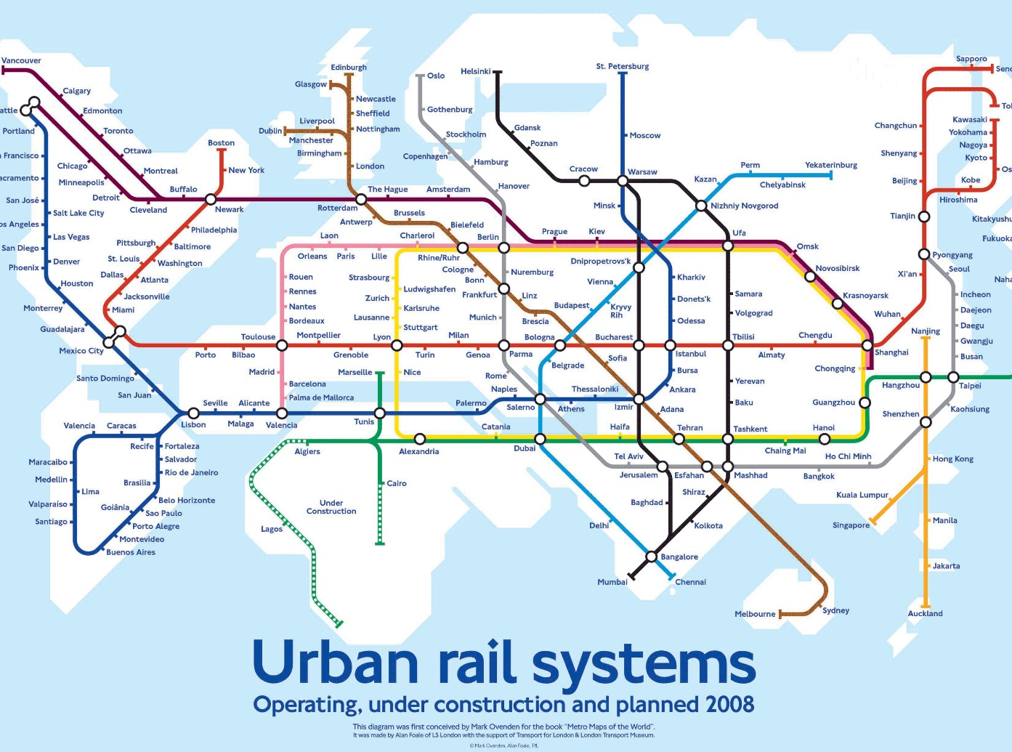
NOVEL IDEAS
Figure 6: Urban rail system
10

Slide 12
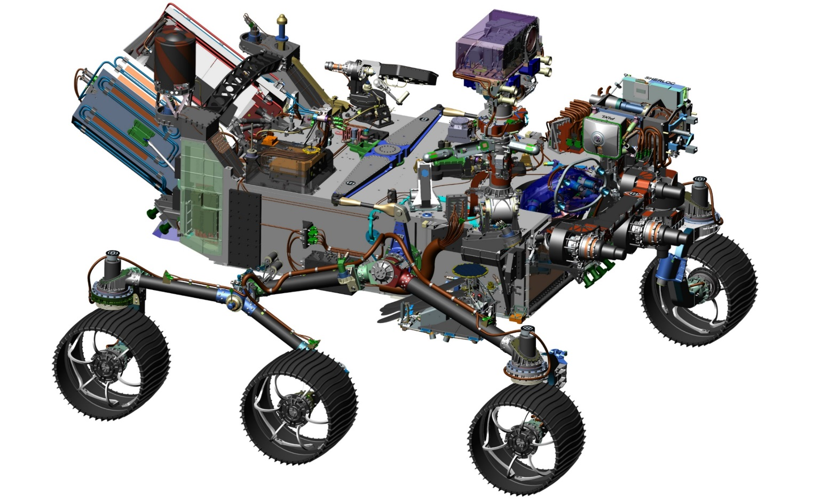
SPECIFICATIONS, DIMENSIONS, PRODUCTION
10

Slide 13
QUESTIONS?

