Slide 1


PROTOYPING A THERMAL INSULATION DEVICE WITH MICROCONTROLLERS AND SENSORS
LAB 3
EG 1004 Introduction to Engineering & Design

Slide 2
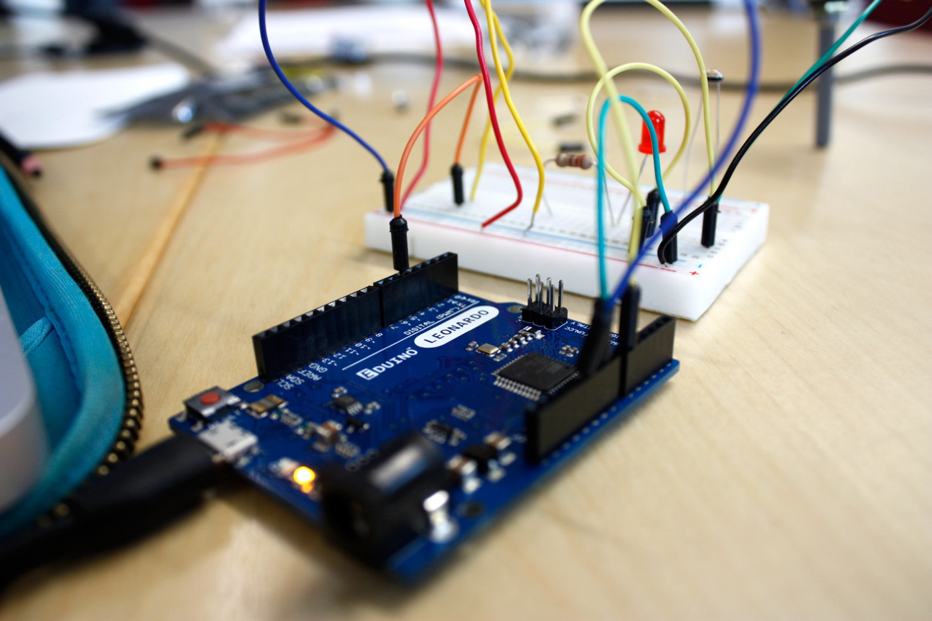
OVERVIEW
Objective
Background Information
Materials
Procedure
Competition Rules
IDBE Implementation
Assignment
Closing
Figure 1: Prototyping with Arduino Board

Slide 3
OBJECTIVE
Utilize electrical components, an Arduino board, and the Arduino IDE to:
  Control an LED with a button
  Test a design prototype
To design a device to slow the rate of heat loss
Enter the device into a competition to obtain the lowest minimal design equation

Slide 4
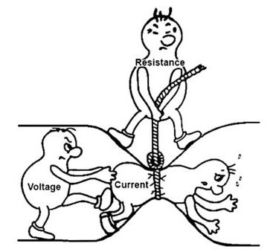

Prototyping – process of designing and building an early model of a product
Electricity – the movement of electrons
BACKGROUND INFORMATION
Ohm’s Law: V = IR
Current [A]: Flow of electrons
Resistance [$Ω$]: Opposition to current
Voltage [V]: Difference in charge
Figure 3: Ohm’s Law Courtesy of Instructables
Notes:
Tandon Areas of Excellence
Sustainability
Urban
Telecommunications & IT
Health
Artificial Intelligence
Professional Skills & Tandon Resources
MakerSpace & RAD
Teamwork & Vertically Integrated Projects
Career Services
Project Management & Technical Writing
World Trade Center Construction

Slide 5
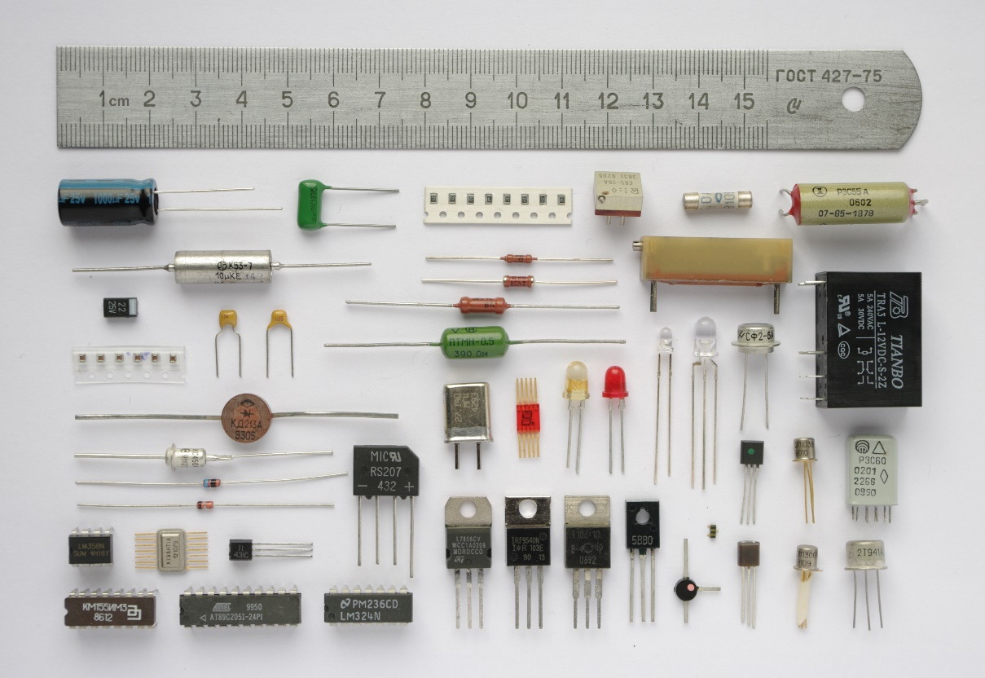
BACKGROUND INFORMATION
Common electrical components:
  Breadboards
  DC voltage sources
  Resistors
  Push-buttons and switches
  Diodes and transistors
  Light emitting diodes
Figure 4: Electrical Components courtesy of Wikipedia
Notes:
Tandon Areas of Excellence
Sustainability
Urban
Telecommunications & IT
Health
Artificial Intelligence
Professional Skills & Tandon Resources
MakerSpace & RAD
Teamwork & Vertically Integrated Projects
Career Services
Project Management & Technical Writing
World Trade Center Construction

Slide 6
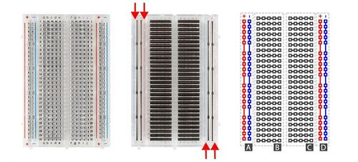
BACKGROUND INFORMATION
Breadboards
                Small boards used for circuit prototyping
Allow temporary connection between circuit components
Power rails connected vertically (Sections A & D)
Non-colored rows connected horizontally (Sections B & C)
Figure 5: Breadboard Diagram
Notes:
Tandon Areas of Excellence
Sustainability
Urban
Telecommunications & IT
Health
Artificial Intelligence
Professional Skills & Tandon Resources
MakerSpace & RAD
Teamwork & Vertically Integrated Projects
Career Services
Project Management & Technical Writing
World Trade Center Construction

Slide 7
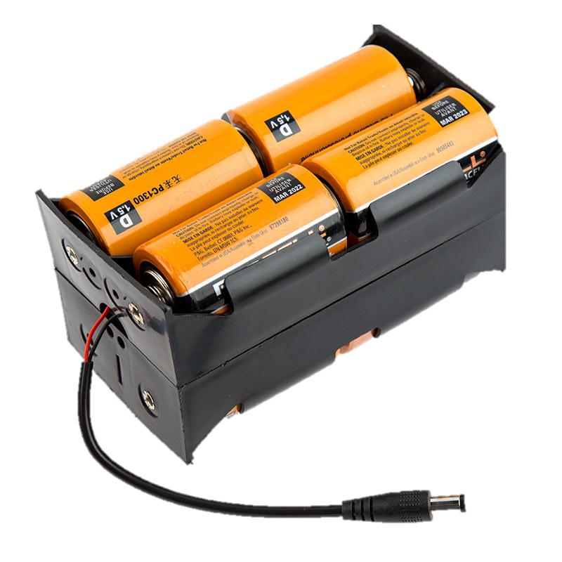
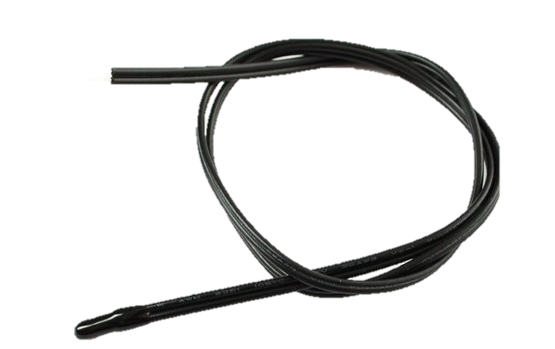
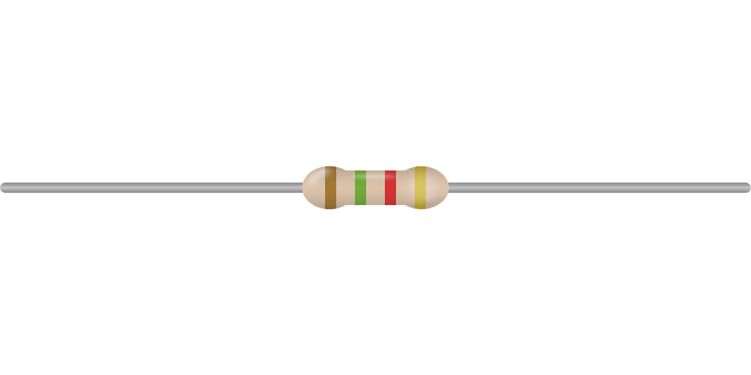
BACKGROUND INFORMATION
DC Voltage Sources
Resistors
Thermistor
Power circuits with voltage difference
Reduce the current flowing through a circuit
Color coded to indicate resistance value
Thermal resistor used to measure temperature
Figure 6: DC Voltage Source (Left), Resistor (Middle), Thermistor (Right)
Notes:
Tandon Areas of Excellence
Sustainability
Urban
Telecommunications & IT
Health
Artificial Intelligence
Professional Skills & Tandon Resources
MakerSpace & RAD
Teamwork & Vertically Integrated Projects
Career Services
Project Management & Technical Writing
World Trade Center Construction

Slide 8
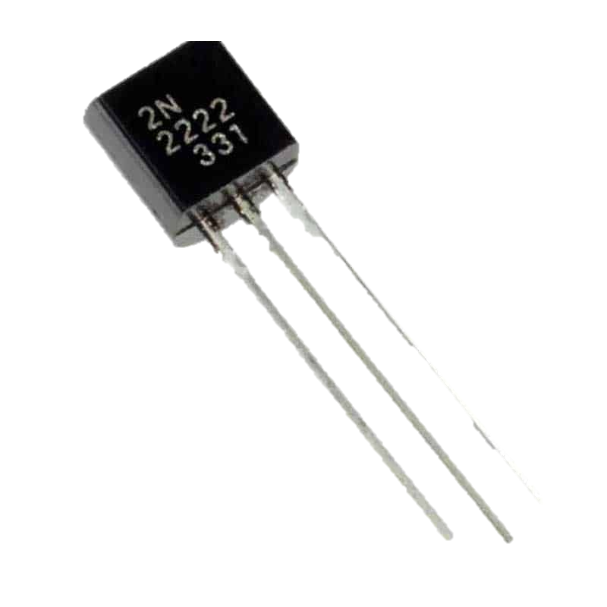
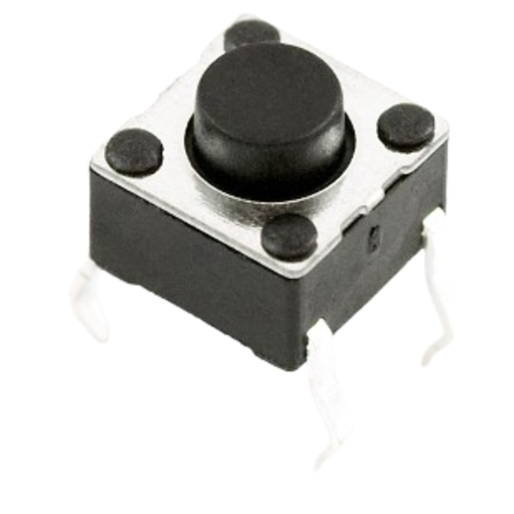
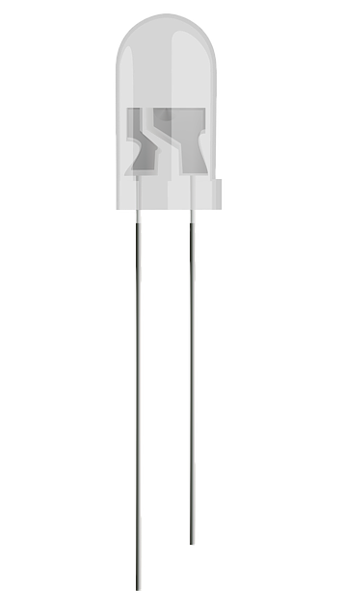
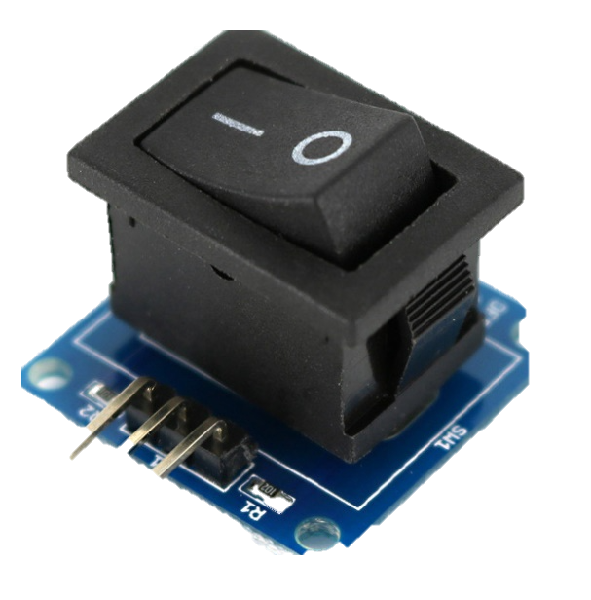
BACKGROUND INFORMATION
Diodes & Transistors
Light Emitting Diodes
(LEDs)
Push Buttons & Switches
Interrupt or divert current
Allow current to pass in only on direction
Diodes that use low voltage and current
Figure 7: Push Button (Left),
Switch (Right)
Figure 8: Transistor (Left), LED (Right)
Notes:
Tandon Areas of Excellence
Sustainability
Urban
Telecommunications & IT
Health
Artificial Intelligence
Professional Skills & Tandon Resources
MakerSpace & RAD
Teamwork & Vertically Integrated Projects
Career Services
Project Management & Technical Writing
World Trade Center Construction

Slide 9
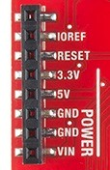
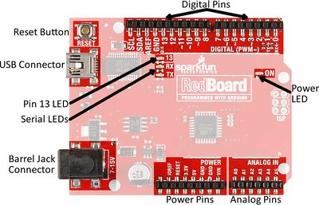
Microcontroller – inexpensive, programmable computer
BACKGROUND INFORMATION
3.3 V
GND
Typically used to power low voltage sensors
Ground pin (0 V)
VIN
5 V
Commonly used to power circuits
Can be used to power board with battery
Figure 9: Arduino Redboard
Notes:
Tandon Areas of Excellence
Sustainability
Urban
Telecommunications & IT
Health
Artificial Intelligence
Professional Skills & Tandon Resources
MakerSpace & RAD
Teamwork & Vertically Integrated Projects
Career Services
Project Management & Technical Writing
World Trade Center Construction

Slide 10
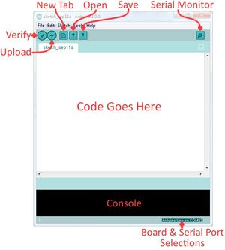
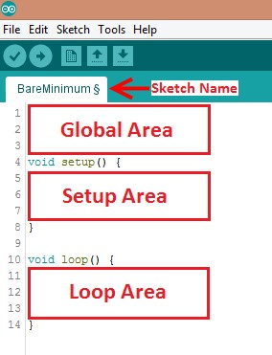
Arduino IDE – program to edit, compile, and upload code to the Arduino board
Code written in the Arduino programming language (based on C/C++)
BACKGROUND INFORMATION
Figure 10: Arduino IDE
Notes:
Tandon Areas of Excellence
Sustainability
Urban
Telecommunications & IT
Health
Artificial Intelligence
Professional Skills & Tandon Resources
MakerSpace & RAD
Teamwork & Vertically Integrated Projects
Career Services
Project Management & Technical Writing
World Trade Center Construction

Slide 11
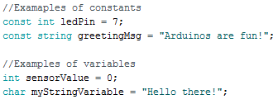
BACKGROUND INFORMATION
Datatypes
Operators
Variables and Constants
Perform operations on variables or constants
(eg.+, =, ==, <=)
Different data values
(eg. Int, double, char)
Hold data according to datatype
Figure 11: Examples of Constants and Variables
Notes:
Tandon Areas of Excellence
Sustainability
Urban
Telecommunications & IT
Health
Artificial Intelligence
Professional Skills & Tandon Resources
MakerSpace & RAD
Teamwork & Vertically Integrated Projects
Career Services
Project Management & Technical Writing
World Trade Center Construction

Slide 12
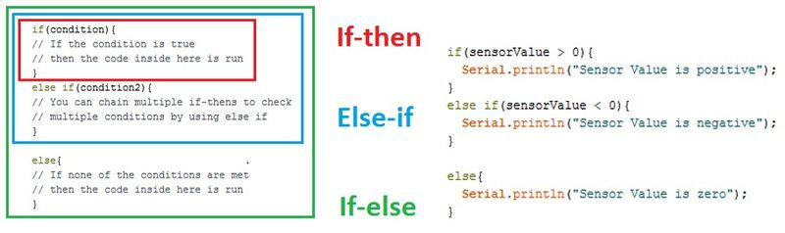
BACKGROUND INFORMATION
Conditional Statements
Run code enclosed by curly brackets when condition is met
Figure 12: Conditional Statements
Notes:
Tandon Areas of Excellence
Sustainability
Urban
Telecommunications & IT
Health
Artificial Intelligence
Professional Skills & Tandon Resources
MakerSpace & RAD
Teamwork & Vertically Integrated Projects
Career Services
Project Management & Technical Writing
World Trade Center Construction

Slide 13
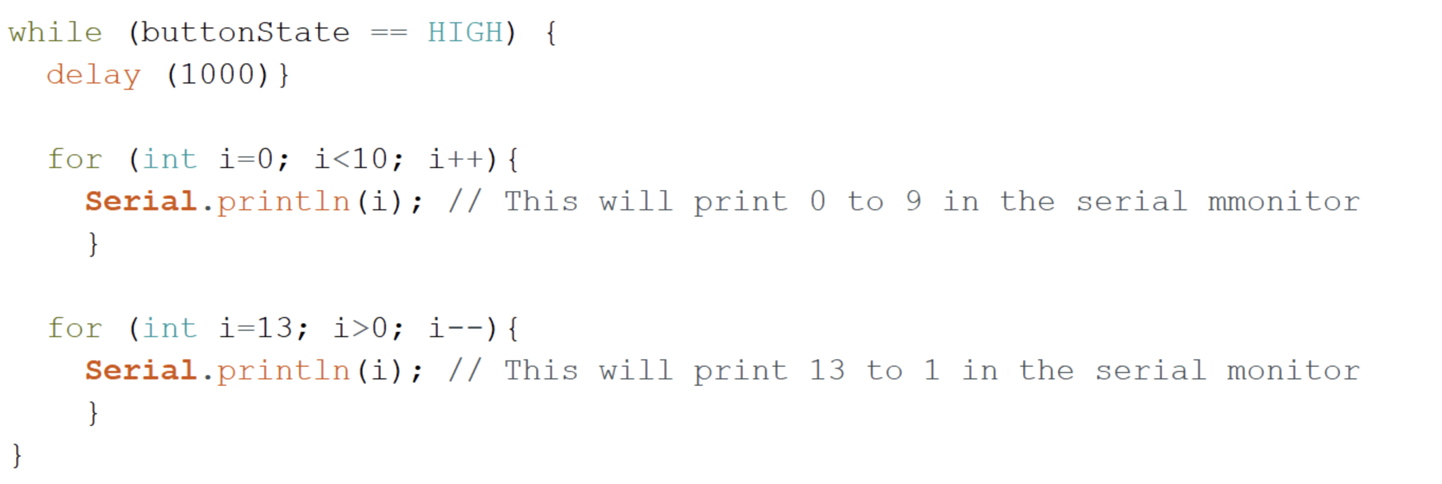
BACKGROUND INFORMATION
While loops
Loops
Runs code until end condition is met
Run sections of code repeatedly
For loops
Runs code for a specific number of times
Figure 13: While and For Loops
Notes:
Tandon Areas of Excellence
Sustainability
Urban
Telecommunications & IT
Health
Artificial Intelligence
Professional Skills & Tandon Resources
MakerSpace & RAD
Teamwork & Vertically Integrated Projects
Career Services
Project Management & Technical Writing
World Trade Center Construction

Slide 14
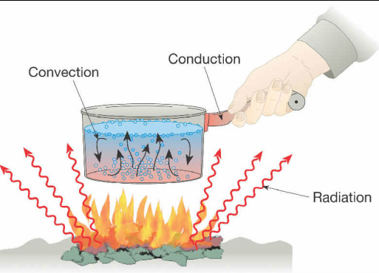
BACKGROUND INFORMATION
Heat – form of energy
Heat transfer – process of thermal energy moving from one body to another
Conduction
Through solids
Convection
Within a fluid medium (liquid or gas)
Radiation
Emitted energy in all directions with or without a medium
Figure 14: Modes of Heat Transfer Courtesy of
Mr. Oey’s Science Classes
Notes:
Tandon Areas of Excellence
Sustainability
Urban
Telecommunications & IT
Health
Artificial Intelligence
Professional Skills & Tandon Resources
MakerSpace & RAD
Teamwork & Vertically Integrated Projects
Career Services
Project Management & Technical Writing
World Trade Center Construction

Slide 15
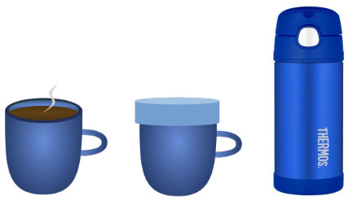
BACKGROUND INFORMATION
Thermodynamic system – defined area in the Universe separated by a boundary
Open
Transfers mass and heat
Closed
Only transfers heat
Isolated
Cannot transfer mass or heat
Figure 15: Open (Left), Closed (Center), and
Isolated (Right) Systems Courtesy of x-engineer.org
Notes:
Tandon Areas of Excellence
Sustainability
Urban
Telecommunications & IT
Health
Artificial Intelligence
Professional Skills & Tandon Resources
MakerSpace & RAD
Teamwork & Vertically Integrated Projects
Career Services
Project Management & Technical Writing
World Trade Center Construction

Slide 16
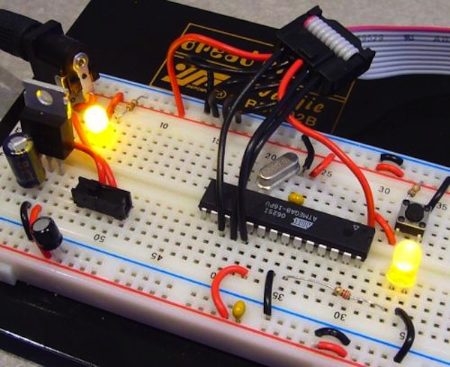

MATERIALS
Arduino RedBoard and USB cable
Computer with Arduino IDE
Breadboard
Jumper wires
220 Ω resistor
10 kΩ resistor
2.2 kΩ resistor
LED
Push-button
Thermistor
Figure 16: Prototyping with Breadboard
Courtesy of SparkFun

Slide 17
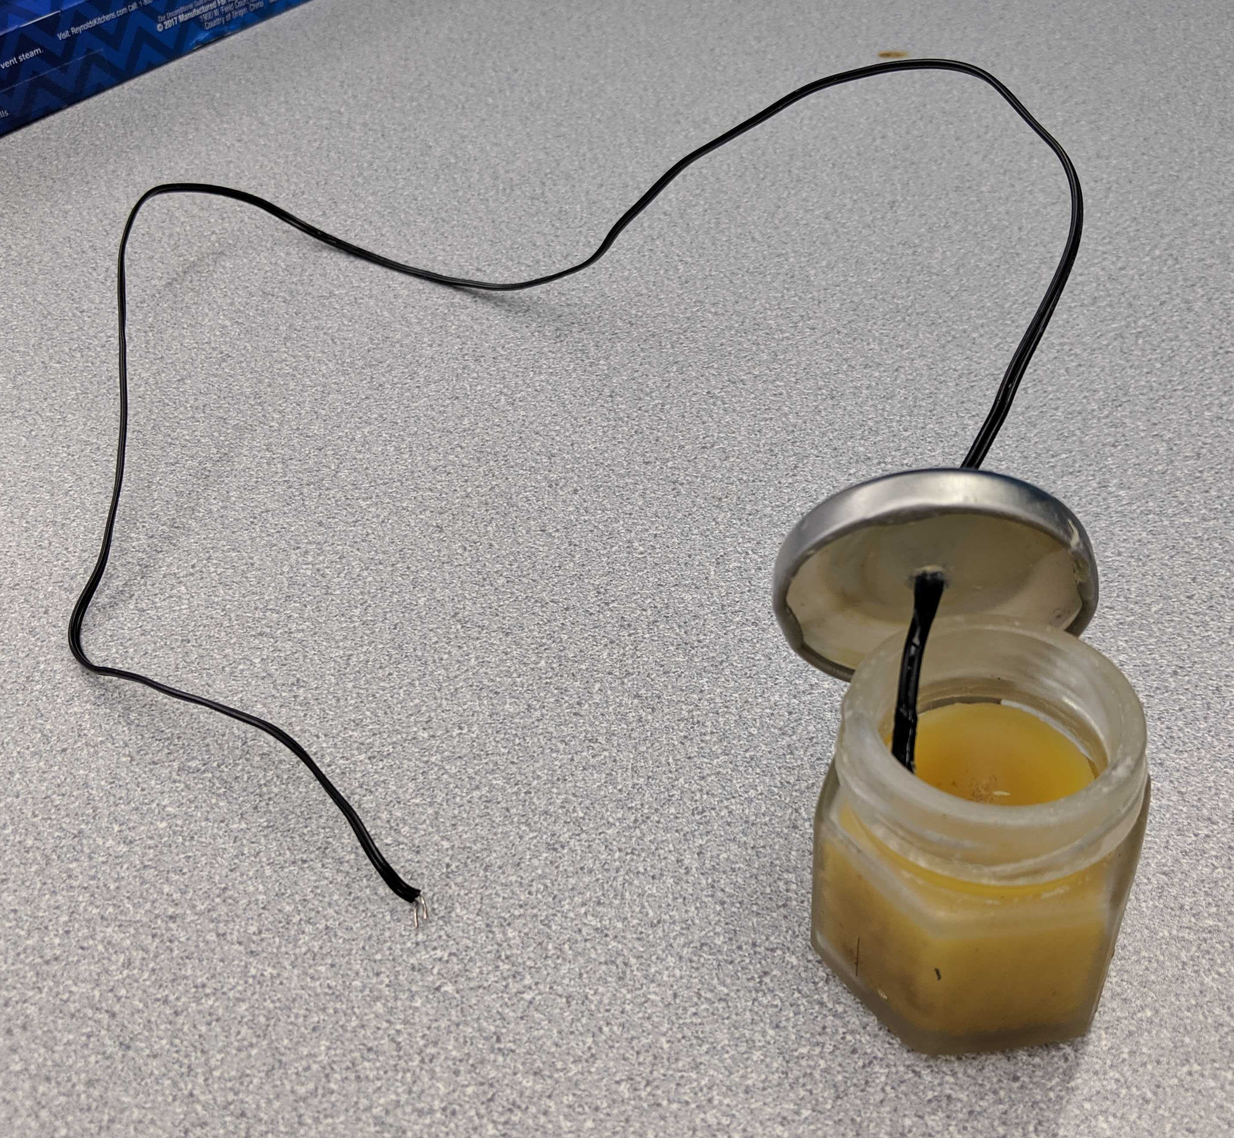
PROCEDURE
Part 1: Build an LED and Button circuit
Part 2: Thermal insulation device competition
  Goal is to slow heat loss from a heated jar of beeswax
  Add code to the Arduino program for the thermistor
  Build the thermistor circuit using the Arduino board
  Design and build a thermal insulating device
  Test the thermal insulating device and analyze the data
Figure 17: Jar of Beeswax
with Thermistor

Slide 18

COMPETITION RULES
Competition will be judged by the lowest minimal design equation (MDE):
$$MDE=\left|IC\right|\left[\text{°}F \min^{−1}\right] × Cost[\$]×\frac{T_{R}[\text{°}F]}{T_{F}[\text{°}F]}$$
  Insulating capacity (IC) is the change in temperature over time
  of the beeswax
  Cost is the total cost of the insulating device
  T_{R} is the room temperature (obtain from TA)
  T_{F} is the final temperature of the beeswax (obtain from data)
  10 minute run starts from the same temperature (±1°F) for all groups

Slide 19
COMPETITION RULES
Table 1: Material Costs for Thermal Insulation Device Competition
Material | Unit | Cost Per Unit
Large foam cup | 1 | $0.50
Pack of clay | 1 bag | $0.20
Wool fabric | 2 pieces | $0.10
Cotton balls | 3 balls | $0.05
Popsicle sticks | 1 | $0.01
Paper cup | 1 | $0.40
Styrofoam pieces | 5 | $0.05
Tape | 1 ft | $0.10
Aluminum foil | 1 ft² | $0.30
Plastic wrap | 1 ft² | $0.02

Slide 20
COMPETITION RULES
Cannot move thermistor placement with respect to the lid
Insulating device cannot be touched while testing
External heat sources are prohibited
Jar of beeswax must be inside the container within 30 seconds of receiving
Jar of beeswax cannot be returned (no restarts)
A minimum of $0.40 must be used in the design of the insulating device
Try not to touch the hot jar or beeswax
10 minute run starts from the same temperature (±1°F) for all groups

Slide 21

IDBE IMPLEMENTATION
Socially-conscious Engineering
  What is the goal of our designs?
Social, Economic, and Environmental Implications
  Who is involved in the design and who are we innovating for?
  Engineering impacts all areas of daily life
  Connect the following inventions to the above implications: cars, antibiotics, the internet
Figure 18: Socially Conscious Engineers
Notes:
Tandon Areas of Excellence
Sustainability
Urban
Telecommunications & IT
Health
Artificial Intelligence
Professional Skills & Tandon Resources
MakerSpace & RAD
Teamwork & Vertically Integrated Projects
Career Services
Project Management & Technical Writing
World Trade Center Construction

Slide 22
ASSIGNMENT
Individual lab report:
  Answer discussion questions in manual
  Include original graph (temperature vs. time) of insulating device
  Provide minimal design ratio calculation
  Provide price list and design improvements
  Include spreadsheet with competition results
  Due at 11:59 PM the night before Lab 4
Team presentation:
  Address discussion points in manual
  Describe the design of the insulating device
LED Circuit Diagram does not need to be included in report or presentation
Notes:
Tandon Areas of Excellence
Sustainability
Urban
Telecommunications & IT
Health
Artificial Intelligence
Professional Skills & Tandon Resources
MakerSpace & RAD
Teamwork & Vertically Integrated Projects
Career Services
Project Management & Technical Writing
World Trade Center Construction

Slide 23

CLOSING
Think safety! Don’t touch hot wax or jar
Submit all work electronically
Take pictures of the insulating device
Clean up workstations
Return all unused materials to the TA
Notes:
Tandon Areas of Excellence
Sustainability
Urban
Telecommunications & IT
Health
Artificial Intelligence
Professional Skills & Tandon Resources
MakerSpace & RAD
Teamwork & Vertically Integrated Projects
Career Services
Project Management & Technical Writing
World Trade Center Construction

Slide 24
QUESTIONS?

