Slide 1

DATA IS YOUR ARGUMENT
EG1004 | RECITATION 6

Slide 2
STORYTELLING
When writing, consider who is reading
  What compels your reader?
    The reader wants to see
    The reader wants to learn what’s possible
    The reader wants to try it later… and do it better
1

Slide 3
THE LAB REPORT IS A STORY
“Clear communication builds trust. Technical competence is necessary; it is never sufficient.” - Irish, Writing in Engineering: A Brief Guide, 2015.
  Analyze
    Lab reports, design reports, calculations, feasibility
  Recommend
    Proposals
  Control
    Specifications that define work and optimal performance
1

Slide 4
THE LAB REPORT IS A STORY
Data is the central element in report
Beginning to end: Abstract, Data/Observations, Conclusion
Report is an argument, not “on the one hand, on the other”
Data supports one conclusion
1,500 to 3,000 words. Some longer, none shorter
Make an outline, cut and paste Assignment section
2

Slide 5
WHAT COUNTS
EMPHASIZED
These are criteria by which a device passes or fails and need to be discussed to determine the success of the experiment
PRESENTED
All data from an experiment must be presented in the lab report, not all of it needs to be discussed
Data that isn’t useful for the report should be presented but time should not be wasted discussing it
e.g. Calculated safety factor in Lab 2
7

Slide 6
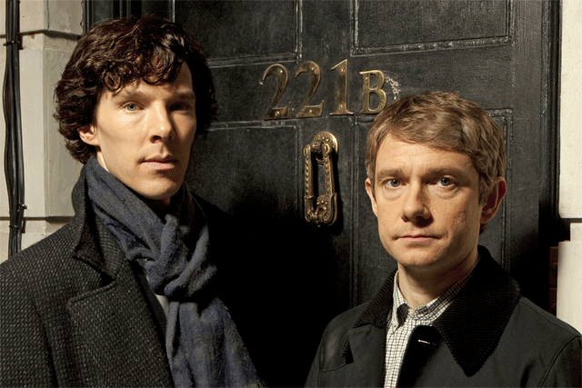
WHAT ARE OBSERVATIONS?
Measured data
Data in the form of well-labeled tables, graphs, photos, and other illustrations
Recorded without analysis
Objective description
What was observed
Figure 1: Holmes & Watson Courtesy of BBC Sherlock
1

Slide 7
DATA AND OBSERVATIONS
Present data, do not analyze data (analyze in the conclusion)
Past tense
Example competition results on the next slide
  State trial results and competition results
  Describe the contents of the table or figure in surrounding text
  Don’t include the table or figure if it’s not referenced in the text
2

Slide 8
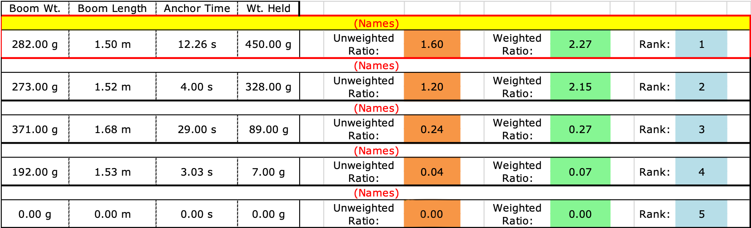
DATA AND OBSERVATIONS
Table 1: Boom Construction Competition Ranking
3

Slide 9
DATA AND OBSERVATIONS
Figure 1 shows the boom was built using two thick dowels, two thin dowels, four 3D-printed dowel connectors, and Kevlar string.
It had a boom weight of 269 g, a boom length of 1.51 m, an anchor time of 101 s, and held 450 g. Its unweighted ratio was 1.67 and its weighted ratio was 0.77. It placed fourth in the competition (Table 1).
4

Slide 10
RESOURCES
EG1004 Student Manual:
  Writing Consultants will meet with you 1:1 during recitation to answer questions
  EG1004 Writing Style Guide
  Sample Lab Report
  Writing Consultant Lab Report Rubric
Writing Center:
  Schedule an appointment: nyupoly.mywconline.com
  Location: 2 MTC, 9th Floor
  NYU Writing Center Website & Peer Tutor Program
6

Slide 11
QUESTIONS?

