Slide 1

RECITATION 12
EG1003

Slide 2
AGENDA
Emerging Global Topics
1

Slide 3
EMERGING GLOBAL TOPICS

Slide 4
QUESTION 1 - WHAT?
What are the great problems that engineers will solve in the coming decades and centuries?
3

Slide 5
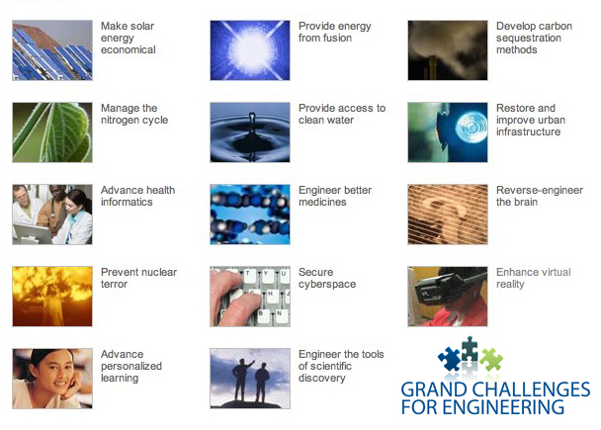
NAE GRAND CHALLENGES
Figure 1: NAE grand challenges for engineering courtesy of NAE
4

Slide 6
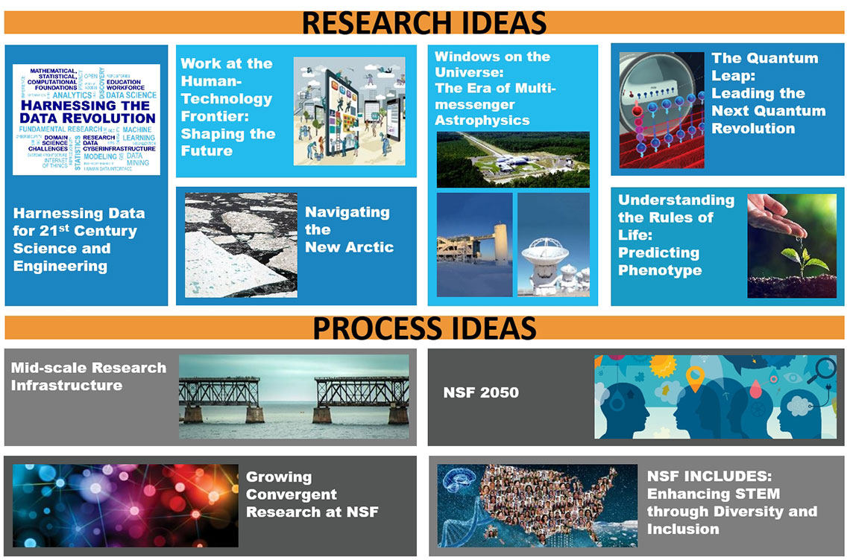
NSF TEN BIG IDEAS
Figure 2: Ten Big Ideas courtesy of NSF
5

Slide 7
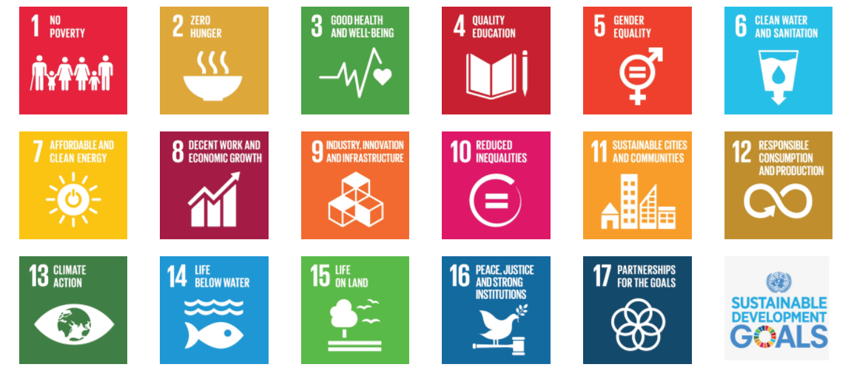
UN SUSTAINABLE DEVELOPMENT CHALLENGES
Figure 3: UN Challenges for development courtesy of UN
6

Slide 8
QUESTION 2 - WHO?
Who are the people who are going to solve these problems?
7

Slide 9
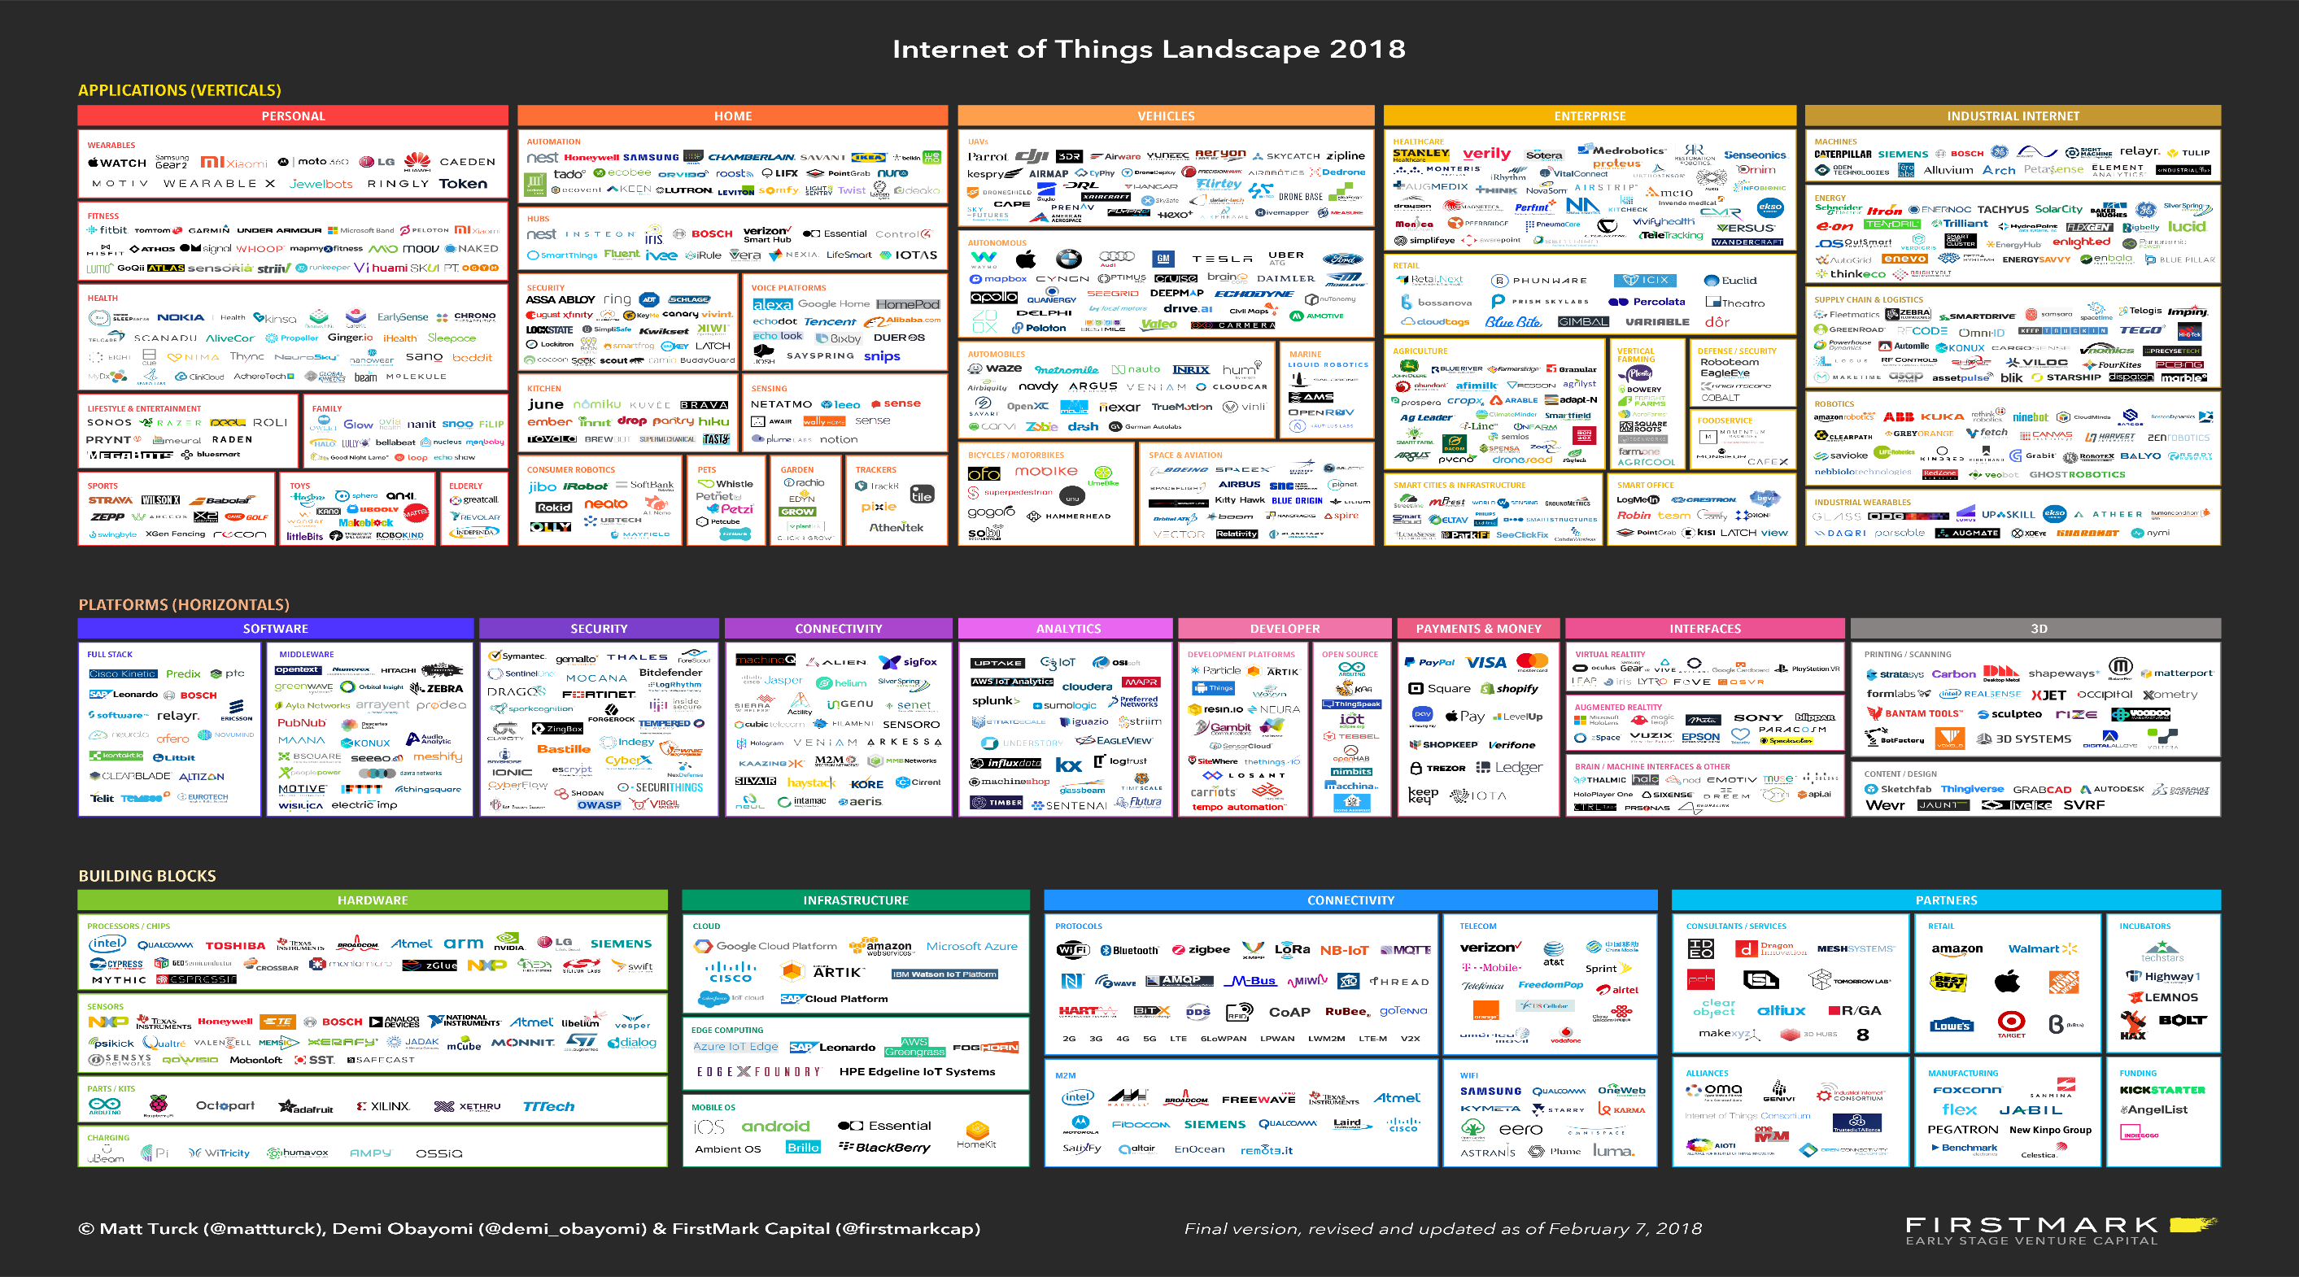
INTERNET OF THINGS (IoT)
Figure 4: Full 2018 Internet of things chart courtesy of FirstMark
8

Slide 10
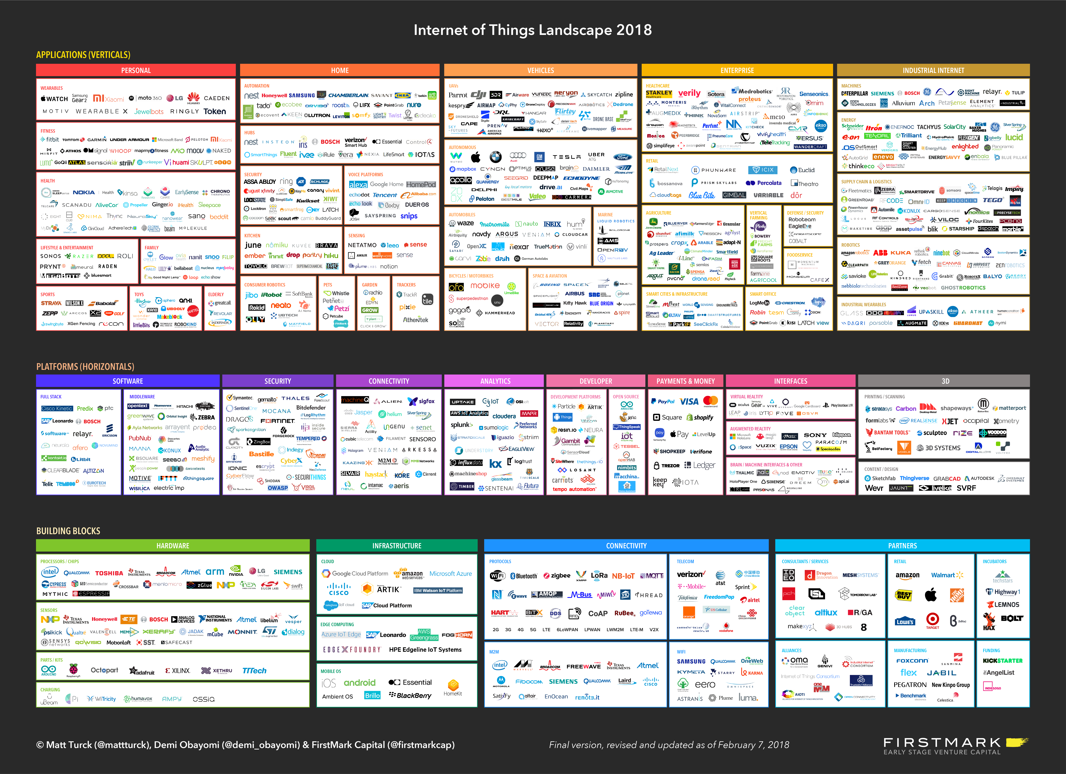
IoT APPLICATIONS
Figure 5: 2018 Internet of Things applications part 1 courtesy of FirstMark
9

Slide 11
IoT APPLICATIONS
Figure 6: 2018 Internet of Things applications part 2 courtesy of FirstMark
10

Slide 12
IoT PLATFORMS
Figure 7: 2018 Internet of Things platforms courtesy of FirstMark
11

Slide 13
IoT BUILDING BLOCKS
Figure 8: 2018 Internet of Things building blocks part 1 courtesy of FirstMark
12

Slide 14
IoT BUILDING BLOCKS
Figure 9: 2018 Internet of Things building blocks part 2 courtesy of FirstMark
13

Slide 15
QUESTION 3 - HOW?
How do the solutions to these problems impact society?
14

Slide 16
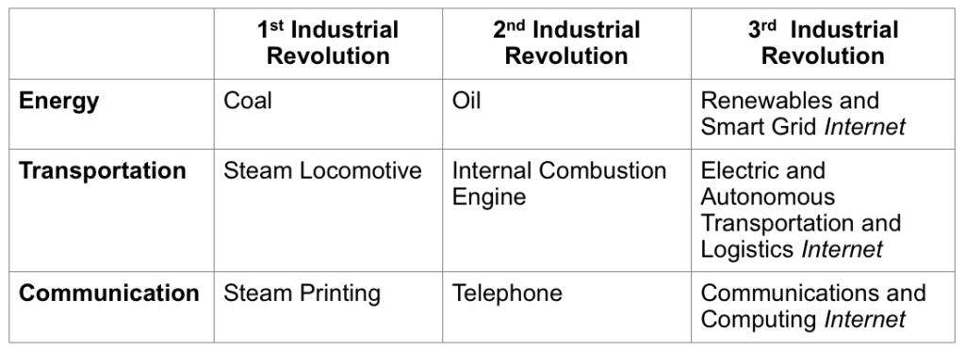
INDUSTRIAL REVOLUTIONS
Table 1: Table of industrial revolutions’ impacts courtesy of McMillan
15

Slide 17
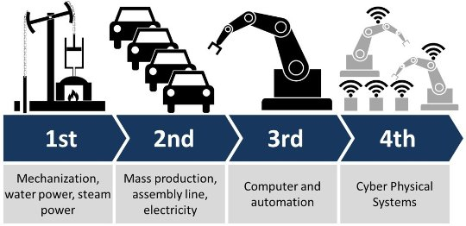
THE FOURTH REVOLUTION
Figure 10: All four industrial revolutions courtesy of Forbes
Learn More
16

Slide 18
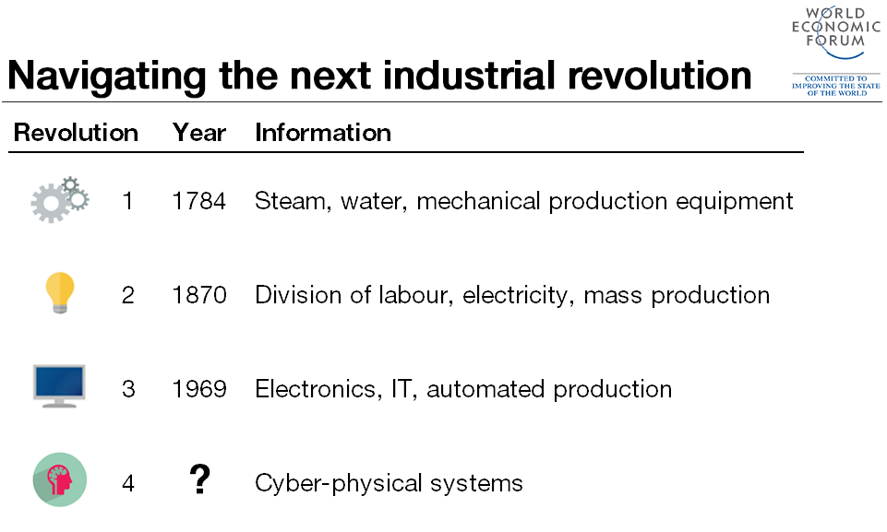
THE FOURTH REVOLUTION
Learn More
Figure 11: Fourth industrial revolution courtesy of WeForum
17

Slide 19
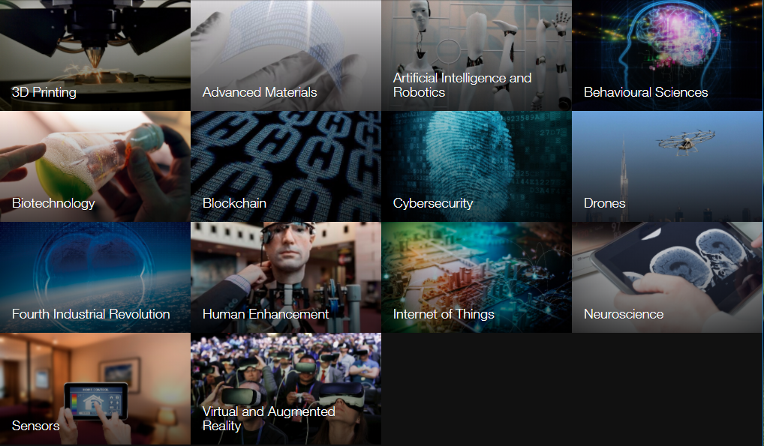

WORLD ECONOMIC FORUM
Learn More
Figure 12: Contributing factors to transformation courtesy of WEF
18

Slide 20
QUESTIONS?

