Slide 1

SUSTAINABLE ENERGY VEHICLE COMPETITION
LAB 10
EG 1004 Introduction to Engineering & Design

Slide 2
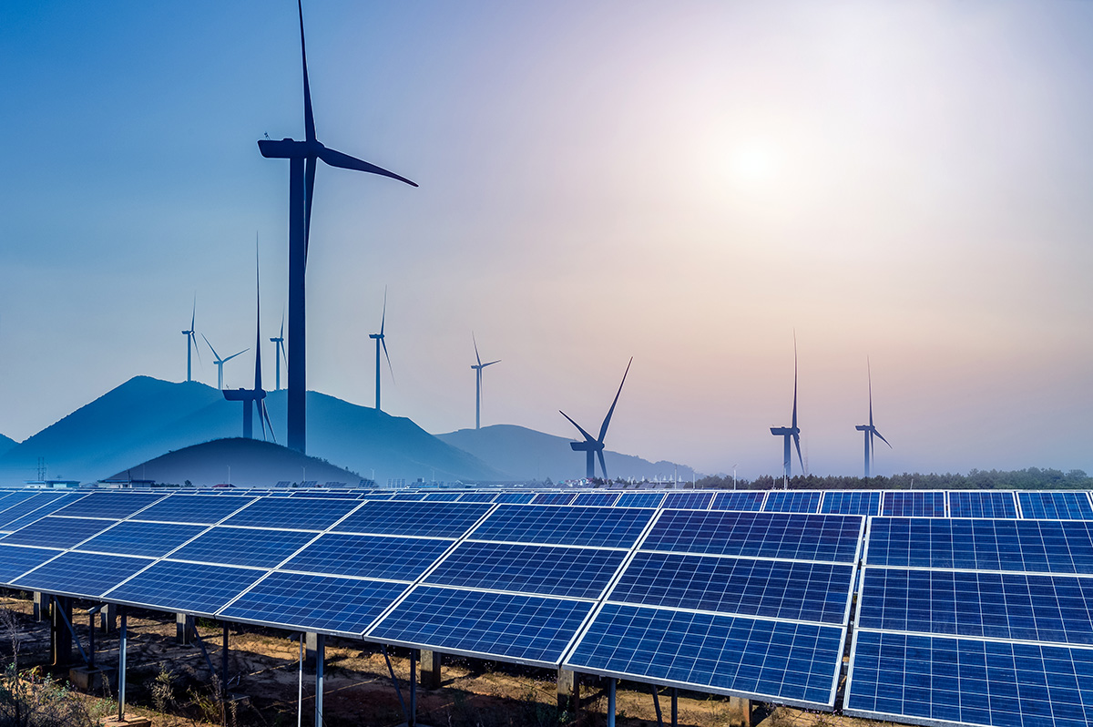
OVERVIEW
Objective
Background Information
Materials
Procedure
Competition Rules
IDBE Implementation
Assignment
Closing
Figure 1: Renewable Energy Sources
Courtesy of Physics World

Slide 3
OBJECTIVE
Evaluate energy storage devices
Analyze different sources of renewable energy
Design a sustainable energy vehicle to enter in a competition

Slide 4
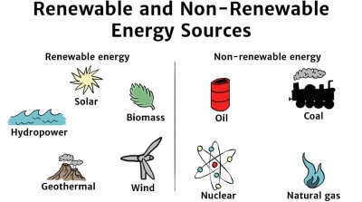
BACKGROUND INFORMATION
Renewable energy: energy harnessed from naturally replenished resources
Figure 2: Renewable vs. Non-Renewable Energy Sources Courtesy of Solar Schools

Slide 5
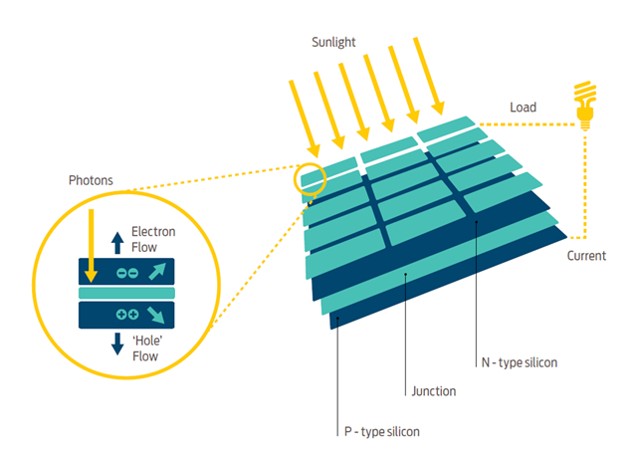
BACKGROUND INFORMATION
Solar panels – convert sunlight to electrical energy
  Incident sunlight excites electrons to next energy level, emitting energy
  Usually made of silicon
Figure 3: How Solar Panels Work
Courtesy of Good Energy

Slide 6
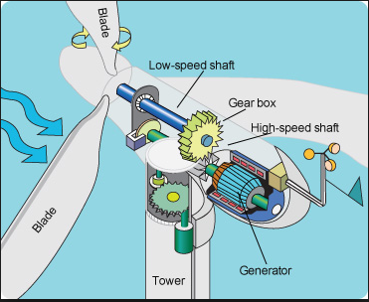
BACKGROUND INFORMATION
Wind turbine – converts wind energy to electrical energy
  Wind causes pressure difference on turbine blades
  Utilizes gear ratios to power generator
Figure 4: How Wind Turbines Work
Courtesy of Tech-Addict

Slide 7
BACKGROUND INFORMATION
Solar panels – convert sunlight to electrical energy
  Incident sunlight excites electrons to next energy level, emitting energy
  Usually made of silicon
Figure 3: How Solar Panels Work
Courtesy of Good Energy

Slide 8
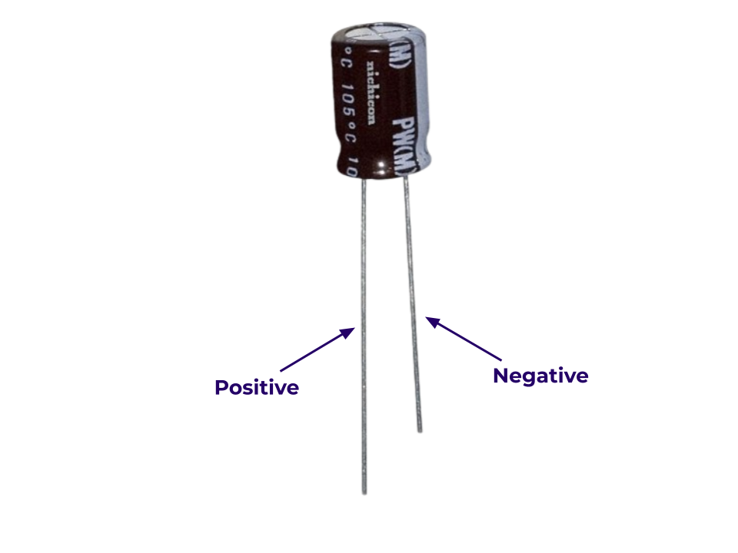
BACKGROUND INFORMATION
Capacitor – stores charge temporarily
  Are polarized
  Charged logarithmically (initially charges very fast but rate of charging slows down)
Figure 4: Polarized Capacitor
Courtesy of DigiKey
Notes:
Tandon Areas of Excellence
Sustainability
Urban
Telecommunications & IT
Health
Artificial Intelligence
Professional Skills & Tandon Resources
MakerSpace & RAD
Teamwork & Vertically Integrated Projects
Career Services
Project Management & Technical Writing
World Trade Center Construction

Slide 9
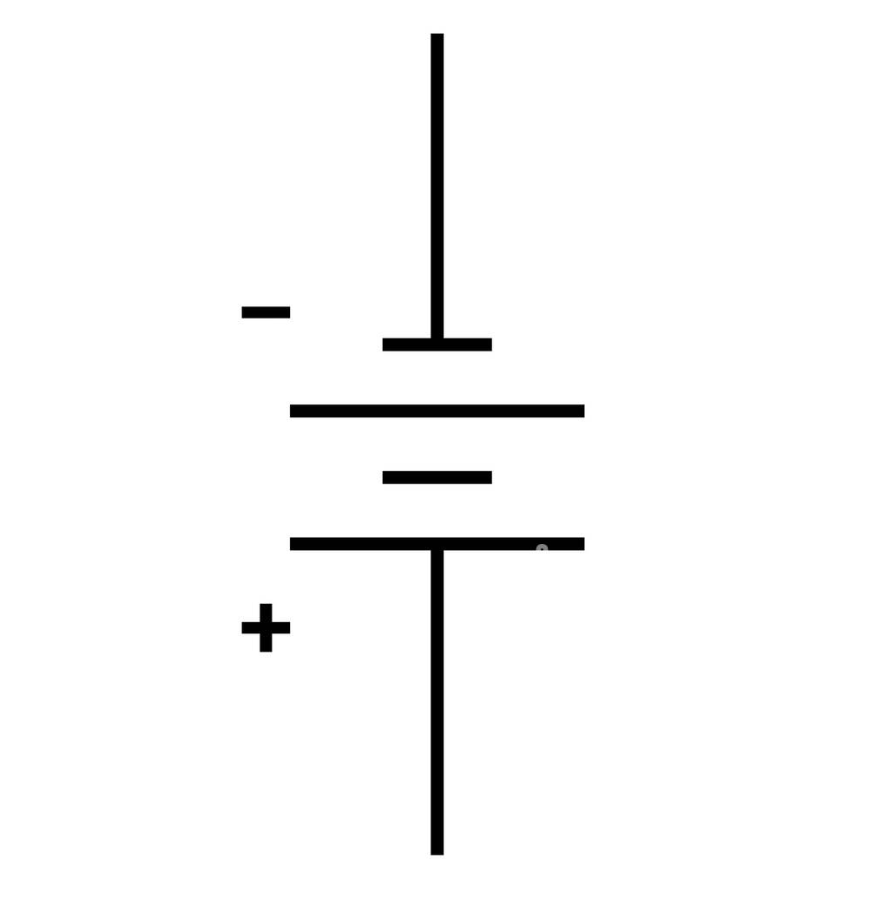
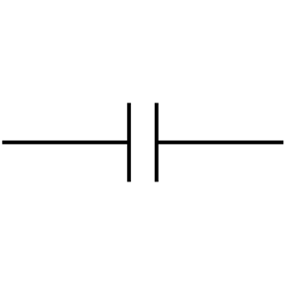
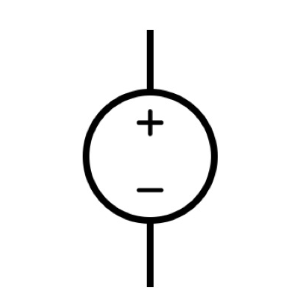
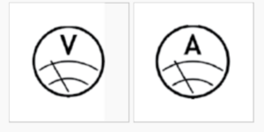
BACKGROUND INFORMATION
Symbols for common electrical components:
Battery
Capacitor
DC Source
Voltmeter
Ammeter
Notes:
Tandon Areas of Excellence
Sustainability
Urban
Telecommunications & IT
Health
Artificial Intelligence
Professional Skills & Tandon Resources
MakerSpace & RAD
Teamwork & Vertically Integrated Projects
Career Services
Project Management & Technical Writing
World Trade Center Construction

Slide 10
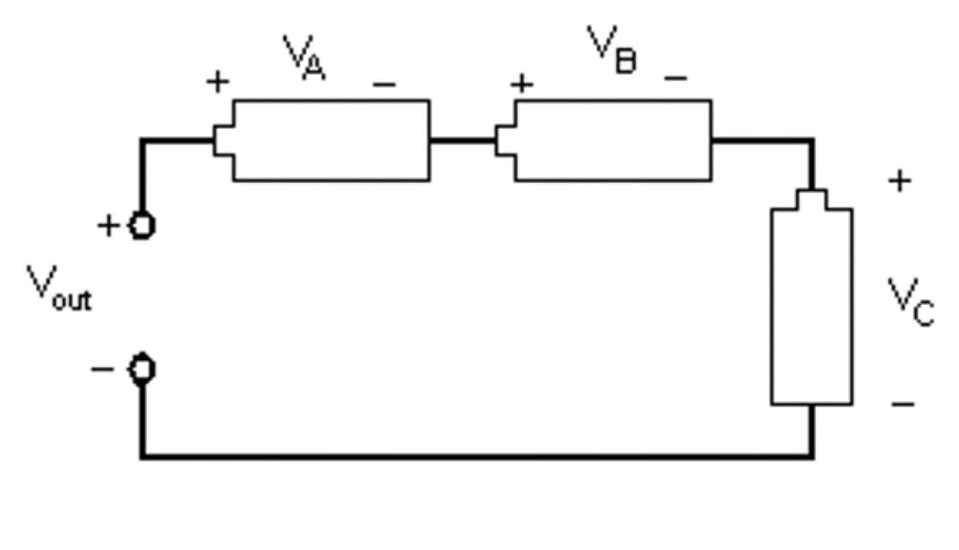
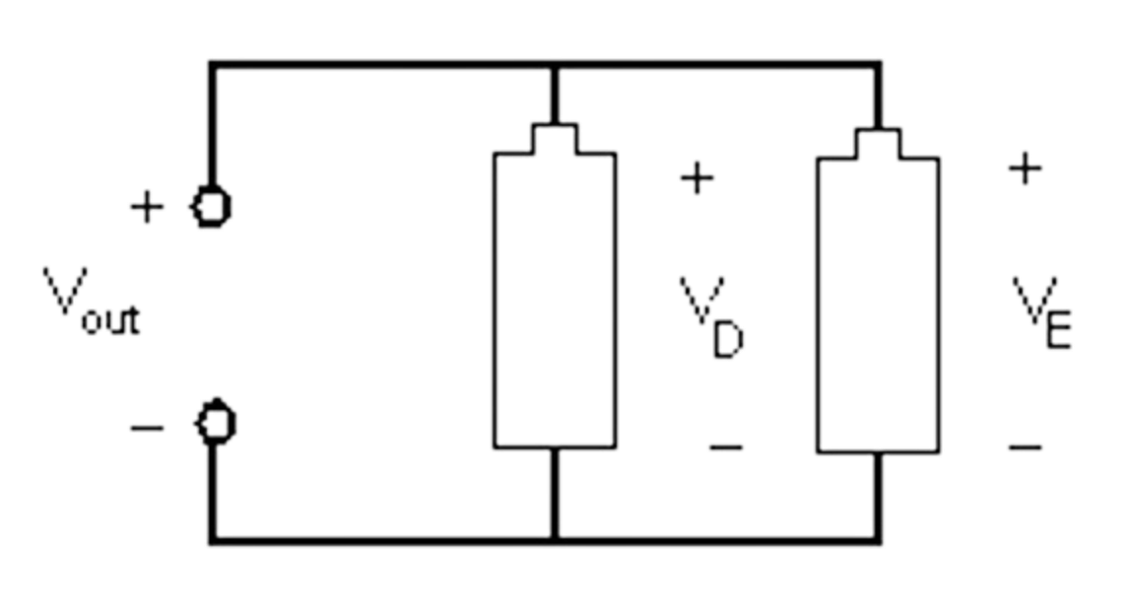


BACKGROUND INFORMATION
Series Connection
Current is equal across components
Voltage across each component:
$${V_{out}=V}_{A}+V_{B}+V_{C}$$
Parallel Connection
Current varies across components
Voltage across each component:
$${V_{out}=V}_{D}=V_{E}$$
Figure 6: Series Connection
Figure 7: Parallel Connection
Notes:
Tandon Areas of Excellence
Sustainability
Urban
Telecommunications & IT
Health
Artificial Intelligence
Professional Skills & Tandon Resources
MakerSpace & RAD
Teamwork & Vertically Integrated Projects
Career Services
Project Management & Technical Writing
World Trade Center Construction

Slide 11
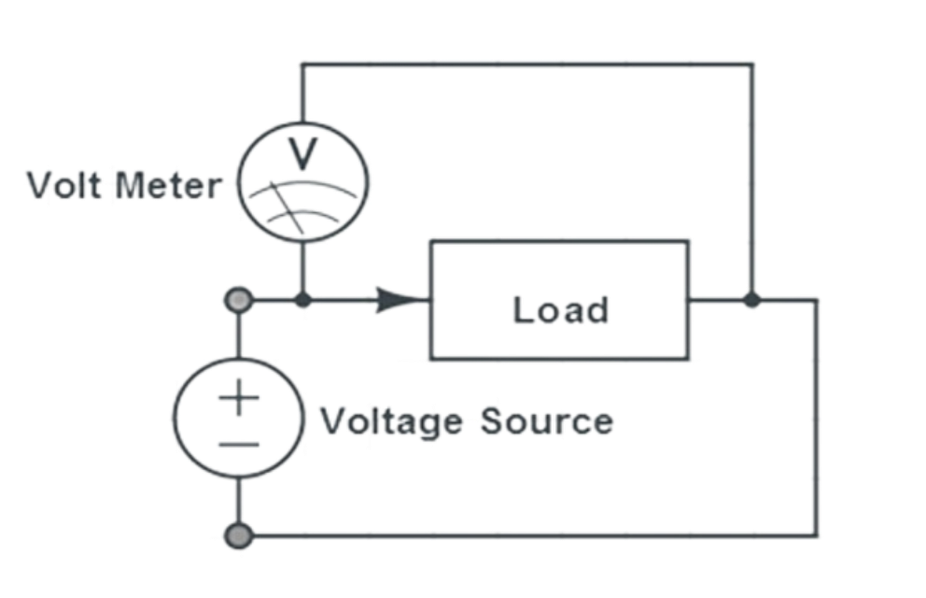
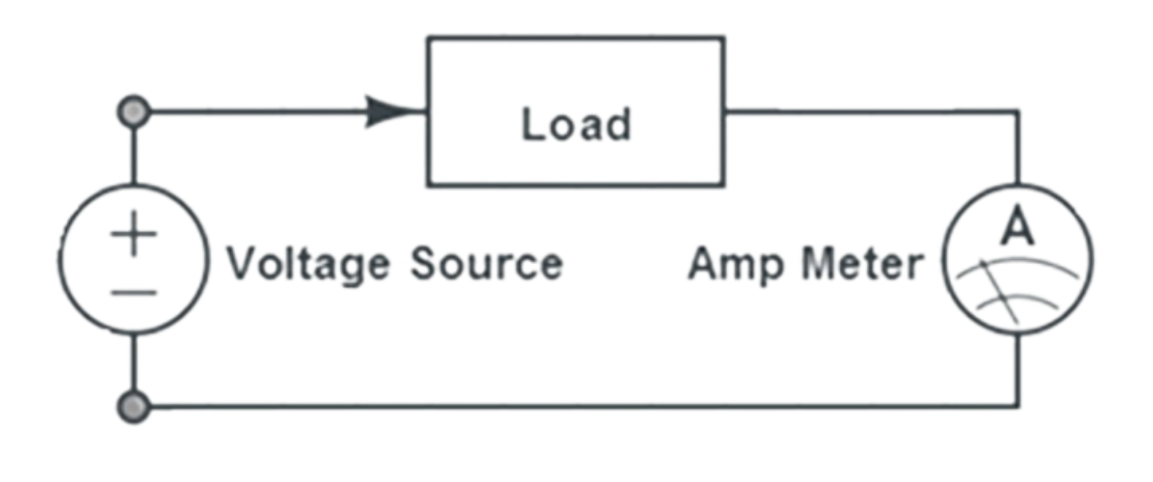
BACKGROUND INFORMATION
Digital multimeter: reads current and voltage across circuits
  Measure current in series, called ammeter
  Measure voltage in parallel, called voltmeter
Figure 8: Circuits for Using a Multimeter
Notes:
Tandon Areas of Excellence
Sustainability
Urban
Telecommunications & IT
Health
Artificial Intelligence
Professional Skills & Tandon Resources
MakerSpace & RAD
Teamwork & Vertically Integrated Projects
Career Services
Project Management & Technical Writing
World Trade Center Construction

Slide 12
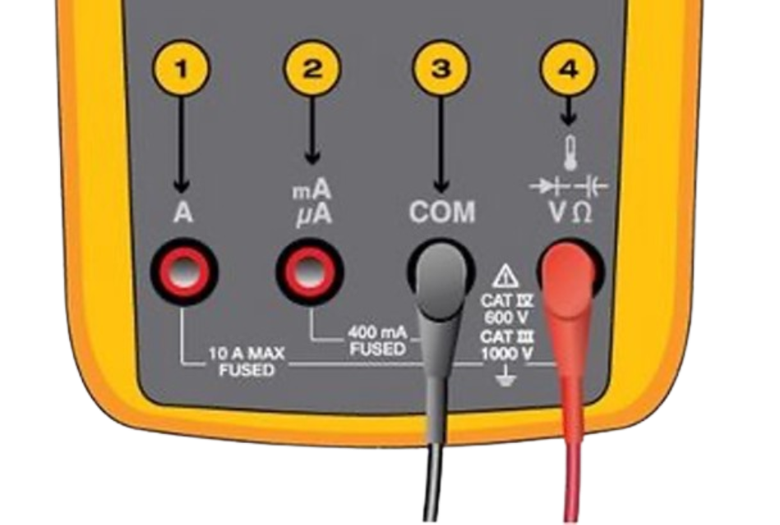
BACKGROUND INFORMATION
Multimeter Guidelines
  Ensure that the red lead is connected to the correct port
  Measuring current – Multimeter in series
  Measuring voltage – Multimeter in parallel
Figure 9: Ports on a Multimeter
Notes:
Tandon Areas of Excellence
Sustainability
Urban
Telecommunications & IT
Health
Artificial Intelligence
Professional Skills & Tandon Resources
MakerSpace & RAD
Teamwork & Vertically Integrated Projects
Career Services
Project Management & Technical Writing
World Trade Center Construction

Slide 13
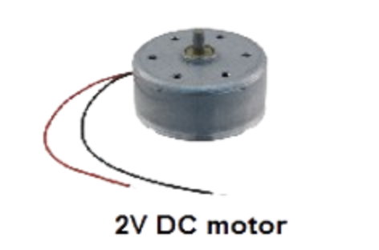
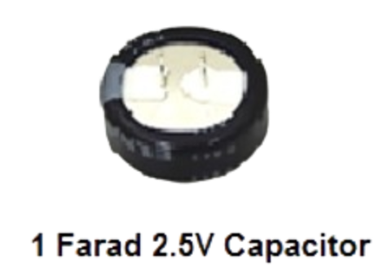
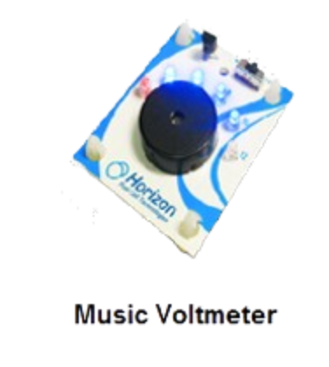
MATERIALS
Horizon wind-turbine
Sunforce 50013 1 W solar battery charger
Adjustable table fan
Heat lamp
3V power supply
Digital multimeter
LEGO to alligator clip connector
Scissors
3 alligator clip sets
Standard LEGO kit
9V DC motor
1 F 2.7 V capacitors
Music voltmeter
Notes:
Tandon Areas of Excellence
Sustainability
Urban
Telecommunications & IT
Health
Artificial Intelligence
Professional Skills & Tandon Resources
MakerSpace & RAD
Teamwork & Vertically Integrated Projects
Career Services
Project Management & Technical Writing
World Trade Center Construction

Slide 14
PROCEDURE
Part 1: Test the power storage device
  Charge a capacitor
  Test capacitors in series and parallel
Part 2: Test the assigned power source using music voltmeter
  Solar panel
  Wind turbine
Part 3: Design a sustainable energy vehicle using the power source of choice and enter in competition
Notes:
Tandon Areas of Excellence
Sustainability
Urban
Telecommunications & IT
Health
Artificial Intelligence
Professional Skills & Tandon Resources
MakerSpace & RAD
Teamwork & Vertically Integrated Projects
Career Services
Project Management & Technical Writing
World Trade Center Construction

Slide 15
PROCEDURE
Part 1
Test the power storage device
Charge a capacitor
Test capacitors in series and parallel
Part 2
Test the assigned power source using music voltmeter
Solar panel
Wind turbine
Part 3
Design a sustainable energy vehicle using the power source of choice and enter in competition
Notes:
Tandon Areas of Excellence
Sustainability
Urban
Telecommunications & IT
Health
Artificial Intelligence
Professional Skills & Tandon Resources
MakerSpace & RAD
Teamwork & Vertically Integrated Projects
Career Services
Project Management & Technical Writing
World Trade Center Construction

Slide 16

COMPETITION RULES
Competition is judged by the competition ratio (CR):
$$CR=\frac{Distance [ft]}{1 \left[s\right]+Time [s]}×\frac{100}{Cost [\$]}+Distance \left[ft\right]$$
The sustainable energy vehicle must carry the power storage device
Capacitors can only be charged for one minute using the provided power sources
A minimum of 2 capacitors must be used
Each design will only be allowed one trial
Cannot touch vehicle once trial has started
The trial will end after five minutes or when the car stops moving
Notes:
Tandon Areas of Excellence
Sustainability
Urban
Telecommunications & IT
Health
Artificial Intelligence
Professional Skills & Tandon Resources
MakerSpace & RAD
Teamwork & Vertically Integrated Projects
Career Services
Project Management & Technical Writing
World Trade Center Construction

Slide 17
COMPETITION RULES
Table 1: Cost List for Competition
Material | Unit | Cost Per Unit
Horizon Wind Turbine | 1 | $7.50
Solar Panel | 1 | $10.00
1 F 2.7 V Capacitor | 1 | $3.00
Alligator Clip Set | 1 pair | $0.50
LEGO Kit (Limit One Per Design) | 1 | $0.00
LEGO to Alligator Clip Connector | 1 | $0.10
Tape | 1 foot | $0.10
Notes:
Tandon Areas of Excellence
Sustainability
Urban
Telecommunications & IT
Health
Artificial Intelligence
Professional Skills & Tandon Resources
MakerSpace & RAD
Teamwork & Vertically Integrated Projects
Career Services
Project Management & Technical Writing
World Trade Center Construction

Slide 18
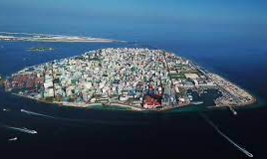
IDBE IMPLEMENTATION
High cost of sustainability
  Renewable energy sources can require new infrastructure- higher cost
  Companies are reluctant to invest in renewable energy because it is slower to produce
High price of remaining environmentally unethical
  Minority groups are disproportionately affected by climate change due to increased resource cost and the changing environments in their communities
Figure 10: Rising Sea Levels in the Maldives
Notes:
Tandon Areas of Excellence
Sustainability
Urban
Telecommunications & IT
Health
Artificial Intelligence
Professional Skills & Tandon Resources
MakerSpace & RAD
Teamwork & Vertically Integrated Projects
Career Services
Project Management & Technical Writing
World Trade Center Construction

Slide 19
ASSIGNMENT
Team lab report:
  Answer discussion questions in manual
  Include picture and explanation of vehicle design
  Include spreadsheet with power source data and competition results
    Address how measurements from power sources impacted the design
  Due at 11:59 PM the night before Lab 11
Team presentation:
  Address discussion points in manual
  Include cost of vehicle design
Notes:
Tandon Areas of Excellence
Sustainability
Urban
Telecommunications & IT
Health
Artificial Intelligence
Professional Skills & Tandon Resources
MakerSpace & RAD
Teamwork & Vertically Integrated Projects
Career Services
Project Management & Technical Writing
World Trade Center Construction

Slide 20
ASSIGNMENT
Team Lab Reports
Answer discussion questions in manual
Include picture and explanation of vehicle design
Include spreadsheet with power source data and competition results
Address how measurements from power sources impacted the design
Due at 11:59 PM the night before Lab 11
Team Presentation
Address discussion points in manual
Include cost of vehicle design
Notes:
Tandon Areas of Excellence
Sustainability
Urban
Telecommunications & IT
Health
Artificial Intelligence
Professional Skills & Tandon Resources
MakerSpace & RAD
Teamwork & Vertically Integrated Projects
Career Services
Project Management & Technical Writing
World Trade Center Construction

Slide 21
CLOSING
Measure current in series and voltage in parallel
Submit all work electronically
Take pictures of the vehicle design
Clean up workstations
Return all unused materials to the TA
Handle the batteries with caution! Be careful not to touch the two leads together
Notes:
Tandon Areas of Excellence
Sustainability
Urban
Telecommunications & IT
Health
Artificial Intelligence
Professional Skills & Tandon Resources
MakerSpace & RAD
Teamwork & Vertically Integrated Projects
Career Services
Project Management & Technical Writing
World Trade Center Construction

Slide 22
QUESTIONS?

