Slide 1

SUSTAINABLE ENERGY VEHICLE COMPETITION (VIRTUAL)
EG1003 | LAB 5

Slide 2
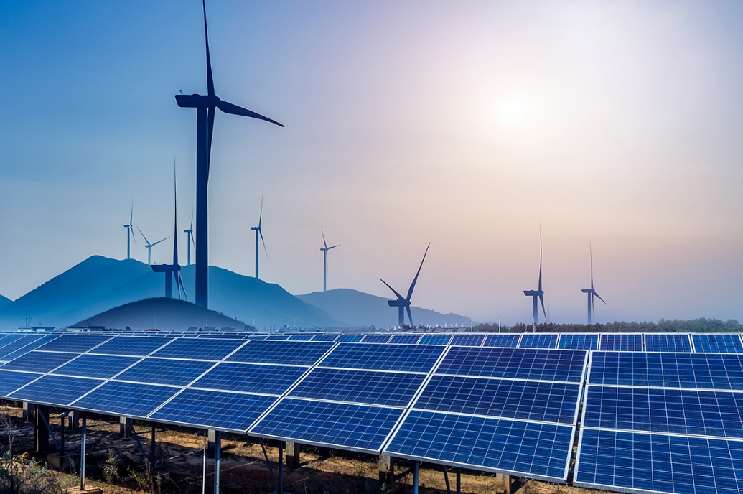
OVERVIEW
Objective
Background Information
Materials
Procedure
Assignment
Closing
Figure 1: Renewable Energy Sources
Courtesy of Physics World
1

Slide 3
OBJECTIVE
To evaluate energy storage devices
To evaluate different sources of renewable energy
To design a sustainable energy vehicle to enter in a competition
2

Slide 4
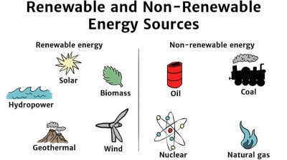
BACKGROUND INFORMATION
Renewable energy – energy harnessed from naturally replenished resources
Figure 2: Renewable vs. Non-Renewable Energy Sources Courtesy of Solar Schools
3

Slide 5
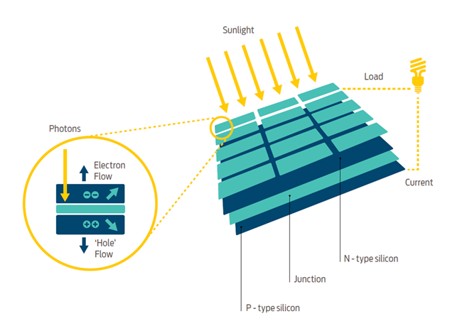
BACKGROUND INFORMATION
Solar panels – convert sunlight to electrical energy
  Incident sunlight excites electrons to
  next energy level, emitting energy
  Usually made of silicon
  Represented by a potato on TinkerCAD
Figure 3: How Solar Panels Work
Courtesy of Good Energy
4

Slide 6
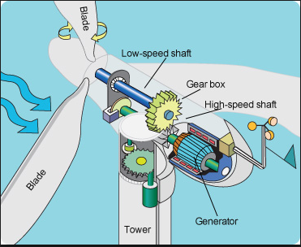
BACKGROUND INFORMATION
Wind turbine – converts wind energy to electrical energy
  Wind causes pressure difference on turbine blades
  Utilizes gear ratios to power generator
  Represented by a lemon on TinkerCAD
Figure 4: How Wind Turbines Work
Courtesy of Tech-Addict
5
Notes:
Rotating blades turn a low-speed shaft to a gearbox, which outputs power to an electrical generator through a high-speed shaft.

Slide 7
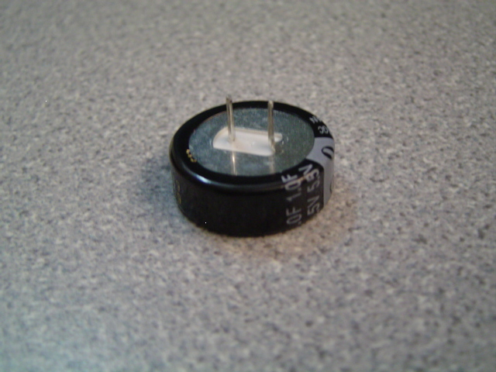
BACKGROUND INFORMATION
Capacitor – stores charge temporarily
  Are polarized
  Charged logarithmically (initially charges very fast but rate of charging slows down)
Positive
Negative
Figure 5: Polarized Leads of 1 Farad Capacitor
6

Slide 8


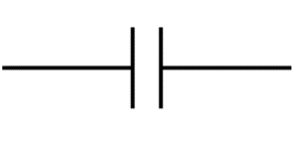

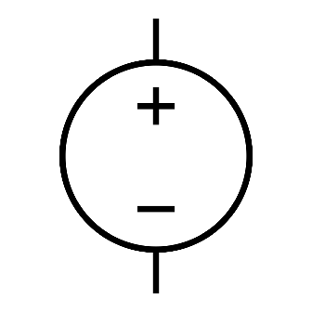
BACKGROUND INFORMATION
Symbols for common electrical components:
  Battery
  Capacitor
  DC source
  Voltmeter
  Ammeter
7

Slide 9
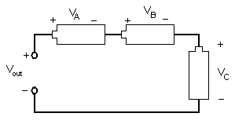
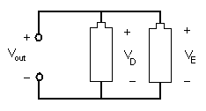


BACKGROUND INFORMATION
Series circuit
  Current is equal across components
  Voltage across each component:
  $${V_{out}=V}_{A}+V_{B}+V_{C}$$
Parallel circuit
  Current varies across components
  Voltage across each component:
  $${V_{out}=V}_{D}=V_{E}$$
Figure 6: Series Circuit
Figure 7: Parallel Circuit
8

Slide 10
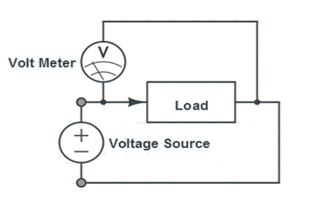
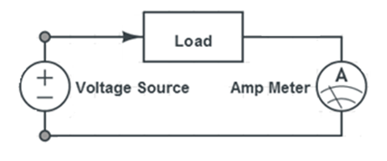
BACKGROUND INFORMATION
Digital multimeter – reads current and voltage across circuits
  Measure current in series, called ammeter
  Measure voltage in parallel, called voltmeter
Figure 8: Circuits for Using a Multimeter
9

Slide 11
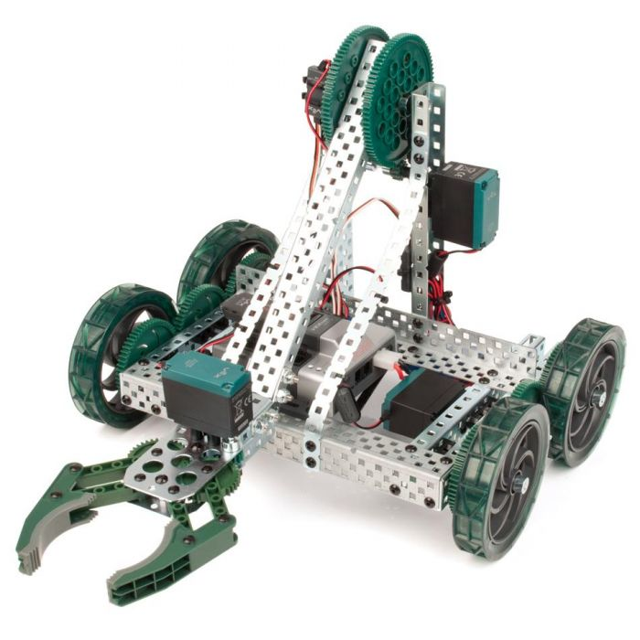
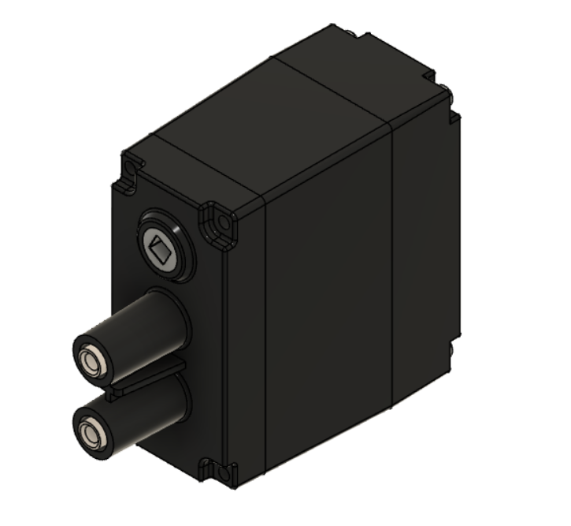
BACKGROUND INFORMATION
VEX Robotics – educational robotics kit used to design interactive robots
Commonly used to model capabilities of vehicles
Will be used to model sustainable energy vehicle design in Fusion 360
Figure 9: VEX Clawbot (Left) and VEX Motor (Right)
Courtesy of Robot Mesh
10

Slide 12
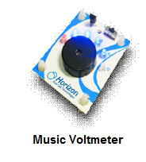
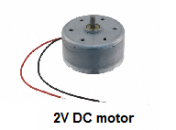
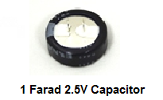
MATERIALS
Materials for in-person lab:
Horizon wind-turbine
Sunforce 50013 1 W solar battery charger
Adjustable table fan
Heat lamp
3V power supply
Digital multimeter
Music voltmeter
9V DC motor
1 F 5.5V capacitor
3 alligator clip sets
Standard LEGO kit
LEGO to alligator clip connector
Scissors
11

Slide 13
PROCEDURE
Part 1: Observe various circuits in TinkerCAD
Part 2: Test the power storage device in TinkerCAD
  Charge a capacitor
Part 3: Test the assigned power source in TinkerCAD
  Solar panel (potato)
  Wind turbine (lemon)
Part 4: Design a sustainable energy vehicle using the power source of choice in Fusion 360 and enter in competition
  The team with the best design for the sustainable energy vehicle will win the competition
12

Slide 14
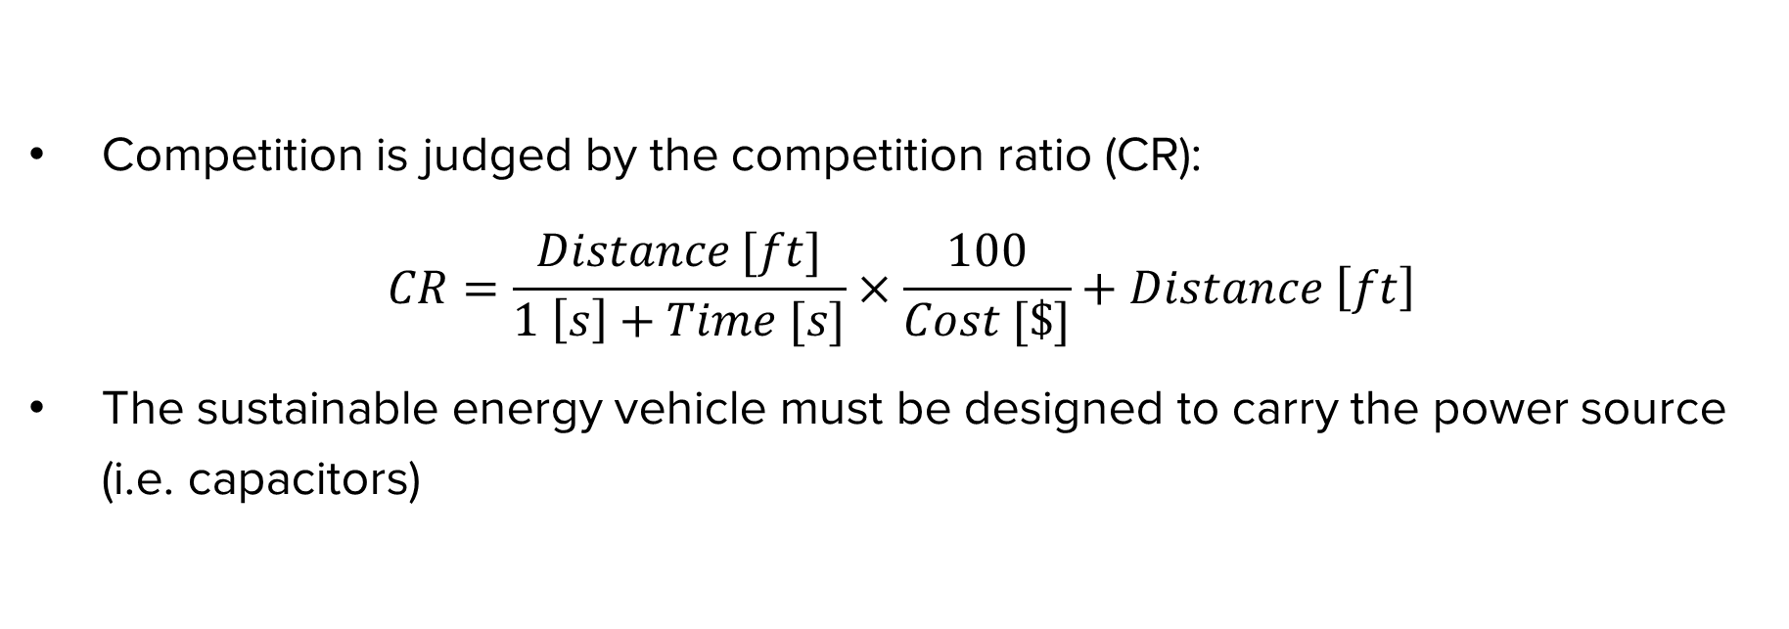
COMPETITION RULES
Competition is judged by the competition ratio (CR):
$$CR=\frac{Distance [ft]}{1 \left[s\right]+Time [s]}×\frac{100}{Cost [\$]}+Distance \left[ft\right]$$
The sustainable energy vehicle must be designed to carry the power source (i.e. capacitors)
13

Slide 15
COMPETITION RULES
Table 1: Cost List for Competition
Material | Unit | Cost Per Unit
Horizon Wind Turbine | 1 | $7.50
Solar Panel | 1 | $10.00
1 F 5.5V Capacitor | 1 | $3.00
VEX Kit (Limit One Per Design) | 1 | $0.00
Wires | 1 pair | $0.50
14

Slide 16
ASSIGNMENT
Optional extra credit individual lab report:
  Answer discussion questions in manual
  Include screenshots and explanation of vehicle design
  Include spreadsheet with power source data and competition results
    Address how measurements from power sources impacted the design
  Due at 11:59 PM the night before Lab 6
Team presentation:
  Address discussion points in manual
  Include cost of vehicle design
15

Slide 17
CLOSING
Measure current in series and voltage in parallel
Submit all work electronically
Take screenshots of the vehicle design
Explain the choice of the power source (solar panel or wind turbine) in the vehicle design in the team lab report
16

Slide 18
QUESTIONS?

