Slide 1
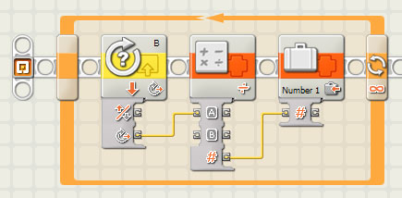
EG1003: Introduction to Engineering and Design
Laboratory 4: Sensors

Slide 2
Overview
Objective
Background
Materials
Procedure
Report / Presentation
Closing

Slide 3
Objectives
Design two sensor programs
Mindstorms: use sensors to stop a motor when a red ball is detected
LabVIEW: use a thermocouple to measure temperature in a heating and cooling program
Apply sensors to Semester-Long Design Projects

Slide 4
Concept : Control Systems
Control system
System created to read and analyze data
Use analyzed data for appropriate action
Examples:
Thermal controls
Lighting systems
Alarm systems
Motion sensors

Slide 5
Concept: Sensors
Sensors
Read data from test environment
Data converted to digital format for computer
Some sensor types:
Light
Temperature
Ultrasonic
Touch
Sensors connect to different control devices:
Lego sensors -> NXT
Thermocouple -> DAC -> PC

Slide 6
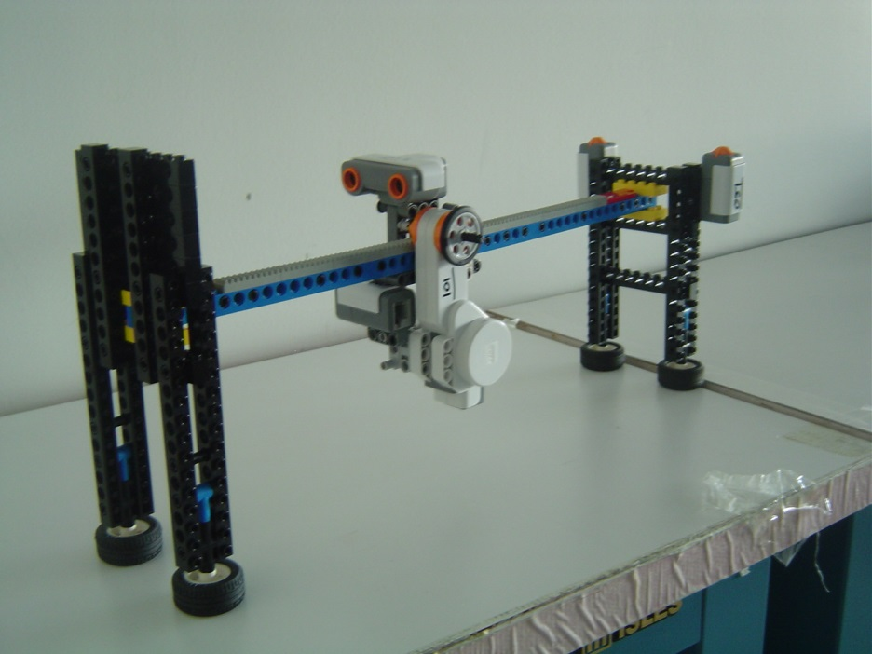
Materials
Mindstorms sensor program
NXT
Test assembly
Computer with Mindstorms
LabVIEW sensor program
Computer with LabVIEW + DAC
Thermocouple

Slide 7
Procedure: Mindstorms Sensor Program Part A
Port 1 touch sensor
Starts program
Starts motor on Port A
Reverses direction of motor
Port 2 touch sensor
Stops motor on Port A
Ends program
Port B motor
Varies speed of Port A motor

Slide 8
Procedure: Mindstorms Sensor Program Part B
Port 3 ultrasonic sensor
Reverse direction of motor when greater than 20cm from wall
Reverse direction of motor when less than 8cm from wall

Slide 9
Procedure: Mindstorms Sensor Program Part C
Port 4 light sensor
Stops motor when red ball is detected (value greater than 45)
Ends program

Slide 10
Assignment: Report/Presentation
No report for this lab
No Presentation for this lab
Milestone 2 due next recitation

Slide 11
Closing
Have all lab notes signed by TA
Each team member should have turn using software
Return all unused materials to TA

