Slide 1

SAFETY GUIDELINES
EG1003 | LAB 1

Slide 2

WHAT IS SAFETY?
To protect life and property from harm
or damage
Safety protects:
  Personal well-being
  Public well-being
  Proper business environment
Figure 1: Safety Things Courtesy of
CYB Human Resources
1

Slide 3
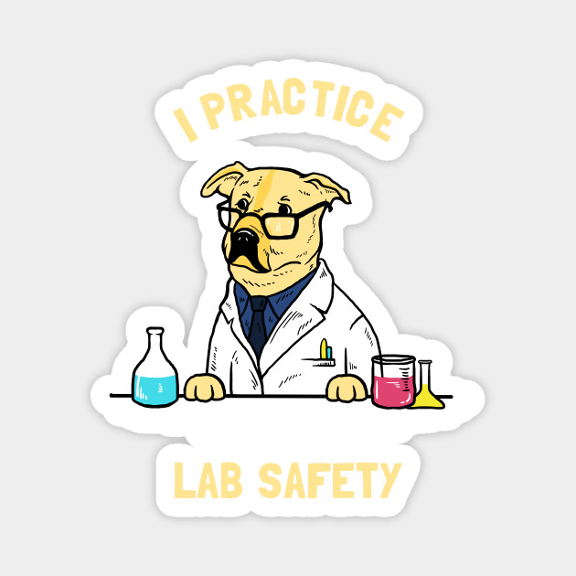
NEED FOR SAFETY
Helps maintain a hazard-free workplace
Creates a comfortable workplace
Keeps order and responsibility
Figure 2: Safety Dog Courtesy of TeePublic
2

Slide 4

SAFETY STAFF
General Engineering
  Head TAs, RH 303B, x3515
Tandon School of Engineering
  Charles Martucci, RH 701E, x3613
  Nicole Romeo, 370 Jay St 2nd Floor, x85335
3

Slide 5
EMERGENCY NUMBERS
Contact | Phone Number
Emergency Closings | (212) 998-1220
Guard Stations | Rogers Hall: (646) 997-3537 Dibner: (646) 997-3727
Public Safety | (212) 998-2222
Wellness | (212) 443-9999
Facilities & Operations | (212) 998-1001
Environmental Health & Safety | (212) 998-1450
4

Slide 6

BASIC SAFETY RULES
Attending the lab virtually
  Know your peers and TAs, do not admit
  strangers into the Zoom call
    Mute your microphone if there is
    excessive background noise
  Attending the lab in person
  Must wear extra personal protective equipment (PPE)
Be courteous
  Maintain a professional environment
  Never work alone
  Don’t talk over the TAs or other
  students
5

Slide 7
RECAP
Know & follow the safety rules
Report any problems to the safety staff
Maintain a professional environment
THINK
SAFETY
ALWAYS………..
6

Slide 8
QUESTIONS?

