Slide 1

HIR WORKSHOP
LAB 4C
EG 1004 Introduction to Engineering & Design

Slide 2

OVERVIEW
Objective
Background Information
Materials
Procedure
IDBE Implementation
Assignment
Closing
Figure 1: Revit icon courtesy of Autodesk

Slide 3
OBJECTIVE
Use BIM software, Revit, to visualize an incomplete building design
Design a plumbing plan and electrical plan for one floor
Complete the incomplete building with a new floor, stairs, and a roof
Design the third floor of the incomplete building

Slide 4
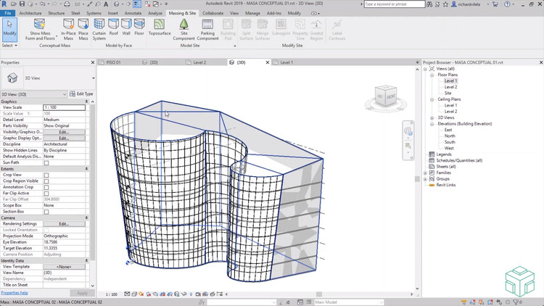
BACKGROUND INFORMATION
Autodesk Revit
  Introduced in “Introduction to Revit”
  Building Information Modeling (BIM) software
  Used by architects, structural engineers, mechanical engineers, electrical engineers, plumbing engineers, and construction professionals
Figure 2: Revit in use courtesy of Autodesk

Slide 5
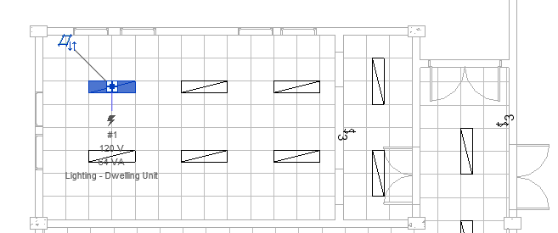
BACKGROUND INFORMATION
Plumbing Plan
  Accounts for plumbing fixtures (sinks, toilets, showers, etc.)
  Hot water, cold water, sanitary water systems
Electrical Plan
  Electrical circuits connected to centralized panelboard
  Circuit breakers, fuses, and electrical outlets
  Allow for efficient wiring of outlets and appliances
Figure 3: Electrical Plan courtesy of CAD Notes

Slide 6
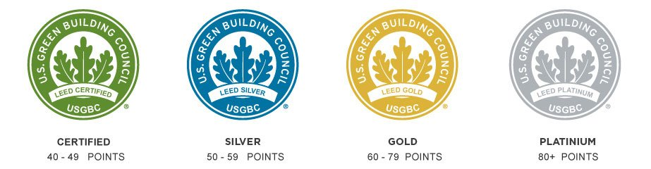
BACKGROUND INFORMATION
LEED Accreditation
Location and Transportation
Materials and Resources
Sustainable Sites
Indoor Environmental Quality
Water Efficiency
Innovation
Energy and Atmosphere
Regional Priority
Figure 4: LEED Accreditation courtesy of Everblue

Slide 7
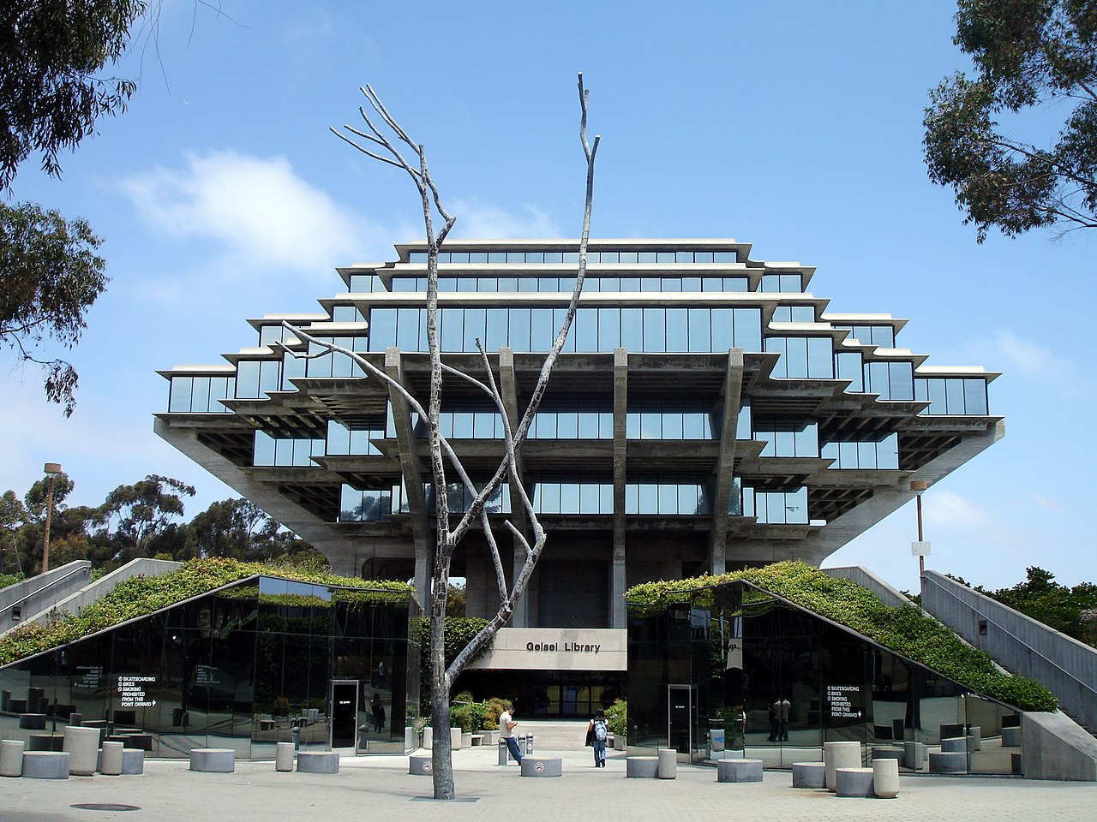
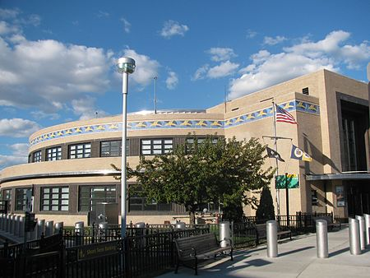
BACKGROUND INFORMATION
Revit Model → Full, Coherent Building
  Person at Point A in building should be able to reach any Point B
  Initial 3D concept sketch/CAD due Benchmark A
Physical Model → 2.5’ x 2.5’ base
Based on REVIT Model
Built from OL Craft Station Materials
Use a strong design concept to showcase your mission statement
Art Deco ↓
Futurism ↑
Marine Air Terminal
Queens, NY
by WIlliam Delano
Geisel Library
San Diego, CA
by William Pereira

Slide 8
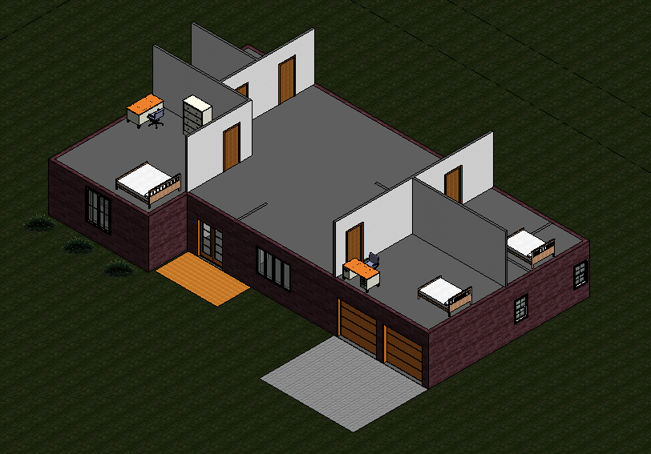
MATERIALS
A lab PC
Autodesk Revit 2020 or newer
Predesigned house template (download directly from the manual)
Figure 5: Incomplete House Template

Slide 9
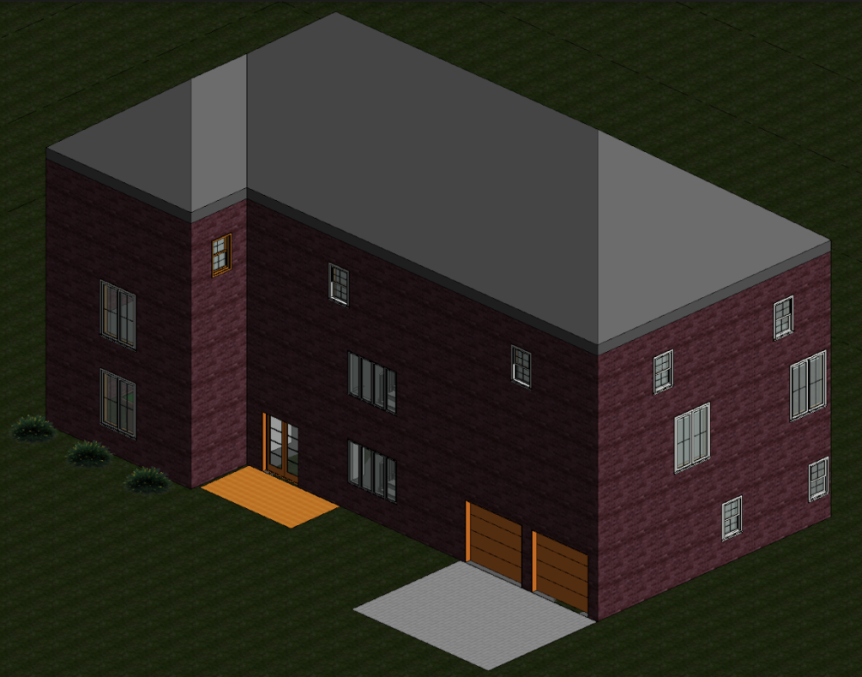
PROCEDURE
Part I: Plumbing Plan
  Only complete cold-water system
Part II: Electrical Plan
  Panelboard, switches, outlets, and circuits
Part III: Complete the Architectural Plan
  Add a third floor, shafts, stairs, and a roof
Extra: Design the Third Floor
  Import a component from a third-party website
  Add rooms and furniture
Figure 6: Completed Architectural Plan

Slide 10
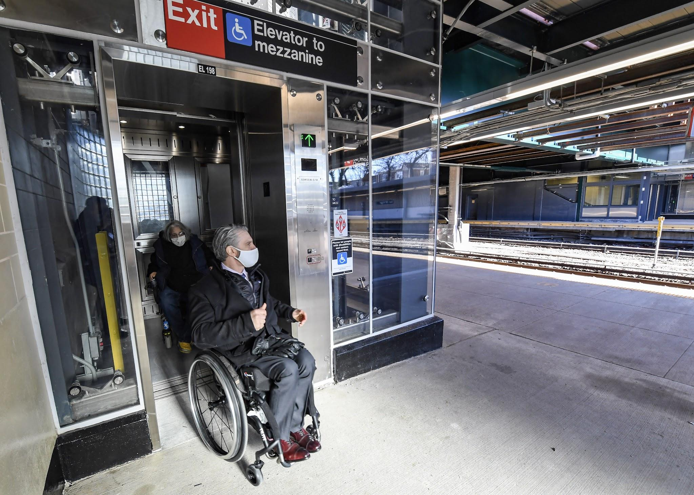
IDBE IMPLEMENTATION
Accessible Architectural Design
  Can be used by people with a variety of disabilities independently
  Includes ramps, elevators, braille signage, etc.
Consider– Who will be using the space you design? What changes could be made to improve accessibility and usability?
Figure 7: Person utilizing accessible design on NYC subway

Slide 11
ASSIGNMENT
No lab report for lab 4
No presentation for lab 4

Slide 12
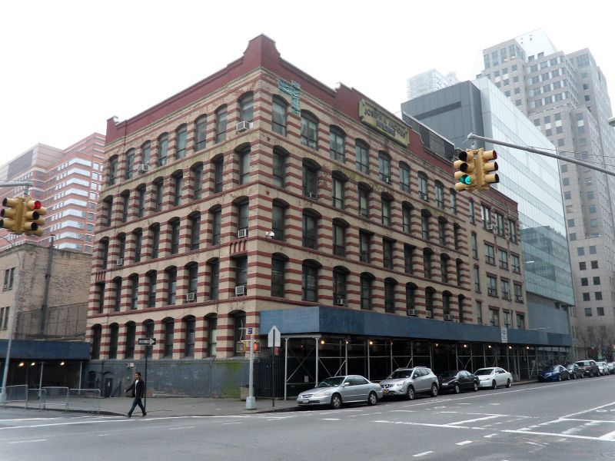
CLOSING
Ask TAs for help if needed
Only finish the architectural plan if time allows
Revit is not backwards compatible, only use Revit 2020 or newer!
Begin working on HIR project after workshop
Figure 8: Jacobs Administrative Building

Slide 13
NEXT STEPS
Draft the Preliminary Design Investigation (PDI) report
Begin working on the Milestone 1 Presentation
Begin working towards Benchmark A deliverables
  One 40-student classroom
  One 20-student classroom
  One recreational space
Remember to create your designs in a single Revit Project (.rvt) file!

Slide 14
QUESTIONS?

