Slide 1


HIR WORKSHOP
EG1004 | LAB 4C

Slide 2

OVERVIEW
Objective
Background Information
Materials
Procedure
Assignment
Closing
Figure 1: Revit icon courtesy of Autodesk
1

Slide 3
OBJECTIVE
Use BIM software, Revit, to visualize an incomplete building design
Design a plumbing plan and electrical plan for one floor
Complete the incomplete building with a new floor, stairs, and a roof
Design the third floor of the incomplete building
2

Slide 4
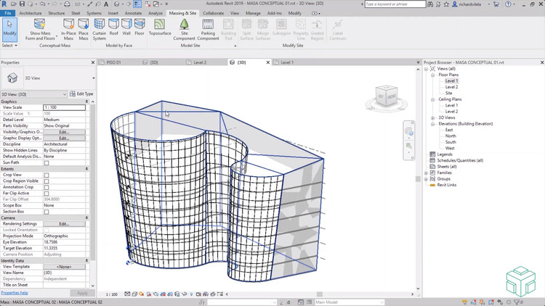
BACKGROUND INFORMATION
Autodesk Revit
  Introduced in “Introduction to Revit”
  Building Information Modeling (BIM) software
  Used by architects, structural engineers, mechanical engineers, electrical engineers, plumbing engineers, and construction professionals
Figure 2: Revit in use courtesy of Autodesk
3

Slide 5
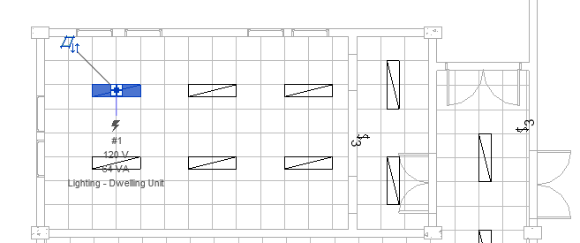
BACKGROUND INFORMATION
Plumbing Plan
  Accounts for plumbing fixtures (sinks, toilets, showers, etc.)
  Hot water, cold water, sanitary water systems
Electrical Plan
  Electrical circuits connected to centralized panelboard
  Circuit breakers, fuses, and electrical outlets
  Allow for efficient wiring of outlets and appliances
Figure 3: Electrical Plan courtesy of CAD Notes
4

Slide 6

BACKGROUND INFORMATION
LEED Accreditation
  Location and Transportation
  Sustainable Sites
  Water Efficiency
  Energy and Atmosphere
  Materials and Resources
  Indoor Environmental Quality
  Innovation
  Regional Priority
Figure 4: LEED Accreditation courtesy of Everblue
5

Slide 7
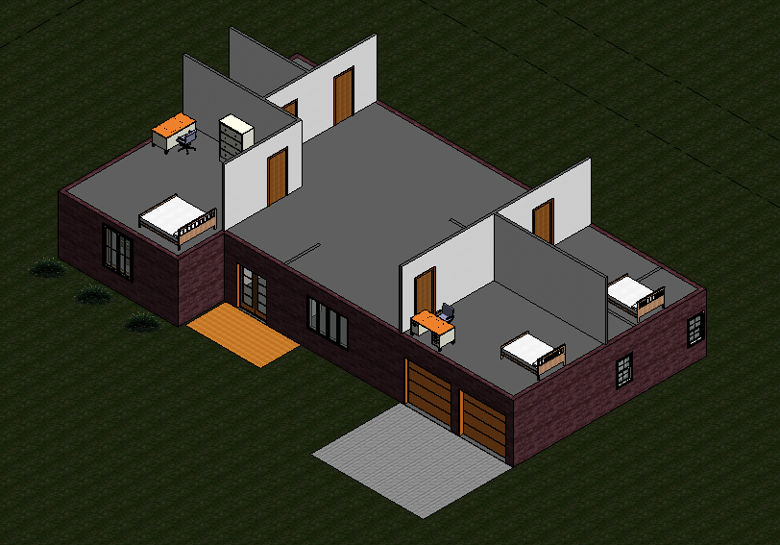
MATERIALS
A lab PC
Autodesk Revit 2020 or newer
Predesigned house template (download
directly from the manual)
Figure 5: Incomplete House Template
6

Slide 8
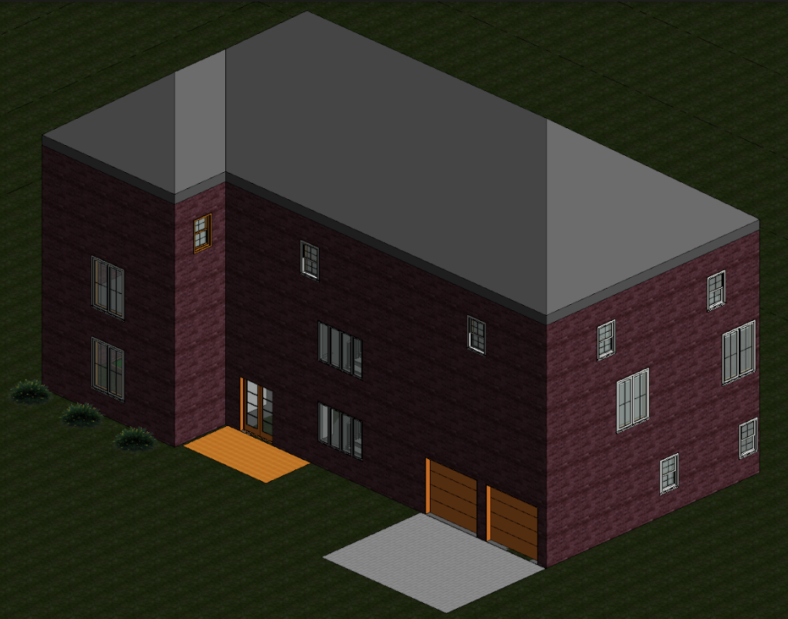
PROCEDURE
Part I: Plumbing Plan
  Only complete cold-water system
Part II: Electrical Plan
  Panelboard, switches, outlets, and circuits
Part III: Complete the Architectural Plan
  Add a third floor, shafts, stairs, and a roof
Extra: Design the Third Floor
  Import a component from a third-party website
  Add rooms and furniture
Figure 6: Completed Architectural Plan
7

Slide 9
ASSIGNMENT
No lab report
No team presentation
8

Slide 10
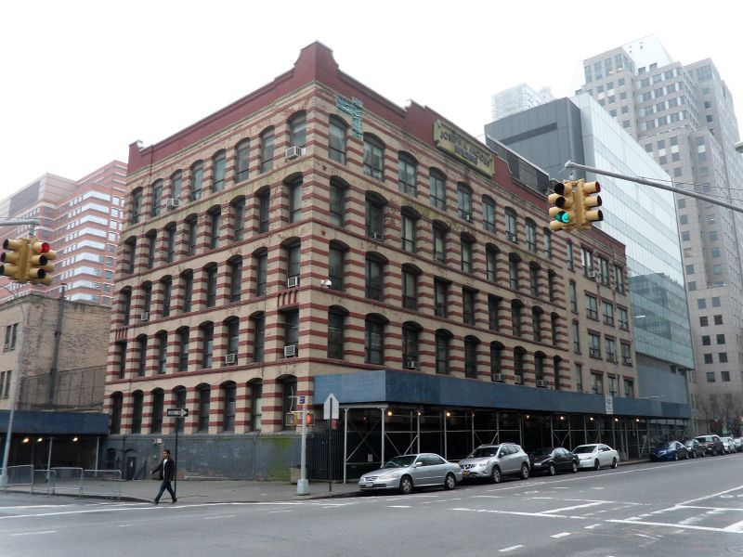
CLOSING
Ask TAs for help if needed
Only finish the architectural plan if time allows
Revit is not backward compatible, only use Revit 2020 or newer!
Begin working on HIR project after the workshop
Figure 7: Jacobs Administrative Building
9

Slide 11
NEXT STEPS
Draft the Preliminary Design Investigation (PDI) report
Begin working on the Milestone 1 Presentation
Begin working towards Benchmark A deliverables
  One 40-student classroom
  One 20-student classroom
  One recreational space
Remember to create your designs in a single Revit Project (.rvt) file!
10

