Slide 1
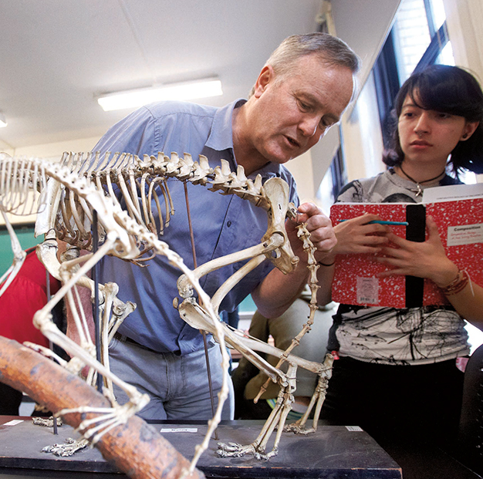
EG 1003: Introduction of Engineering and Design
Lab Safety Guidelines

Slide 2
Overview
What is Safety?
Need for Safety
Safety Staff
Emergency numbers
Basic Safety Rules
Electrical Safety Rules
Mechanical Safety Rules
Re-Cap

Slide 3
What is Safety?
To protect life and property from harm or damage.
Safety Protects:
Personal Well being
Public Well being
Proper business environment

Slide 4
Need for Safety
Helps maintain a hazard-free work place
Creates a comfortable work place
Keeps order and responsibility

Slide 5
Safety Staff
General Engineering
Head TAs RH 515A2, x3515
Polytechnic Institute of NYU
Dr. Charles Martucci RH 316G, x3613

Slide 6
Emergency Numbers
Contact | Phone Number
Emergency Closings | 1-800-POLY-FYI
Guard Stations | Rogers Hall 718-260-3537 Dibner 718-260-3727 Wunsch 718-632-5901
Facilities | 718-260-3020

Slide 7
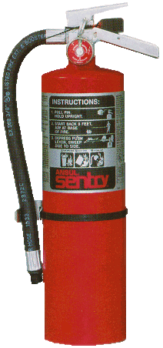
Basic Safety Rules
Be Alert
Note marked exits
Know where the fire extinguishers and first aid kits are located
Know your students/TAs, do NOT admit strangers
Be Tidy
Dispose of garbage properly, do NOT leave paper lying around
Store materials in cabinets

Slide 8
Basic Safety Rules
Be Courteous
Do NOT eat, drink, or smoke in labs
Do NOT overcrowd the laboratories
Maintain a business environment
Be Smart
NEVER work alone, use the “Buddy System”
No horseplay or shouting

Slide 9
Electrical Safety Rules
Avoid exposed wires, use ELECTRICAL TAPE to cover them
Keep electrical cords off the floor and to a minimum
Outlet are for electrical plugs only
(i.e. NO paper clips, scissors, fingers, etc.)
Never force a wrong plug into an outlet
Water and electricity do NOT mix

Slide 10
Mechanical Safety Rules
Wear proper accessories (goggles/work gloves) when working with tools
All tools should be used on a workbench
Work near a window or well ventilated area
Do NOT use broken equipment
Notify a TA immediately

Slide 11
Re-Cap
Know & follow the safety rules
Report any problems to the safety representatives
Maintain a Business Environment
THINK
SAFETY
ALWAYS………..

