Slide 1

HOW TO GIVE A RECITATION PRESENTATION
EG1003 | RECITATION 1

Slide 2

AGENDA
Lab Presentation Overview
Lab Presentation Format
Visual Delivery
Physical Delivery
Classroom Preparation & Etiquette
Questions
1

Slide 3
LAB PRESENTATION OVERVIEW
Timed five-minute presentation on labs
Post-presentation feedback from Professor, WC, and TA
  Listen & learn: penalty for redundant feedback
Graded on visual and verbal presentation
2

Slide 4
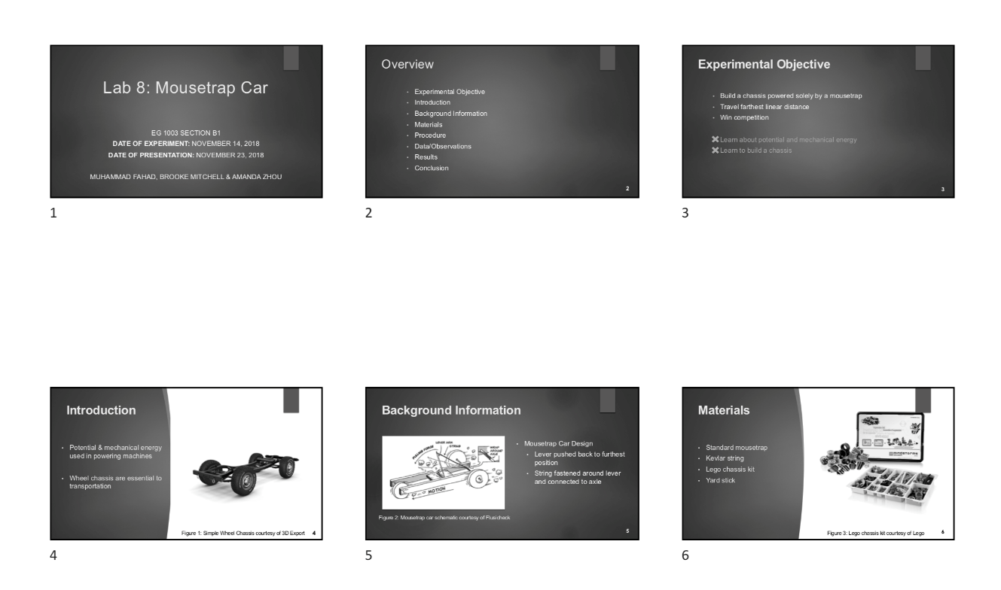
LAB PRESENTATION OVERVIEW
Submission:
EG1003 Website at 11:59 PM night before Recitation
Two printed copies brought to recitation
  Six slides per sheet horizontal
  Stapled
Figure 1: In-class printout
3

Slide 5
PRESENTATION FORMAT
Consistent format and order for all lab presentations:
Title
Overview
Experimental Objective
Introduction
Background Information
Materials
Procedure
Data/Observations
Results
Conclusion
Title
ALWAYS use this order!
4

Slide 6
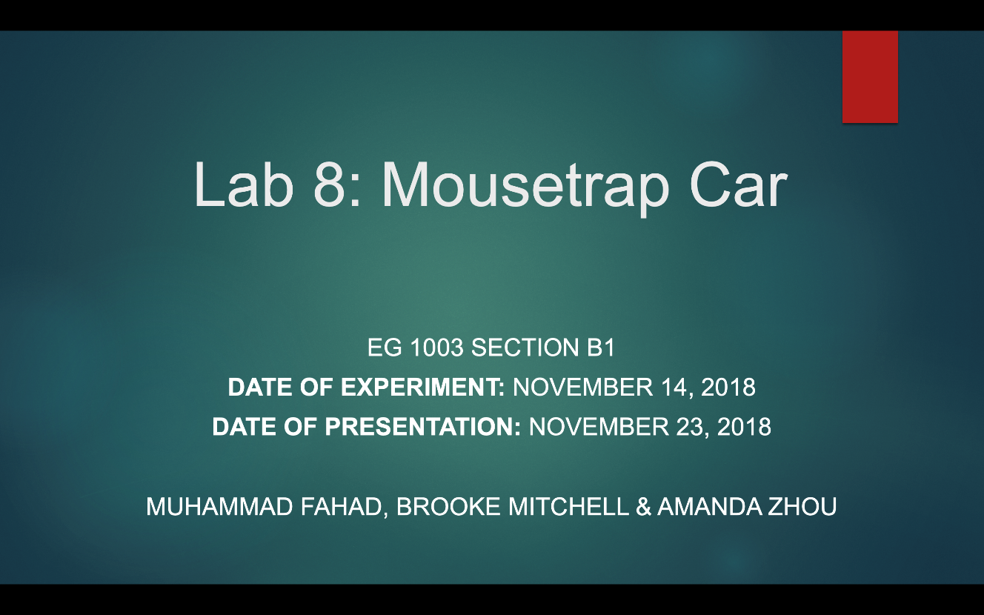
TITLE SLIDE
Lab number and title
Course number and section
Date of experiment
Date of presentation
Team members’ names
  Alphabetical by last name
Repeat title slide at end of presentation
Figure 2: Sample title slide
5

Slide 7
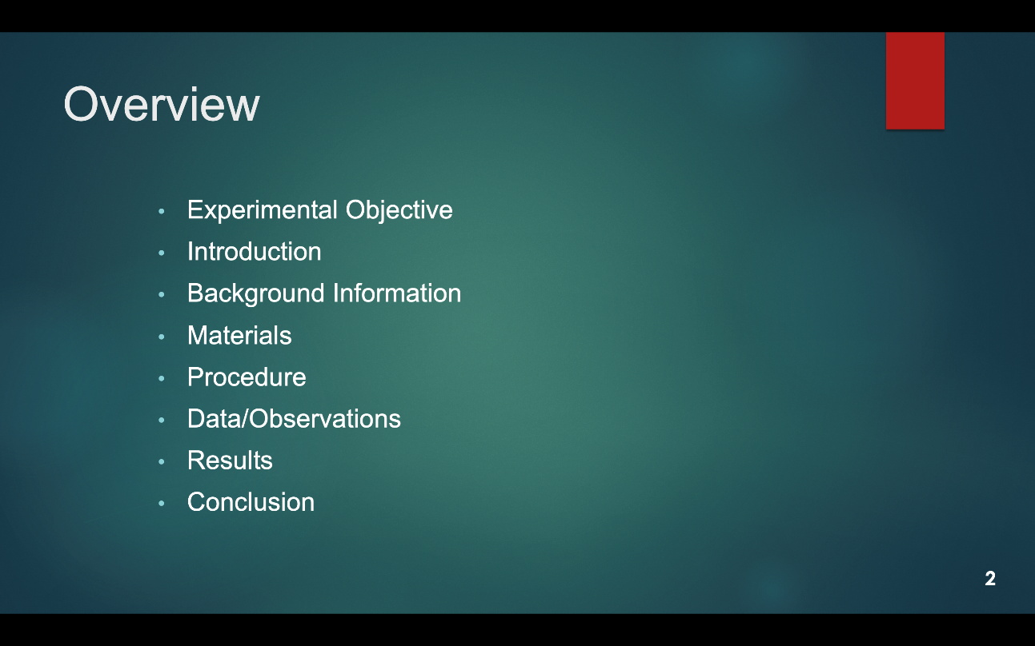
OVERVIEW SLIDE
Slide title “Overview”
No need to read slide aloud during presentation
Same overview slide/order for all presentations!
Figure 3: Overview slide sample
6

Slide 8
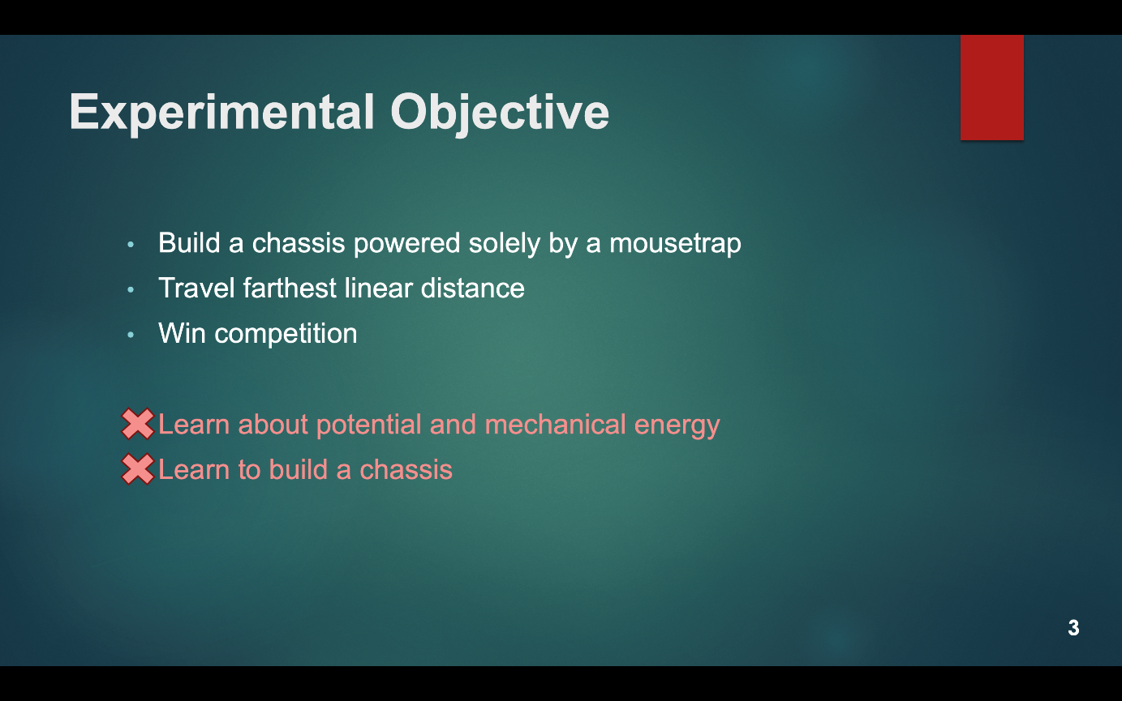
EXPERIMENTAL OBJECTIVE SLIDE
Slide title “Experimental Objective”
Scientific principles/objectives
  No learning objectives
Specify if experiment is a competition
Figure 4: Experimental objective sample
7

Slide 9
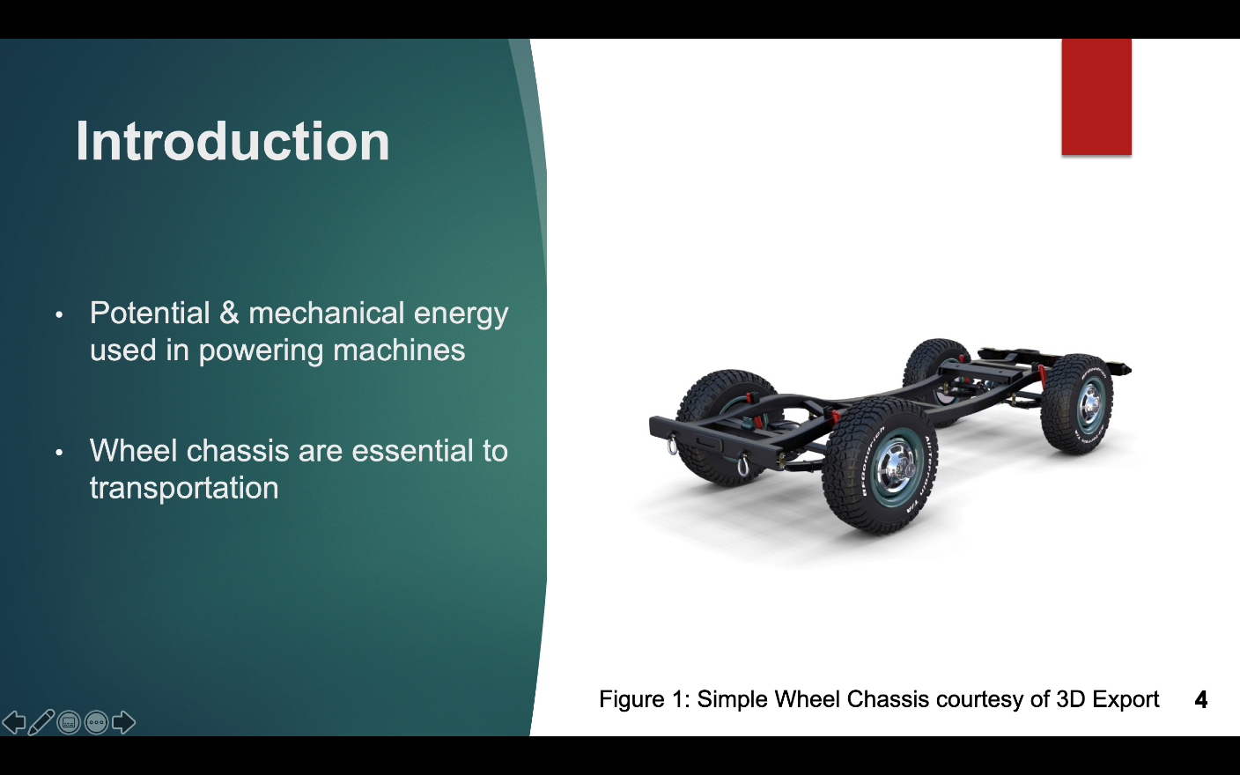
INTRODUCTION SLIDE
Slide title “Introduction”
Relevance & real-life applications
of topics in lab
Importance of topics in engineering
Figure 5: Introduction sample
8

Slide 10
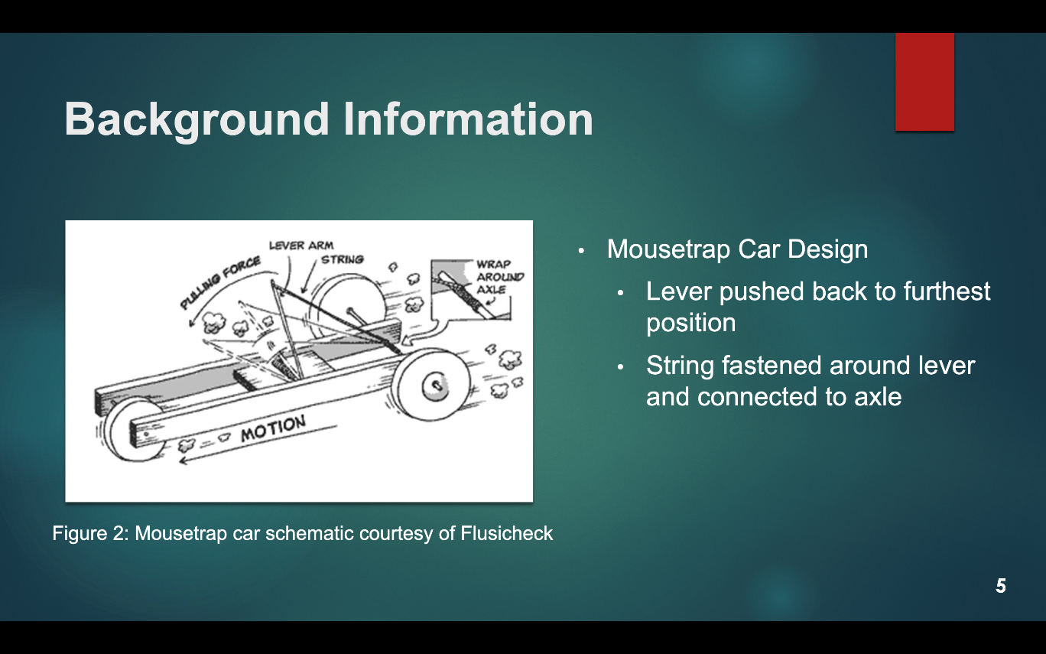
BACKGROUND SLIDE
Slide title “Background Information”
Scientific background:
  Main concepts
  Theories
  Equations
  Competition rules & ratios
Figure 6: Background information sample
9

Slide 11
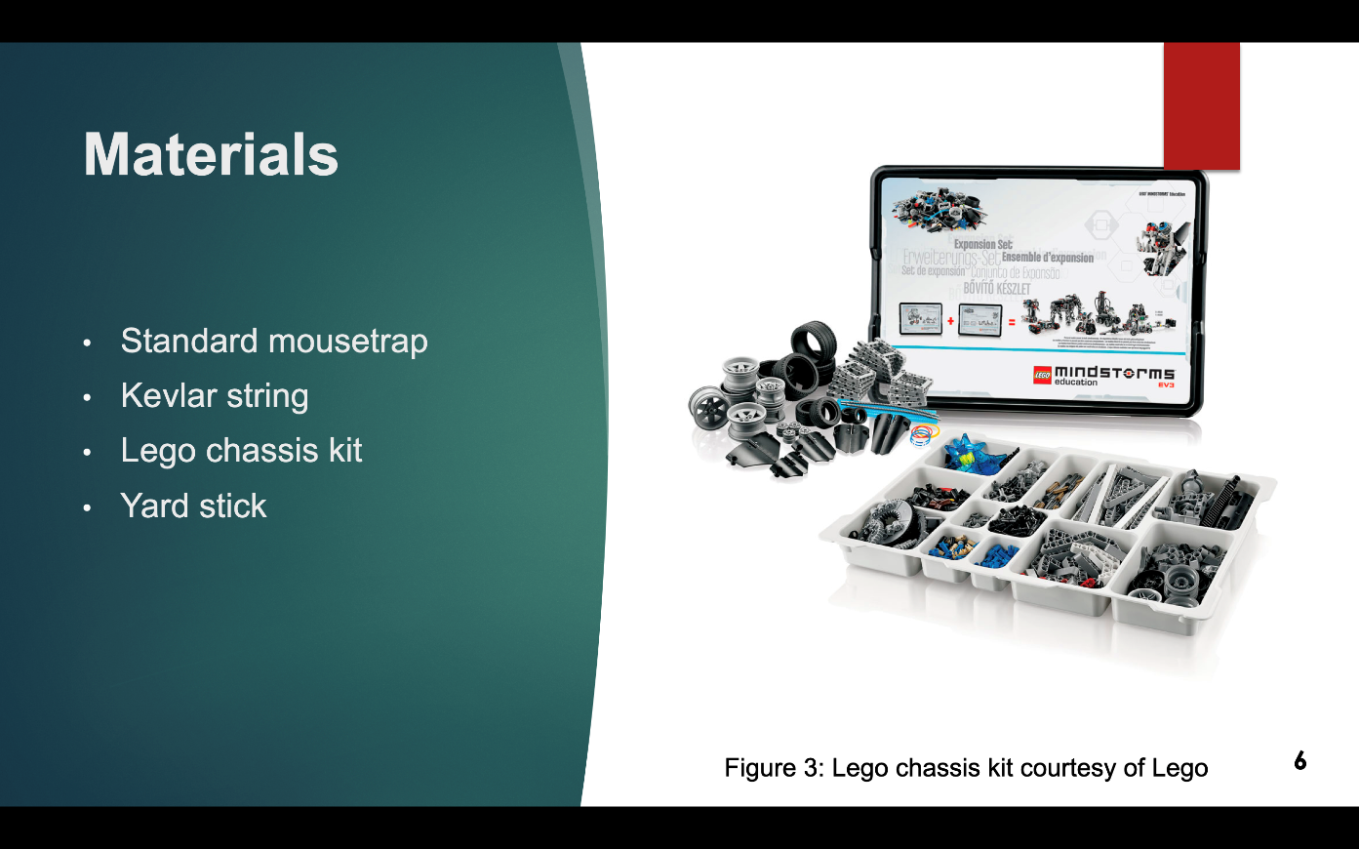
MATERIALS SLIDE
Slide title “Materials”
Only list materials used
No competition cost tables
No need to read aloud during presentation
Figure 7: Materials sample
10

Slide 12
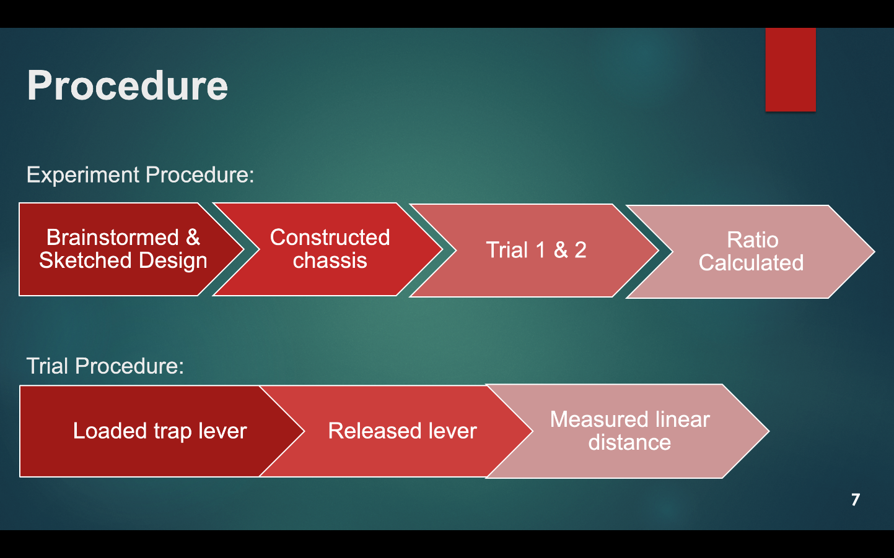
PROCEDURE SLIDE
Slide title “Procedure”
Steps followed in lab
  Flowcharts or bullets
Two slide maximum
Pictures of equipment (optional)
Figure 8: Procedure sample
11

Slide 13
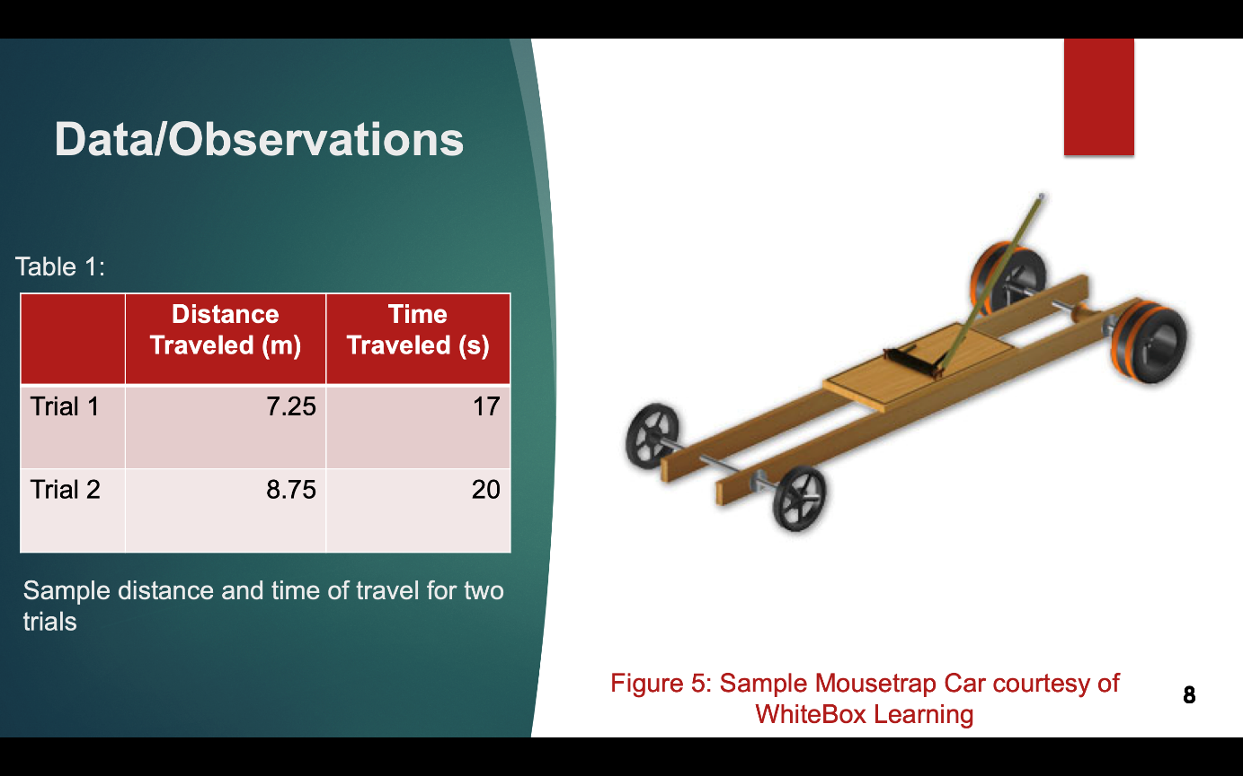
DATA/OBSERVATIONS SLIDE
Slide title “Data/Observations”
What you saw and recorded
  Pictures
  Tables (title)
  Graphs (title & labels)
All media must have captions!
Figure 9: Data/Observations sample
12

Slide 14
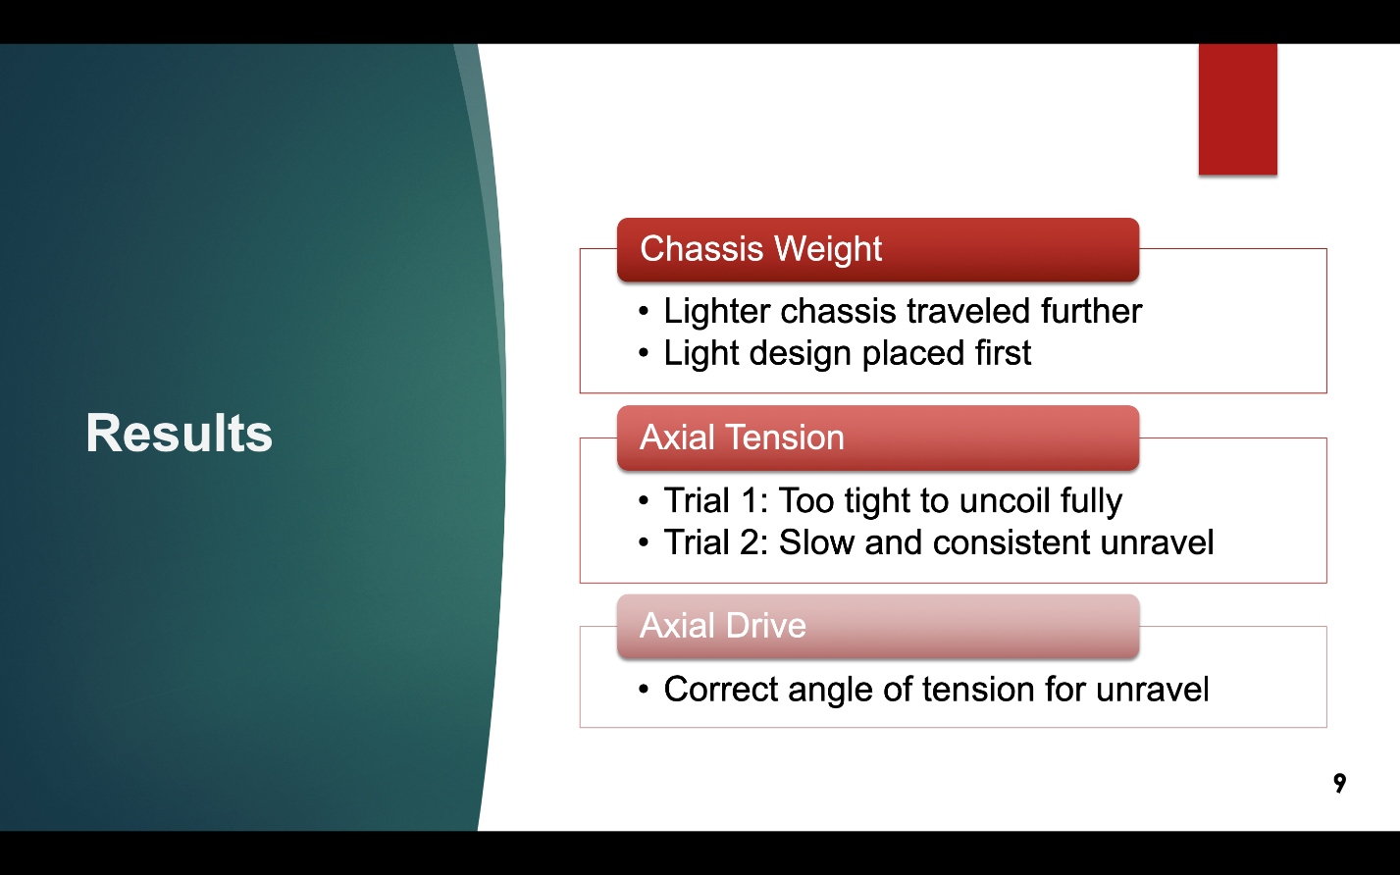
RESULTS SLIDE
Slide title “Results”
Show sample calculations
Compare results to expectations
& other groups design’s
Refer to data to support results
Figure 10: Results sample
13

Slide 15
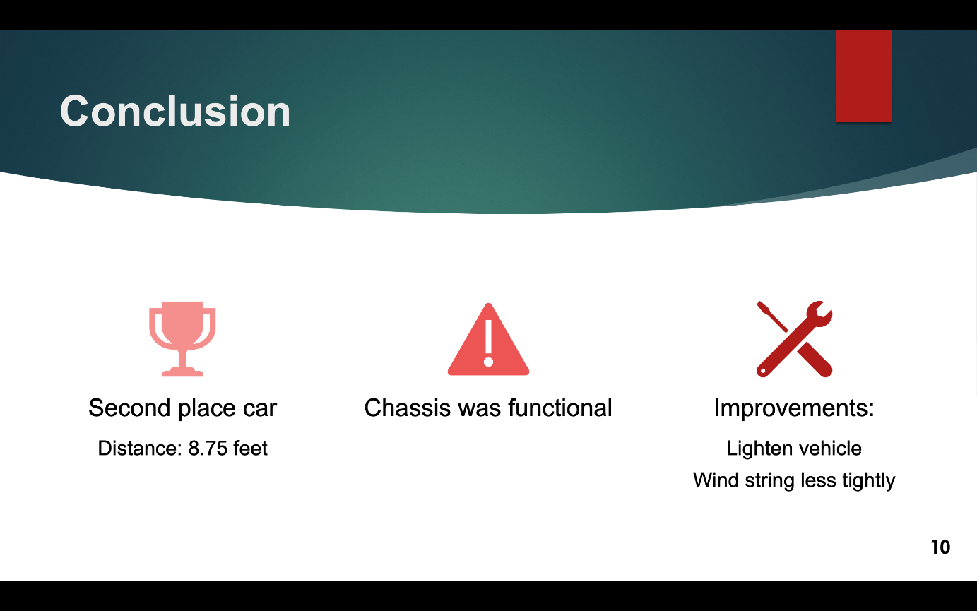
CONCLUSION SLIDE
Slide title “Conclusion”
Was experiment successful?
Objectives achieved
Place in competition
Improvements
Figure 11: Conclusion sample
14

Slide 16

VISUAL DELIVERY
No full sentences
Include images from labs
  No hand-drawn lab notes
Consistent fonts and text sizes
  No sans serif fonts
  18-point font minimum
Slide numbers
Don’t crowd slides
PROFESSIONAL & READABLE
15

Slide 17
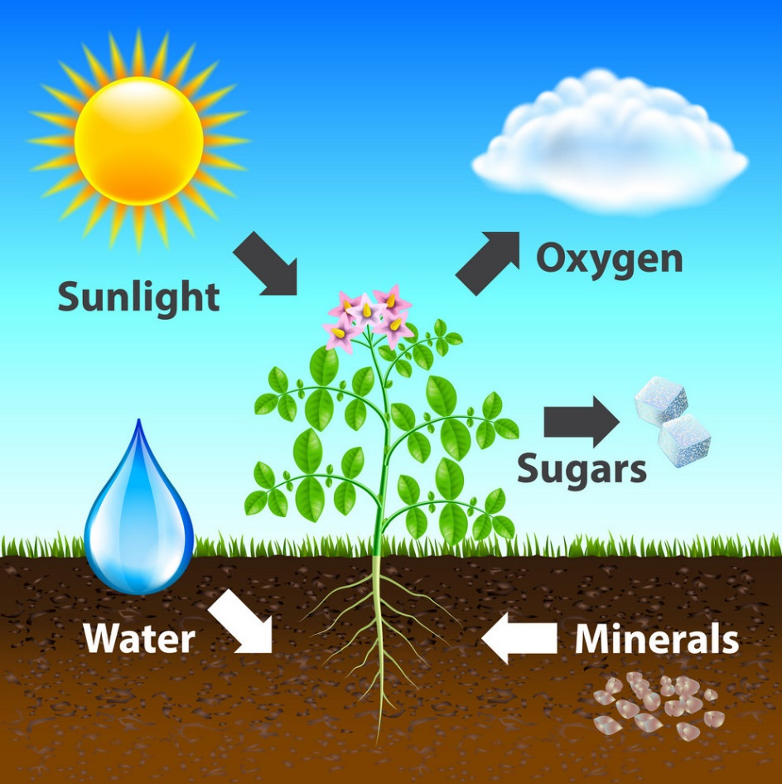
VISUAL DELIVERY
Use figures and images
  e.g. Figure 12 explains photosynthesis
Captions with every image
Main points on slides only
  Elaborate your points verbally
X by X Rule (X = 3, 4, 5, 6, or 7)
  e.g. 5 lines per slide, 5 words per line
Figure 12: Photosynthesis diagram
courtesy of VectorStock
16

Slide 18

PHYSICAL DELIVERY
Speak loudly and slowly
Face the audience
Eye contact with audience
Utilize a laser pointer where appropriate
Mistakes happen!
  Stay calm and keep presenting
Figure 13: Presentation delivery courtesy of NBC
17

Slide 19
CLASSROOM PREPARATION
Preparation:
  Technical difficulties do happen!
  Bring extra copy of presentation on USB or laptop
  Be prepared to present without slideshow
Classroom etiquette:
  No laptop/cellphone/technology use in class
  Give presenter your full attention
    No rehearsal during class time
Etiquette infractions result in loss of points
18

Slide 20
QUESTIONS?

