Slide 1

SOFTWARE FOR
ENGINEERS
EG1004 | LAB 1A & 1B

Slide 2
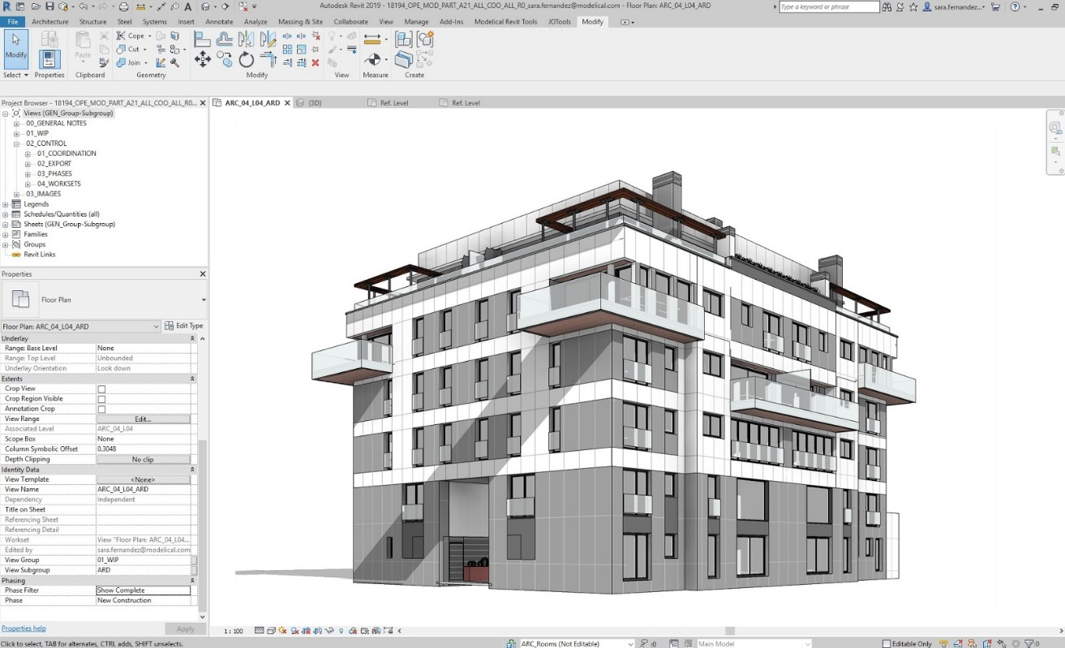
OVERVIEW
Objective
IDBE Implementation
Background
Procedure
Assignment
Closing
Figure 1: Autodesk Revit courtesy of Modelical
1

Slide 3


OBJECTIVE
Familiarization with software relevant to this course
Explore software tools
  Microsoft Excel
  Autodesk Revit
Figure 2: Software Icons Courtesy of AppRecs
2

Slide 4
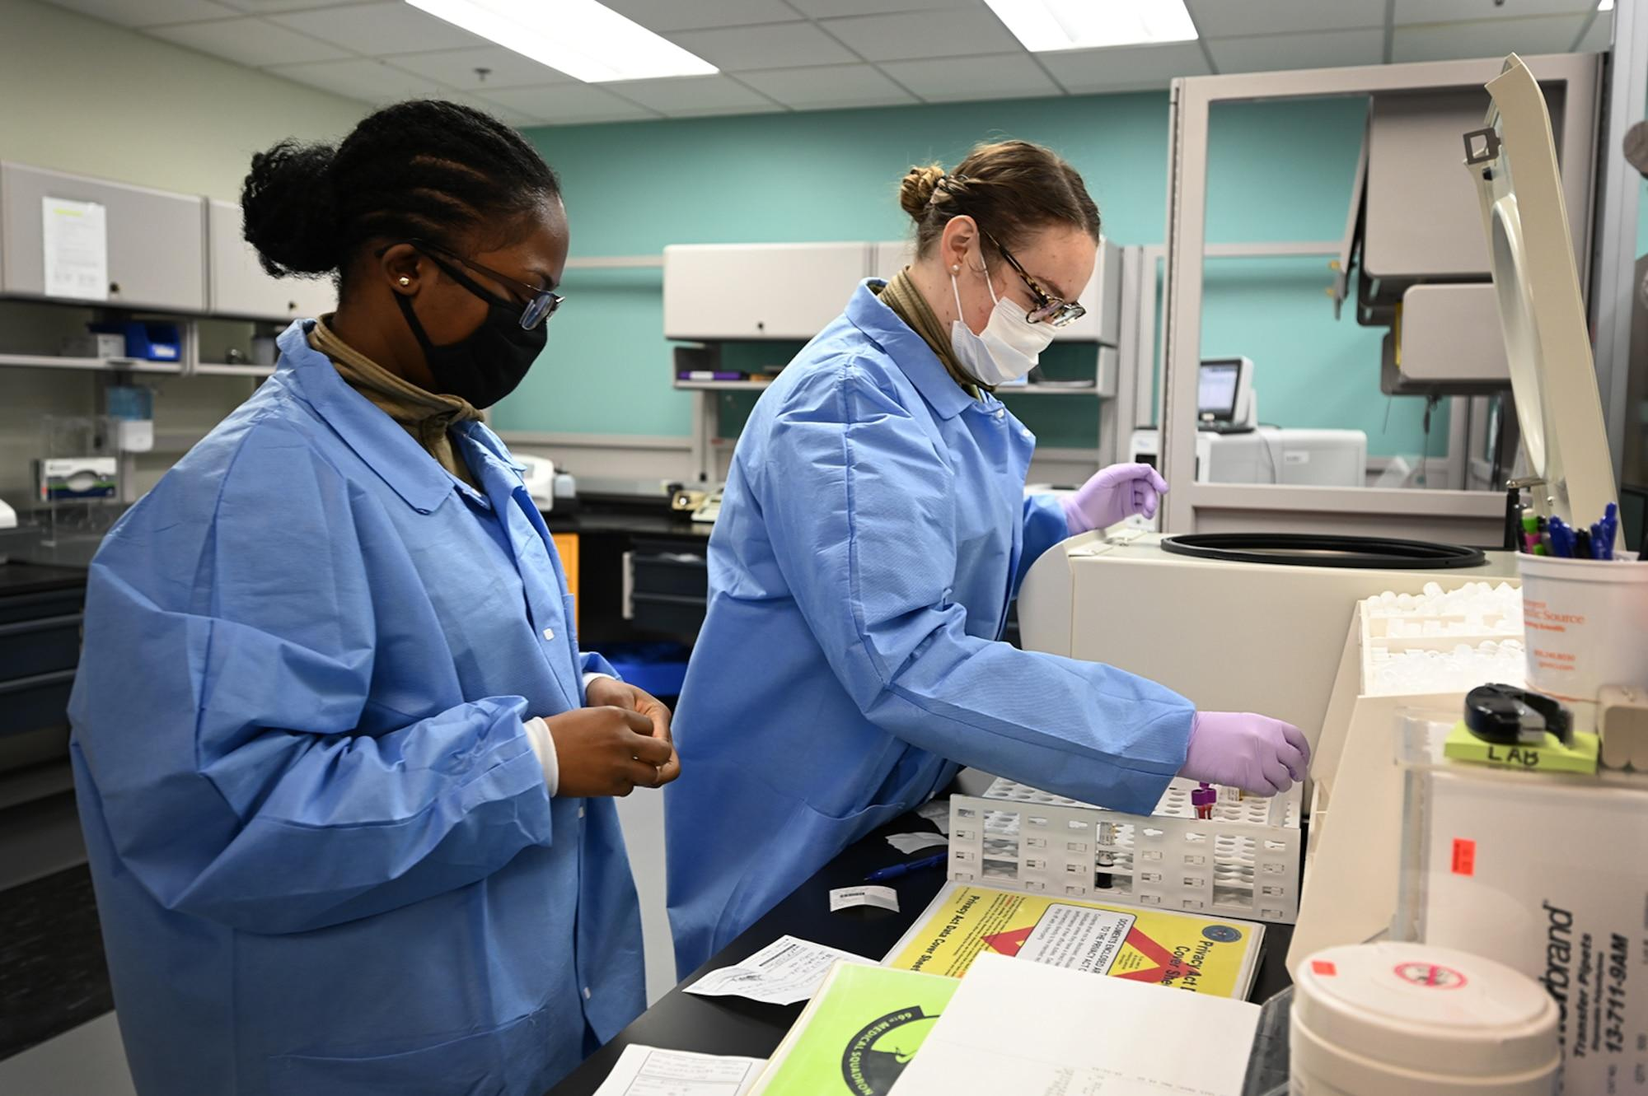

IDBE IMPLEMENTATION
Strength and Areas of Improvement
  What skills can you bring to a team?
  What skills would you like to develop in EG?
Share an element of your identity that is important to you
Community Agreement
  What kind of learning environment would you like to be a part of?
Figure X: Lab Team Working Together
X

Slide 5
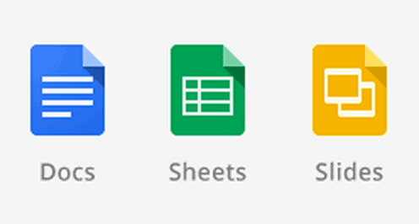
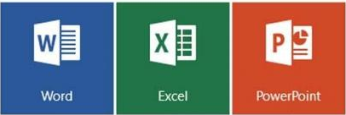
BACKGROUND
Microsoft Excel or Google Sheets
  Spreadsheet program
  Create tables, charts, graphs, data analysis
Microsoft Word or Google Documents
  Word processing program
  Create lab reports, proposals, documents
Microsoft PowerPoint or Google Slides
  Professional presentation program
Figure 3: G Suite (Top) and Microsoft Office (Bottom)
Courtesy of UNC Charlotte and Softpedia
3

Slide 6
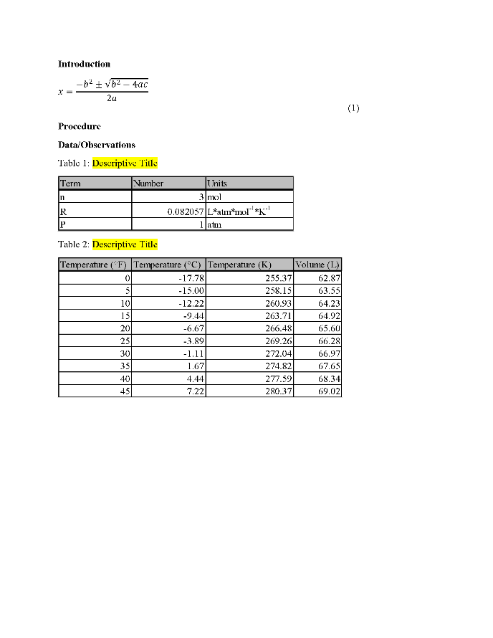
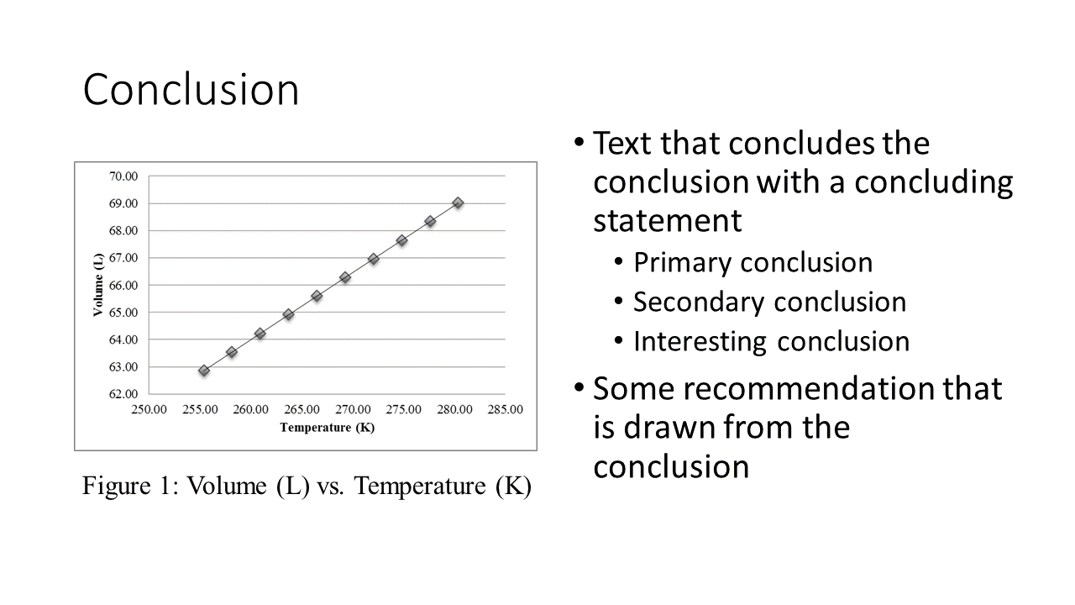
WORD AND POWERPOINT
Figure 4: Examples of Word (Left) and PowerPoint (Right)
4

Slide 7
EXCEL
Figure 5: Example of Excel
5

Slide 8
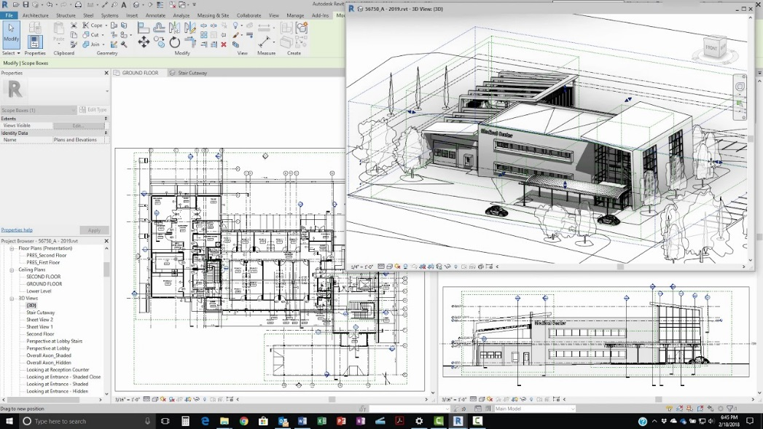
BACKGROUND INFORMATION
Revit
  Building modeling software for architects and civil engineers
  Creates homes, buildings, and structural support systems
  Used to create floor, plumbing, electrical, and HVAC plans
Figure 6: Revit in use courtesy of Revit News
6

Slide 9
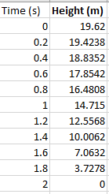
PROCEDURE
Go to Lab 1A – Introduction to Microsoft Office
Excel
  Case Study I: Free-Fall
    Plot velocity vs. time
    Plot a trendline and solve for acceleration
  Case Study II: Historical Energy Statistics
    Create line graphs to model yearly trend
    Create pie charts to model distribution in energy sources
Figure 7: Excel Data Table (Case Study I)
7

Slide 10
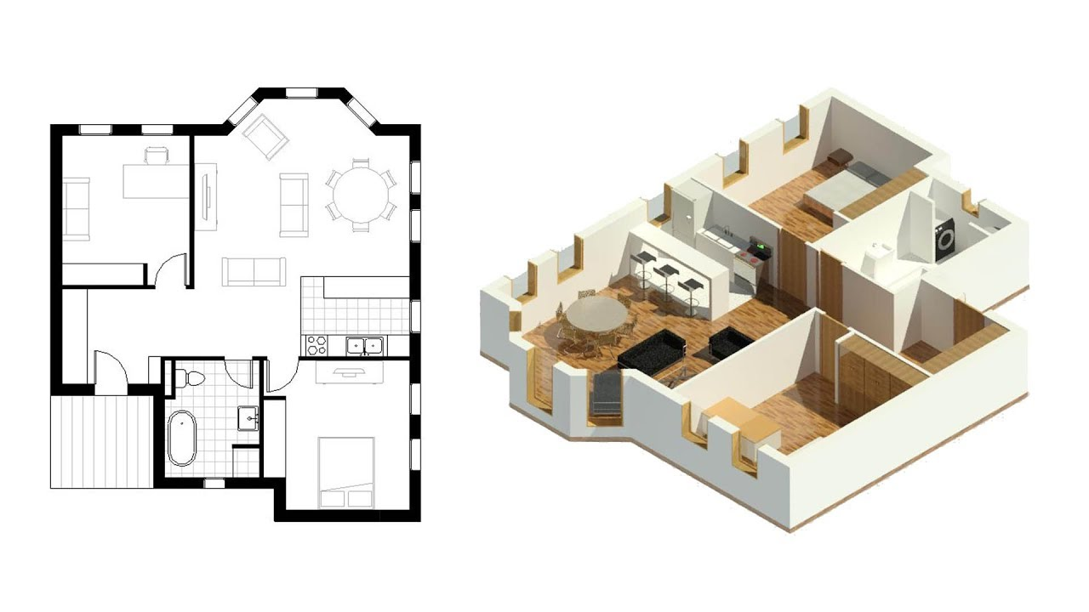
PROCEDURE
Go to Lab 1B – Introduction to Autodesk Revit
Revit
  Create a 350 – 400 square foot apartment
  Contains one of each: bathroom, kitchen, bedroom with bed, table, and desk
  Must have adequate lighting (at least one window) and space
Figure 8: Small apartment in Revit courtesy of Balkan Architect
8

Slide 11
ASSIGNMENT
No lab report for Lab 1A or Lab 1B
No presentation for Lab 1A or Lab 1B
Submit the ZIP file of the two excel files and RVT files on the EG1004 website (eg.poly.edu)
Due at 11:59 PM the night before Lab 2
9

Slide 12
CLOSING
All students must attempt to use the software
TAs are always available for assistance
Must submit the ZIP and RVT files to the EG1004 website before next lab
Go to the EG1004 student manual (manual.eg.poly.edu) for lab instructions
10

Slide 13
QUESTIONS?

