Slide 1
Jacobs academic building ² (JAB ²)
CaZan Buildings
Head of Design: Seizan Arai
Head of Management and Production: Carlos Alexandre Vieira Saddy Torres Medeiros
EG 1004 G2 Final Presentation April 24th, 2024

Slide 2
Agenda
Company Profile
Project Statement
Project Objective
Project Description
Cost Estimate
Project Schedule
Market and building viability
Conclusion

Slide 3
Company Profile
Carlos Medeiros
Head of Management and Production
BS Civil Engineering at NYU Tandon
MS Civil Engineering at UC Berkeley
Former Langan Civil Engineer
Seizan Arai
Head of Design
BS Mechanical Engineer at NYU Tandon
MS Engineering Management at Cornell
Former CBES Engineer

Slide 4
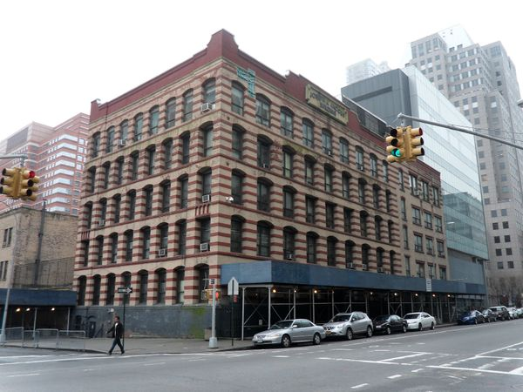
Project Statement
NYU Tandon Jacobs Academic Building is outdated and needs reformulation
Academic buildings should be more inclusive, sustainable, and efficient for its users
The demands of the contemporary world are reliability and sustainability
Figure 1: Isometric View of Jacobs Academic Building

Slide 5
Project Objective
This innovative project has the purpose to develop a more sustainable and inclusive community at NYU Tandon
It will benefit not only students, faculty and staff, but also the community that uses the space around the campus
This project will solve the heat island effect in the university, will be climate neutral, and will improve the traffic quality inside the building
Meets NYU 2040 Sustainability goals
Mission Statement - Renovate constructions following the demands of the contemporary world: sustainability and reliability.
Figure 2: Company Logo

Slide 6
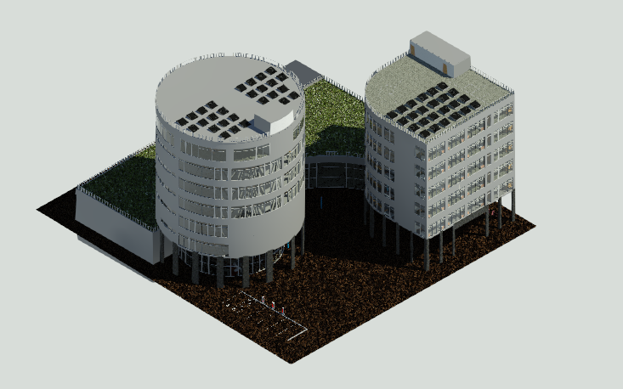
Project Description
Platinum LEED Certification
Sustainable Sites
Green Roof to reduce heat island effect
Glass Facades to maximize natural light
Energy and Atmosphere
Solar panels on both buildings for on-site energy production
Innovation
Wi-fi routers located in common areas, classrooms and dorm rooms
ID scanners to enter the building (Academic and Dorm areas)
Figure 3: Isometric Rendering View of Building

Slide 7
Project Description
LEED Certification
Water Efficiency
Rainwater storage to use for future purposes (bathrooms)
Water Quality Monitor
High efficiency water system in dormitory building
Indoor Environmental Quality
CO detectors
Glazed windows to regulate temperature and reduce outside noise

Slide 8
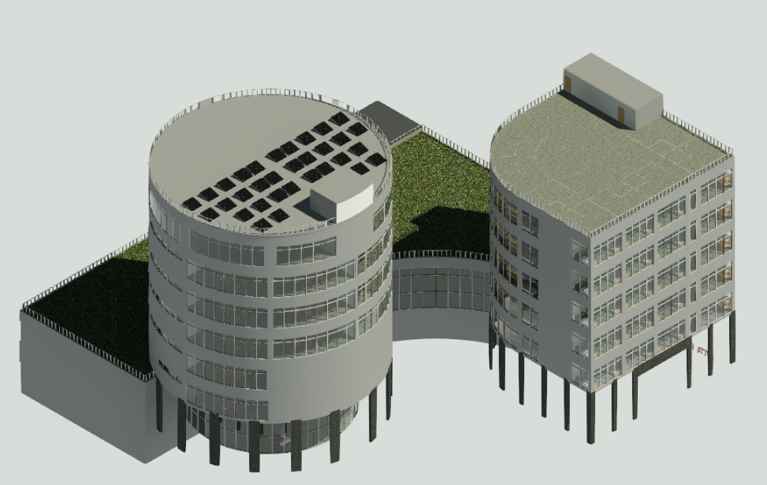
Project Description
Figure 4: Isometric Rendering View of Previous Building
Figure 5: Isometric Rendering View of Revised Building

Slide 9
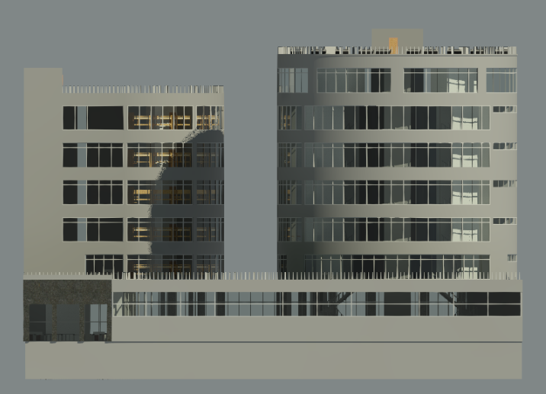
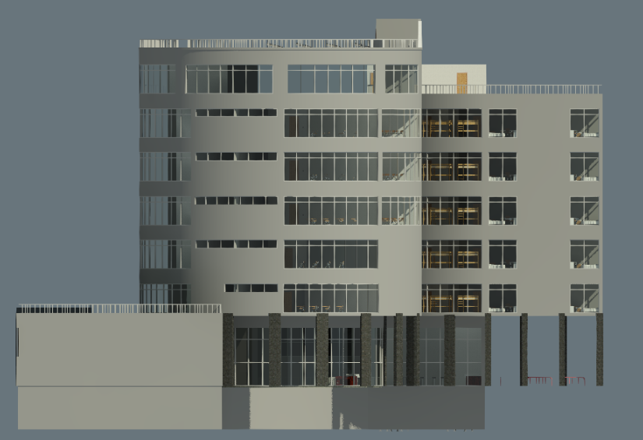
Project Description
Figure 6: Front View of Rendered Building
Figure 7: Side View of Rendered Building

Slide 10
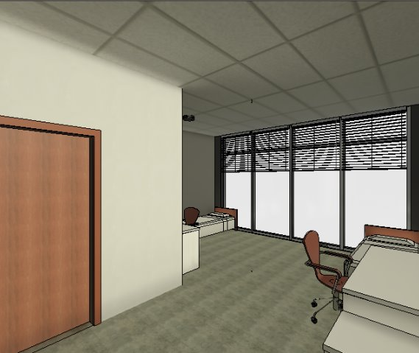
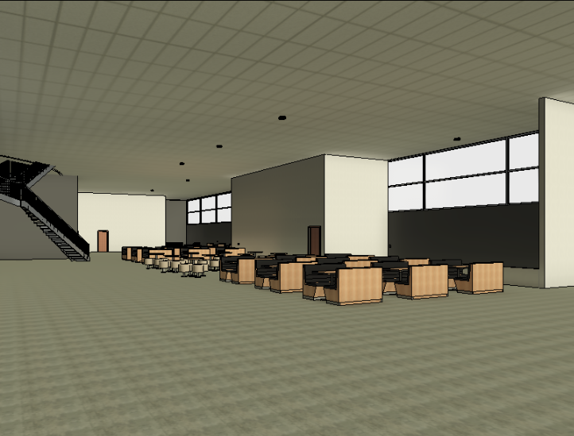
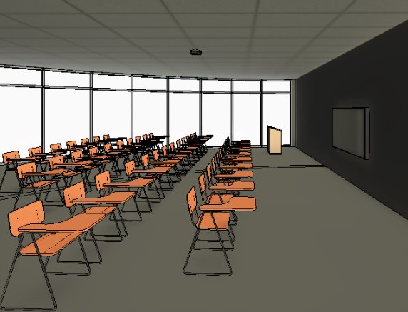
Project Description
Figure 9: 40 People Classroom View
Figure 10: Recreational Area View
Figure 8: Dorm Room View (Double)

Slide 11
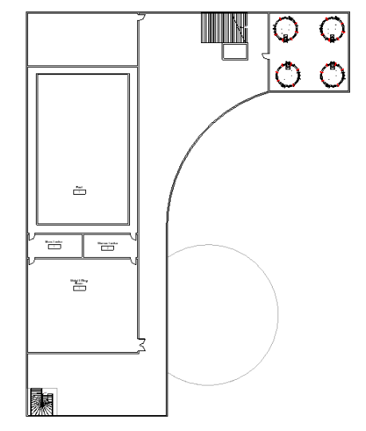
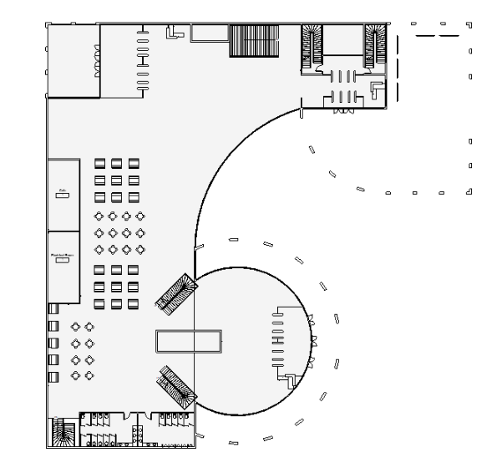
Project Description
17949 SF Total
7744 SF Gym
20000 SF of Recreational Area
Figure 11: Basement Floor Plan
Figure 12: First Floor Plan

Slide 12
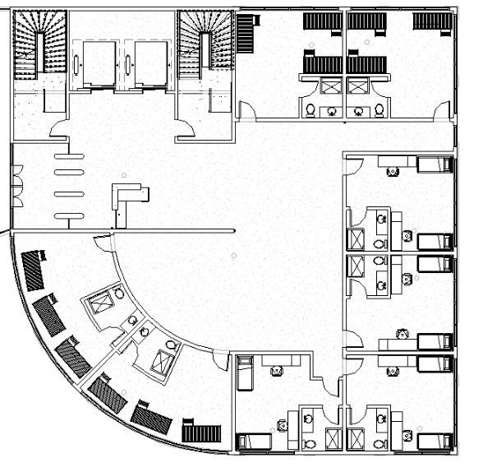
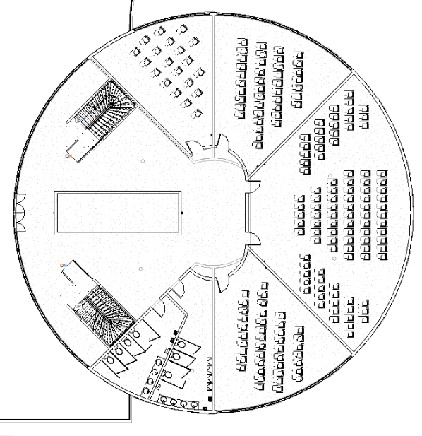
Project Description
14022 SF of Green Roof
-------------------------------------
(614 SF) 20-People Classroom
(820 SF) 40-People Classroom
1719 SF Lecture Hall
--------------------------------------
(354 SF) Dorm Room (Double)
(428 SF) Dorm Room (Triple)
Figure 14: Dorm Building Layout Floor 2
Figure 13: Academic Building Layout Floor 2

Slide 13
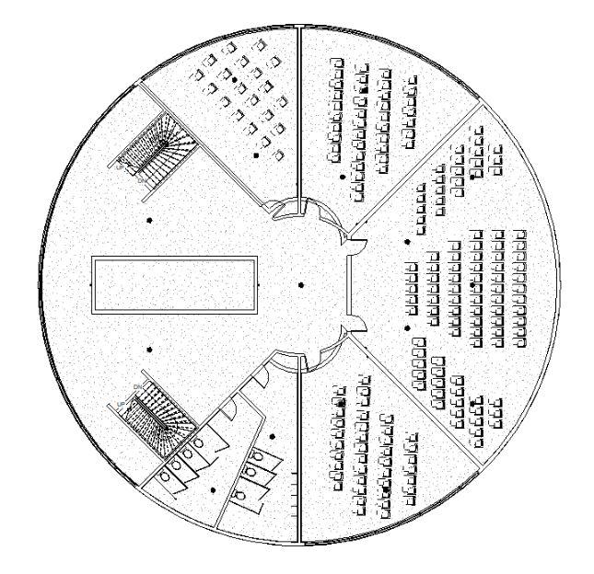
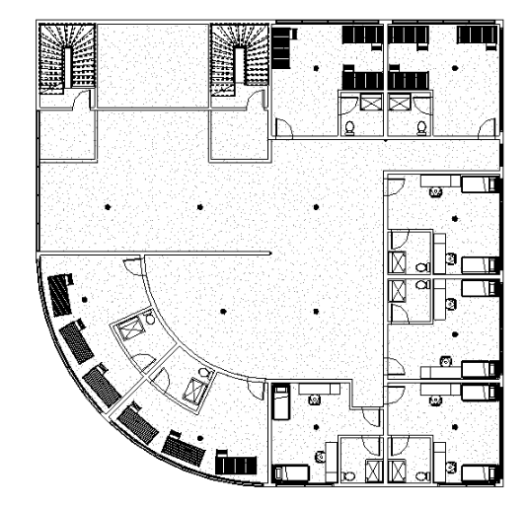
Project Description
Figure 15: Academic Building Layout Floor 3
Figure 16: Dorm Building Layout Floor 3

Slide 14
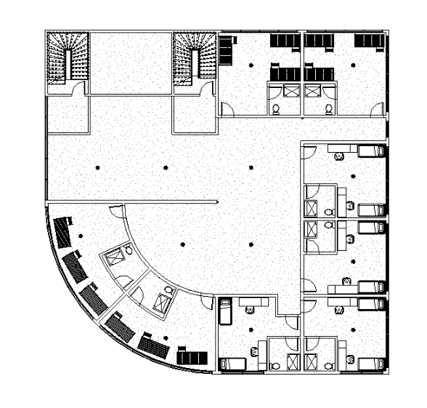
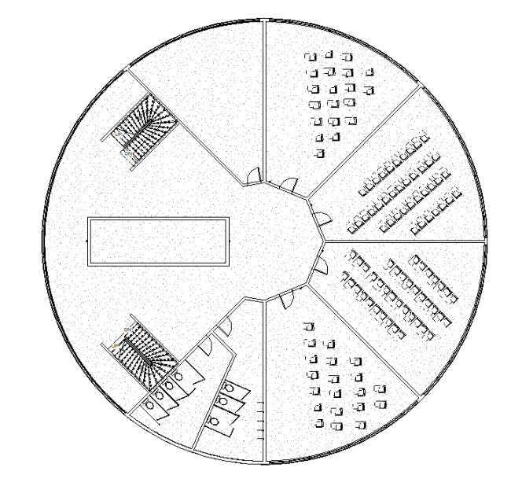
Project Description
Figure 17: Academic Building Layout Floor 4
Figure 18: Dorm Building Layout Floor 4

Slide 15
Project Description
Figure 19: Academic Building Layout Floor 5
Figure 20: Dorm Building Layout Floor 5

Slide 16
Project Description
Figure 21: Academic Building Layout Floor 6
Figure 22: Dorm Building Layout Floor 6

Slide 17
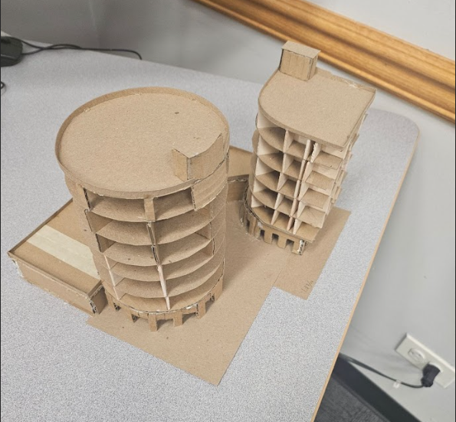
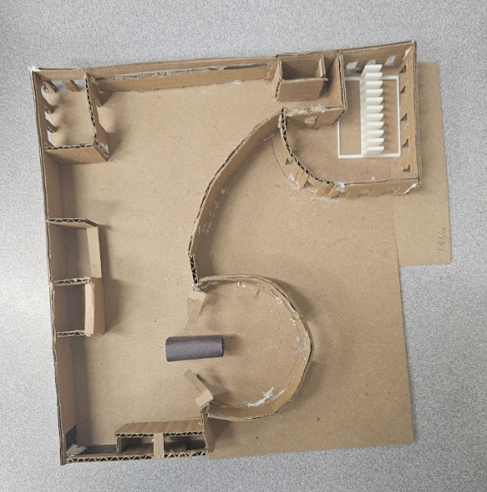
Project Description
Figure 23: Isometric View of Physical Model
Figure 24: Interior View of Physical Model

Slide 18
Project Description
Project Video

Slide 19
Cost Estimate
Table 1: Project Cost of Construction
Resource | Final Project Cost | Final Project Number of Materials | Milestone 3 (Total $)
Curved wall | USD 100.00 / SF | 100,000 SF | USD 10,000,000
Railing | USD 108.00 / LF | 6000 LF | USD 648,000
Poured Concrete Walls | USD 30.00 / SF | 120,000.00 SF | USD 3,600,000
Solar panels | USD 60,000 | 28 units | USD 1,680,000
Green roof | USD 30.00 / SF | 14,050 SF | USD 421,500
Concrete columns | USD 250.00 / LF | 30 units | USD 7,500
Concrete beams | USD 12,000 / unit | 10,000.00 units | USD 120,000,000
Water Tanks 6100 gallons Rainwater | USD 14,000.00 per unit | 4 units | USD 56,000
Miscellaneous (trees, projectors, elevators) | USD 600,000,000 | USD 600,000,000
 |  |  | Total + 15% = 810,000,000

Slide 20
Cost Estimate
Table 2: Project Cost Labor
Resource | Final Cost ($) | Final Quantity3(#) | Final Project (Total cost for 36 months)
Construction Engineers | USD 52 / h | 8 CE | USD 2,645,760
Water Resources Engineers | USD 52 / h | 5 WRE | USD 1,653,600
Environmental Engineers | USD 55 / h | 7 EE | USD 2,448,600
Materials Engineers | USD 60 / h | 5 ME | USD 1,908,000
Miscellaneous (craftsmen, etc) | USD 42 / h | 10 Craftsmen, 1,000 Construction Workers | USD 269,791,200
 |  | Total | USD 278,447,160

Slide 21
Cost Estimate
Table 3: Project Cost of Operation
Role | Salary per hour (USD) | Quantity | Total per year
Security | 20 | 50 | 1,272,000
Miscellaneous(cooks, cleaning) | 20 | 70 | 1,780,800
 |  | Total | USD 3,052,800
Table 4: Total Cost of Project
Table 5: Suggested Cost of Maintenance
 | USD 810,000,000
 | USD 278,447,160
Total | USD 1,088,447,160
Total | USD 278,447,160

Slide 22
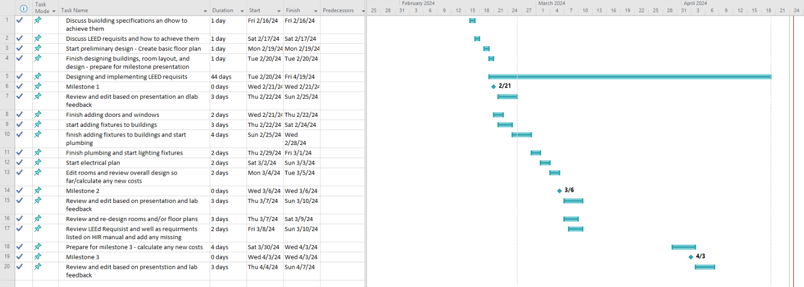
Project Schedule
Figure 25: Current Project Schedule

Slide 23
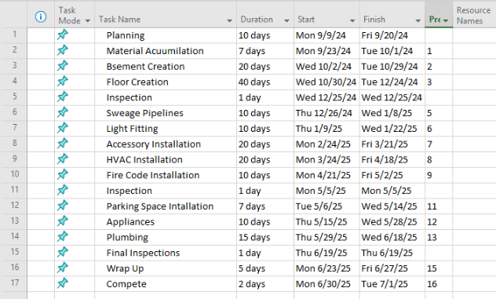
Construction Schedule
Figure 26: Sample Construction Schedule

Slide 24
Market and Building Viability
Competition include other sustainable construction industries such as JRM Construction Management and AECOM. ​
​
Unique two in one design, separating the dorm from the academic wing with innovative and sustainable design choices like the green roof. ​
​
Compared, JAB² offers an effective developed cost, LEED platinum certified features with high-quality materials and professionals​
JAB² is a one for all building, offering spacious area for both the students and the public. Students have access to gym, café, and green roof, enhancing the quality of life at JAB².​
​
The estimated cost is of 1 billion dollars and 1 to 3 years of construction​

Slide 25
Conclusion
Our project goal is to develop academic and social life at NYU Tandon campus with a more sustainable and reliable approach
Since our building will be made with LEED Platinum features, such as Electrical Vehicles charging spots, gym with a pool in the basement, solar panels and water tanks, it will achieve NYU 2040 sustainability goals
With these qualities, we are the most prepared company to develop the project
We look forward to build a new future with you
Figure 27: Company headquarter

Slide 26
Jacobs academic building ² (JAB ²)
CaZan Buildings
Head of Design: Seizan Arai
Head of Management and Production: Carlos Alexandre Vieira Saddy Torres Medeiros
EG 1004 G2 Final Presentation April 24th, 2024

