Slide 1
The Nexus Center
The Civilians
HEAD OF DESIGN: Sofia Espinoza
HEAD OF CONSTRUCTION: Dean Flouras
HEAD OF MODELING: Christina Li

Slide 2
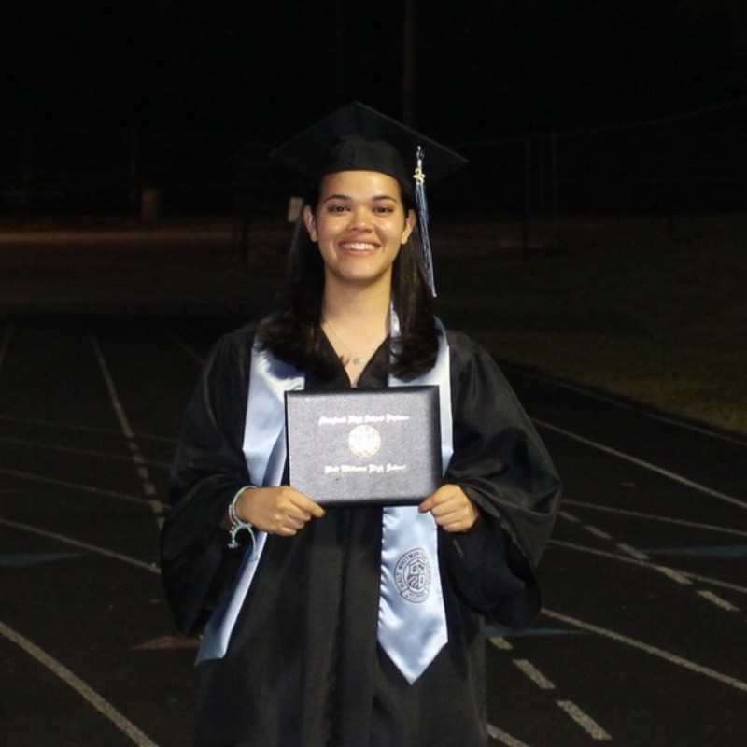
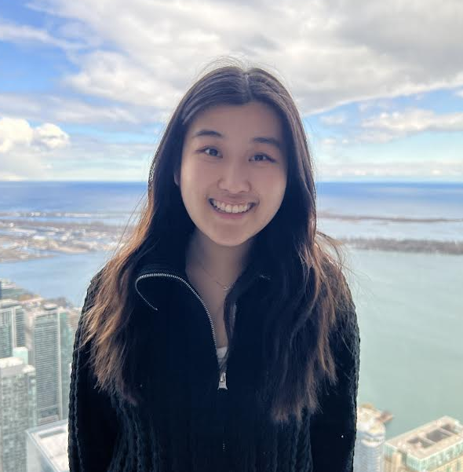
Company Profile
HEADSHOT
(ADD EXPERIENCE BELOW)
Sofia Espinoza
Head of Design
Civil Engineering Student at NYU Tandon
World Bank Intern
Christina Li
Head of Modeling
Civil Engineering Student at NYU Tandon
Engineer Intern at GMCE
Dean Flouras
Head of Construction
Civil Engineering Student at NYU Tandon
American Airlines Intern

Slide 3
Problem Statement
Solve problem of mediocrity and the lack of innovation in educational buildings
Students Spend Most of their Day in Educational Facilities.
Outdated and Non-innovative Educational Buildings
Can Lead to Acceptance of Mediocrity and Decreased Creativity in Students

Slide 4
Project Objective
Design a building that:
Creates a professional student environment
Is Entertaining
Is Sustainable and Accessible to Everyone
Mission Statement
Create a sustainable environment that incentivizes creativity

Slide 5
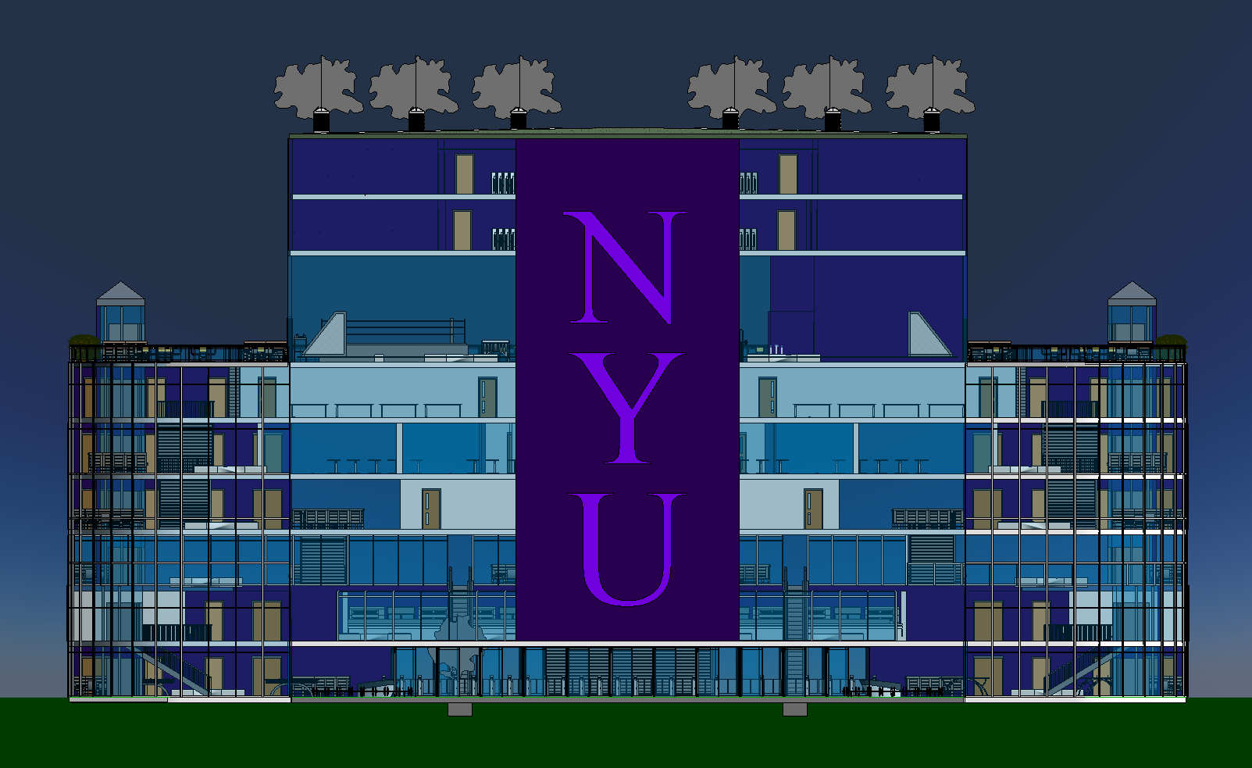
The Nexus Center
For all NYU Students and Faculty
Promotes professional and entertaining environment for students to thrive
Focuses on being environmentally friendly and accessible to all
Inspiring Minds, Fostering Creativity
Figure 1: Front View of the Nexus Center

Slide 6
Project Description
LEED Accreditation:
Table 1: Gold Certification Reached
LEED Category Tackled | Implementation
Location and Transportation | Gym + Cafe Accessibility ADA Compliance
Sustainable Sites | Green spaces Rainwater storage Trees
Energy and Atmosphere | Solar Panels Low energy systems Optimized energy performance
Innovation | Security systems ID scan turnstiles

Slide 7
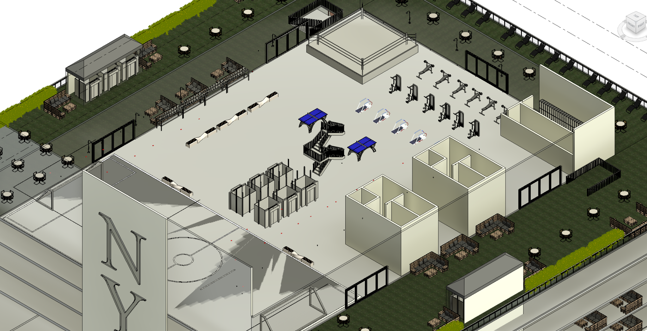
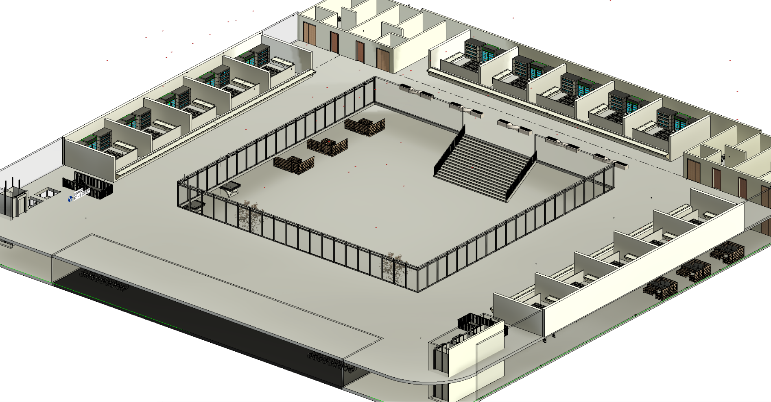
Project Description
LEED Accreditation:
Figure 2: Gym and Outdoor Lounge
Figure 3: Food Court
Notes:
Add Location and Transportation Leed Examples

Slide 8
Project Description
LEED Accreditation:
Figure 4: Roof Plan With Solar and Rain Barrels
Figure 5: Roof Plan Tree Layout
Figure 6: Outdoor Seating Right Side Floor Plan
Notes:
Add Sustainable Sites Examples

Slide 9
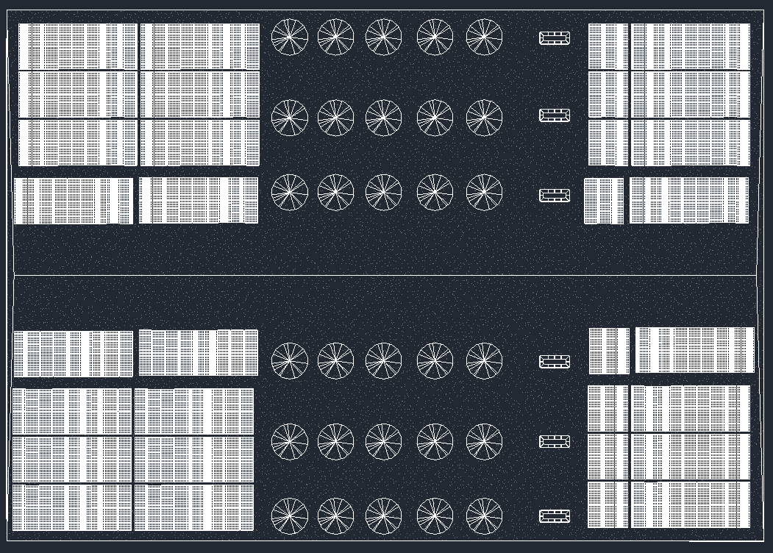
Project Description
LEED Accreditation:
Figure 7: Eleventh Level Roof Plan
Notes:
Add Energy Leed Examples

Slide 10
Project Description
LEED Accreditation:
Figure 8: Entrance Security Screening Floor Plan
Figure 9: Entrance Security Screening Floor Plan
Notes:
Add Innovation Leed Examples

Slide 11
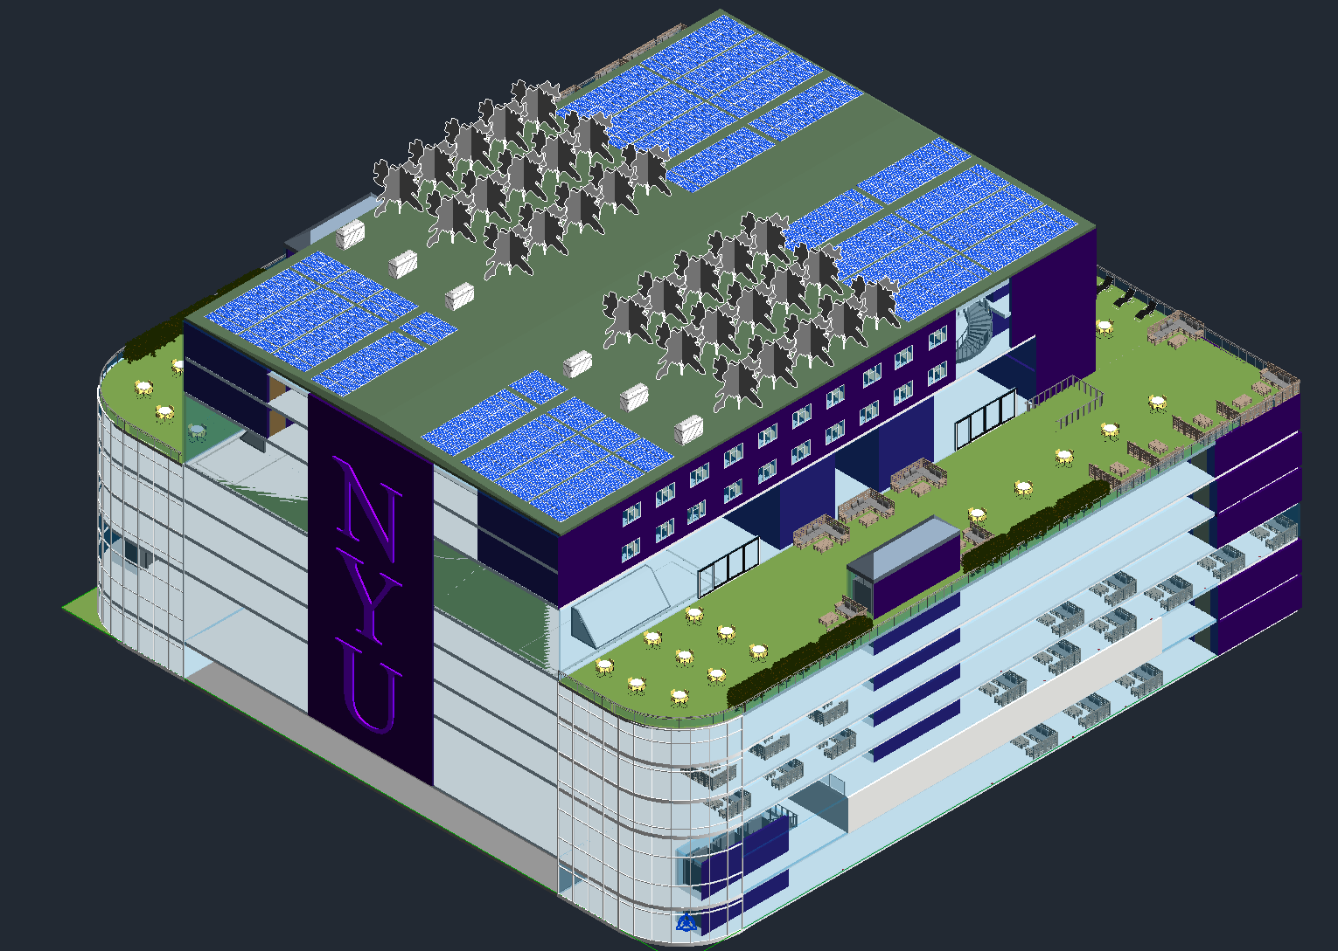
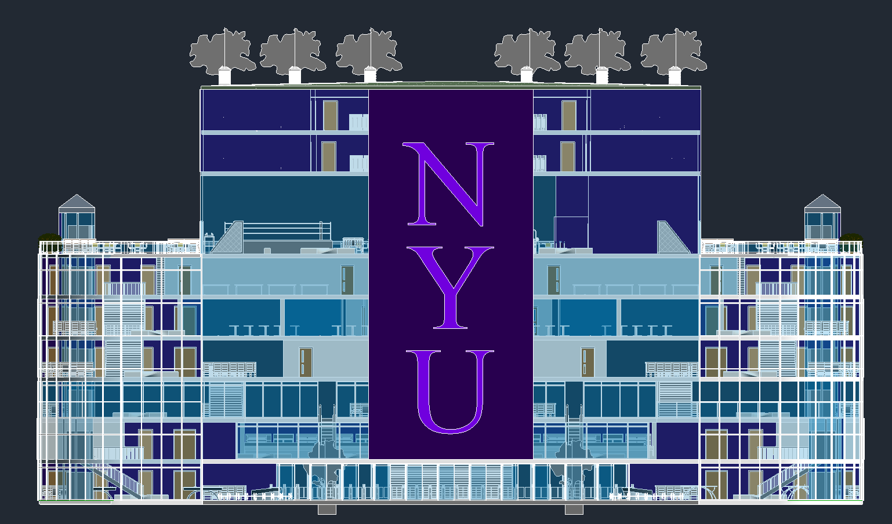
Project Description
3D Views:
Figure 10: Isometric of Building
Figure 11: Front 3D View of Building

Slide 12
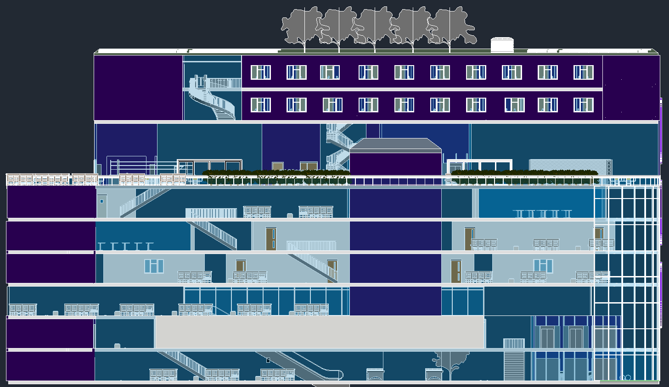
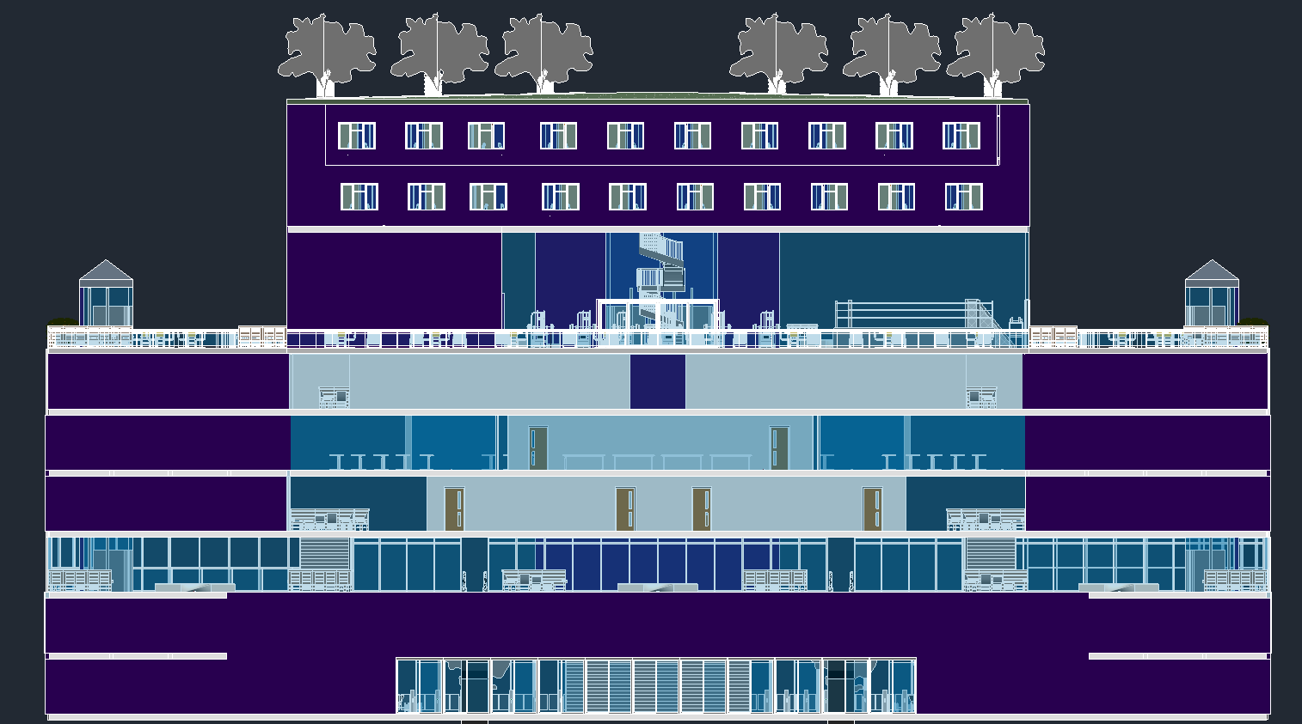
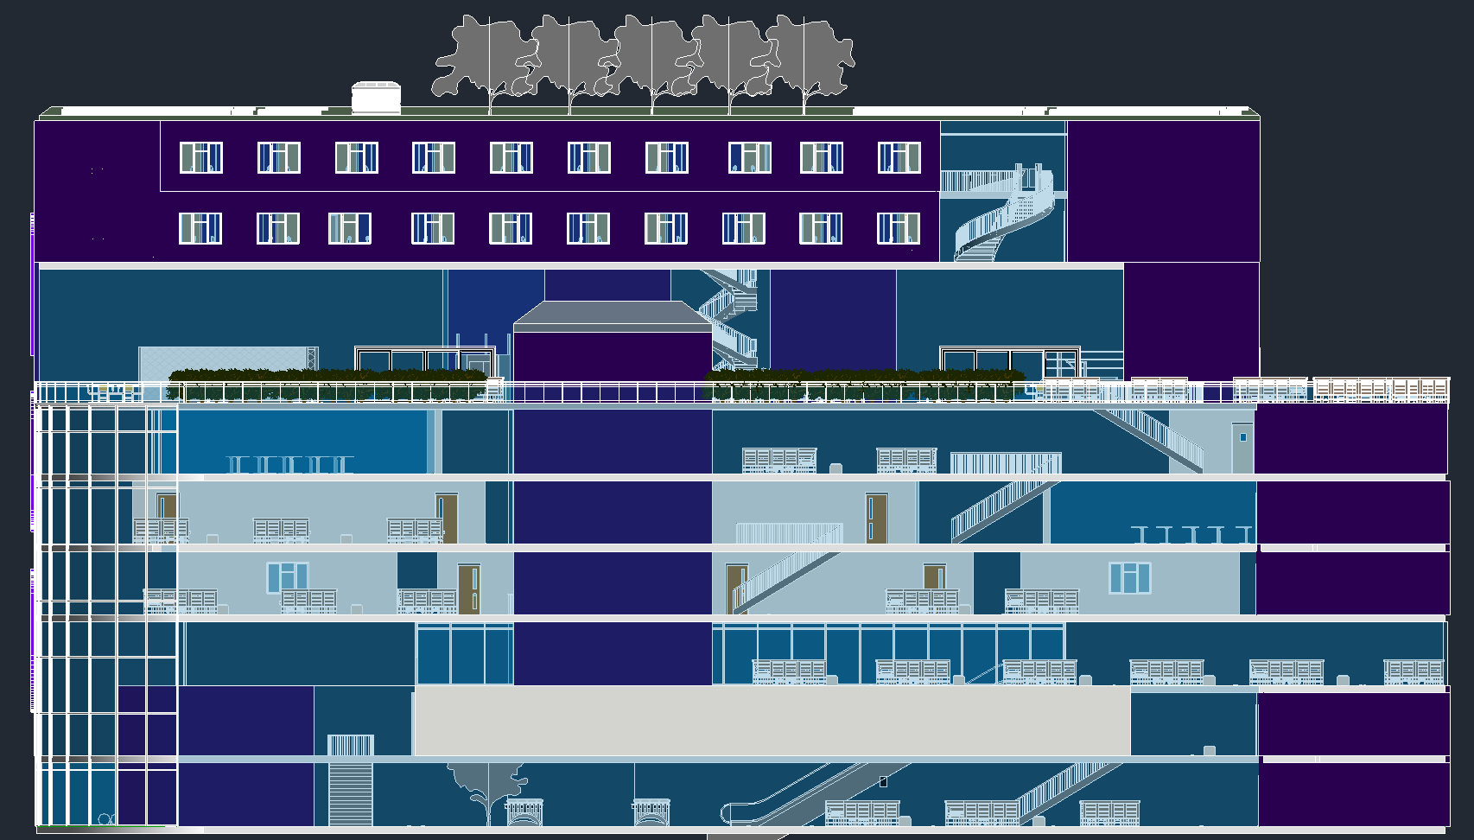
Project Description
3D Views:
Figure 12: 3D Left Side of Building
Figure 13: 3D Rear Side Building
Figure 14: 3D Right Side Building

Slide 13
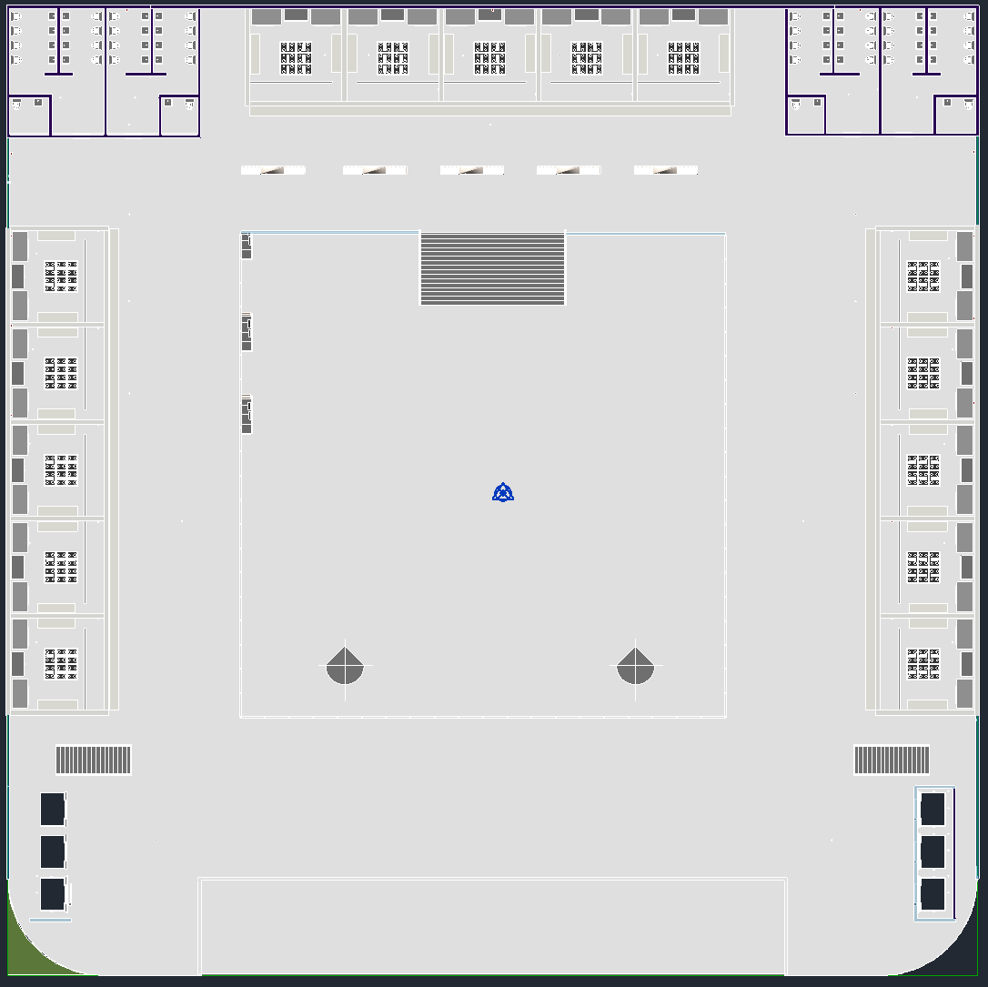
Project Description
Floor Plans:
Figure 15: Floor 1 Plan
Figure 16: Floor 2 Plan

Slide 14
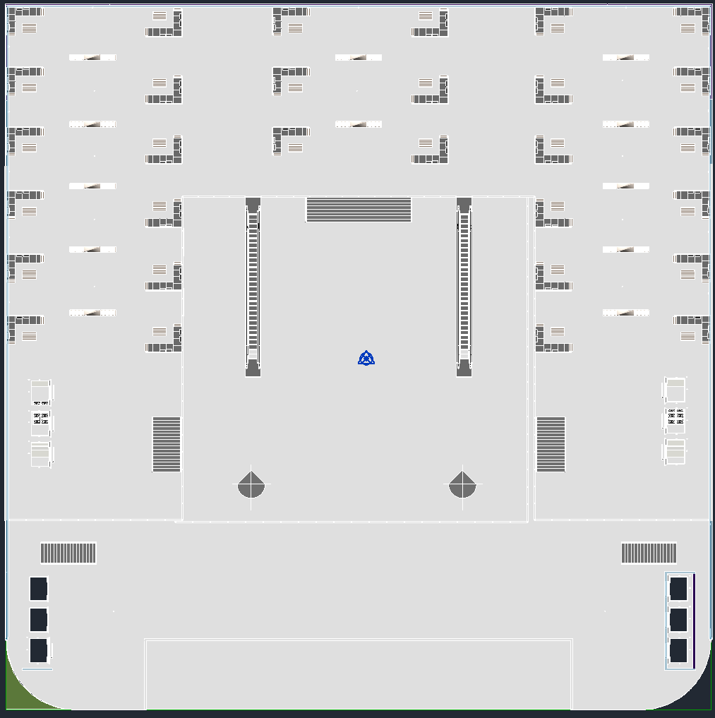
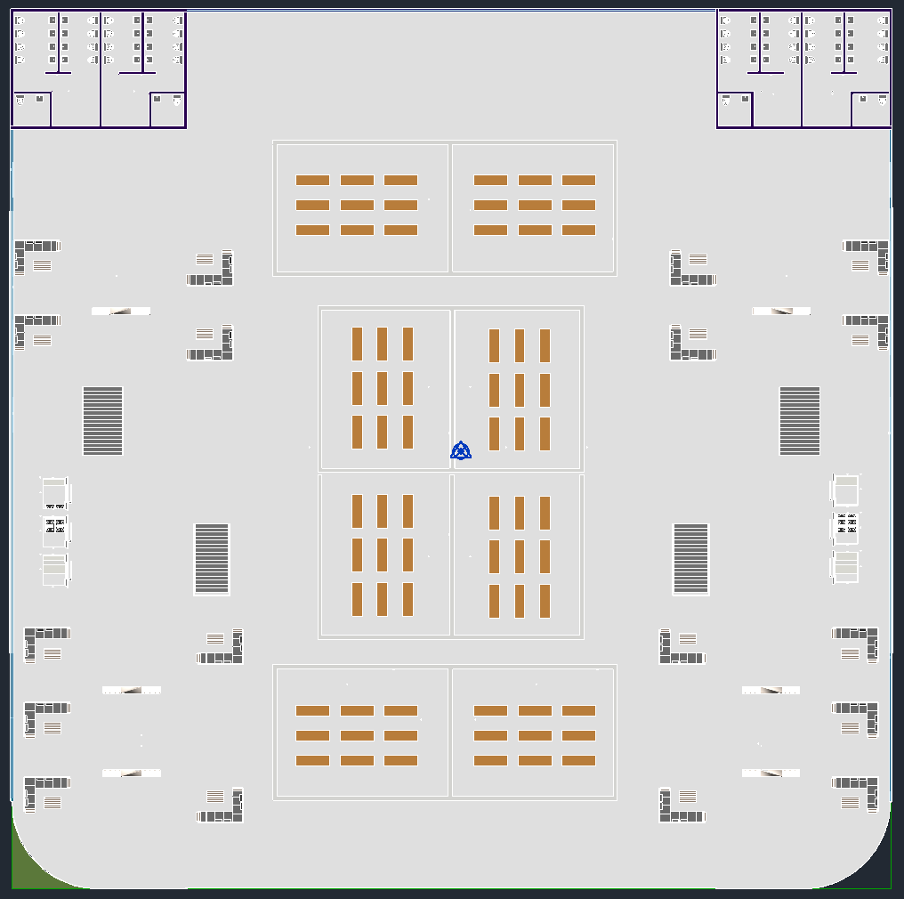
Project Description
Floor Plans:
Figure 17: Floor 3 Plan
Figure 18: Floor 4 Plan

Slide 15
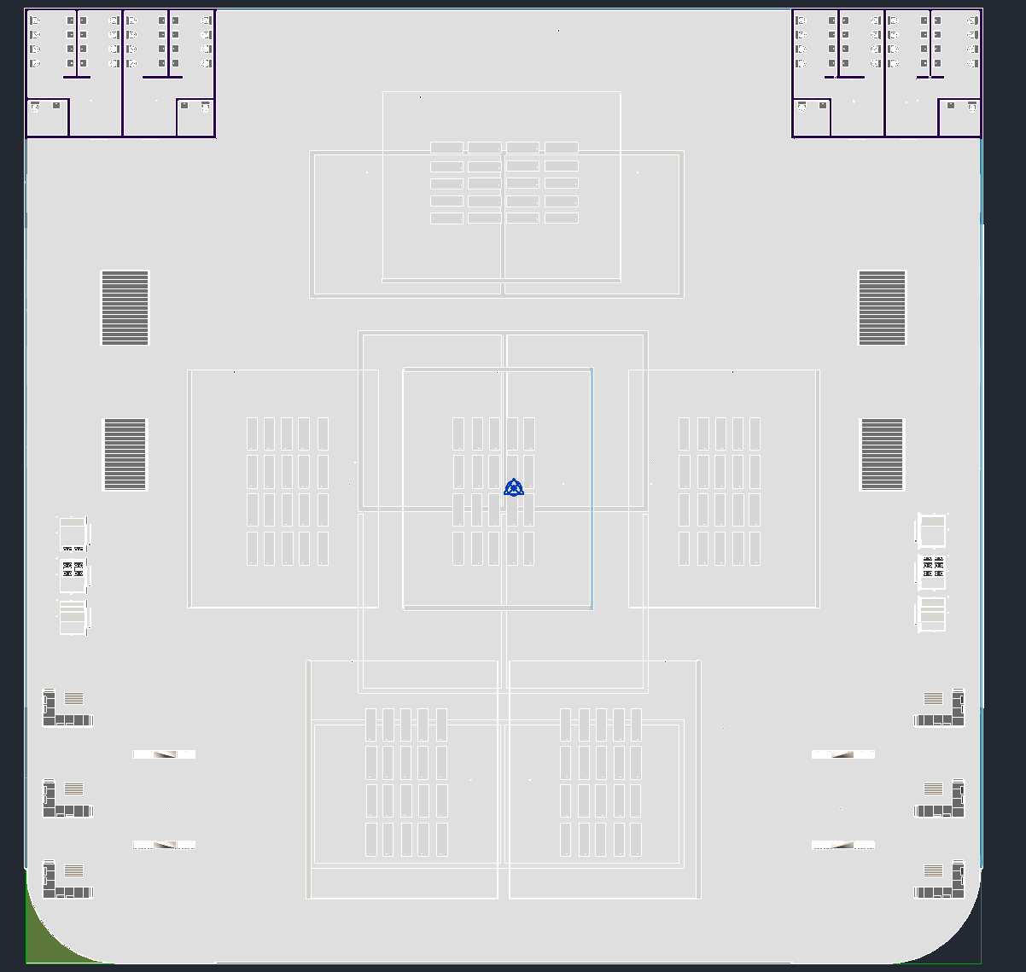
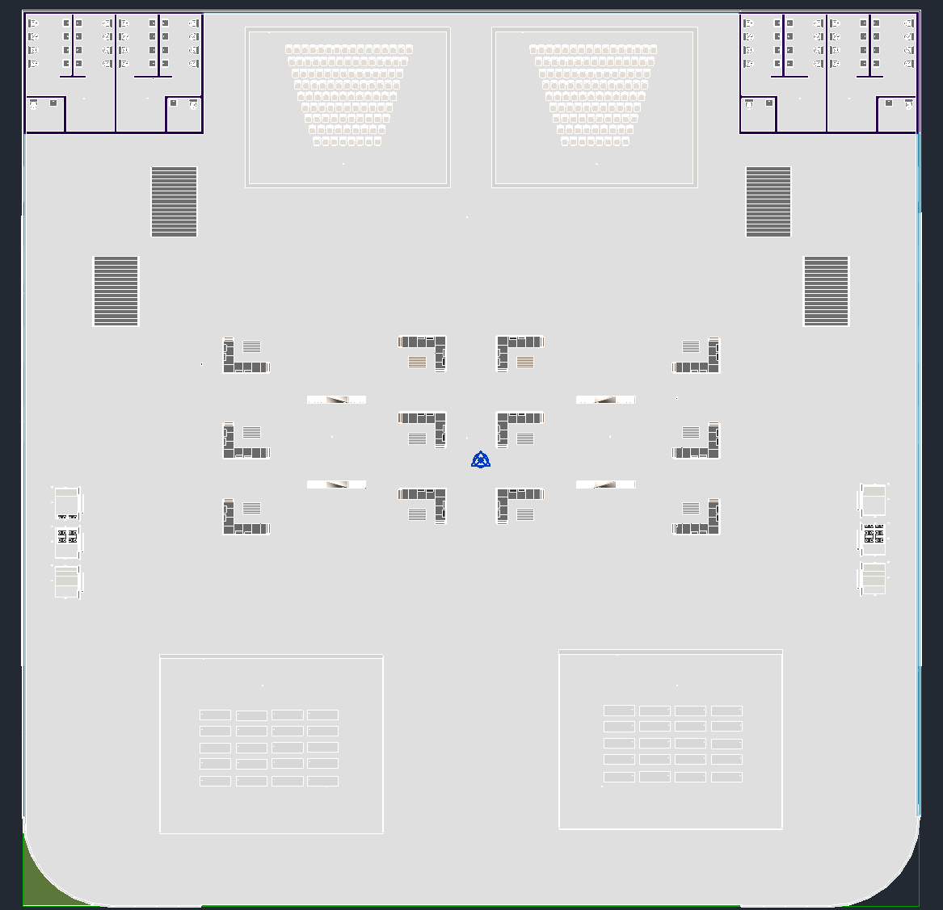
Project Description
Floor Plans:
Figure 19: Floor 5
Figure 20: Floor 6

Slide 16
Project Description
Floor Plans:
Figure 21: Floor 7/8
Figure 22: Floor 9

Slide 17
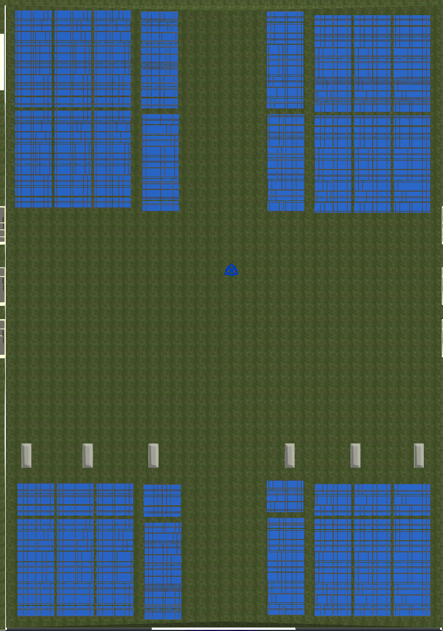
Project Description
Floor Plans:
Figure 23: Floor 10
Figure 24: Floor 11

Slide 18
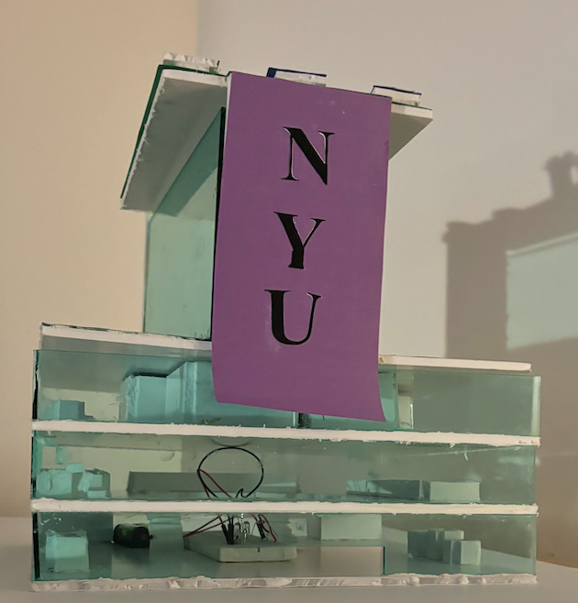
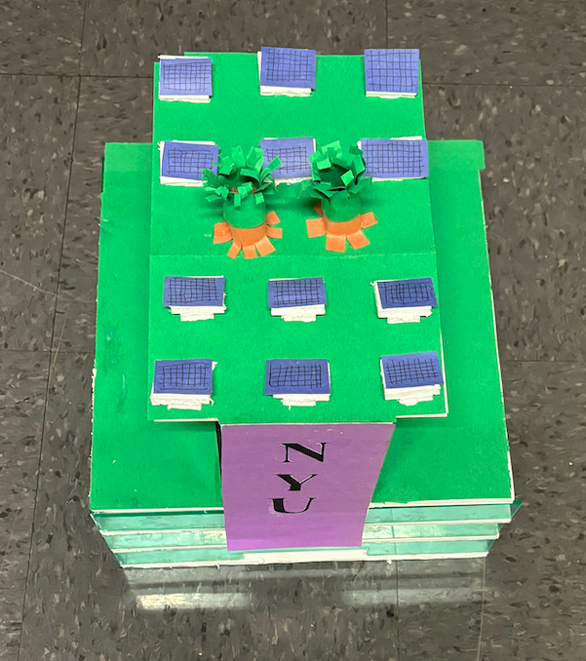
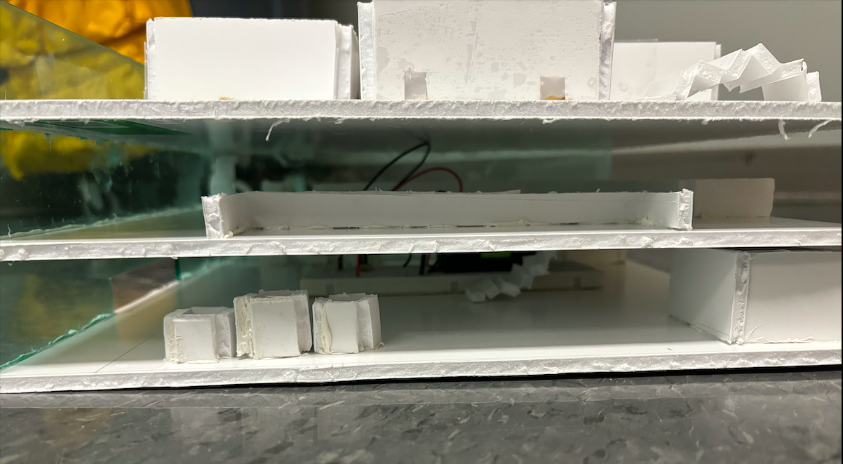
Project Description
Project Model:
Figure 25: Exterior View of Physical Model
Figure 26: LEED Accreditation Elements
Figure 27: Cross-Sectional View of Interior

Slide 19
Market and Building Viability
Competitive Market
What makes us stand out:
Focused on adding non-academic areas for student entertainment
Green + Glass + Colors
Innovative and Sustainable Building
Have Students Mental Health in Mind
As students, we provide a new perspective on our generations needs

Slide 20
Market and Building Viability
Table 2: Final Cost of Building
Cost Effective
In comparison to competitors, cost is lower while building is larger + more innovative
Project is Versatile
Cost of: | Cost ($)
Materials | $21,390,000
Operation | $7,677,024
Labor | $43,680,000
Total | $72,747,024

Slide 21
Market and Building Viability
Construction Schedule:
Figure 28: Final Construction Schedule

Slide 22
Market and Building Viability
Project Schedule:
Figure 29: Final Project Schedule

Slide 23
Conclusion
~The~
Civilians
Highlights
Perfect blend between academia and entertainment
Learning facilities
Spacious lounge areas
Gym
Vast dining options
Game areas
Cost effective
Objective
Create a sustainable environment that incentivizes creativity
Future goals
Maintain a clean and immersive environment for all
Create better elevators for 2 Metrotech

Slide 24
Project Video

Slide 25
The Nexus Center
The Civilians
HEAD OF DESIGN: Sofia Espinoza
HEAD OF CONSTRUCTION: Dean Flouras
HEAD OF MODELING: Christina Li

