Slide 1

SEMESTER-LONG DESIGN PROJECTS
EG1003 | RECITATION 2

Slide 2
AGENDA
2
Project Introduction
Project Grading
SLDP Options
3-D Printing
Closing
Questions

Slide 3
PROJECT INTRODUCTION
3
10
Week Project
Four Project Types:
Autonomous robot obstacle course
Housing Innovation in Revit (HIR)
Biomedical Device
Rapid Assembly and Design
2-4
Member Teams

Slide 4
PROJECT GRADING
4
Table 1: SLDP Grading
Item | % of SLDP Grade
Benchmarks and Commissioning | 50%
Final Presentation | 50%
SLDP is 30% of total course grade

Slide 5
PROJECT GRADING
5
Benchmark
A
Benchmark
B
Benchmarks
Two during semester
Completion of certain portions of project
Due dates on section schedule
Penalties for late completion

Slide 6
PROJECT GRADING
6
Benchmark A
Benchmark B
Commissioning
Submission
Commissioning
Completion of all tasks
Due date on schedule
Failure of completion results in partial commissioning
Submission
Submission of all SLDP material
Same date as commissioning

Slide 7
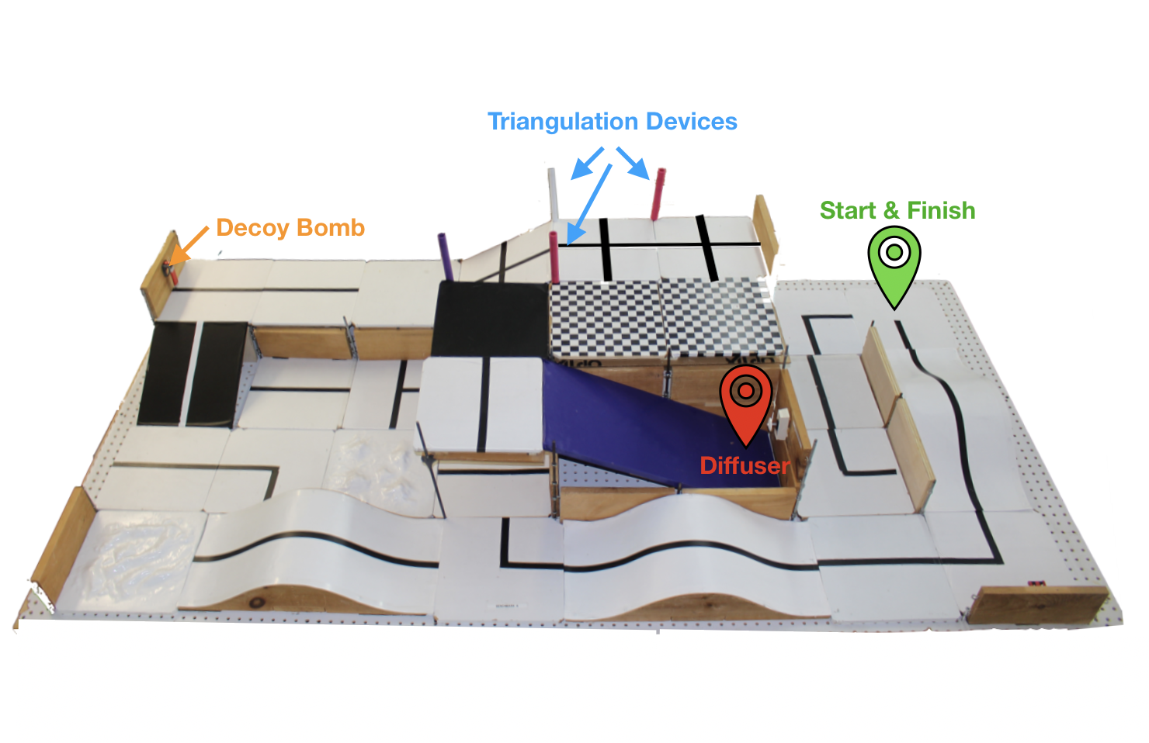
SLDP OPTIONS
7
Autonomous EV3 Robot Courses
Bomb Disarming Robot (BDR)
Disable bomb & return to start
Avoid decoy bombs
Allowed
Jump off levels
Climb walls
Prohibited
Arms
Slingshots
Projectiles
Figure 1: BDR configuration

Slide 8
SLDP OPTIONS
8
Autonomous EV3 Robot Courses
Bomb Disarming Robot (BDR)
Benchmark A
Benchmark B
Commissioning
Pass two hills
Diffuse bomb
Return to start
Extra Credit
Disable/retrieve triangulation devices

Slide 9
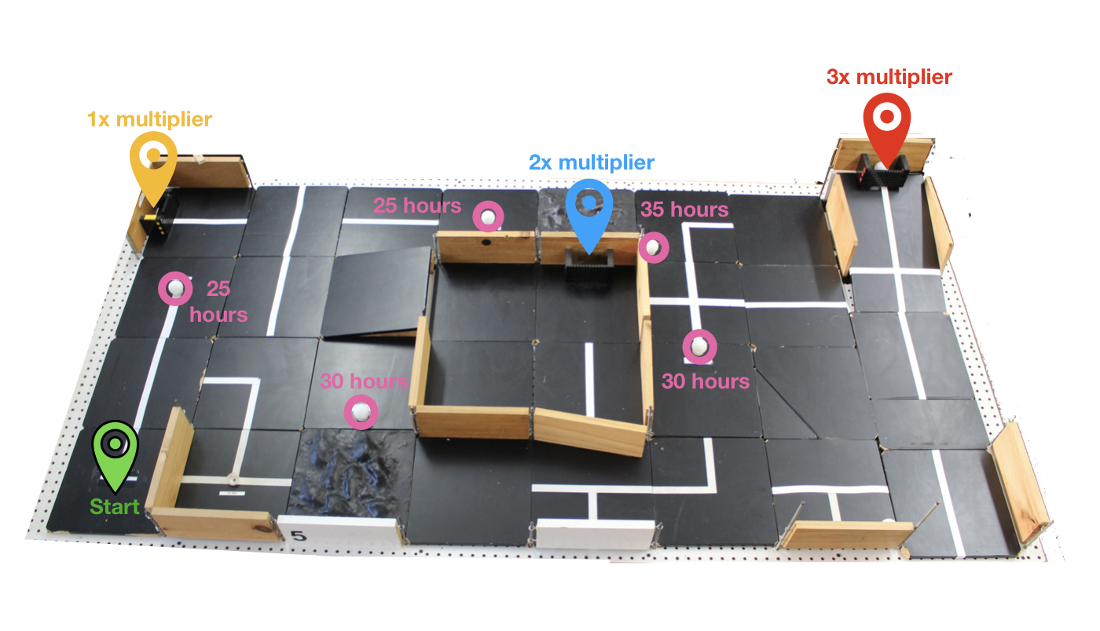
SLDP OPTIONS
9
Autonomous EV3 Robot Courses
Retrieval & Delivery System (RDS)
Retrieve & deliver fuel cells (energy) for hospitals
Hospitals are variable in energy efficiency worth a certain multiplier value
Deliver 200 hours of energy to hospitals
Figure 2: RDS configuration

Slide 10
SLDP OPTIONS
10
Autonomous EV3 Robot Courses
Retrieval & Delivery System (RDS)
Benchmark A
Benchmark B
Commissioning
Deliver 50 hours
Deliver 125 hours
Deliver 200 hours
Extra Credit
Deliver additional fuel cells to hospital
Dependent on number of cells

Slide 11
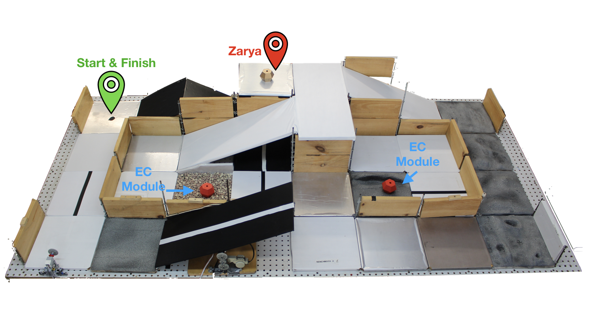
SLDP OPTIONS
11
Autonomous EV3 Robot Courses
Search & Recovery Robot (SRR)
Retrieve lost space module Zarya & return to start
Must fit on 625 square cm start tile
Figure 3: SRR configuration

Slide 12
SLDP OPTIONS
12
Autonomous EV3 Robot Courses
Search & Recovery Robot (SRR)
Benchmark A
Benchmark B
Commissioning
Traverse solar panel hill
Retrieve Zarya
Return to start with Zarya
Extra Credit
Retrieve extra credit modules
Traverse moondust

Slide 13
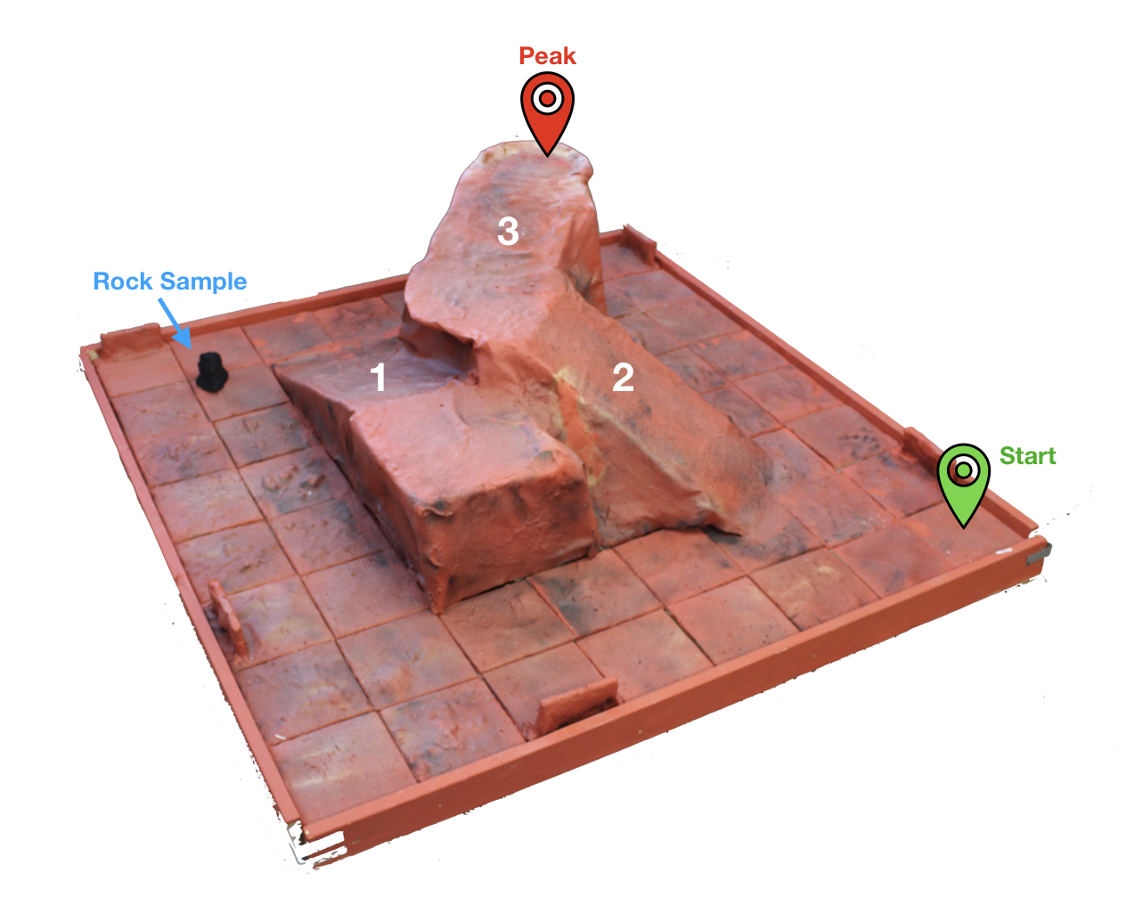
SLDP OPTIONS
13
VEX Mars Rover Robot (MRR)
Collect rock sample
Traverse Olympus Mons to photograph
5 groups piloting for Spring 2020 semester
Prohibited:
Jumping
Projectiles
Flammable materials
Figure 6: MRR configuration

Slide 14
SLDP OPTIONS
14
Autonomous EV3 Robot Courses
Mars Rover Robot (MRR)
Benchmark A
Benchmark B
Commissioning
Physical assembly
Transport rock sample to start
Climb the peak
Motor wiring
Collect rock sample
Extra Credit
Return to start site after summiting
Climb ramp 1

Slide 15
SLDP OPTIONS
15
Housing Innovation in Revit (HIR)
Create 3D Revit model of campus extension to NYU Tandon
Include plumbing & electrical
3-D Print of floorplan
Reach LEED Gold standard
Figure 4: 181 Mercer Street building courtesy of NYU

Slide 16
SLDP OPTIONS
16
Benchmark A
Benchmark B
Commissioning
One recreational space
All classroom spaces
Floor plans for all floors (six minimum) and front elevation
One 20 person-classroom
One 40 person-classroom
Facility of choice
Electrical & plumbing for dorm
LEED Gold and implementation plan
Housing Innovation in Revit (HIR)
Extra Credit
LEED Platinum
Extra 3D Prints

Slide 17
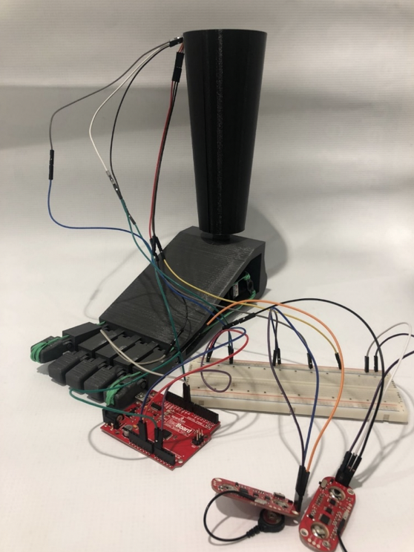
SLDP OPTIONS
17
Biomedical Device (BMD)
Create autonomous prosthetic limb or wearable device
Complete one task listed in manual
Utilize an extra machining method
Create 1:1 scale model
Figure 7: Prosthetic foot BMD device

Slide 18
SLDP OPTIONS
18
Benchmark A
Benchmark B
Commissioning
Determine device choice
Updated CAD model
Incorporated sensors & functional device
Initial CAD model
One functioning sensor with code
Machining method
All parts manufactured
Complete one extra task from manual
Biomedical Device (BMD)
Extra Credit
Complete additional extra tasks
3-D printed component

Slide 19
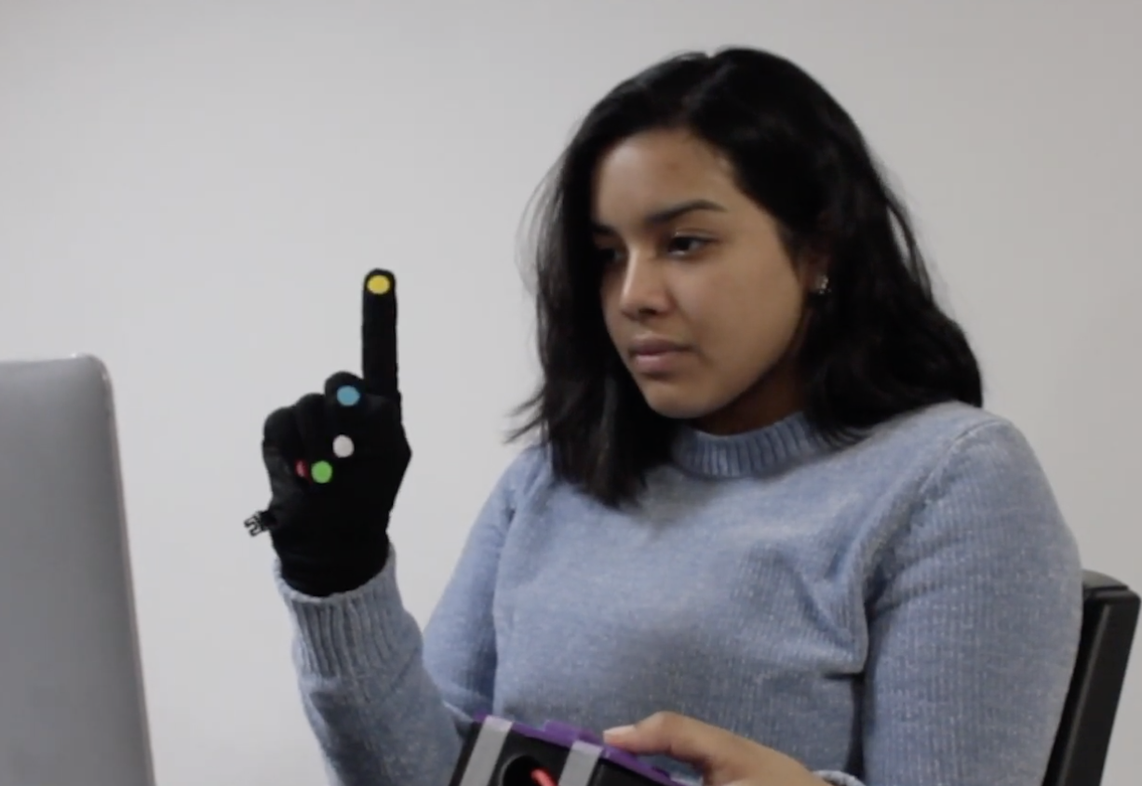
SLDP OPTIONS
19
Rapid Assembly & Design (RAD)
Identify a problem or address a proposed problem
Develop a solution
Manufacture a proof of concept
$100 budget
Additional resources: EG workshops, RAD Open Lab, MakerSpace machines
Figure 5: Previous student’s RAD project, SpeakSign

Slide 20
SLDP OPTIONS
20
Rapid Assembly Design (RAD)
Benchmark A
Benchmark B
Commissioning
Initial coding or wiring
Some functions completed
Fully functional proof of concept
Initial physical prototype
Design Feasibility Report (DFR)
New prototype iteration
Extra Credit
Additional functionality
3-D printing components
Benchmarks, Commissioning & Extra Credit determined by RADOLs

Slide 21
3-D PRINTING
21
Table 2: 3-D Printing Breakdown
Project | Mandatory | Extra Credit
EV3 Robot Projects | 1 color logo | 2 color logo Course modification Robot part
Housing Innovation in Revit | 1 color logo 1 printed floor plan | 2 color logo Up to 2 additional floor plans
Rapid Assembly & Design | Determined by RAD mentor | 2 color logo Determined by RAD mentor
Biomedical Device | 1 color logo | 2 color logo
Extra credit prints initial submission deadline is Milestone 2

Slide 22
3-D PRINTING
22
Benchmark A
Benchmark B
Final required print(s) approved
Commissioning
Print(s) complete
Initial required print(s) submission due
Prints must be creative and unique
Logo cannot be pure text
Completing extra credit 3-D print exempts logo requirement
Always have a contingency plan for course & part prints
Visit EG Proto Lab for 1:1 help
More info on 3-D Printing Guide on Student Manual

Slide 23
CLOSING
23
Which projects interest you?
Refer to manual.eg.poly.edu for full project information
Speak with professors and TAs regarding projects

Slide 24
QUESTIONS?
24

