Slide 1

INTRODUCTION
TO LABVIEW
EG1003 | LAB 10

Slide 2

OVERVIEW
Objective
Background Information
Materials
Procedure
Assignment
Closing
Figure 1: LabVIEW courtesy of CIOL
1

Slide 3
OBJECTIVE
Understand the logic of graphical programming in LabVIEW
Design two systems in LabVIEW:
  Heating and cooling system
  Lighting system
Obtain physical data with the virtual instruments
2

Slide 4
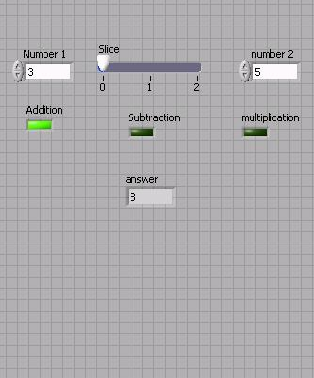
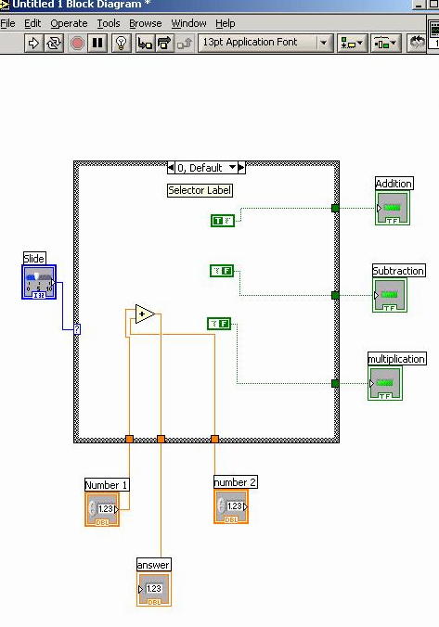
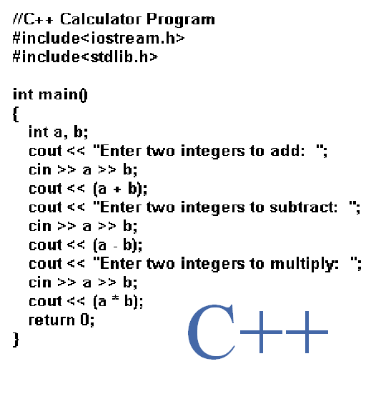
BACKGROUND INFORMATION
LabVIEW – Laboratory Virtual Instrument Engineering Workbench
  Used to design systems for data acquisition, instrument control,
  and industrial automation
  Uses graphical programming language based on G
Figure 2: Text-based (left)
and graphic-based (right)
programming languages
3

Slide 5
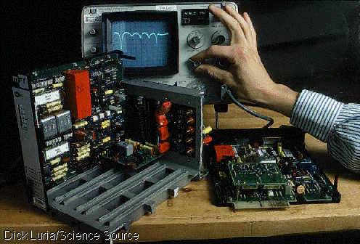
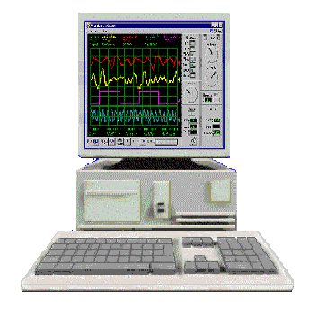
BACKGROUND INFORMATION
Virtual Instrument (VI) – programs created within LabVIEW
  Programming and functionality simulate physical instruments
  The instrument hardware is non-physical and based on the computer
Figure 3: Physical instrument (left) versus virtual instrument (right)
4

Slide 6
BACKGROUND INFORMATION
The LabVIEW interface:
  Front panel – where the program is controlled and executed, and the
  user interacts with the instrument
  Back panel – backend where
  the program is written
5

Slide 7
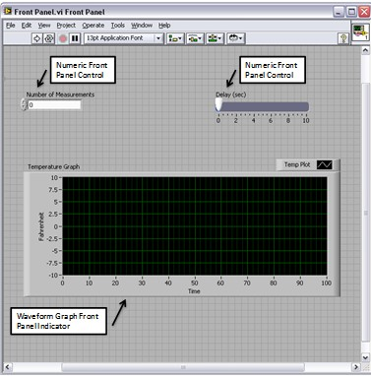
BACKGROUND INFORMATION
Front panel:
  Controls – inputs that allow a user to supply information to the VI
  Indicators – outputs that display results based on the inputs to the VI
  Controls and indicators are located on the controls palette
Figure 4: Controls and indicators
courtesy of National Instruments
6

Slide 8
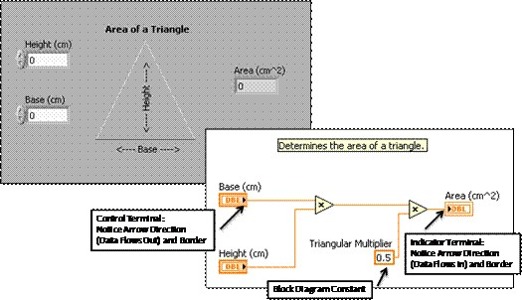
BACKGROUND INFORMATION
Back panel (aka block diagram):
  Terminals – objects placed on the front panel appear on the back panel
  Functions and structures – perform operations on controls and supply data to indicators
  Functions and structures are located on the functions palette
Figure 5: Terminals and functions courtesy of National Instruments
7

Slide 9

BACKGROUND INFORMATION
Tools palette – helps in navigating the environment of the back panel
  Operating tool – changes values of controls
  Positioning tool – positions, resizes, selects objects
  Labeling tool – creates and edits text
  Wiring tool – wires nodes on the back panel
  Scrolling tool – used to scroll in the window
Figure 6: Tools Palette
8

Slide 10
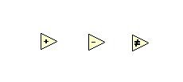
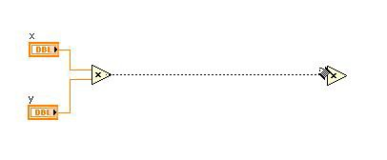
BACKGROUND INFORMATION
Functions – fundamental operating elements
  Have input and output terminals to pass data in and out
  Can perform numeric, Boolean, comparison operations, and more
Figure 7: Examples of functions courtesy of
National Instruments
9

Slide 11
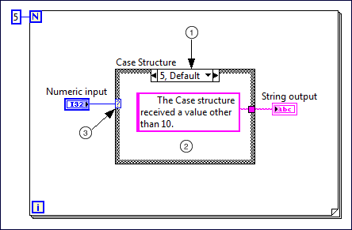
BACKGROUND INFORMATION
Structures – used for process control and include for loops, while loops, and case structures
Case structure – similar to if/else statements, contains multiple subdiagrams with different outputs depending on the input value
In Figure 7:
  1 – value for case to execute
  2 – code that executes for case
  3 – inputs data to case structure
Figure 8: Example of a case structure courtesy of National Instruments
10

Slide 12
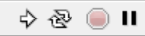
BACKGROUND INFORMATION
Toolbar – used to execute and stop the program
  Run – runs the program once
  Run Continuously – runs the program until the program is stopped
  Abort Execution – stops program
  Pause – pauses the program
Figure 9: Toolbar
11

Slide 13
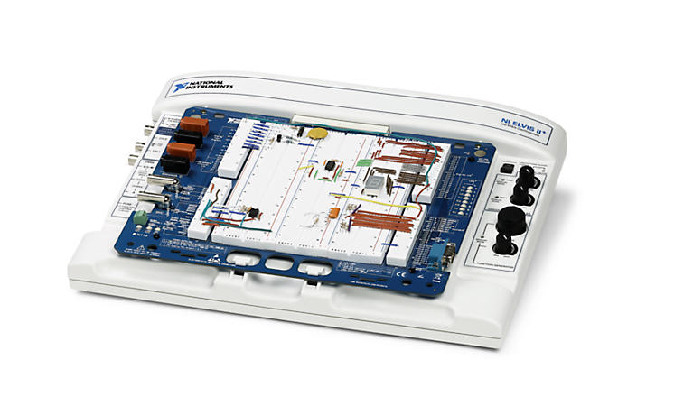
BACKGROUND INFORMATION
NI ELVIS board – National Instruments' Educational Laboratory Virtual Instrumentation Suite
  Modular engineering device that includes a breadboard, power supply, ground, thermocouple, etc.
  Interfaces the VIs with physical devices
Figure 10: NI ELVIS board courtesy of National Instruments
12

Slide 14
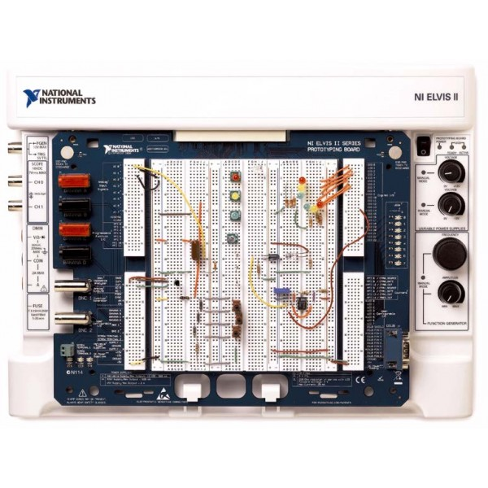
MATERIALS
Lab PC
LabVIEW 2019 software
NI ELVIS II+ prototyping board
Two 100 kΩ resistors
Wires
Figure 11: NI ELVIS board courtesy of Yotta Volt
13

Slide 15
PROCEDURE
System 1: Heating and Cooling System
  Must be able to be controlled manually or automatically
  In manual mode:
    The heater and AC can be turned on/off by the user
  In automatic mode:
    The AC turns on when the temperature is above 80˚F
    The heater turns on when the temperature is below 60˚F
    Both are turned off when the temperature is between 60-80˚F
14

Slide 16
PROCEDURE
System 1: Heating and Cooling System
  Steps to create the VI are explicitly laid out in the manual
  Next, the system will be wired and interfaced with a heat cube:
    A physical device that houses a heater, fan, and thermocouple
    Download and import the pre-written sub-VIs into LabVIEW
    Edit the heating and cooling system VI with the sub-VIs
    Wire the system on the NI ELVIS board
    Test to observe if the heat cube can be controlled with the VI
15

Slide 17
PROCEDURE
System 2: Lighting System
  Control the lights in four rooms
  Turn off all the lights with a master switch (similar to a circuit breaker)
  Wired and interfaced with the NI ELVIS board:
    Utilize the NI ELVISmx Digital Writer function in LabVIEW
    Control the LEDs on the NI ELVIS board with the VI
16

Slide 18
ASSIGNMENT
Submit a ZIP file of both VIs (in VI file format) to the EG1003 website by 11:59 PM the night before your next lab
Team lab report:
  Answer discussion questions in manual
  Include screenshots of the LabVIEW Vis
  Only include the lighting system in the Procedure section of the report
  Due at 11:59 PM the night before Lab 11
No team presentation
17

Slide 19

CLOSING
Take screenshots of the VIs
Save and send the VIs to you and your teammates
Take turns using the software
Submit all work electronically
Clean up workstations
Return all unused materials to the TA
18

Slide 20
QUESTIONS?

