Slide 1

BOOM CONSTRUCTION COMPETITION
EG1003 | LAB 2

Slide 2

OVERVIEW
Objective
Background
Materials
Procedure
Competition Rules
Assignment
Closing
Figure 1: Cable-Stayed (Cantilever) Bridge
1

Slide 3
OBJECTIVE
Design lightweight boom to hold significant load and minimally deflect
Consider material properties when designing a boom
  Stress and strain
Construct and test boom
Enter boom into competition to obtain highest design ratio
2

Slide 4
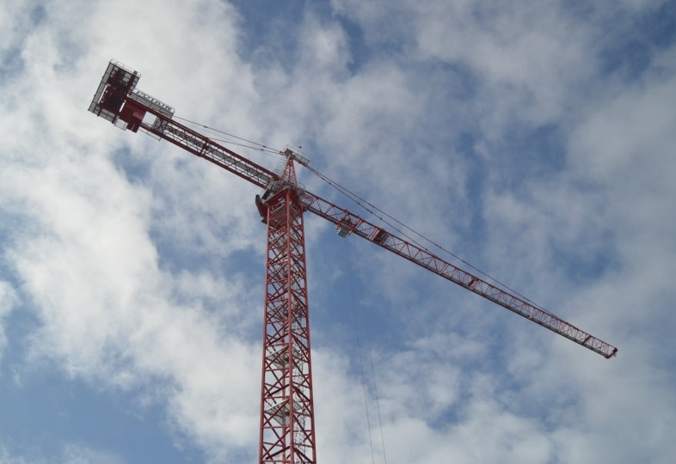
BACKGROUND INFORMATION
Boom:
  Lifts and moves heavy objects
  Objects much heavier than the boom
Examples:
  Construction cranes
  Cantilever bridges
  Swing bridges
Figure 2: Tower Crane Courtesy of
Philadelphia Magazine
3

Slide 5
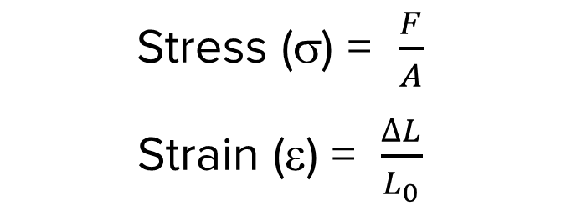
BACKGROUND INFORMATION
Stress: external force acting on an object per unit cross-sectional area
Strain: measure of deformation resulting from an applied stress
Fixed Support
Stress (σ) = $\frac{F}{A}$
Strain (ε) = $\frac{∆L}{L_{0}}$
Cross-Sectional
Area of Bar (A)
L_{o}
F = applied force
A = cross-sectional area
ΔL = change in length
L_{o} = original length
ΔL
F
4

Slide 6
BACKGROUND INFORMATION
UTS
Stress-strain curve
Key points/regions
  Elastic limit
  Ultimate tensile strength (UTS)
  Fracture stress
  Elastic region {E}
  Plastic region {P}
{P}
Stress (σ)
{E}
Elastic Limit
Fracture Stress
Strain (ε)
5

Slide 7
BACKGROUND INFORMATION
UTS
Elastic limit – point where the material becomes permanently deformed
Ultimate tensile strength (UTS) – greatest amount of stress a material can withstand
Fracture stress – point where the material fails
{P}
Stress (σ)
{E}
Elastic Limit
Fracture Stress
Strain (ε)
6

Slide 8
BACKGROUND INFORMATION
UTS
Elastic region {E} – material will return to its original shape when load is removed
Plastic region {P} – material will permanently deform even after load is removed
{P}
Stress (σ)
{E}
Elastic Limit
Fracture Stress
Strain (ε)
7

Slide 9
BACKGROUND INFORMATION
The Nervous Student & Pen Cap Example
1. Elastic Region – The student applies a force, bending the tip of the pen cap back. When they let go, the tip of the cap returns to its original position.
2. Plastic Region – The student twists and bends the tip of the cap. When they let go, the tip of the cap stays slightly twisted and bent.
3. UTS – The student bends the cap more. The cap is still in one piece, but certain areas are very weak and are on the verge of breaking.
4. Fracture Stress – The student bends the cap one more time. The cap
finally breaks into two pieces.
1
2
3
4
8

Slide 10


MATERIALS
2 thin dowels (0.8 cm dia. x 122 cm)
2 thick dowels (1.1 cm dia. x 122 cm)
6 bamboo skewers (30.5 cm)
3D-printed dowel connectors
Cellophane tape
Kevlar string
9

Slide 11

PROCEDURE
Design a boom to obtain the highest weighted design ratio:
Also consider the basic weight ratio:
10

Slide 12
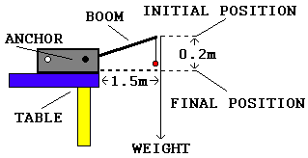
PROCEDURE
Figure 3: Setup for Competition
11

Slide 13
COMPETITION RULES
Boom must be anchored to the white plastic anchorage
Boom must be anchored in less than two minutes
Boom may not touch anything besides the anchorage
Boom must extend at least 1.5 meters horizontally from the edge of the anchorage
12

Slide 14
COMPETITION RULES
Make a sketch of your design and get a TA to sign off on it
Anchor time will be timed from when the TA says “go” to when all hands
are off the boom
TA will place a holder for the weights at the end of the boom
TA will place weights in the holder until the boom deflects 20 cm or fails
Values will be entered into a competition scoresheet which will be available on the EG1003 Website
13

Slide 15
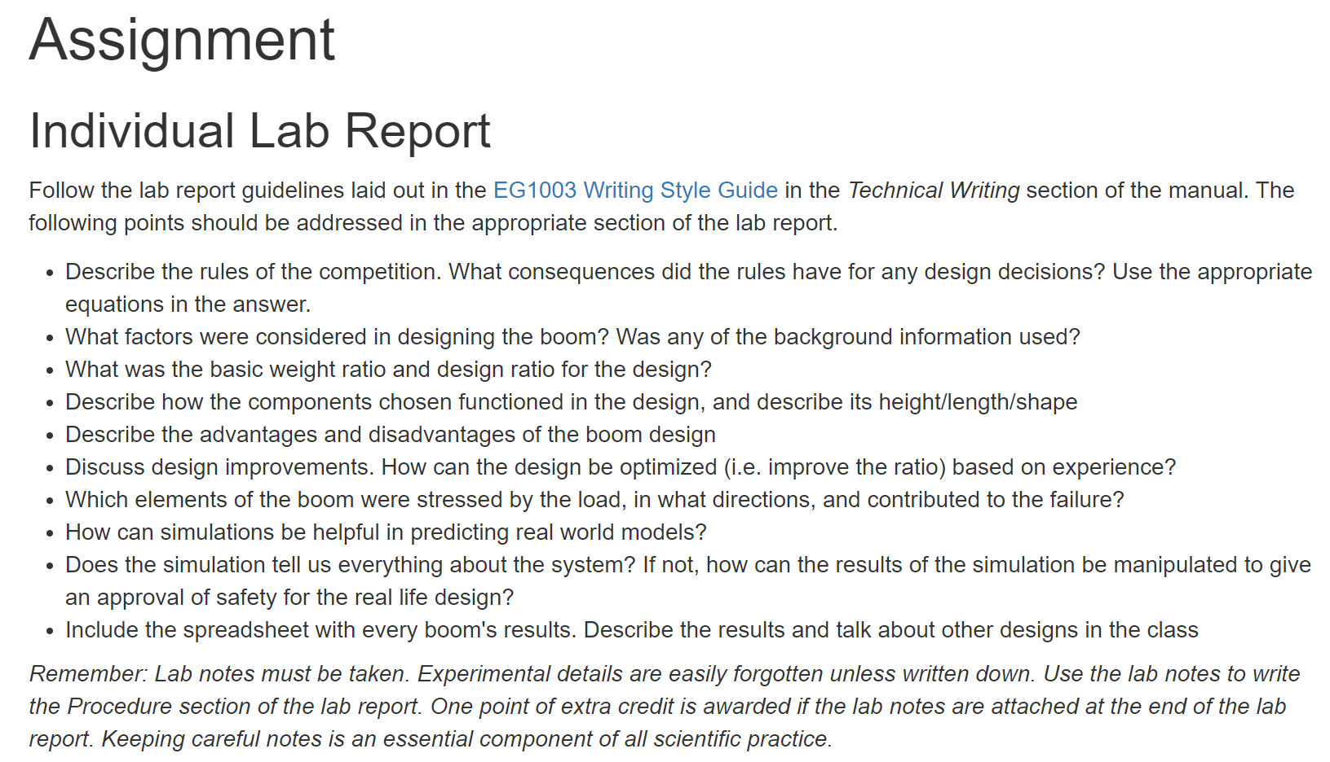
ASSIGNMENT
Optional bonus individual lab report:
  Answer discussion questions in manual
  Include competition scoresheet results
  Include pictures of the boom
  Due at 11:59 PM the night before Lab 3
Team presentation:
  Address discussion points in manual
  State rules of the competition
  Include pictures, competition scoresheet, sketches
  Due at 11:59 PM the night before the next Recitation
14

Slide 16
CLOSING
Think safety! Be careful not to poke classmates with the dowels
Get a TA to help if dowels need to be sawed
Have all original data signed by a TA
Submit all work electronically
Take pictures
Clean up workstations
Return the dowel connectors – do not throw them away
Return all unused materials to the TA
15

Slide 17
QUESTIONS?

