Slide 1


RESUMES, REVISITED
EG1004 | RECITATION 10

Slide 2
COMMON MISTAKES – YOUR INFO
Include a mailing address, even when applying to remote positions.
    Yes: “111 Tandon Ave, Apt 3, Brooklyn, NY 55555”
    No: “Brooklyn, NY”
Include location/city for each position.
    Yes: “Etsy, Data Science Intern, Brooklyn, NY”
    No: “Etsy, Data Science Intern”
    Remote Work: “Etsy, Data Science Intern (Remote)”
Include anticipated graduation year

Slide 3
COMMON MISTAKES - LANGUAGE
Avoid unnecessary adjectives
    Yes: “Addressed customer service concerns.”
    No: “Gave incredible customer service.”
Too much detail in descriptions.
    Yes: “Organized merchandise displays.”
    No: “Set up new merchandise and making sure it doesn’t get too messy.”
Figure 1: Screenshot from “Succession” on HBO

Slide 4
COMMON MISTAKES – TONE & FORMAT
Skills section is only for concrete, industry-specific skills.
Programming languages; verbal/written language, industry-related software
    Yes: “Python, C++, Javascript, Microsoft Office Suite”
    No: “teamwork,” “leadership,” “collaboration,” “fast learner,” “gifted,” etc.
Tiny font size
    Doesn’t matter if you fit in all your experience if we can’t read the text!
    Try not to use below size 12 or 11

Slide 5
COMMON MISTAKES - SUBMITTING
Whenever possible, upload/attach your resume as a PDF
    Worried about formatting? Email it to a friend, relative, or colleague
File Name: Include name OR name + job you are applying for
    Resume.pdf
    Swift, Taylor_Resume.pdf
    Swift, Taylor_TikTokInternship_Resume.pdf

Slide 6
OK, I HAVE A RESUME. NOW WHAT?
Standard Resume:
    Polished resume that details your experience.
    Update every 6-12 months, during school 1-2 times per semester
    Used for general professional inquiries, job fairs, last minute interviews
LinkedIn:
    Should be updated regularly and reflect your current resume
    Still important to have a separate, up-to-date resume file

Slide 7
TAILORING YOUR RESUME
Tailoring your resume: edit for job posting
Benefits:
    Optimize file for HR software
    Demonstrate applicable skills
    Strengthen likelihood of interview
Drawbacks:
    Time-consuming
    Potential new errors

Slide 8
TAILORING YOUR RESUME
Tailoring your resume may include
    Adjusting active verbs
    Highlighting or adding relevant experience
    Emphasizing positions related to the job
Figure 2: Courtesy of Resume Genius

Slide 9
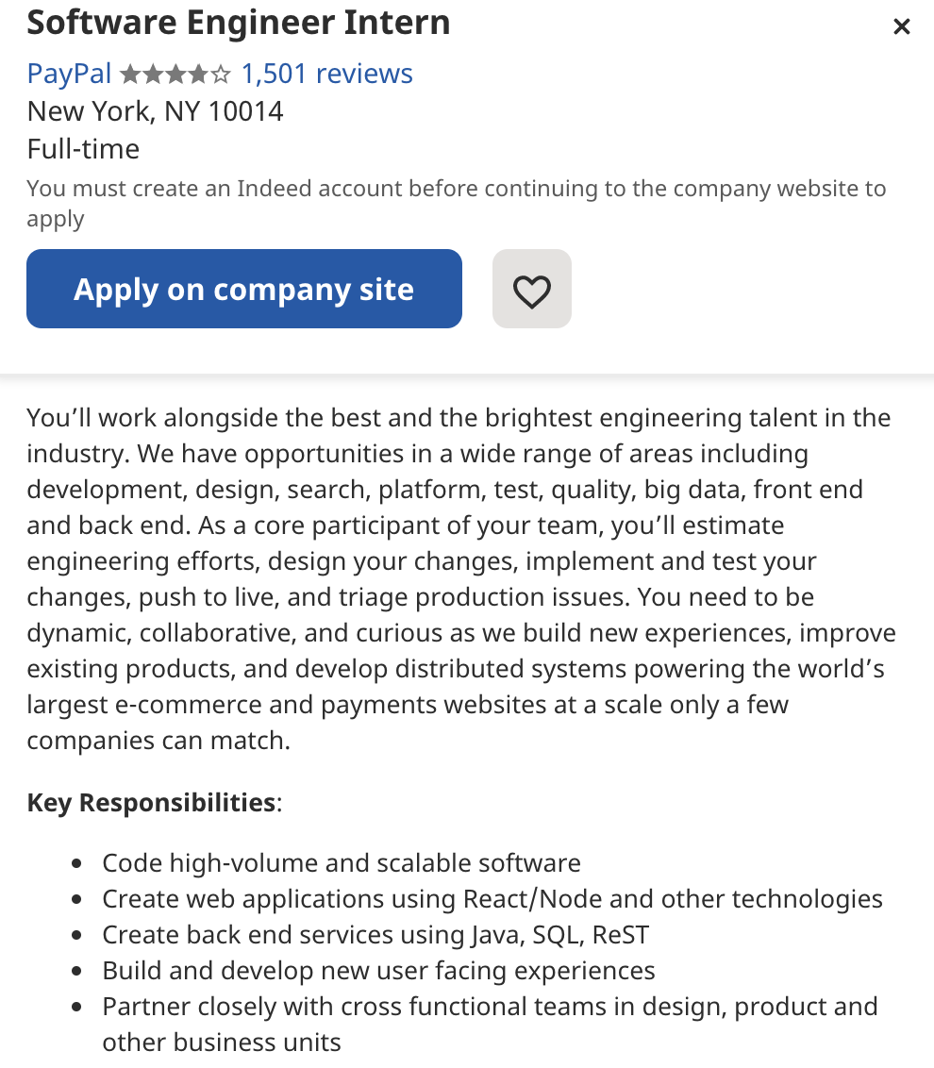
New York University, Tandon School of Engineering. Brooklyn, NY.
Research Assistant, Computer Science. January 2021-May 2021.
    Analyzed datasets produced in AI robotics experiments.
    Compiled relevant AI robotics articles from industry publications.
Starbucks. Paris, TX.
Part-Time Barista. January 2020 - September 2021.
    Fulfilled drink orders at drive-thru.
    Trained new baristas.
    Restocked pastries, drinks, and coffee accessories as needed.
Sadie’s STEM Summer Camp for Kidz. Paris, TX.
Camp Counselor. June 2020-August 2020.
    Led group of 10 second and third grade campers.
    Came up with and taught “Rad Robotics 101” workshop.
    Worked on a team with 5 other camp counselors.
    Participated in a week-long training.

Slide 10
RESOURCES
EG1004 Student Manual:
  Writing Consultants will meet with you 1:1 during recitation to answer questions
  EG1004 Writing Style Guide
  Sample Lab Report
  Writing Consultant Lab Report Rubric
Writing Center:
  Schedule an appointment: nyupoly.mywconline.com
  Location: 2 MTC, 9th Floor
  NYU Writing Center Website & Peer Tutor Program
5

Slide 11
QUESTIONS?

