Slide 1

RECITATION 11
EG1004

Slide 2
AGENDA
Engineering & Social Justice
Alternative Visualizations of Data For Your Argument
Writing as a Professional
Lab 10 Presentations
1

Slide 3

ENGINEERING & SOCIAL JUSTICE
Notes:
Beyond classic examples of data visualization in charts, data visualization is the core of a continuously growing snowball that allows engineers to ideate and innovate.

Slide 4
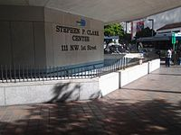
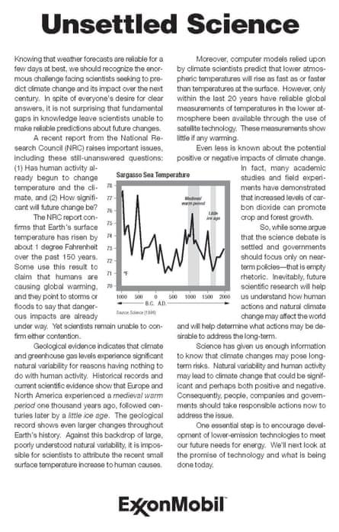
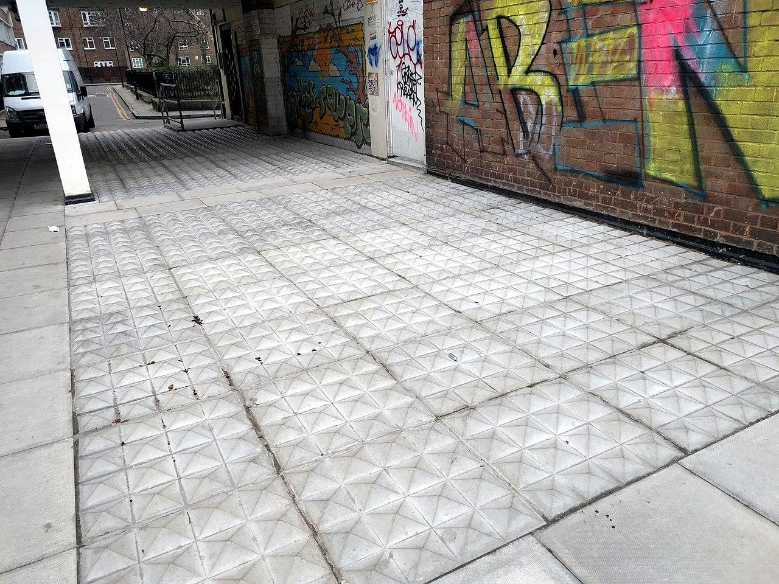
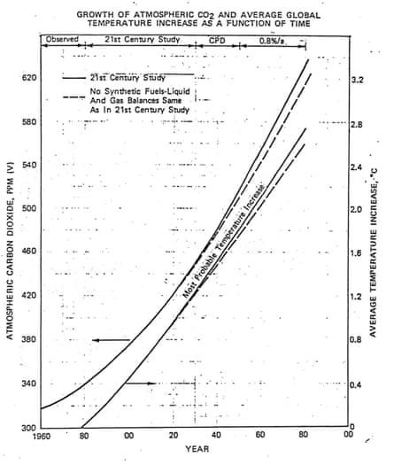

Social justice considerations in the engineering design process
DISCUSSION TOPICS
Responsibly communicating data with stakeholders
3
Notes:
Intro slide to preface the two parts of the discussion we’ll have in class – hostile architecture (engineering design) and Exxon’s role in climate denial (technical communication)

Slide 5
HOSTILE ARCHITECTURE
Examples: fencing around buildings, spikes on the ground, few and small seating areas at subway stops
Discussion Questions:
What objectives do these designs have?
What does this suggest about the engineering profession and implicit engineering values?
What role do engineers play in these design processes?
3
Notes:
**Give students time to discuss this question in groups and/or have a larger group discussion**

Slide 6
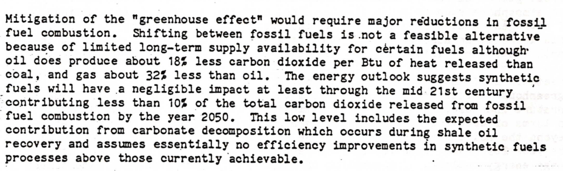
CLIMATE COMMUNICATION
Discussion Questions:
What responsibilities do engineers have to consider and disclose societal impacts of their work to stakeholders?
What conflicts might arise in choosing to withhold information from stakeholders?
3
Notes:
ExxonMobil internally reported on the impact of fossil fuels on global warming in 1982. Their findings show a relationship between CO₂ in the atmosphere and global temperature, and in the report, they acknowledge the relationship between the greenhouse gas effect and fossil fuel combustion

Slide 7
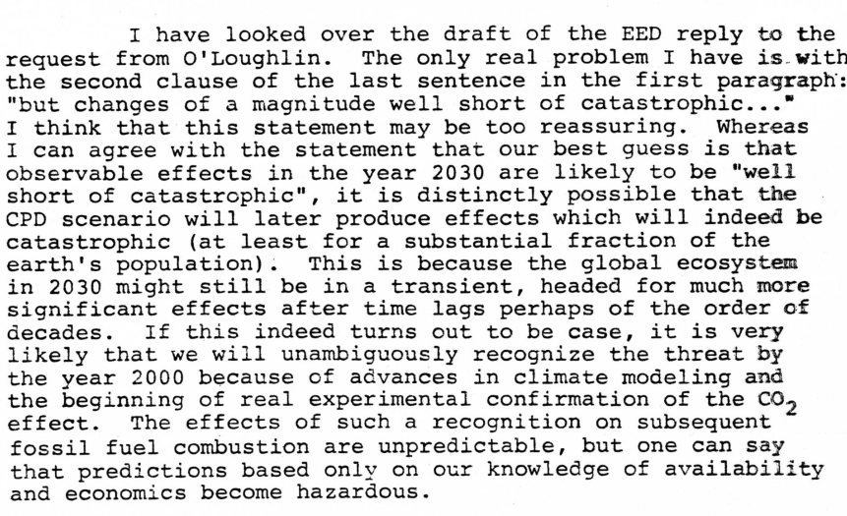
CLIMATE COMMUNICATION
Internal Exxon Memo (1982)
Public Exxon Commentary in New York Times (2000)
3
Notes:
To sum up the discussion – example text of how Exxon has handled the situation.
On the left: Exxon’s early conclusions that increases in CO2 may be catastrophic versus on the right: an example of public commentary that they made casting uncertainty on their own findings

Slide 8
ALTERNATIVE VISUALIZATIONS OF DATA FOR YOUR ARGUMENT
Notes:
Beyond classic examples of data visualization in charts, data visualization is the core of a continuously growing snowball that allows engineers to ideate and innovate.

Slide 9
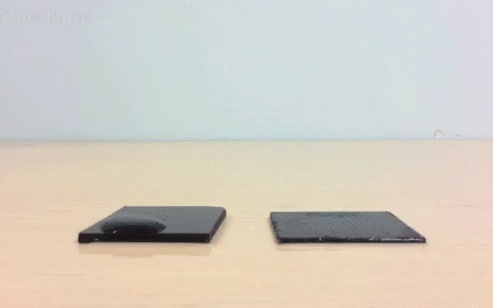
EXPLAINING CONCEPTS
5

Slide 10
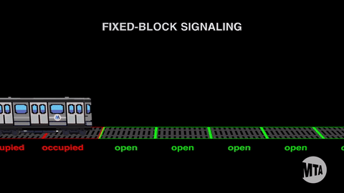
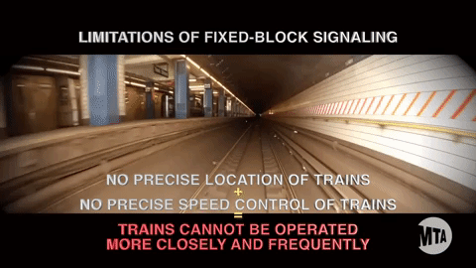
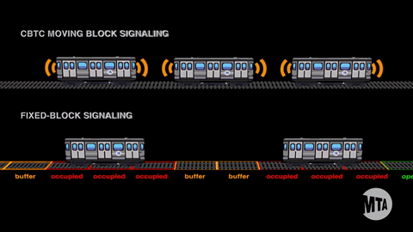
IDENTIFYING PROBLEMS
Learn More
6

Slide 11
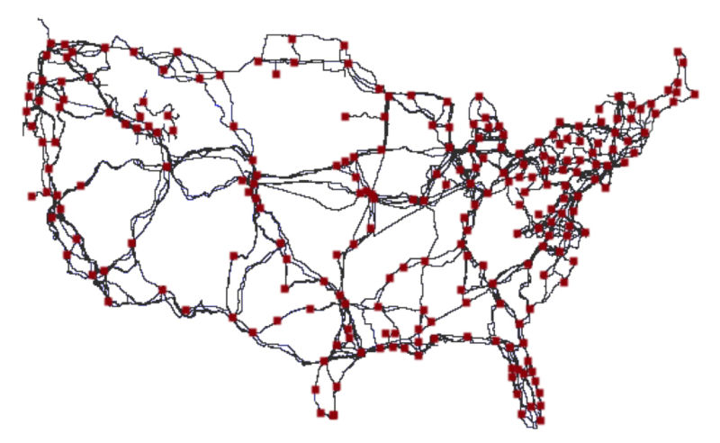
DATA COLLECTION
Figure 1: Map courtesy of Gizmodo
7
Notes:
**Ask students what they think this map shows** Answer: Major Internet Cables

Slide 12
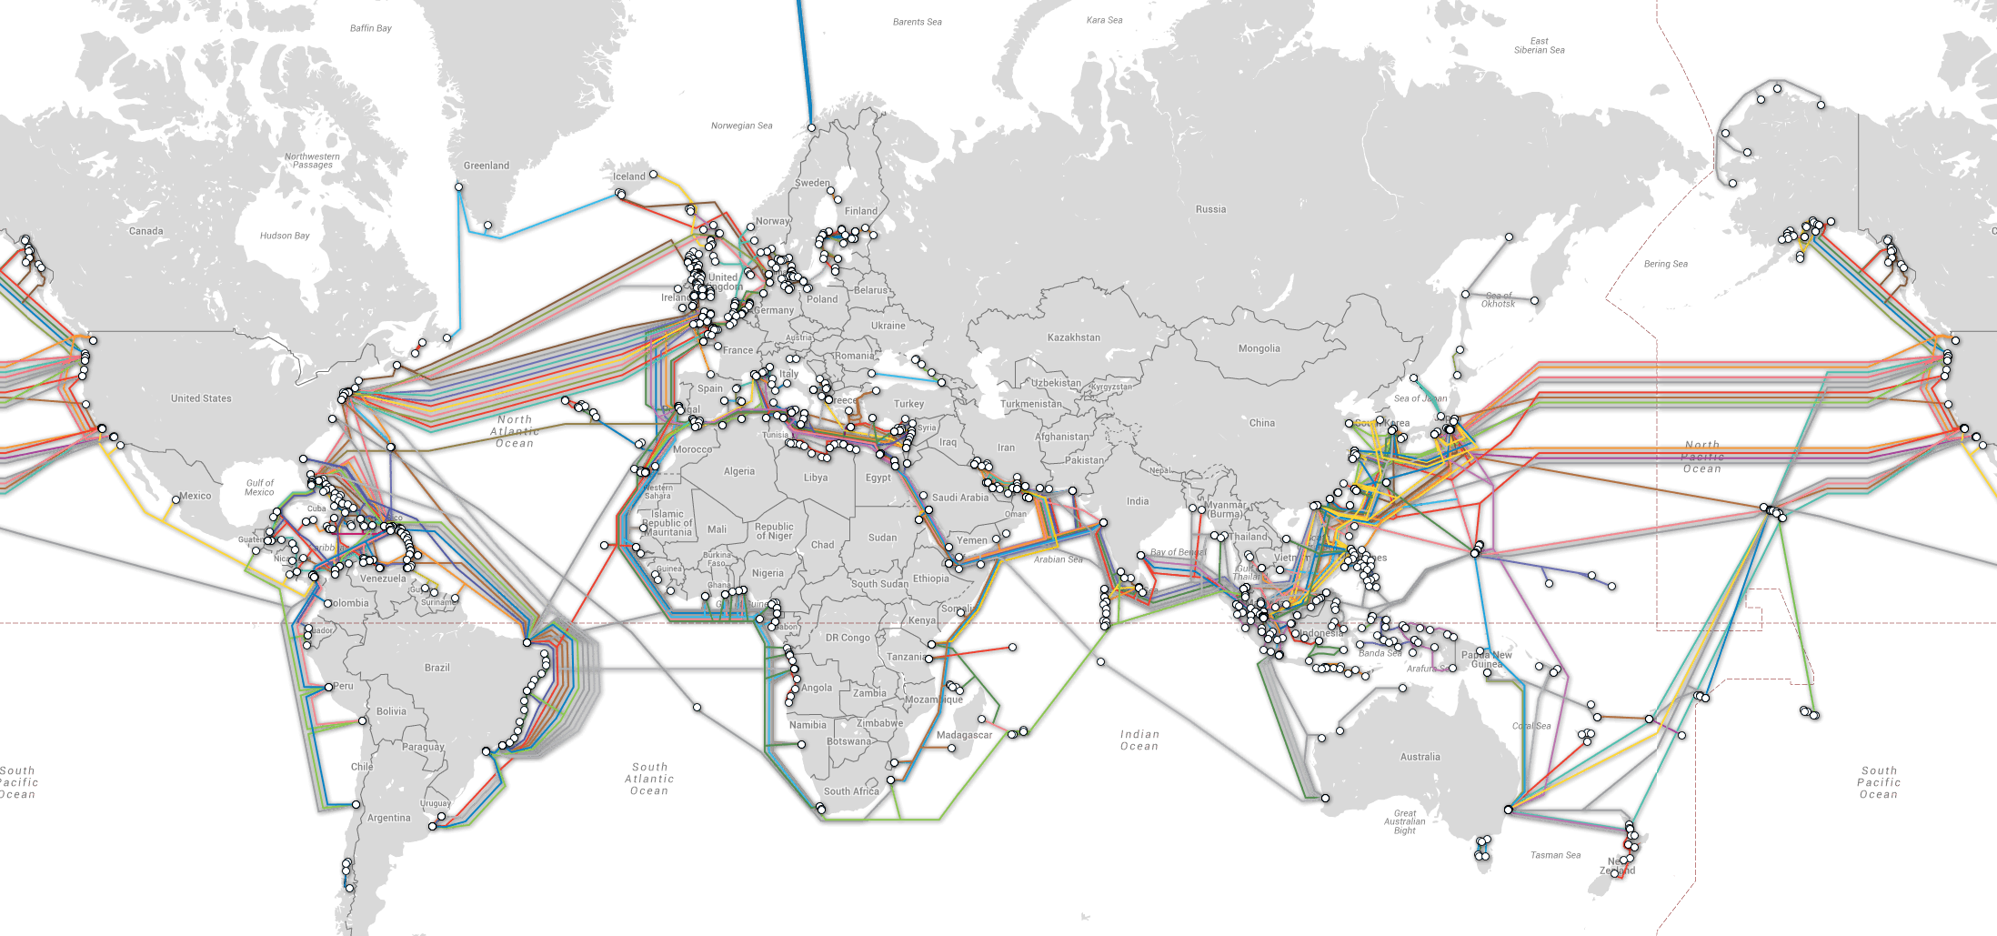
DATA MANAGEMENT
Figure 2: Map courtesy of Reddit
8
Notes:
**Ask students what they think this map shows**

Slide 13
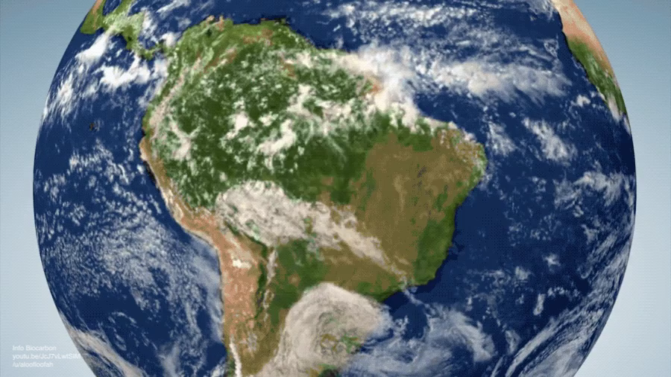
INNOVATIVE SOLUTIONS
9
Notes:
**Ask students what they think this map shows**

Slide 14
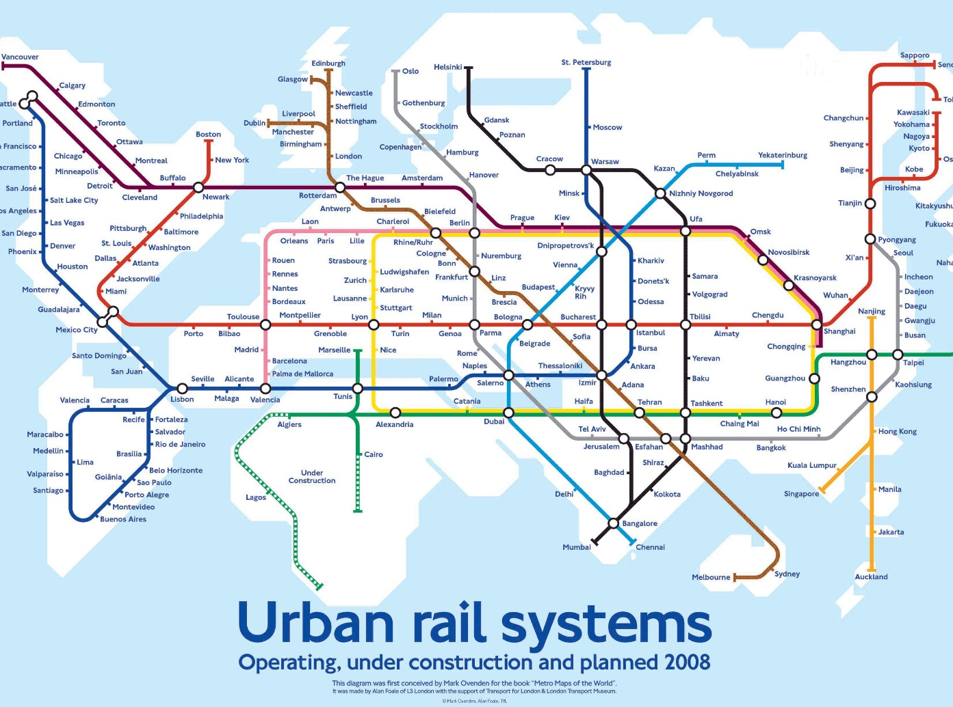
NOVEL IDEAS
Figure 6: Urban rail system
10

Slide 15
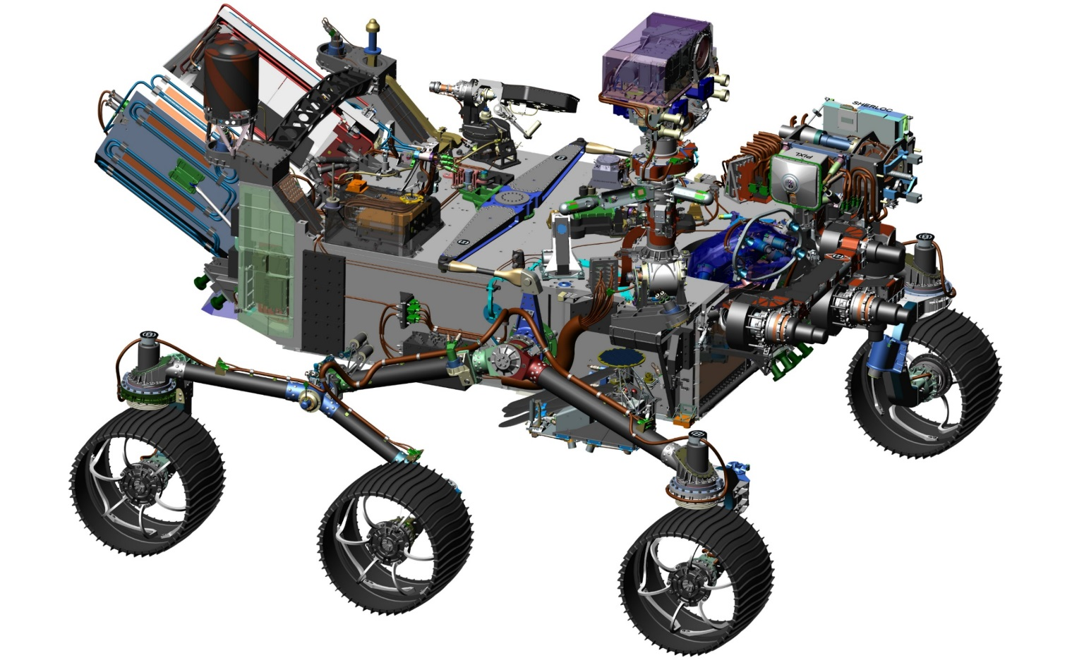
SPECIFICATIONS, DIMENSIONS, PRODUCTION
11

Slide 16
QUESTIONS?

