Slide 1
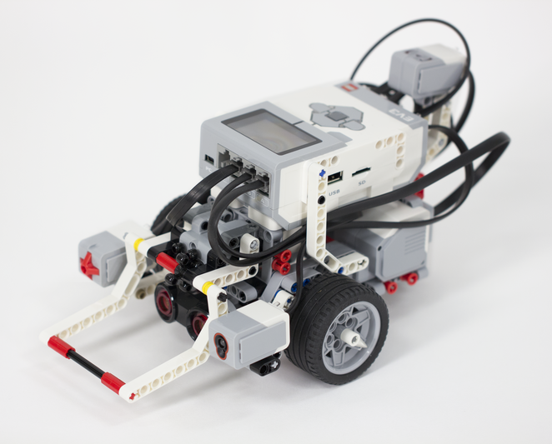
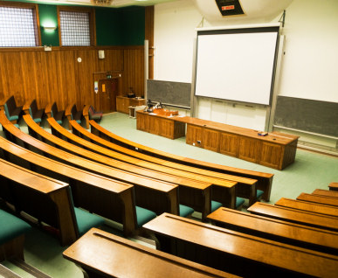
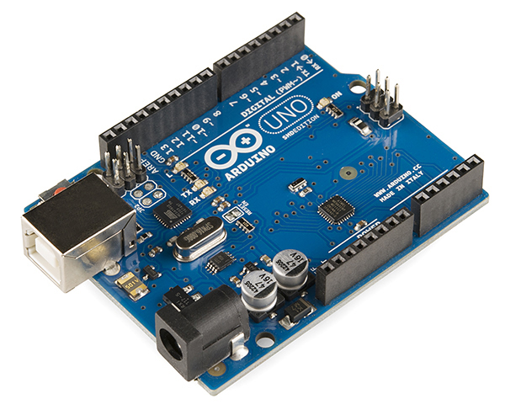
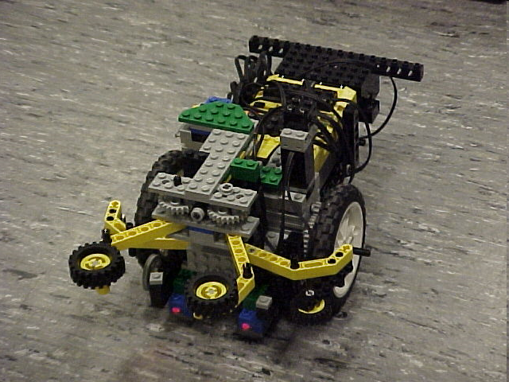
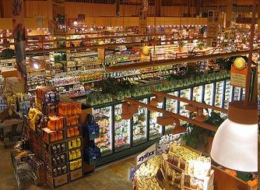
Semester-Long Design Project

Slide 2
Project Introduction
Project duration: Ten weeks
Teams of 2-3 people
Projects to choose from:
  Four types of autonomous robots
  Housing & Innovation in Revit
  Rapid Assembly & Design
  Biomedical Device

Slide 3
Project Grading
Item | % of Grade
Benchmarks and Commissioning | 50%
Final Presentation | 50%
NOTE: The SLDP counts toward 30% of your course final grade!

Slide 4

Project Grading
Benchmarks:
  Completion of a specified portion of the project
  Cumulative (Benchmark B includes Benchmark A)
  Two throughout semester
  Refer to schedule for due dates
  Penalties for not completing on time

Slide 5
Project Grading
Commissioning:
  Completion of all required tasks
  Last phase of project
  Refer to syllabus for due dates
  Failure to commission will result
  in penalties (partial commissioning)

Slide 6
Project Grading
Partial Commissioning:
  Benchmark A = 30% minimum
  Benchmark B = 70% minimum
  Any higher percentage achieved beyond your benchmark is decided by two TAs watching a full run

Slide 7
Project Grading
Project Submission:
  Submit all documents via EG website
  Google Form must be submitted for SLDP grade
  Any missing items will result in penalties
  Refer to syllabus for deadline
  Refer to Submission Guidelines

Slide 8
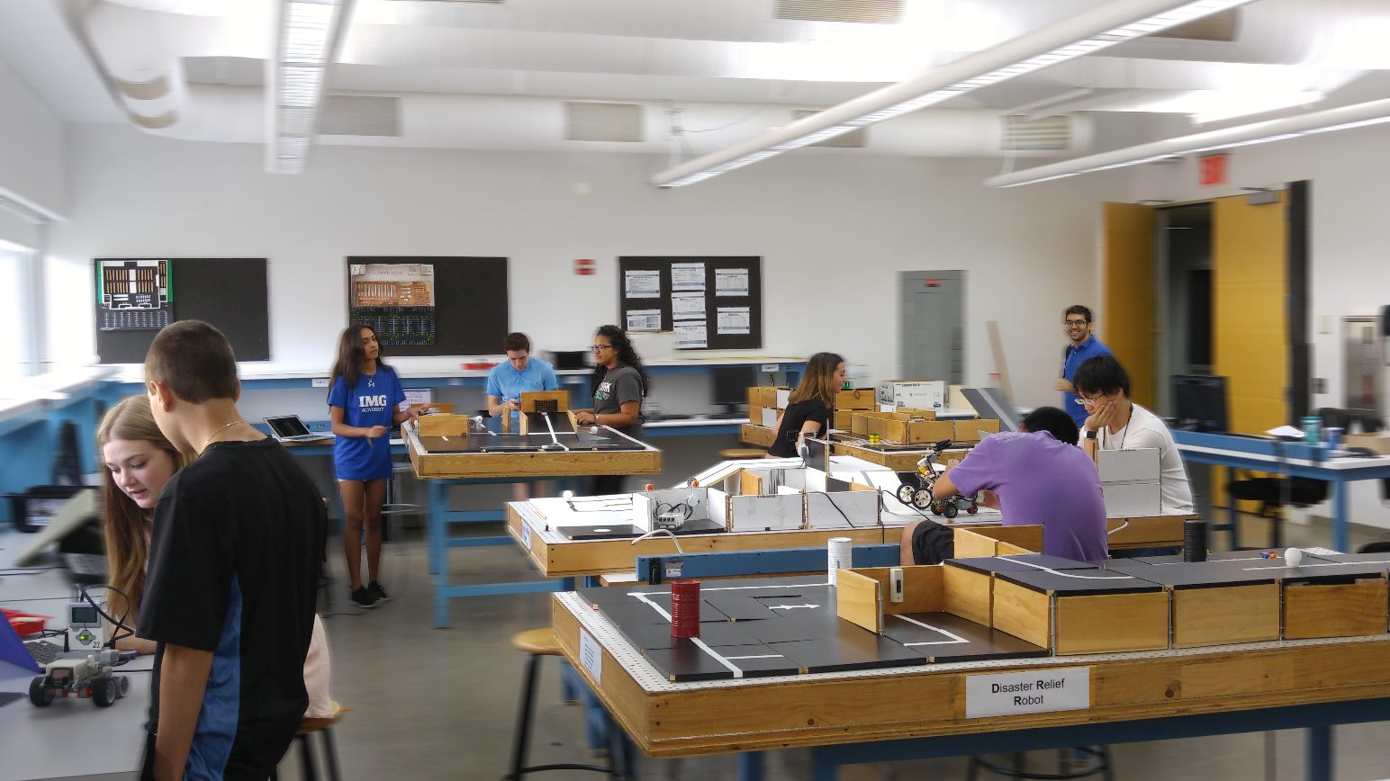
SLDP Options
Four Autonomous Robot Variants
Housing & Innovation
in Revit
Rapid Assembly & Design Challenge
Biomedical Device

Slide 9
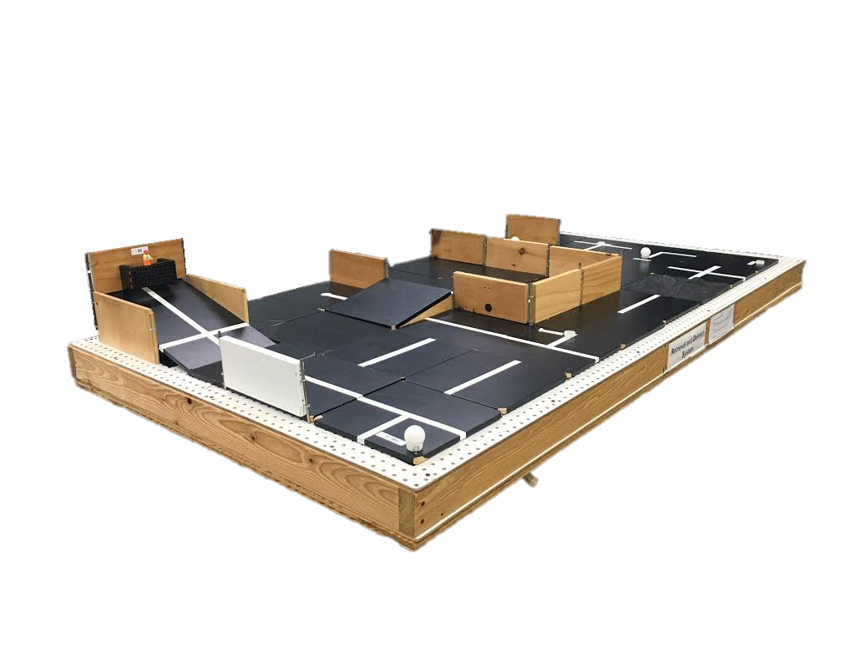
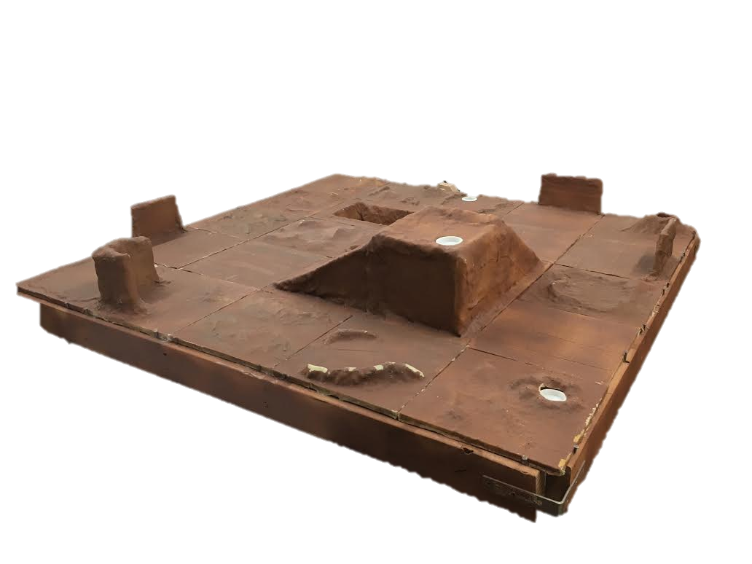
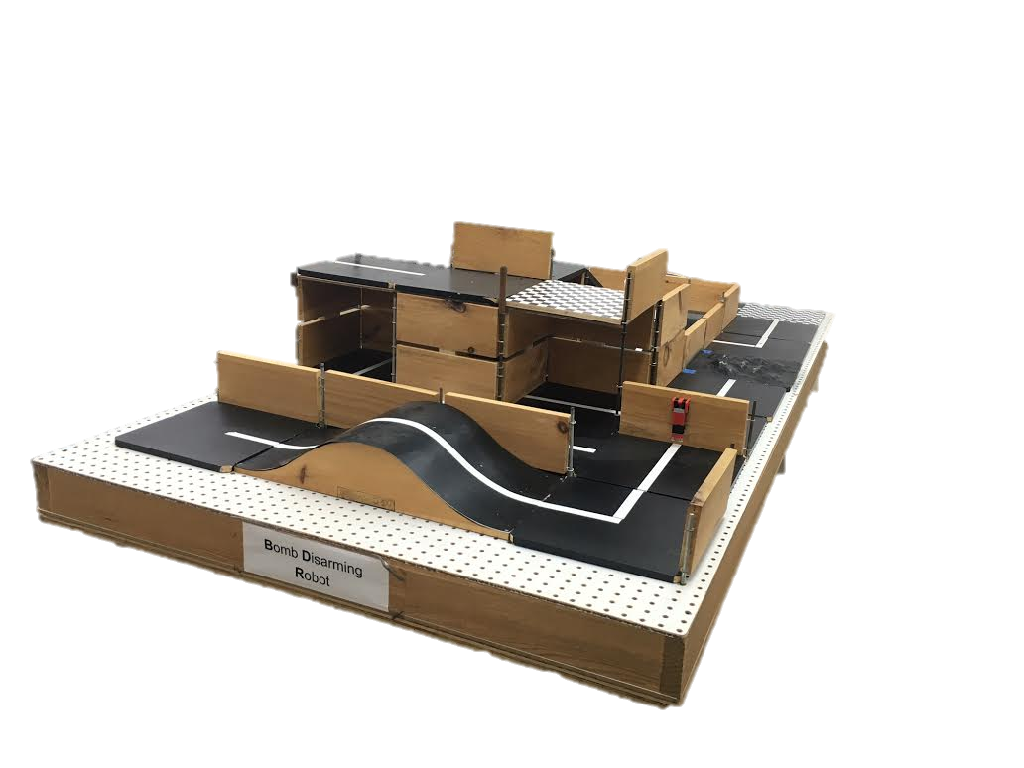
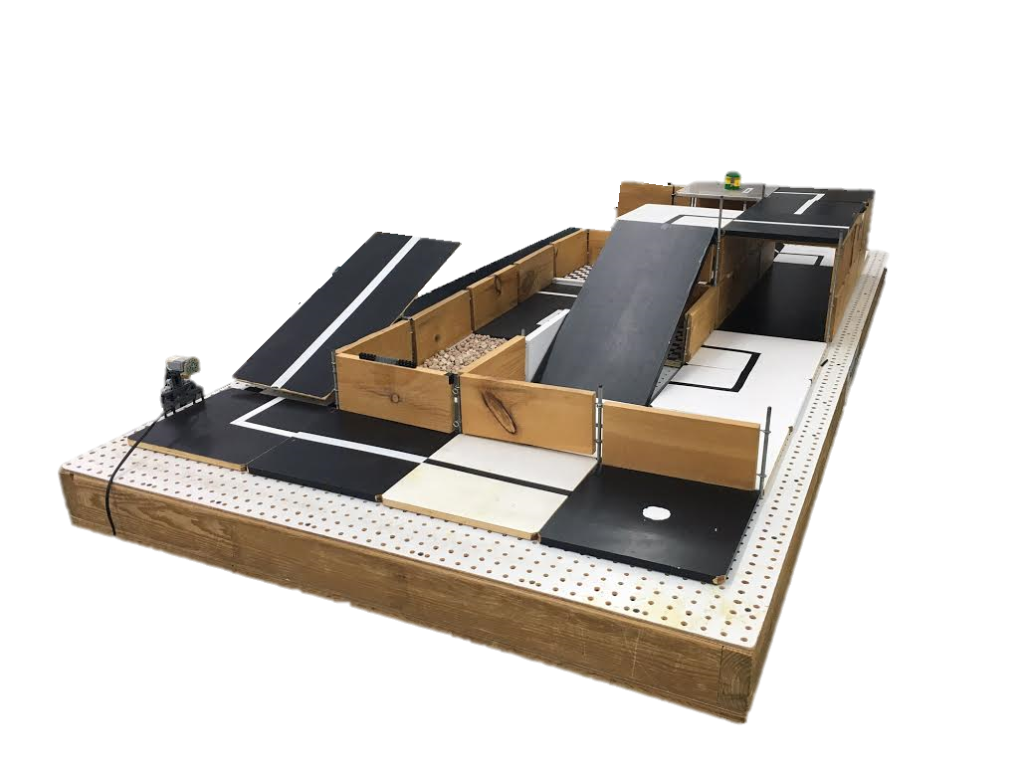
SLDP Options
Example Robot Variants

Slide 10
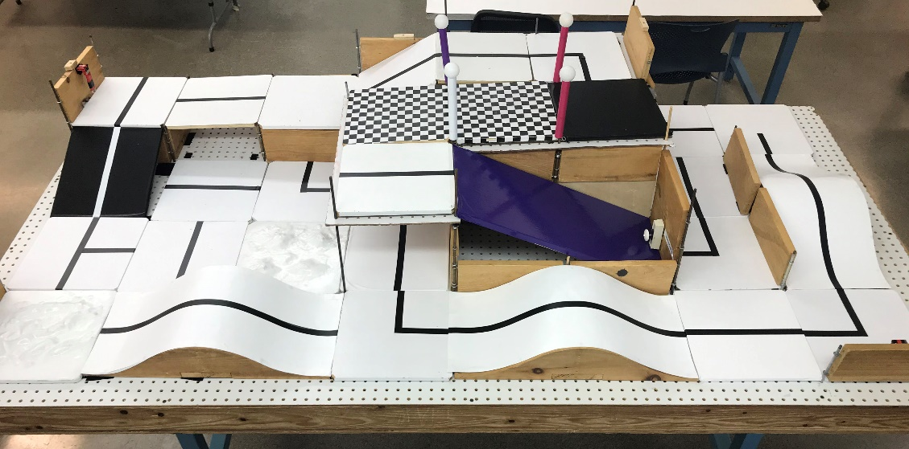
SLDP Options
Bomb Disarming Robot (BDR)
Disarm bomb and return to start
Avoid decoy bombs
Robot must be able to autonomously
navigate the obstacle course provided
Robot must fit in a start area that is 25cm x 25cm
Maximum height is 20cm

Slide 11

SLDP Options
Bomb Disarming Robot (BDR)
Allowed
Jumping off
upper levels
Climbing walls
Prohibited
Arms
Slingshots
Projectiles
Extra Credit: Disable and/or retrieve triangulation device(s)

Slide 12
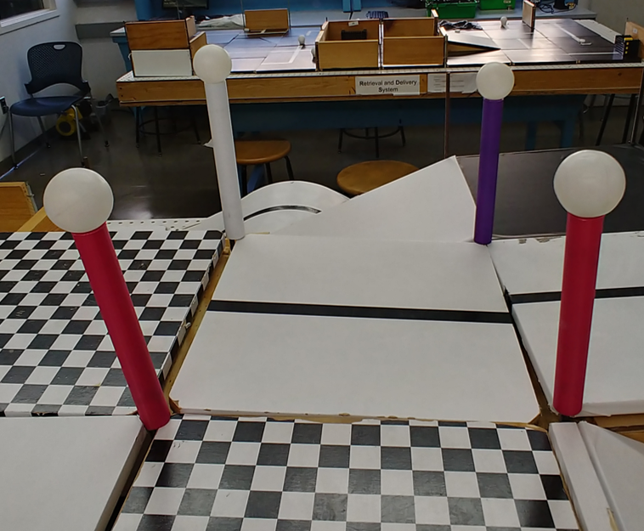
SLDP Options
Bomb Disarming Robot (BDR)
Benchmark A:
Pass two hills
Logo design submission
Extra Credit: Disable and/or retrieve triangulation device(s)
Benchmark B:
Disarm bomb
Logo design approval
Commission:
Return to start
Printed logo

Slide 13
SLDP Options
Mars Rover Robot (MRR)
Collect one soil and one water reading
Pick up sensor between readings if necessary
Carry module(s) FROM start TO respective tile
Answer Data Specifications questions

Slide 14
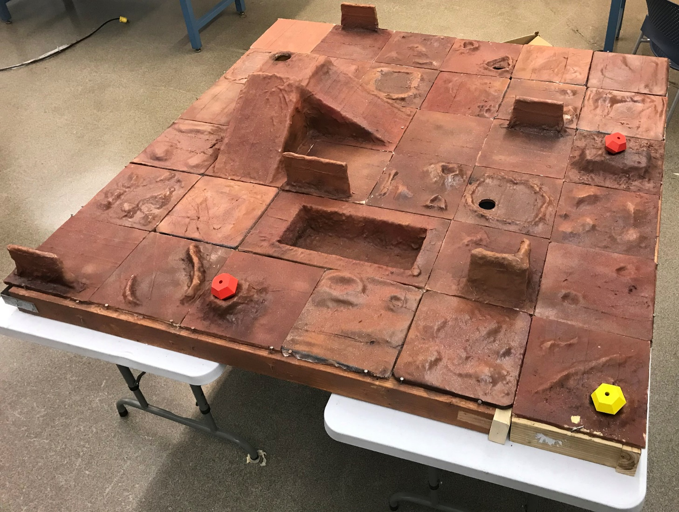
SLDP Options
Mars Rover Robot (MRR)

Slide 15
SLDP Options
Mars Rover Robot (MRR)
Benchmark A:
Obtain one reading
Benchmark B:
Obtain first reading
Return to pick up module if necessary
Obtain second different reading
Commission:
Obtain a water and soil reading
Return to landing site
Conduct all corresponding tests and answer Data Spec questions

Slide 16
SLDP Options
Mars Rover Robot (MRR)
Extra Credit:
Obtain all 3 types of readings
Cross the canyon
Traverse up and down mountain
Collect reading from an EC tile

Slide 17
SLDP Options
Retrieval & Delivery System (RDS)
Retrieve fuel cells
Deliver them to three different hospitals
Hospitals consume power at different
levels of efficiency
Deliver a total of at least 200 hours of battery life
The robot must fit in a start area that is 25cm x 25cm

Slide 18
SLDP Options
Retrieval & Delivery System (RDS)
Fuel Cells
Center of tile = 25 hrs
Edge of tile = 30 hrs
Corner of tile = 35 hrs
Power Supply
Yellow = 1x
Blue = 2x
Red = 3x
Extra Credit: Additional fuel cells
  Depends on extra number of cells, not hours

Slide 19
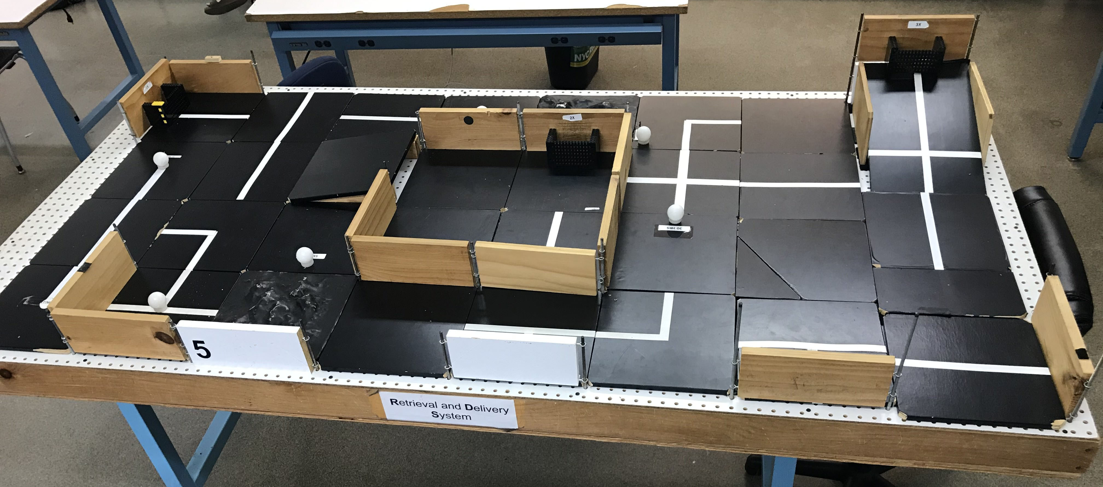
SLDP Options
Retrieval & Delivery System (RDS)

Slide 20
SLDP Options
Retrieval & Delivery System (RDS)
Benchmark A:
Deliver 50 hrs
Logo design submission
Extra Credit: Additional fuel cells
Depends on extra number of cells, not hours
Benchmark B:
Deliver 125 hrs total
Logo design approval
Commission:
Deliver 200 hrs total
Printed logo

Slide 21
SLDP Options
Search & Recovery Robot (SRR)
Retrieve lost space module Zarya and return to start
The robot must fit in a start area that is 25cm x 25cm
Extra Credit: Retrieve other modules; traverse moon dust

Slide 22
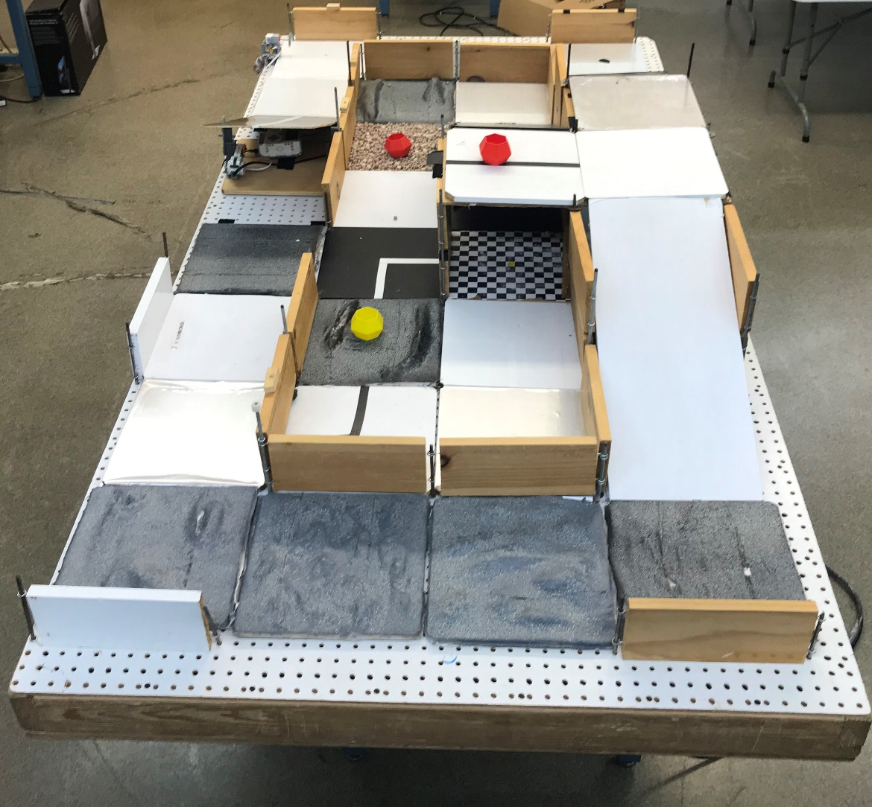
SLDP Options
Search & Recovery Robot (SRR)

Slide 23
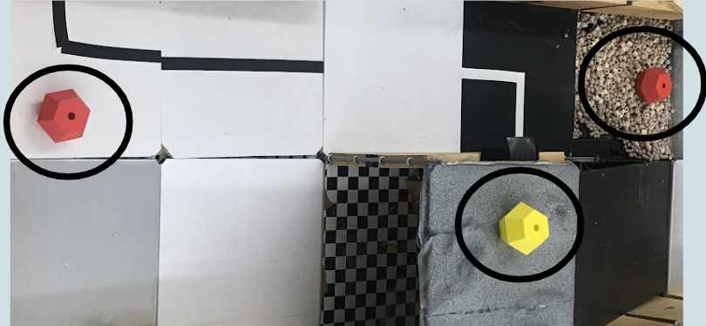
SLDP Options
Search & Recovery Robot (SRR)
Modules:

Slide 24
SLDP Options
Search & Recovery Robot (SRR)
Extra Credit: Retrieve other modules; Traverse moon dust
Benchmark A:
Traverse the solar panel hill
Logo design submission
Benchmark B:
Retrieve Zarya
Logo design approval
Commission:
Return to start with Zarya
Printed logo

Slide 25
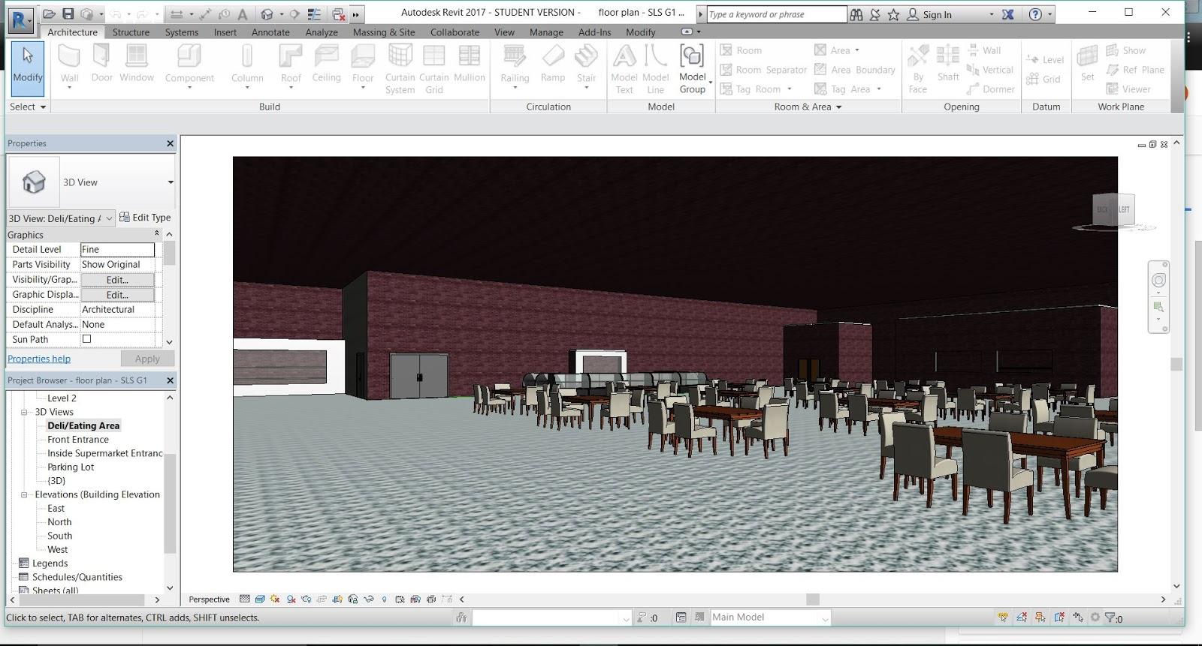
SLDP Options
NYU Housing & Innovation in Revit (HIR)
Create a 3D Revit model of a
college campus extension to
NYU Tandon
Plan utilities layout
      Electrical system
      Plumbing system
    3D-printed exterior frame

Slide 26
SLDP Options
NYU Housing & Innovation in Revit (HIR)
Benchmark A
  One recreational space design
  One 20-student classroom design
  One 40-student classroom design
  Logo design submission
Benchmark B
  Everything from Benchmark A
  All classroom designs
  Facility of choice
  Electrical and plumbing for one dorm
  Logo design approval

Slide 27
SLDP Options
NYU Housing & Innovation in Revit (HIR)
Commission:
Revit drawings
  Floor plans for all floors
  (minimum 6)
  Plumbing system
  Electrical system
  Front elevation
  Most detailed side
  Gold LEED certification
  LEED Implementation Report
Model of Building:
  3D Revit model (in software)
  Walk through video
Extra Credit:
  3D printed exterior of building
  Platinum LEED certification
Printed Logo

Slide 28

SLDP Options
NYU Housing & Innovation in Revit (HIR)
LEED Description:
Leadership in Energy & Environmental Design (LEED) is a green building certification program
Different levels of certification
  LEED Silver (2 categories)
  LEED Gold (4 categories) - Mandatory
  LEED Platinum (All 6 categories) – Extra Credit
Teams choose the categories that best fit their design

Slide 29
SLDP Options
NYU Housing & Innovation in Revit (HIR)
LEED Categories:
Location & Transportation
Sustainable Sites
Water Efficiency
Energy & Atmosphere
Indoor Environmental Quality
Innovation

Slide 30
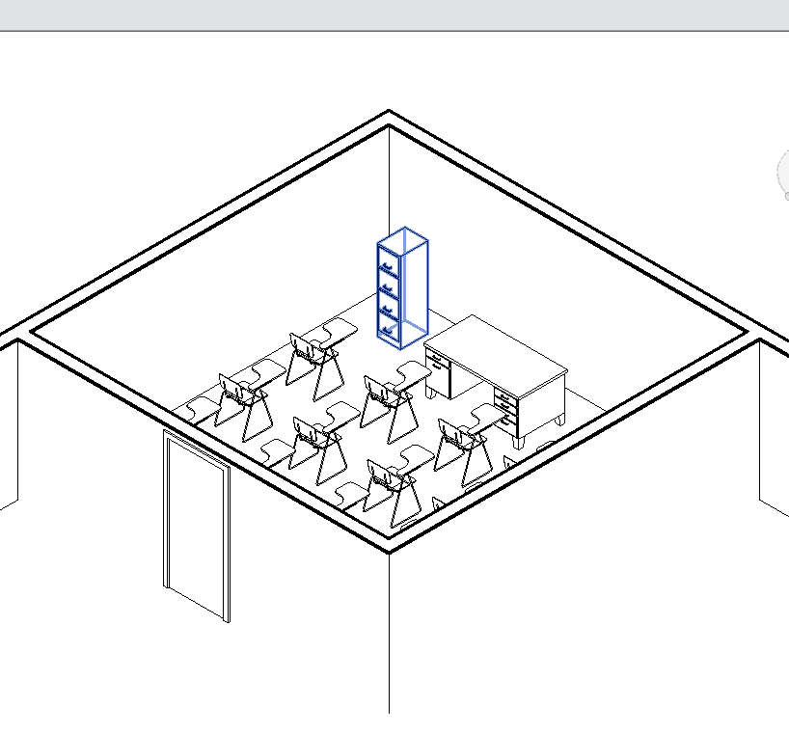
SLDP Options
NYU Housing & Innovation in Revit (HIR)
Examples:

Slide 31

SLDP Options
Rapid Assembly & Design Challenge (RAD)
Identify a problem (free-choice) or address a proposed problem (prompt-based), develop a solution, and manufacture a proof of concept
Work around an $100 budget
Includes additional resources such as EG workshops, RAD Open Lab, MakerSpace machines, etc.
Ingenuity
Learning
Invention
MakerSpace
Creativity
Tinkering

Slide 32
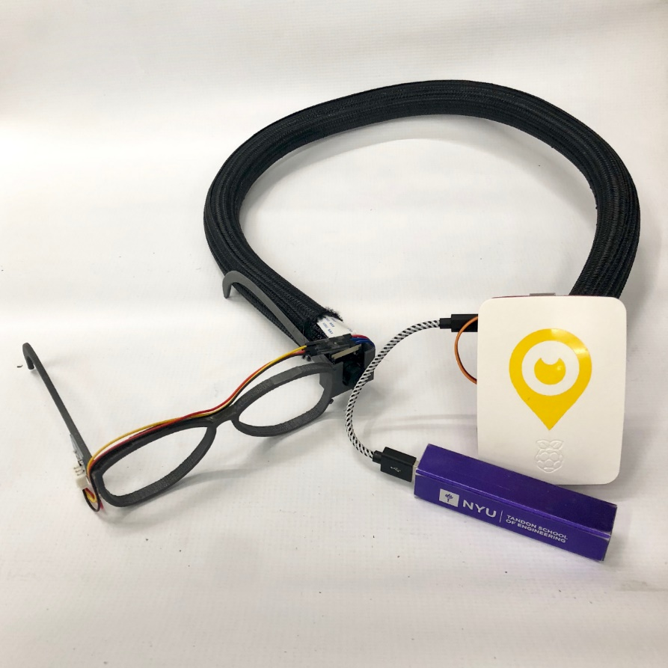
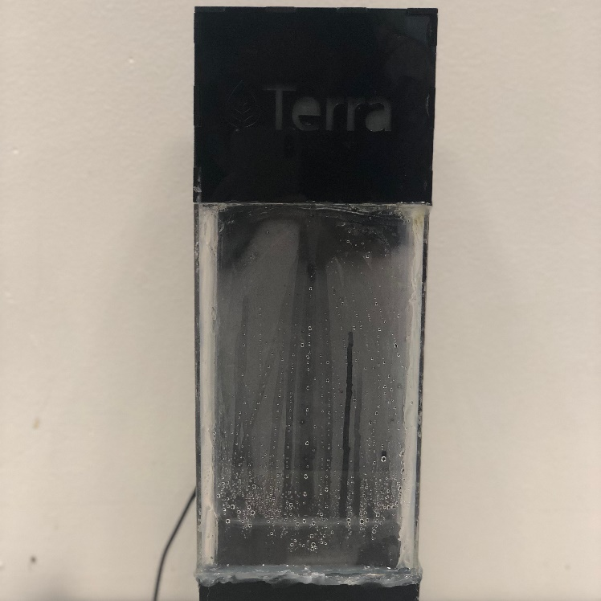
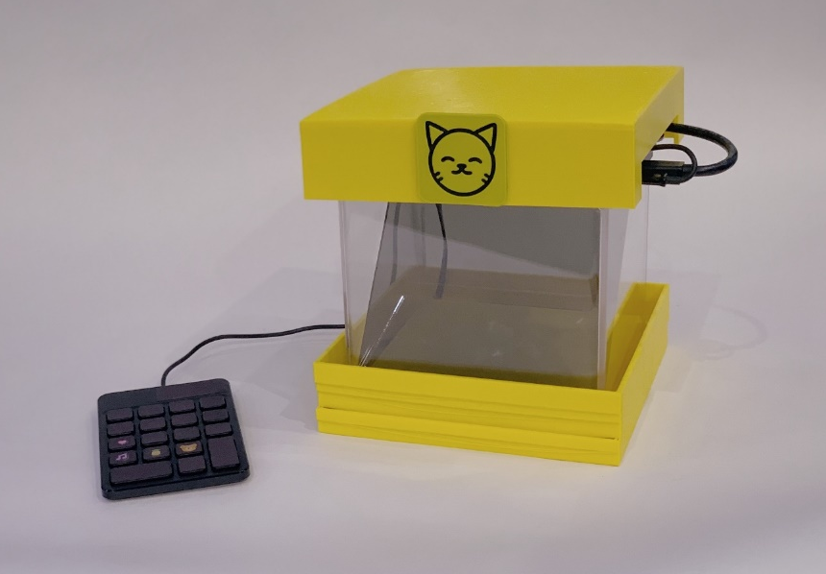
SLDP Options
Rapid Assembly & Design Challenge (RAD)
Holographic Pet Toy
Weather Simulator
Blind Assistive Technology

Slide 33
SLDP Options
Rapid Assembly & Design Challenge (RAD)
Benchmark A:
Determined by RADOLs
Initial coding or wiring
Initial physical prototype
Design Feasibility Report (DFR)
Benchmark B:
Determined by RADOLs
Some functions completed
New prototype iteration
Commissioning:
Determined by RADOLs
Fully functioning proof of concept
Extra Credit:
Determined by RADOLs
Additional functions on top of the existing ones
3D printing besides logo

Slide 34
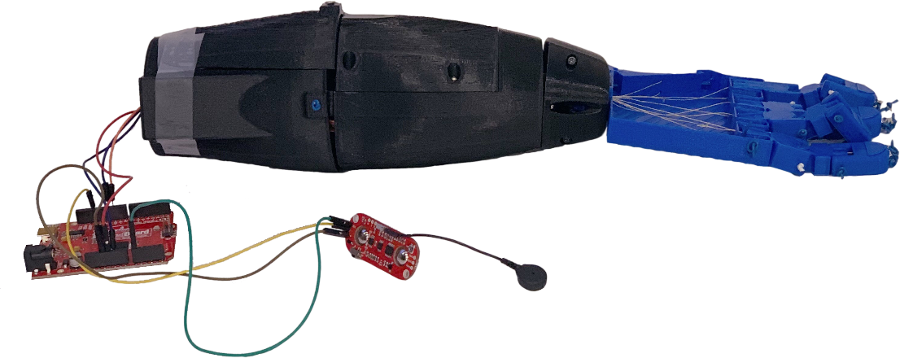
SLDP Options
Biomedical Device (BMD)
Design and develop an autonomous prosthetic limb
or wearable device
Complete an Extra Task and Machining Method
Create a 1:1 scale model
Essentially a more guided RAD project that
involves specific requirements and tools

Slide 35
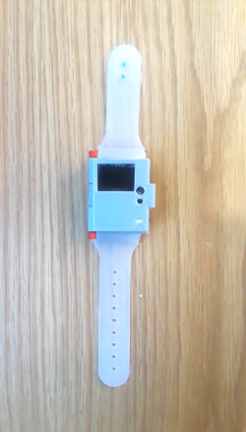
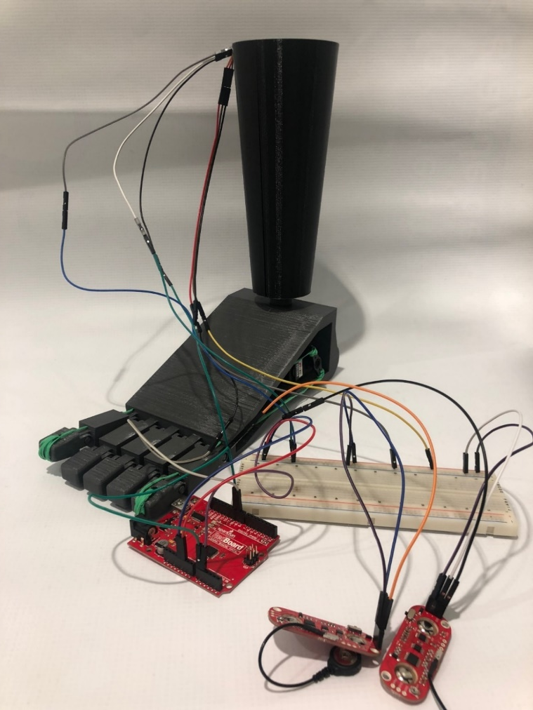
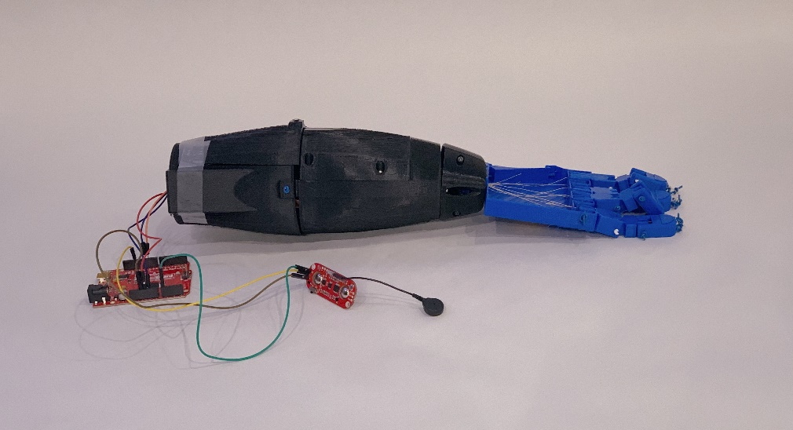
SLDP Options
Biomedical Device (BMD)
Prosthetic Arm
Prosthetic Foot
UV Ray Detection Watch

Slide 36
SLDP Options
Biomedical Device (BMD)
Benchmark A:
Determine device choice
Initial CAD model
One functioning sensor with Arduino code
Commissioning:
Sensors fully incorporated and functioning with proper battery
Can complete tasks in manual
Complete one Extra Task
Benchmark B:
Updated CAD model
Machining Method
Finished manufacturing parts
Extra Credit:
Additional Extra Tasks
3D printing besides logo

Slide 37
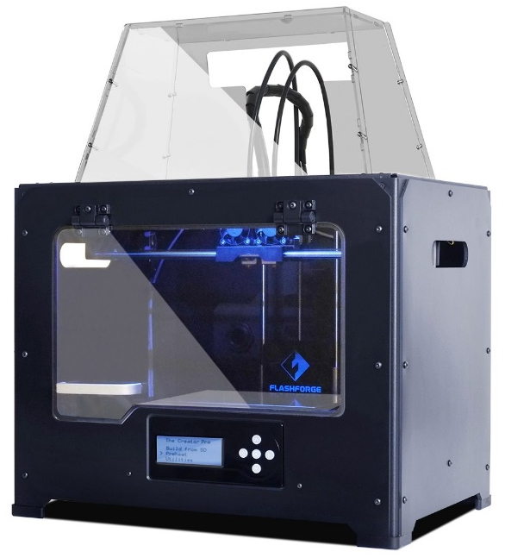
Mandatory 3D Printing
All SLDP groups must design a one-color logo
Be creative with your design
  Design must be approved by a Protolab TA
  Cannot be only text like the Lab 1C keychain
  Multiple colors are available: purple, black, white,
  yellow, red, green, pink, light blue, blue, clear
More info on 3D Printing Guide page on lab manual

Slide 38
Mandatory 3D Printing Submission
Applies to one-color logo, mandatory HIR prints (single-floor plan), and extra credit prints being used to fulfill the mandatory print requirements
Benchmark A
  Initial submission of .STL file to 3D Printing Submission Portal
Benchmark B
  Approval of design by Protolab TA
Commissioning
  Completed Print

Slide 39
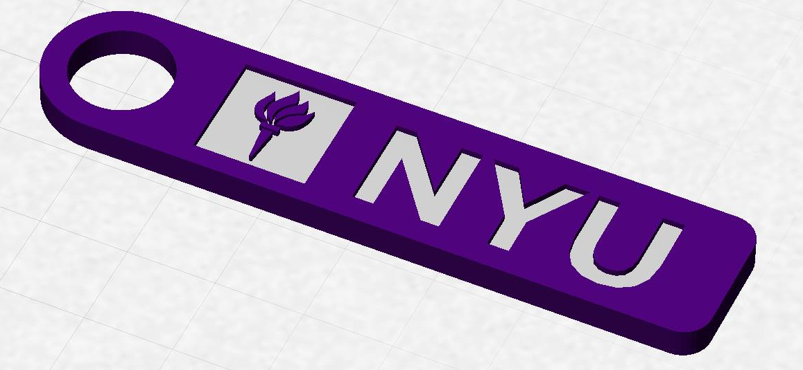
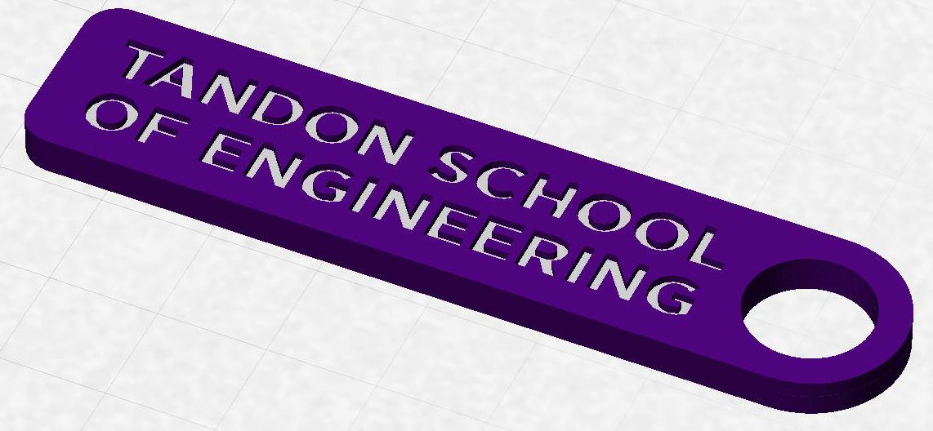
3D Printing Extra Credit
Constraints:
  Maximum weight of 15 grams
  No copyrighted logos
  Must be attached to robot or worn
  as pin during Final Presentation

Slide 40
3D Printing Extra Credit ADVANCED
Create a prototype of a custom, 3D-printed robot part or terrain modification (robots)
  Can also be used to fulfill mandatory print requirements
Constraints:
  Due by Milestone 2 Presentations
  YOU MUST HAVE A CONTINGENCY PLAN if the piece does not
  work or cannot be printed
  For full list of constraints see the 3D Printing Guide page on lab manual
You can receive one-on-one instruction in the EG Prototyping Lab, but you may also print parts in the MakerSpace with Protolab approval

Slide 41
3D Printing Extra Credit Submission
Submit your design at eg.poly.edu under the
3D Printing Submission tab
  Your first submission is due by Milestone 2
  Your design(s) must be an .stl file
  After your submission has been received you will be contacted by a TA to go into Protolab to get your print approved

Slide 42
Closing
Refer to manual.eg.poly.edu for details
Think about which project interests you
Brainstorm ideas
Speak with professors and TAs regarding projects

Slide 43

Semester-Long Design Project
QUESTIONS?

