Slide 1
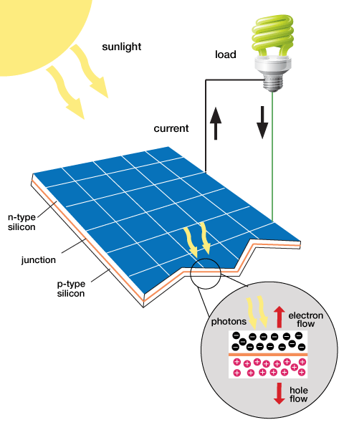
Sustainable Vehicle Lab

Slide 2
Overview
Experimental Objective
Background Information
Materials
Procedure
Assignment
Closing

Slide 3
Experimental Objective
Test the capabilities of solar panels and wind turbines
Test the capabilities of the citrus cells, hydrogen fuel cells and capacitors
Design a sustainable energy car to compete against the other groups

Slide 4
Background Information
Electrolytic Cells
Renewable Energy
Solar panels
Wind-turbine technology
Hydrogen fuel cells
Electronic Components

Slide 5
Electrolytic Cells
Uses two different electrodes and an electrolytic solution
Applications in industry include electrorefining and production of high-purity copper and zinc
Electrolytic Solution
Non-metallic part of circuit
Electrolytes dissociate free ions to create an electrically conductive solution
Lemon juice used as electrolyte
Electrodes
Two metals of differing electron affinity
Notes:
Al = aluminum
Cu = copper
Zn = zinc
Pb = lead

Slide 6
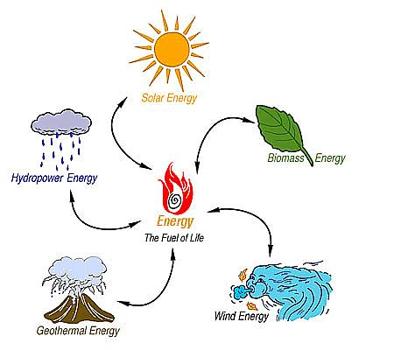
Renewable Energy
Harnessed from natural resources
Clean energy sources
Sources for energy are abundant in supply^{[1]}

Slide 7
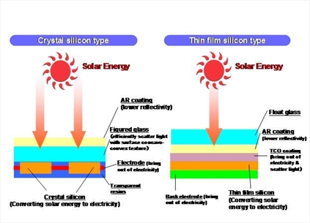
Solar Panels
Made from silicon or copper indium gallium (di)selenide (CIGS)
Converts sunlight to electrical current
Absorbed sunlight excites electrons to allow freedom of motion (generates an electric current)^{[2]}

Slide 8
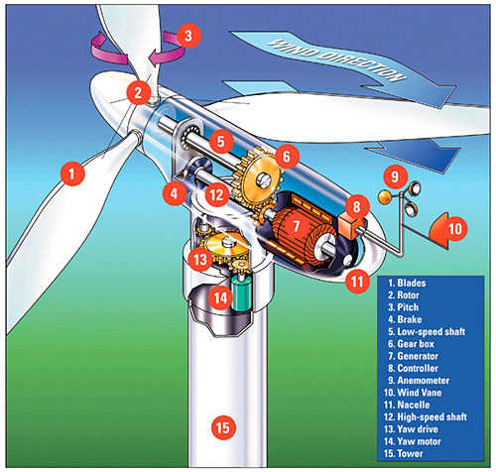
Wind-Turbine Technology
Use pressure difference generated by the wind to spin the turbine blades
Converts mechanical energy into electrical energy
The wind vane is used to determine the direction the wind-turbine will face^{[3]}

Slide 9
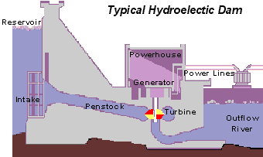
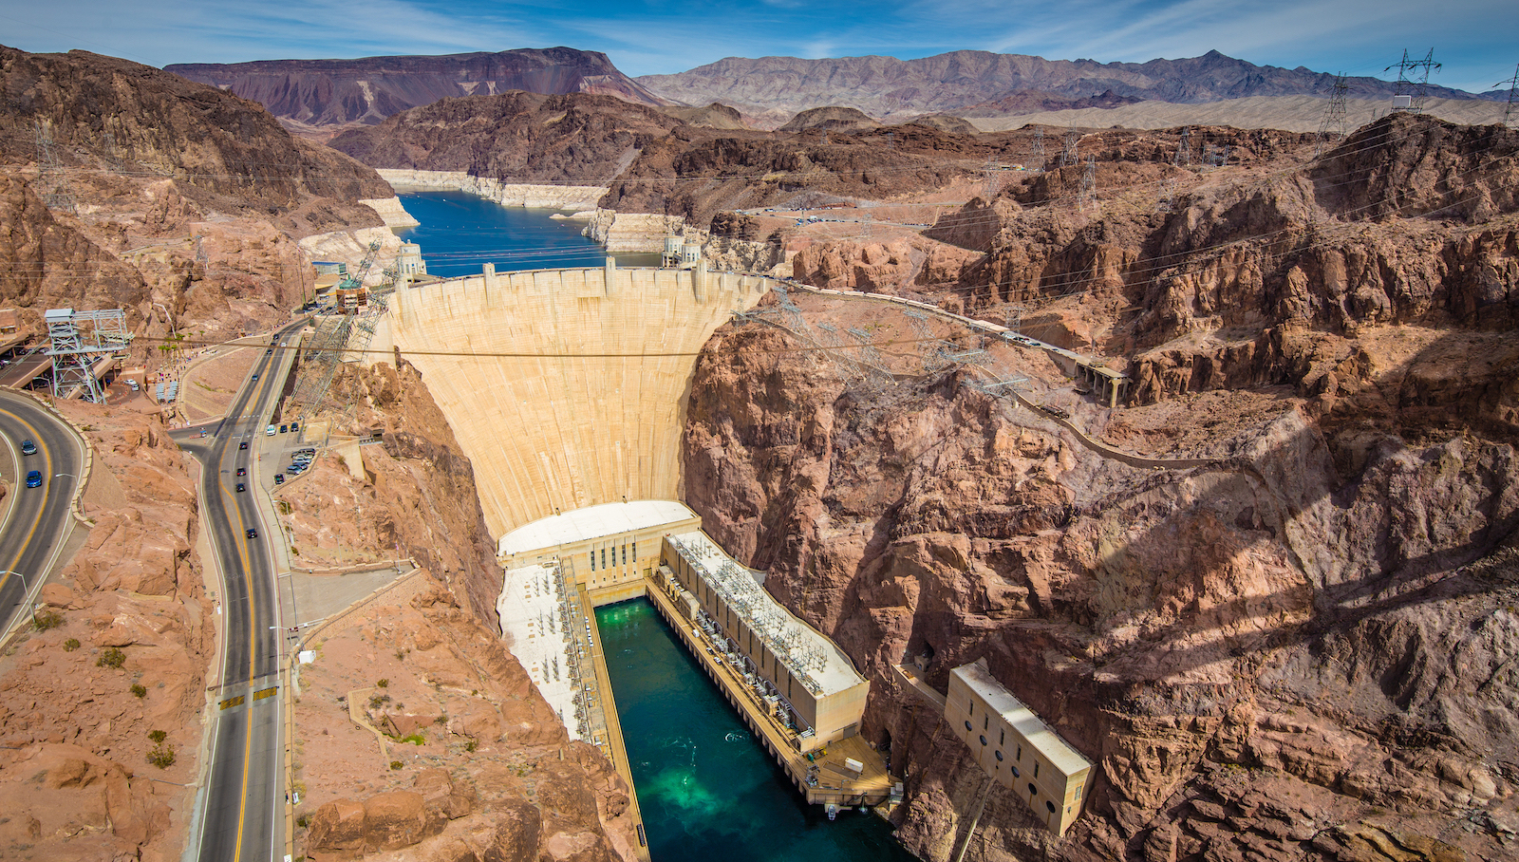
Hydroelectric Generation
Nearly identical to wind turbine
Geographically constrained
Largest source of renewable energy generation

Slide 10
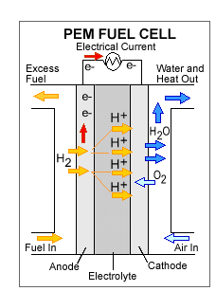
Hydrogen Fuel
Stores chemical energy and converts it into electrical energy
Types of fuels used include (but are not limited to) hydrogen, methane, and gasoline
Reversible fuel cells can separate water into hydrogen and oxygen, then use it to generate electrical energy ^{[4]}

Slide 11
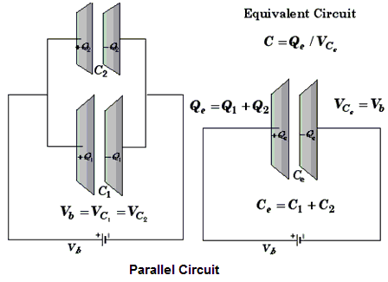
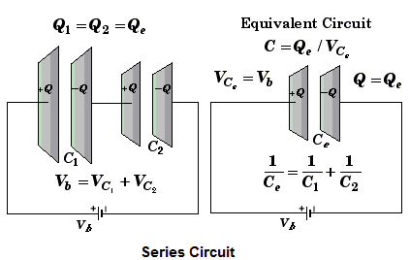
Capacitors
A capacitor is an electrical device used to store charge
Capacitors can be connected in parallel (increases charge stored) and in series (increases voltage stored)^{[5]}

Slide 12
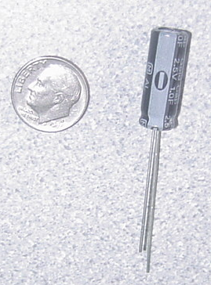
Capacitors
Store electrical energy
1 F (Farad) polarized capacitor
Positive
Negative

Slide 13
Capacitor Charging
Capacitor charge limit is restricted by charge voltage
Maximizing applied voltage maximizes energy stored
Capacitor is charged in time increments called the time constant (tau):
τ = RC
R = resistance, C = capacitance

Slide 14
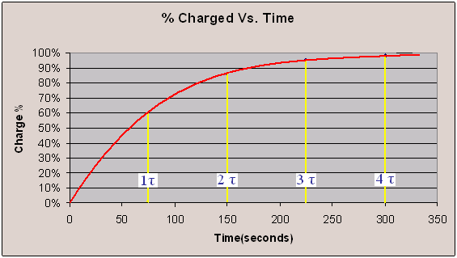
Percentage Charged
Charge is logarithmic
It takes approximately 4τ to charge the capacitor
Ex:

Slide 15
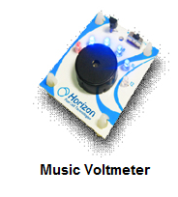
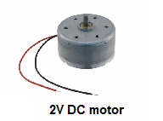
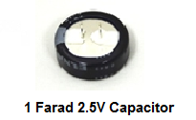
Materials
Horizon Wind-Turbine
Solar Battery Panels
Water Turbine
Adjustable Table fan
Heat Lamp
DMM (Digital Multi-meter)
Music Voltmeter
3V DC Motor
Horizon Hydrogen Fuel cell
1 Farad 2.5V Capacitor
Alligator cable sets
Standard Lego Car Chassis plus Lego parts kit
Mini Electric propeller
LED (Light Emitting Diode)
Lego to Alligator Cable Clip Connector
Scissors
Tape

Slide 16
Materials Price List
Horizon Wind-Turbine ($7.50/each)
Solar Battery Panels ($10.00/each)
Water Turbine ($5.00/each)
Horizon Hydrogen Fuel cell ($4.00/each)
1 Farad 5.5V Capacitor ($3.00/each)
Alligator cable sets ($0.50/each pair)
2oz Lemon Juice (with cup): ($0.50)
Cu and Zn: $0.75/strip
Lego to Alligator Cable Clip Connector ($0.10/each)
Duct Tape ($0.10/feet)

Slide 17
Procedure
Part 1: Test the power storage devices
Lemon juice
Hydrogen fuel cell
Capacitor
Part 2: Test the assigned power source using music voltmeter
Solar panel
Wind turbine
Water turbine
Part 3: Design a sustainable energy car using the power sources and power storage devices of your choice

Slide 18
Competition Rules
Power storage devices must be contained in the car
The sustainable energy car may not be pushed or launched
The sustainable energy car should not be touched after it has started to move
The car will run for up to five minutes or until the car comes to a stop

Slide 19
Competition Ratio
$$CR=\frac{distance [ft]}{1 \left[s\right]+time[s]}×\frac{100}{Cost [\$]}+distance[ft]$$
Where distance is measured in feet (1 tile = 1 ft), time is time elapsed for the trial, and cost is the total cost of constructing the car

Slide 20
Assignment: Report
Team lab report
Title page
Discussion of topics in the manual
Include a picture of your vehicle
Scan in lab notes (ask TA for assistance)
TA must initial that table and graph were completed

Slide 21
Assignment: Presentation
Team presentation
State rules of competition
Describe your design and its concepts
Include table of class results, cost and photo/video of design
How could your current design be improved?
Refer to “Creating PowerPoint Presentations” found on EG website

Slide 22
Closing
Have all original data signed by TA
Submit all work electronically
Clean up workstations
Return all materials to TA

Slide 23
Works Cited
Eriksson, J.. "Renewable energy vs. fossil fuel." Renewable power news. N.p., 2010. Web. 26 Jul 2012. <http://www.renewablepowernews.com/archives/1413>.
http://www.agc-flatglass.com/AGC-Flat-Glass/English/Other/News-Overview/News-Detail/page.aspx/1014?newsitem=1273.
. The structure of a modern wind turbine – an overview. N.p., n.d. Web. 26 Jul 2012. <http://www.wwindea.org/technology/ch01/en/1_2.html>.
Reg Tyler, . "Types of Fuel Cells." Energy efficeny and renewable energy. U.S. Department of Energy, 2011. Web. 24 Jul 2012. <http://www1.eere.energy.gov/hydrogenandfuelcells/fuelcells/fc_types.html>.
. Rotational Equilibrium. WWU, n.d. Web. 26 Jul 2012. <http://faculty.wwu.edu/vawter/PhysicsNet/Topics/TopicsMainTemplate.html>.
http://www.horizonfuelcell.com/files/Education_Series_PDF.pdf

Slide 24
Sustainable Vehicle Lab
QUESTIONS?

