Slide 1

INTRODUCTION TO THE SEMESTER LONG DESIGN PROJECT (SLDP)
EG1003 | RECITATION 2

Slide 2
AGENDA
Project Introduction
Project Grading
SLDP Options
Additional Information
Questions
1

Slide 3
PROJECT INTRODUCTION
Three Project Types:
Housing & Innovation in Revit (HIR)
Biomedical Device (BMD)
Rapid Assembly & Design (RAD)
10
Week Project
2-4
Team Members
2

Slide 4
PROJECT GRADING
Item | Percentage of Grade
Benchmarks & Commissioning | 50%
Final Presentation | 50%
The SLDP is 30% of your total course grade!
3

Slide 5
PROJECT GRADING
Benchmarks
Two benchmarks
Completion of certain portions of project
Due dates on schedule on eg.poly.edu
Penalties for late completion
Extra credit for early completion
Benchmark
B
Benchmark
A
Benchmark A
Benchmark B
4

Slide 6
PROJECT GRADING
Commissioning
Completion of all tasks
Due date on schedule on eg.poly.edu
Can partially commission if unable to complete all tasks on time
Submission
Submission of all SLDP material
Due on same date as commissioning
Can submit early for extra credit
Benchmark A
Benchmark B
Commissioning
Submission
5

Slide 7
SLDP OPTIONS
Housing & Innovation in Revit (HIR)
Create 3D Revit model of campus extension to NYU Tandon
Include plumbing & electrical plans
Obtain LEED Gold certification
Engineering notebook
Figure 1: 181 Mercer Street Building Courtesy of NYU
6

Slide 8
SLDP OPTIONS
Benchmark A
Benchmark B
Commissioning
Preliminary Design Investigation
All classroom spaces
Floor plans for all floors (six minimum) and front elevation
One 20 person-classroom
One 40 person-classroom
Facility of choice
Electrical & plumbing plans for dorm
LEED Gold and implementation plan
Model of building
One recreational space
Housing & Innovation in Revit (HIR)
Extra Credit
LEED Platinum certification
7

Slide 9
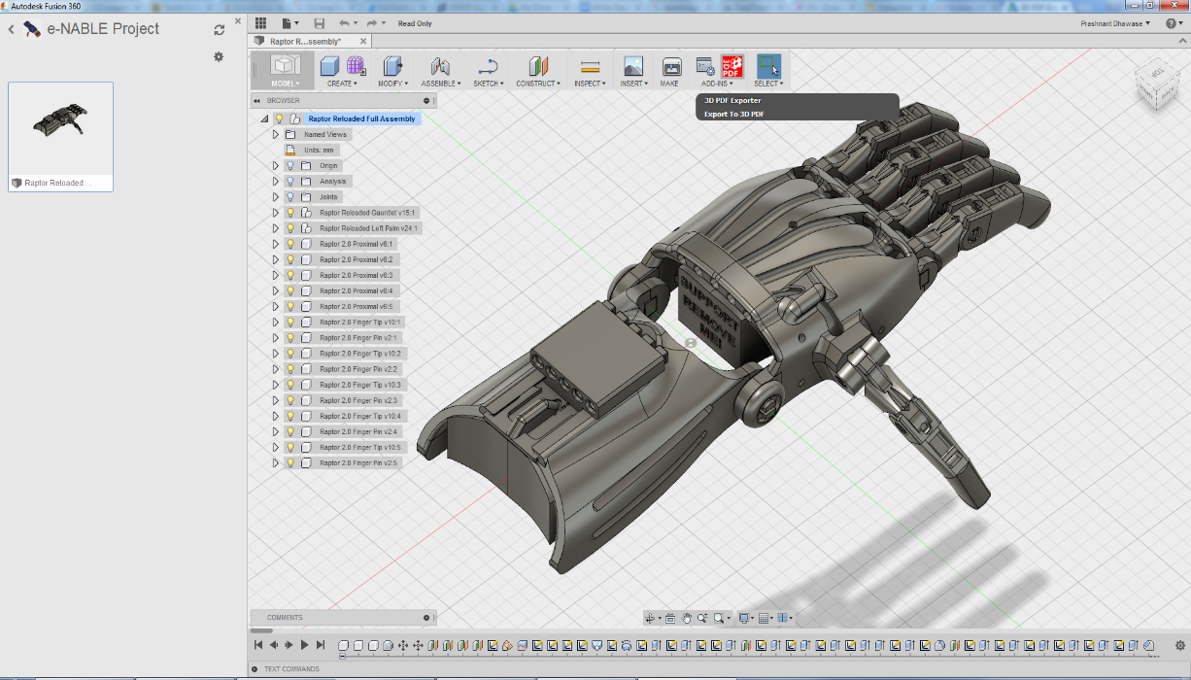
SLDP OPTIONS
Biomedical Device (BMD)
Create an autonomous prosthetic limb or wearable device
Device achieves three tasks
Model design with CAD
Wiring diagrams
Engineering notebook
Figure 2: Prosthetic Hand Courtesy of Autodesk
8

Slide 10
SLDP OPTIONS
Benchmark A
Benchmark B
Commissioning
Preliminary Design Investigation
Updated CAD model
Final CAD model
Initial CAD model
One completed task
Two completed tasks
Schematic diagrams
Three completed tasks
Determine device choice
Biomedical Device (BMD)
Extra Credit
Complete extra tasks
9

Slide 11

SLDP OPTIONS
Rapid Assembly & Design (RAD)
Identify a problem or address a proposed problem
Develop a solution
Manufacture a proof of concept
  $100 budget
  Additional resources: RAD Mentor, EG workshops, Tech OL TAs, MakerSpace machines
Engineering notebook
Figure 3: SpeakSign RAD Project
10

Slide 12
SLDP OPTIONS
Benchmark A
Benchmark B
Commissioning
Preliminary Design Investigation
Updated CAD model
Final assembled CAD model
Initial CAD model
Circuit & wiring diagrams
Final integrated Arduino code
New iteration physical prototype
Initial physical prototype
Rapid Assembly & Design (RAD)
Extra Credit
Additional functionalities as determined by RAD Mentor
11

Slide 13
ADDITIONAL INFORMATION
Which projects interest you?
Refer to manual.eg.poly.edu for full project information
Speak with Professors and TAs for information regarding projects
12

Slide 14
QUESTIONS?

