Slide 1

BIOMEDICAL FORENSICS
EG1003 | LAB 11

Slide 2
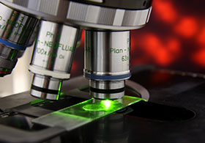
OVERVIEW
Objective
Background Information
Materials
Procedure
Assignment
Closing
Figure 1: Biomedical Forensic Science
Courtesy of Boston University
1

Slide 3
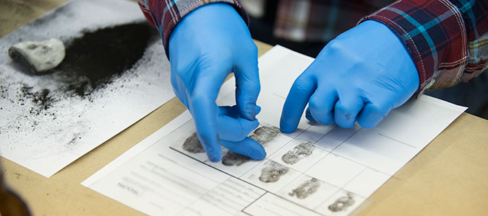
OBJECTIVE
Use basic forensic techniques
  DNA extraction
  Fingerprinting
  Drug testing
  Blood typing
Solve a murder mystery
Figure 2: Fingerprinting Courtesy of Marian University
2

Slide 4
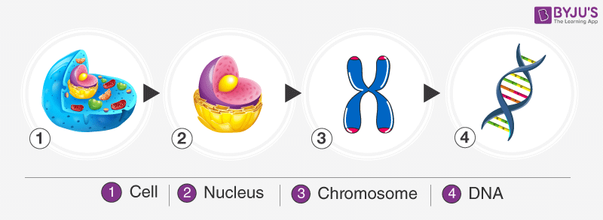
BACKGROUND INFORMATION
Deoxyribonucleic acid (DNA)
  Packaged in the form of chromatin (which make up chromosomes)
  Exist in the nuclei of cells
  Plant cells have a cell wall that must be penetrated to access the DNA
Figure 3: DNA Packaging Sequence Courtesy of Byju’s
3

Slide 5
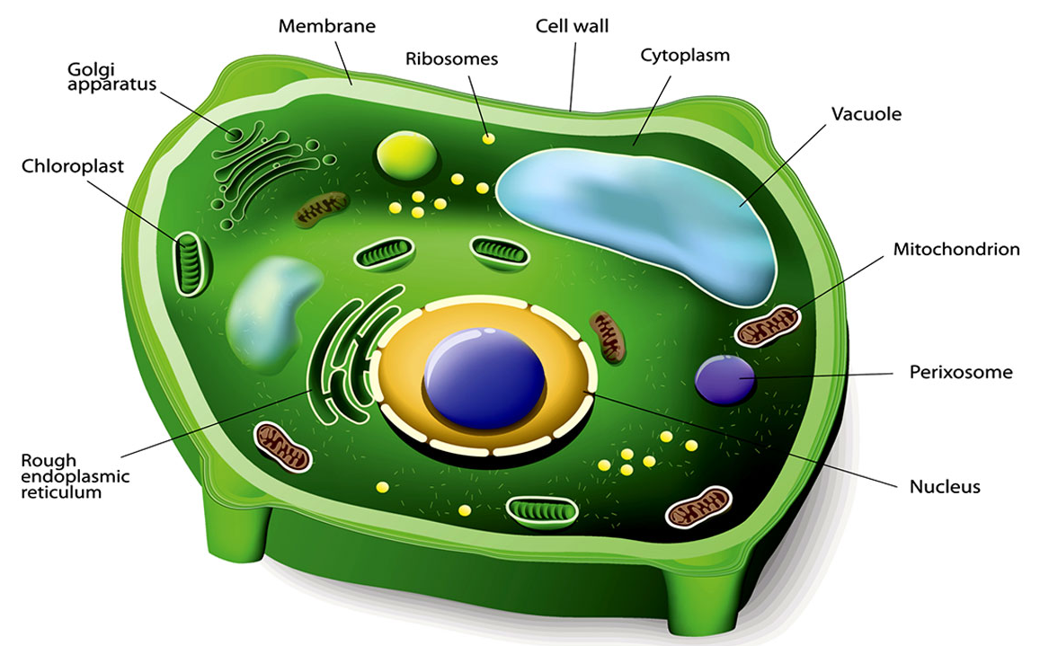
BACKGROUND INFORMATION
DNA extraction (of a plant cell)
  Break the cell wall (cell lysis) to expose the DNA within the cell
  Destroy the plasma membrane
  to further expose the DNA
  Precipitate the DNA to make
  the DNA visible
Figure 4: Plant Cell Structure Courtesy of Biology Wise
4

Slide 6
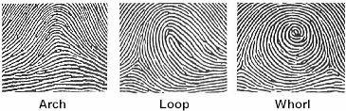
BACKGROUND INFORMATION
Fingerprints – unique patterns consisting of friction ridges and burrows
  Loops – 60% of pattern types
  Whorls – 35% of pattern types
  Arches – 5% of pattern types
Figure 5: Fingerprint Types Courtesy of
Headlines on Human Hands
5

Slide 7
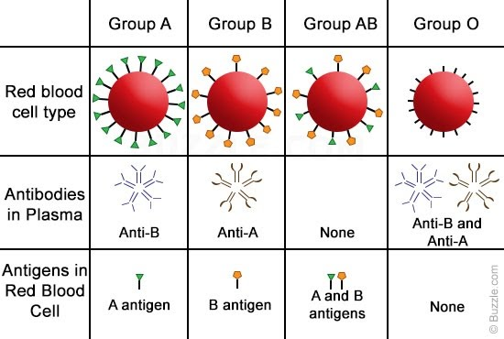
BACKGROUND INFORMATION
Blood typing (ABO system)
  Existence of antigens on red blood cells determine blood type
  A and B antigens determine type of blood (A, B, AB, or O)
  Rh antigen determines presence of Rhesus factor (indicated by +/-)
Figure 6: ABO Blood Type System Courtesy of Buzzle.com
6

Slide 8
MATERIALS
Strawberry
Non-iodized table salt (NaCl)
Hand soap (clear, unscented)
95% isopropyl alcohol (0°C)
Distilled water
Strainer
Plastic cups
Ziploc bag
Iron magnetic wand
Iron powder
Blood typing kit
Pipettes
Beaker
Test tubes
Microcentrifuge tubes
Plexiglass pieces
Baby wipes
String
Meter stick
7

Slide 9

PROCEDURE
Follow the video story to solve the
murder mystery
Learn techniques in Forensic Academy
  DNA extraction (In-Person)
  Fingerprinting (Hybrid)
  Drug testing (Remote)
8

Slide 10

PROCEDURE
Conduct the crime scene investigation
  Biological dimensional analysis (Hybrid)
  Drug testing (Remote)
  Blood typing (Hybrid)
  Fingerprinting (In-Person)
Compare data to the Suspect
Information Sheet
Determine who is the killer
9

Slide 11
ASSIGNMENT
Team Memo and Individual Self Reflection:
  Each group does a single memo
  Each student writes their own self-reflection
  Follow format in EG1003 Lab 11 Memo and Self Reflection
  Due at 11:59 PM the night lab session
Team presentation:
  Address discussion points in manual
  Rely heavily on graphics and pictures
10

Slide 12
CLOSING
Take pictures of the extracted DNA, fingerprint on murder weapon, and drug present in victim’s blood
Record data in the Suspect Information Sheet
Tell a TA who you think the killer is before leaving lab
Submit all work electronically
Clean up workstations
Return all unused materials to the TA
11

Slide 13
QUESTIONS?

