Slide 1

VIRTUAL PRODUCT DISSECTION
EG1003 | LAB 1B

Slide 2
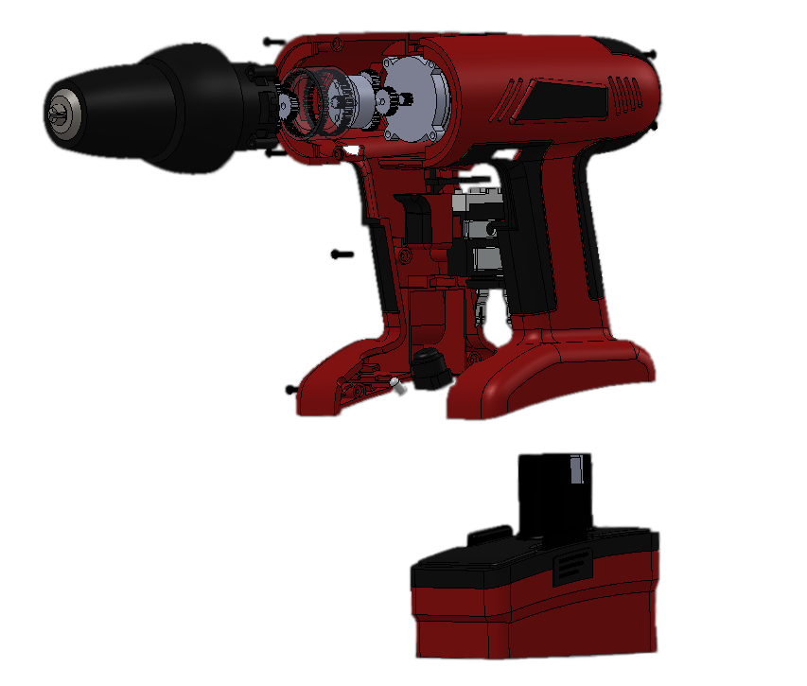
OVERVIEW
Objective
Background
Materials
Procedure
Assignment
Closing
Figure 1: Product Dissection of Cordless Drill
2

Slide 3
OBJECTIVE
To evaluate the functional design of an existing product to apply to the ideation of a new product
To develop and design an idea for a water toy to be used by children ages 4 – 6
Figure 2: Child at Water Park Courtesy of BabyCouture
3

Slide 4
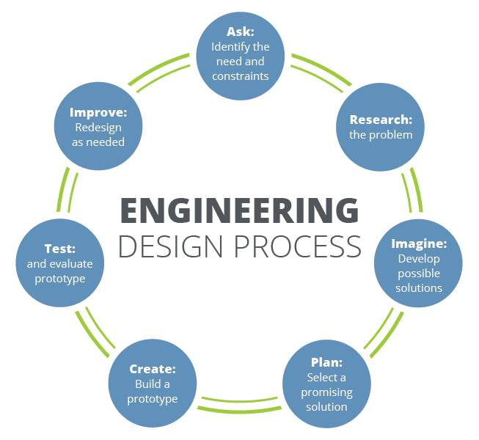
BACKGROUND
Engineering design process
  Systematic approach to designing a new product
  Idea generation occurs during the “Imagine” phase
Design fixation – having preconceived notions of an initial idea and the inability to think of alternatives
Reverse engineering – process of reproducing a product by examination of the product’s components and functions
Figure 3: Engineering Design Process
Courtesy of Teach Engineering
4

Slide 5
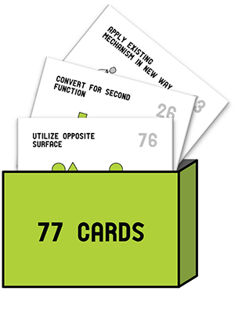

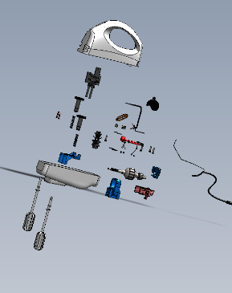
BACKGROUND
Design fixation can be overcome with these idea generation methods:
Substitute
Combine
Adapt
Modify
Put to another use
Eliminate
Reverse
Design Heuristics
Brainstorming
Product Dissection
Scamper
Figure 4: Idea Generation Methods
5

Slide 6













RULES FOR BRAINSTORMING
No (self) judgement
Encourage wild ideas
Stay focused on the topic
Be visual
Go for quantity
(9 or more)
Combine and improve ideas
Figure 5: Rules for Brainstorming
6

Slide 7
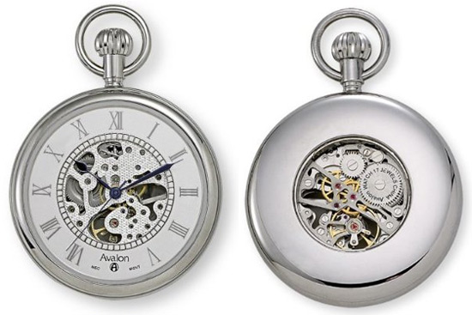
BACKGROUND
Product dissection – systematic disassembly of products
  Power supply/energy source – how is power supplied?
  Primary motion – how is mechanical motion achieved?
  Energy flow – how is power transferred to create motion?
  Form and outer body – how do users interact with outer components?
  Ex: Pocket watch
    Power supply – battery and compressed spring
    Primary motion – gear train drives clock hands
    Energy flow – spring gets wound and mechanical energy powers watch
    Form – winding crown, cover, case body
Figure 6: Pocket Watch Courtesy of Retro Thing
7

Slide 8
MATERIALS
SolidWorks eDrawings
Product dissection files
Virtual product dissection handout
Any materials needed for hypothetical design of a water toy
8

Slide 9

PROCEDURE
Part 1: Creativity (10 minutes)
  Get in groups and take out paper and a pencil
  Write down as many alternative ways as possible to use a paperclip (2 minutes)
  Count the number of ideas generated as a group
  Identify the greatest number of ideas generated – winner gets a prize!
Figure 7: Paperclip
9

Slide 10
PROCEDURE
Part 2: First Idea Generation Session (10 minutes)
  Work individually
  List down all ideas for a water toy for use by children ages 4 – 6
  Focus on a fun toy rather than a safe toy
Figure 8: Child at Water Park Courtesy of BabyCouture
10

Slide 11
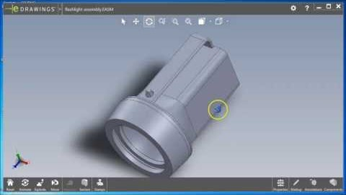
PROCEDURE
Figure 9: SolidWorks eDrawings Tutorial Courtesy of Elizabeth Starkey
11

Slide 12
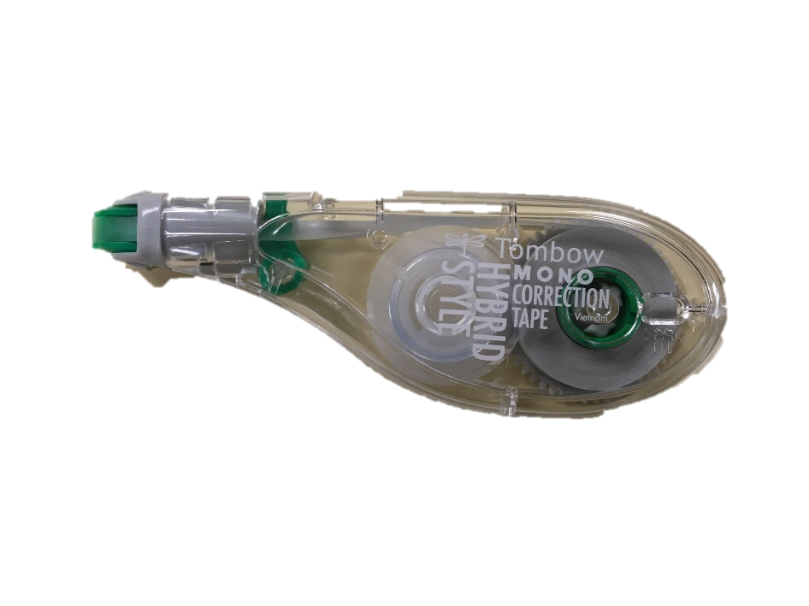
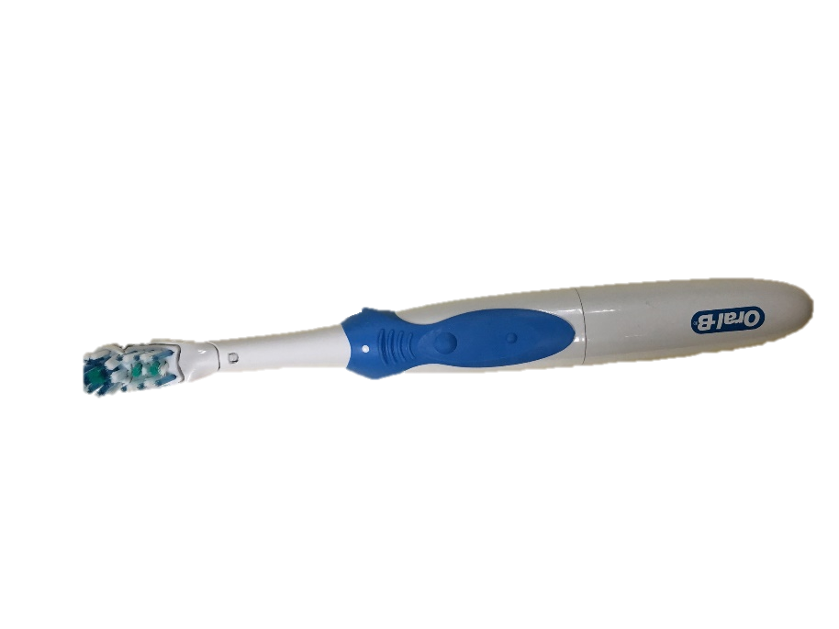
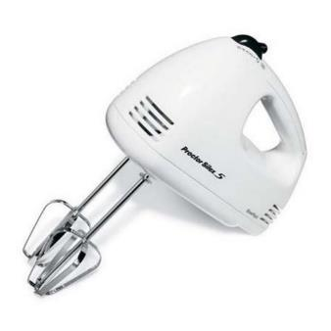
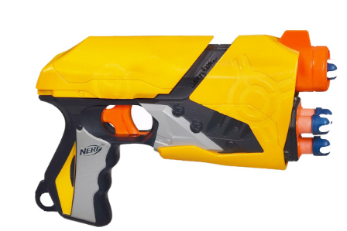
PROCEDURE
Part 3: Product Dissection Activity (20 minutes)
  Go to Lab 1B – Virtual Product Dissection
  Download products to dissect – different for each team member
  Fill out the virtual product dissection handout individually
Figure 10: Products Available for Dissection
12

Slide 13
PROCEDURE
Part 4: Second Idea Generation Session (10 minutes)
  Work individually
  List down all ideas for a water toy for use by children ages 4 – 6
  Focus on a fun and safe toy
Figure 11: Child at Water Park Courtesy of BabyCouture
13

Slide 14
REFLECTION
Share your ideas with your teammates and think about the following questions:
  In what way did the product dissection activity help you develop ideas?
  Did the product you dissected impact the ideas you developed?
  Do you think it is useful to dissect different products when working in a group?
14

Slide 15
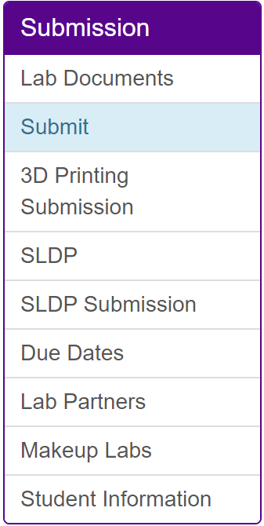
ASSIGNMENT
Individual lab report:
  Only for Lab 1B
  Follow the lab report format given for this lab in the manual
  Answer discussion questions
  Include pictures
  Due at 11:59 PM the night before Lab 2
  Submit on the EG1003 website (eg.poly.edu)
Team presentation:
  No presentation for Lab 1B
15

Slide 16
CLOSING
Each team member should dissect their own product
Submit all work electronically
Take screenshots
Take pictures of the product dissection handout
Follow detailed lab report format for Lab 1B in student manual
16

Slide 17
QUESTIONS?

