Slide 1
LAZ & MRR WORKSHOP
EG1003 | LAB 4A

Slide 2
OVERVIEW
Objective
Background Information
Materials
Procedure
Assignment
Closing
Figure 1: VEX Robotics Logo Courtesy of VEX Robotics
1

Slide 3
OBJECTIVE
Program a small VEX robot to navigate a mini-course
Become familiar with the Arduino VEX library
Understand when and how to use a gyro sensor
2

Slide 4
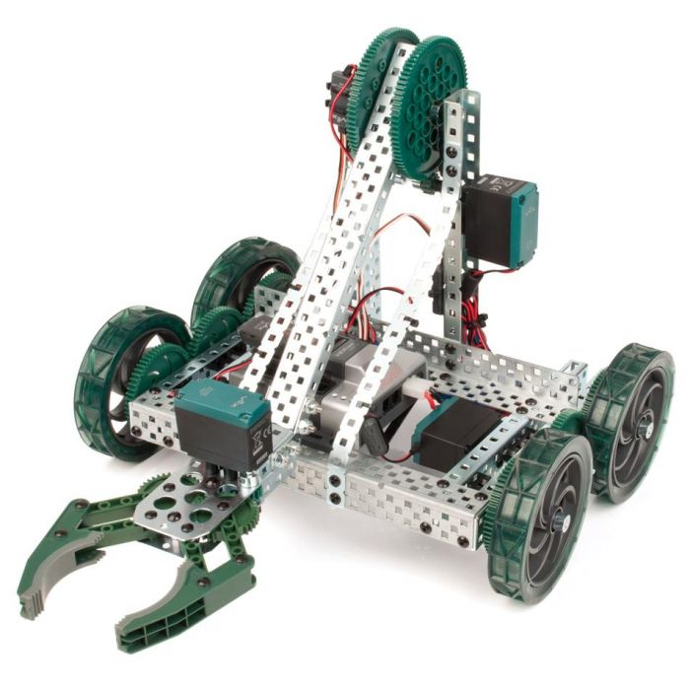
BACKGROUND INFORMATION
VEX Robotics
Used for LAZ and MRR projects
Educational robotic system
Microcontroller, motor shield, motors, battery, gyro sensor
Figure 2: VEX Clawbot Courtesy of Robot Mesh
3

Slide 5
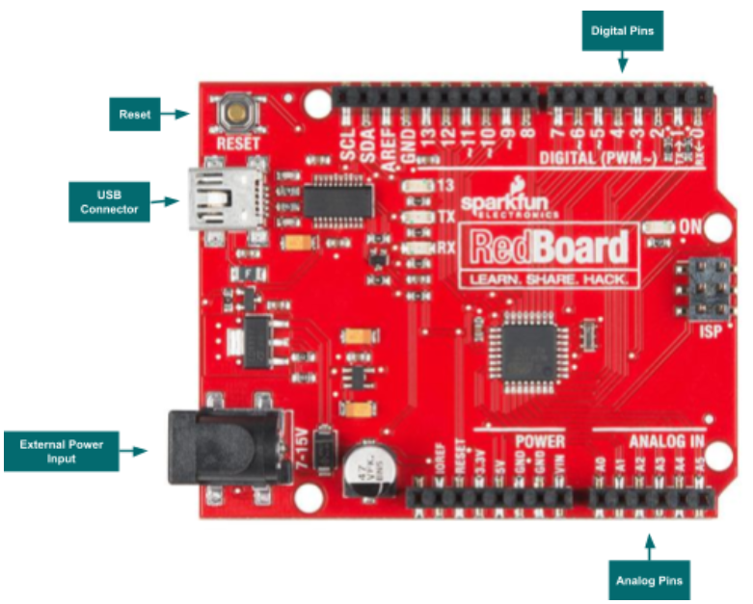
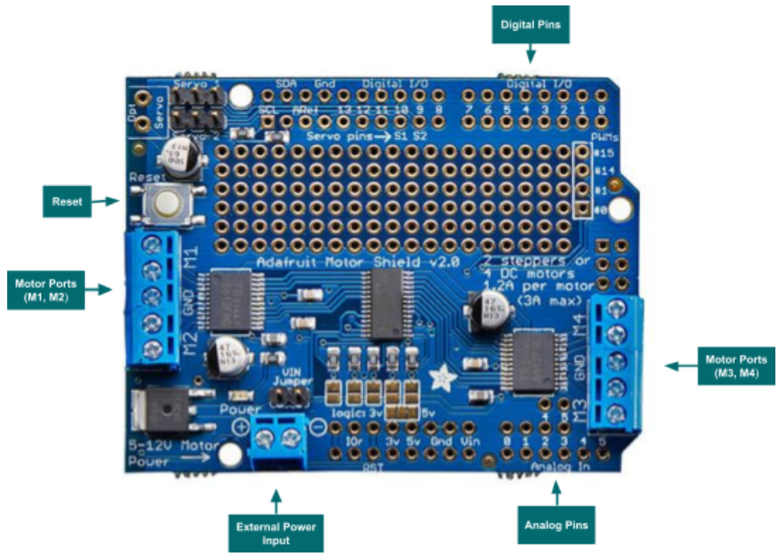
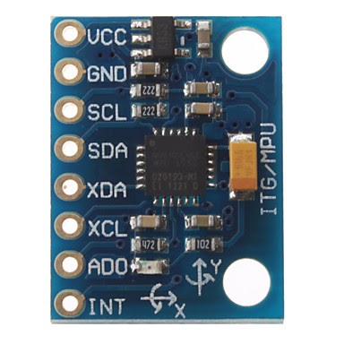
BACKGROUND INFORMATION
Figure 3: Arduino Microcontroller Layout
Figure 4: Arduino Motor Shield Layout
Figure 5: Gyro Sensor
4

Slide 6
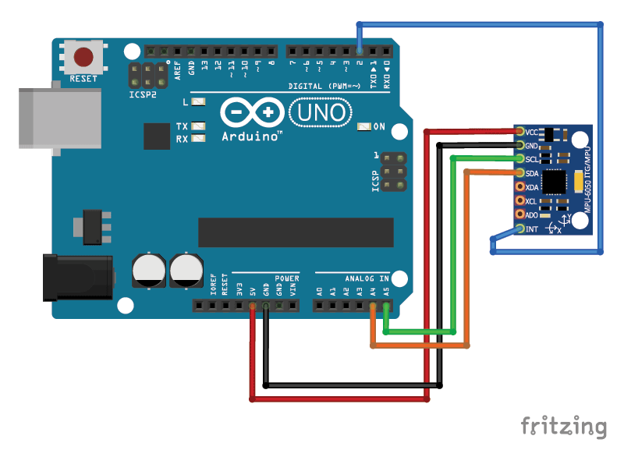
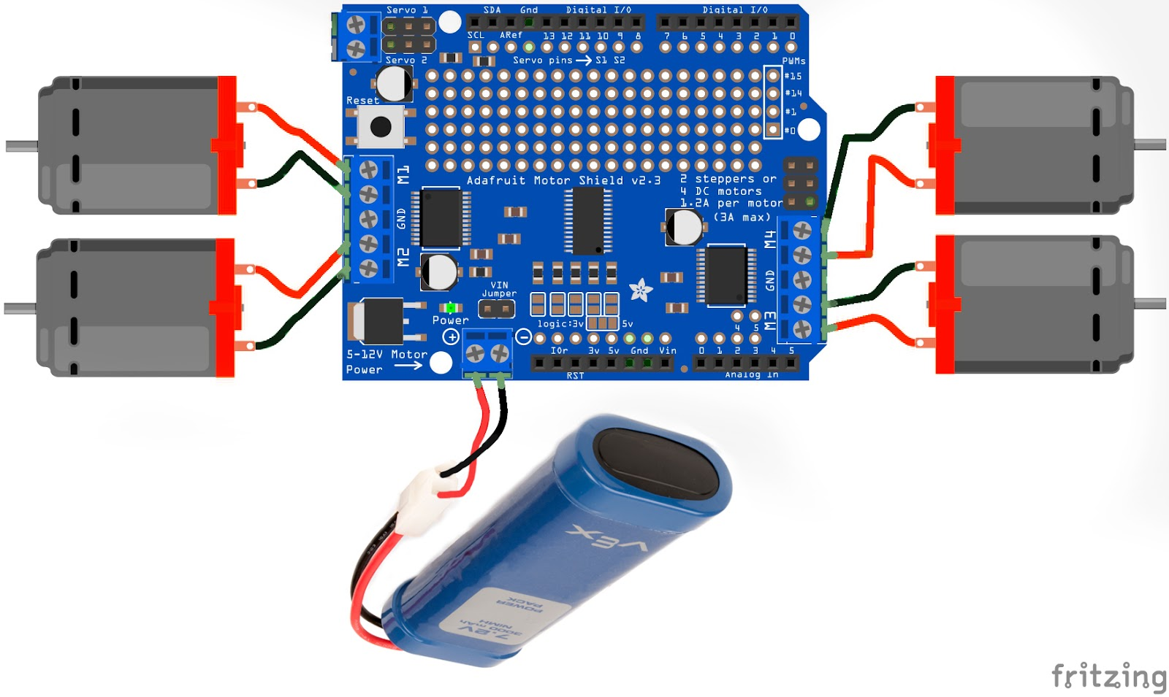
BACKGROUND INFORMATION
Figure 6: Motors and Battery Wiring
Figure 7: Gyro Wiring
5

Slide 7
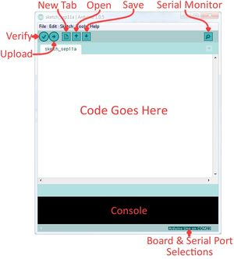
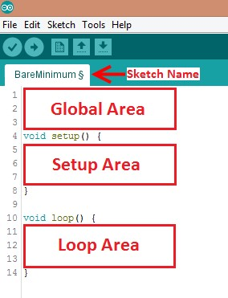
BACKGROUND INFORMATION
Arduino IDE – program to edit, compile, and upload code to the Arduino board
Code written in the Arduino programming language (based on C/C++)
VEX Library
Figure 8: Arduino IDE
6

Slide 8
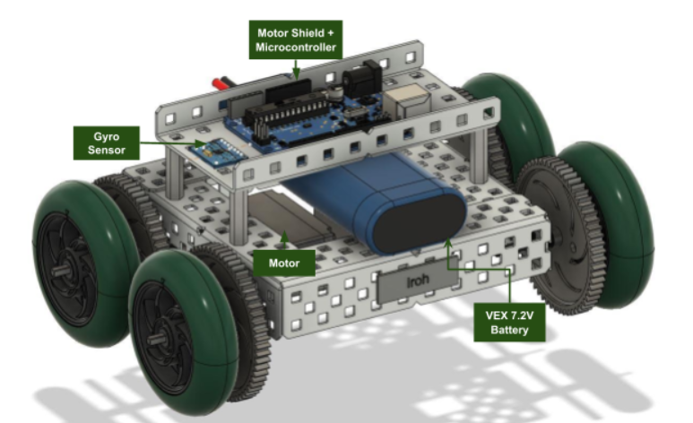
MATERIALS
A lab PC
Pre-built mini VEX robot
Mini VEX Course
Gyro Sensor
Arduino
Figure 9: Mini VEX robot
7

Slide 9
PROCEDURE
Part I: Importing the Library
Download and import the VEX library into Arduino
Part II: Setting up the VEX object
Coding the robot to move forward
Traverse tiles 1 - 4
Part III: Setting up the Gyro Sensor
Use gyro sensor to turn the robot
Traverse tiles 4 - 5
Extra: Complete the Entire Course
Traverse tiles 5 - 8
Figure 10: Mini VEX Robot
8

Slide 10
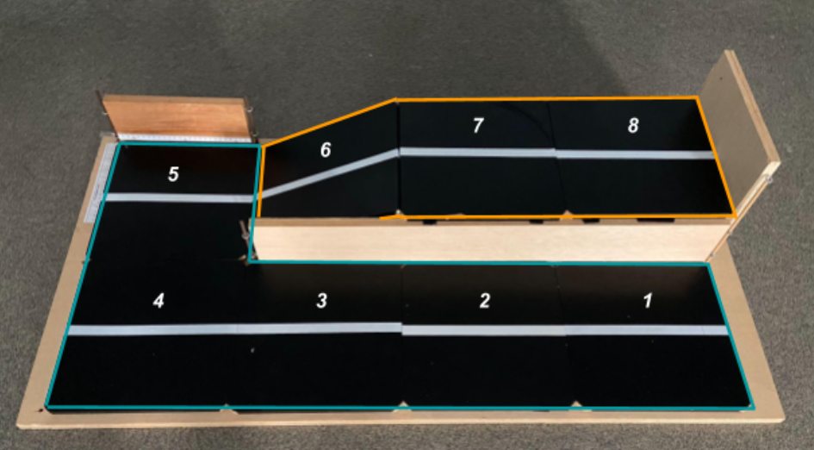
PROCEDURE
Figure 11: Mini VEX Course
9

Slide 11
ASSIGNMENT
No lab report
No team presentation
10

Slide 12
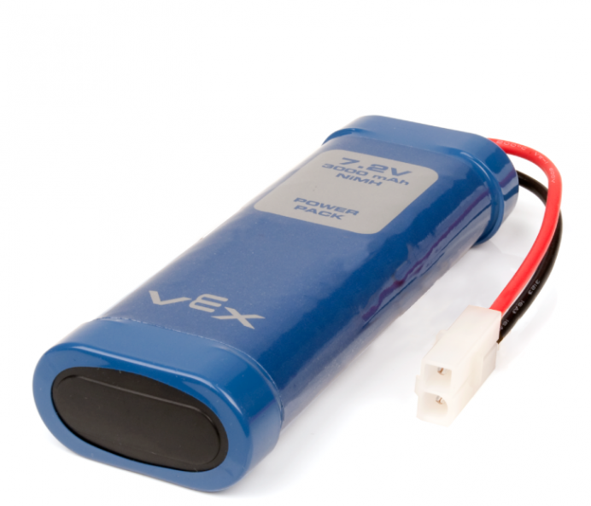
CLOSING
Ask TAs for help if needed
Only finish the entire course if time allows
Be careful not to go full power
Do not let any two exposed wires touch
Do not unplug the gyros or remove the motor shield
Disconnect the VEX battery when not in use
Figure 12: VEX Battery Courtesy of VEX Robotics
11

