Slide 1

RECITATION 3
EG1004

Slide 2
AGENDA
Technical Presentation
CATME
Creating a LinkedIn Profile
Lab 2 Presentations
2

Slide 3
TECHNICAL PRESENTATIONS
Notes:
During recitation you have the opportunity to watch your peers present. It is important that you are able to take feedback from the TA and the professor for all presentations--Not just your own. During our first recitation we went over how to give a lab presentation. This is time to practice.

Slide 4
COMMON PRESENTATION ERRORS
Know your audience
Incorporate the audience’s background when framing ideas
Pretend there are not multiple groups for EG 1004
Formatting
Use bullet points
Do NOT use sentences
Utilize figures & diagrams instead of text on the slide
Slides & presentation look should be cohesive
4

Slide 5
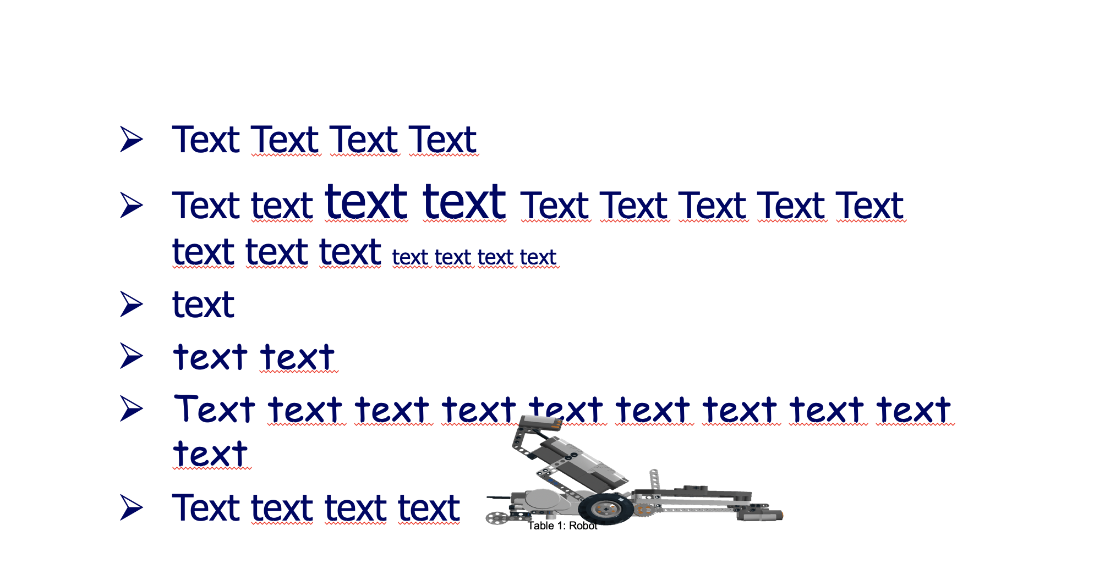
POWERPOINT LAYOUT
Figure 1: Bad slide example
5
Notes:
**Ask students to raise their hand and comment on what is wrong with this slide OR if possible, put students in groups and give them one minute to come up with answers to this question- have each group share one or two improvements to be made. Ask students what is positive with the slide ** Some negative answers: inconsistent font, stretched image, tiny caption, image is labeled as a table, inconsistent capitalization, inconsistent text size, images overlapping text, missing title, too many lines of text.. etc

Slide 6
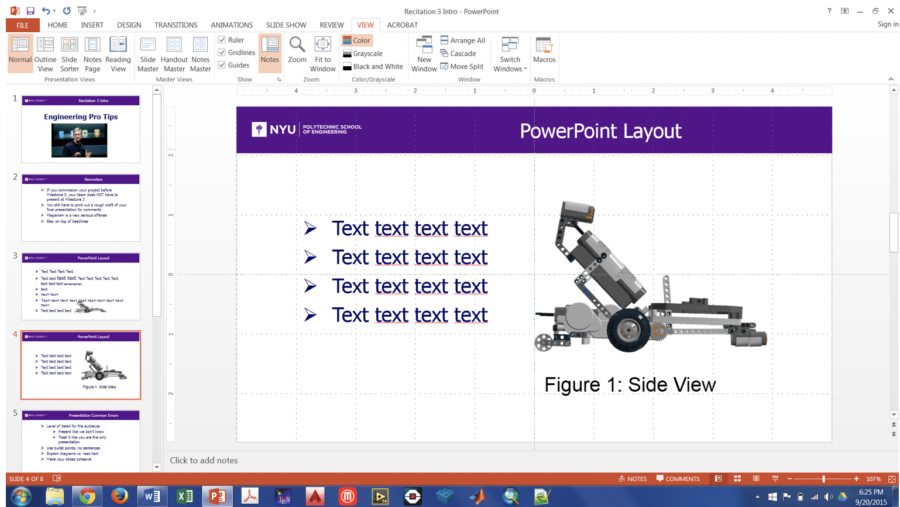
POWERPOINT LAYOUT
4
Figure 2: Layout tools screenshot
6
Notes:
To help with positioning and layout, utilize the gridline, guide and ruler tools nested under the ‘View’ table on the tool bar.

Slide 7
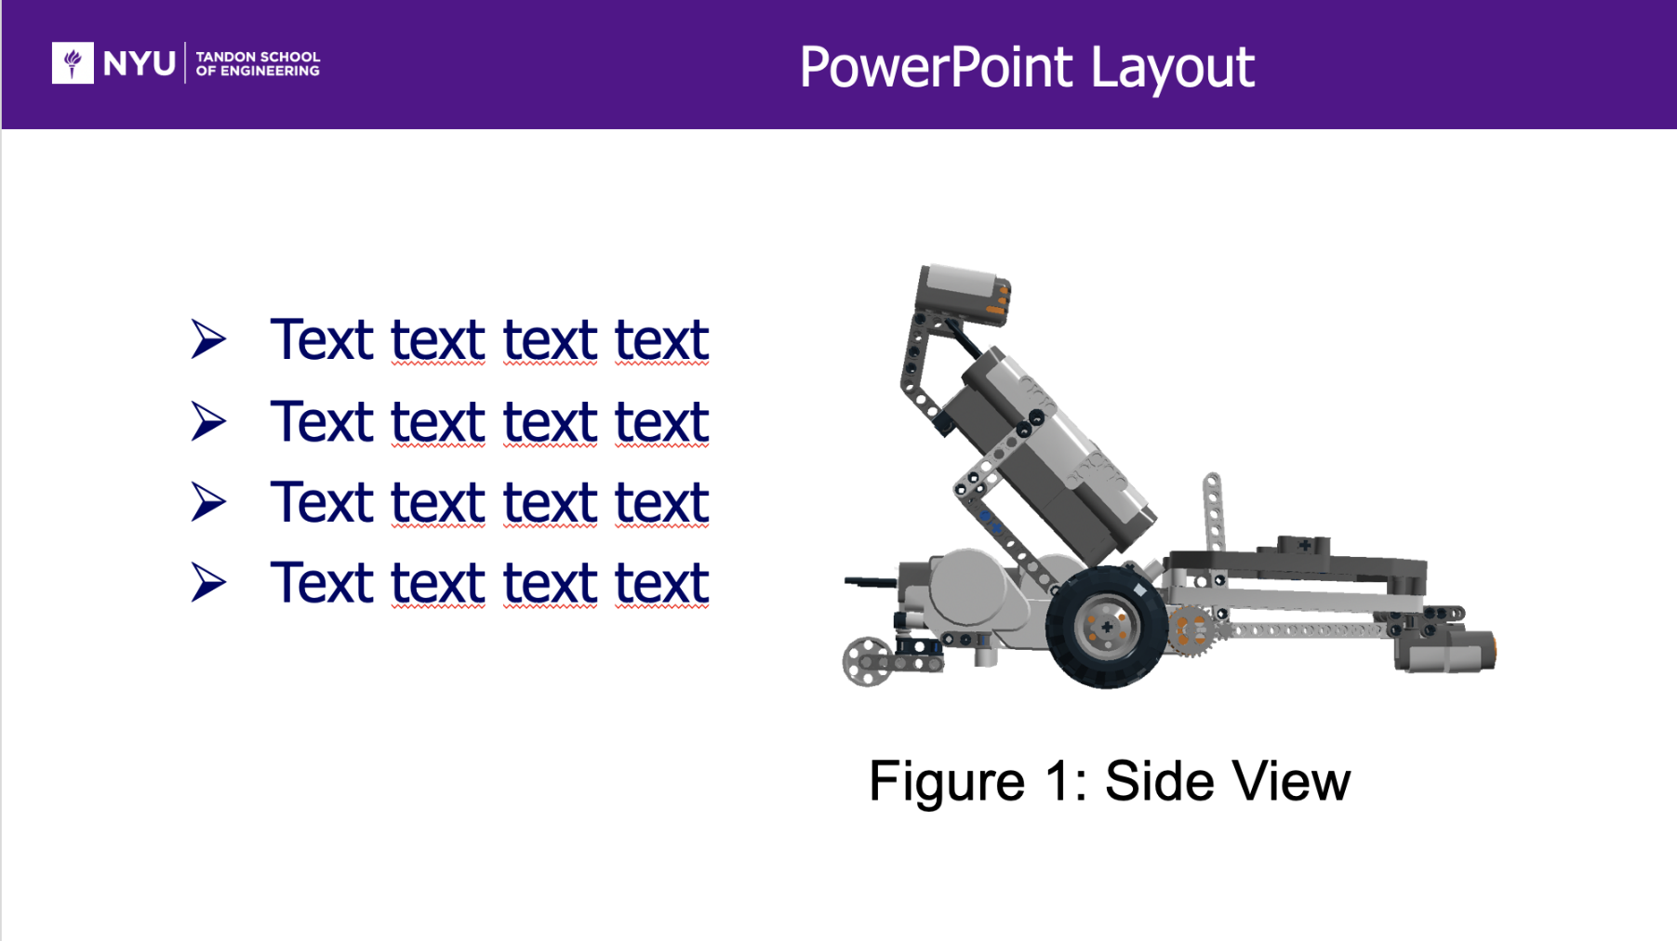
POWERPOINT LAYOUT
4
Figure 3: Improved slide
7
Notes:
Here’s a visual of the cleaned-up slide.

Slide 8
INSERTING TABLES
Table 1: Proper table format example
Keep source formatting
  Allows for digital screen readers
  Microsoft Project: ‘Copy as Picture’
Remove unnecessary gridlines
  Excel: Page Layout > Uncheck ‘View Gridlines’
8
Notes:
It is a good idea to use Excel to create tables to display your data since Excel has more advanced functionality than creating a table in PowerPoint. To ensure any stylistic changes are carried over between Excel and PowerPoint, when you copy and paste use the ‘Copy as Picture’ option from the drop down menu next to the ’copy’ icon. If you don’t do this the cell sizes, fonts, coloring and gridlines may change between applications. On the example above you may notice that there are cell gridlines that are not shown in order to deliver the data more clearly. To do this, uncheck the ‘View Gridlines option on the ‘Page Layout’ tab. After you’ve done this, you can create gridlines where you want them.

Slide 9
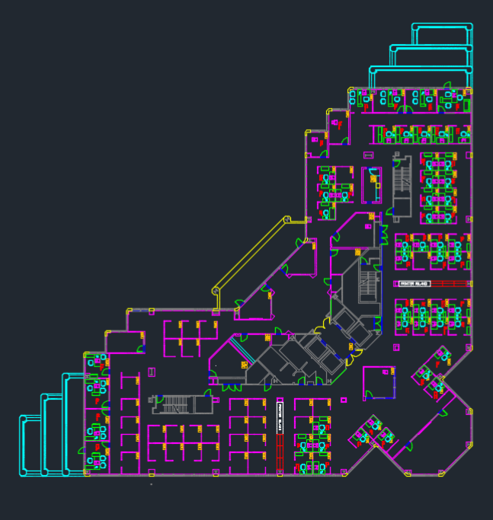
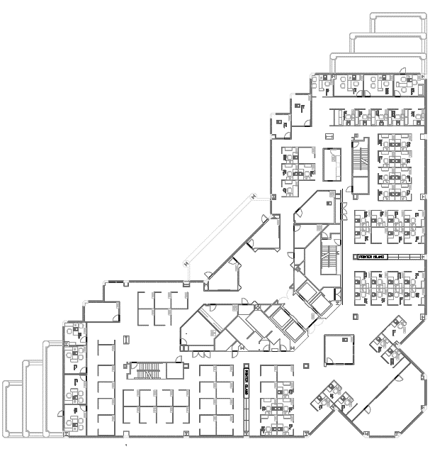
INSERTING CAD DRAWINGS
CAD Colorized Images
Used for working on computer
Define layers (plumbing, electrical, walls, etc.) in 2D
Reports & slides use black & white
Plot> Properties> Paper/Quality> Color>Black & White
Figures 4 & 5: Plain and colorized CAD drawings
9
Notes:
Besides being more exciting to look at, a color-coded image of a CAD layout can help the presenter easily display different features and layers of the sketch in one image instead of multiple. To do this, press the printer icon at the top of the window and select the ‘Properties’ button. A visual how-to is shown on the next slide.

Slide 10
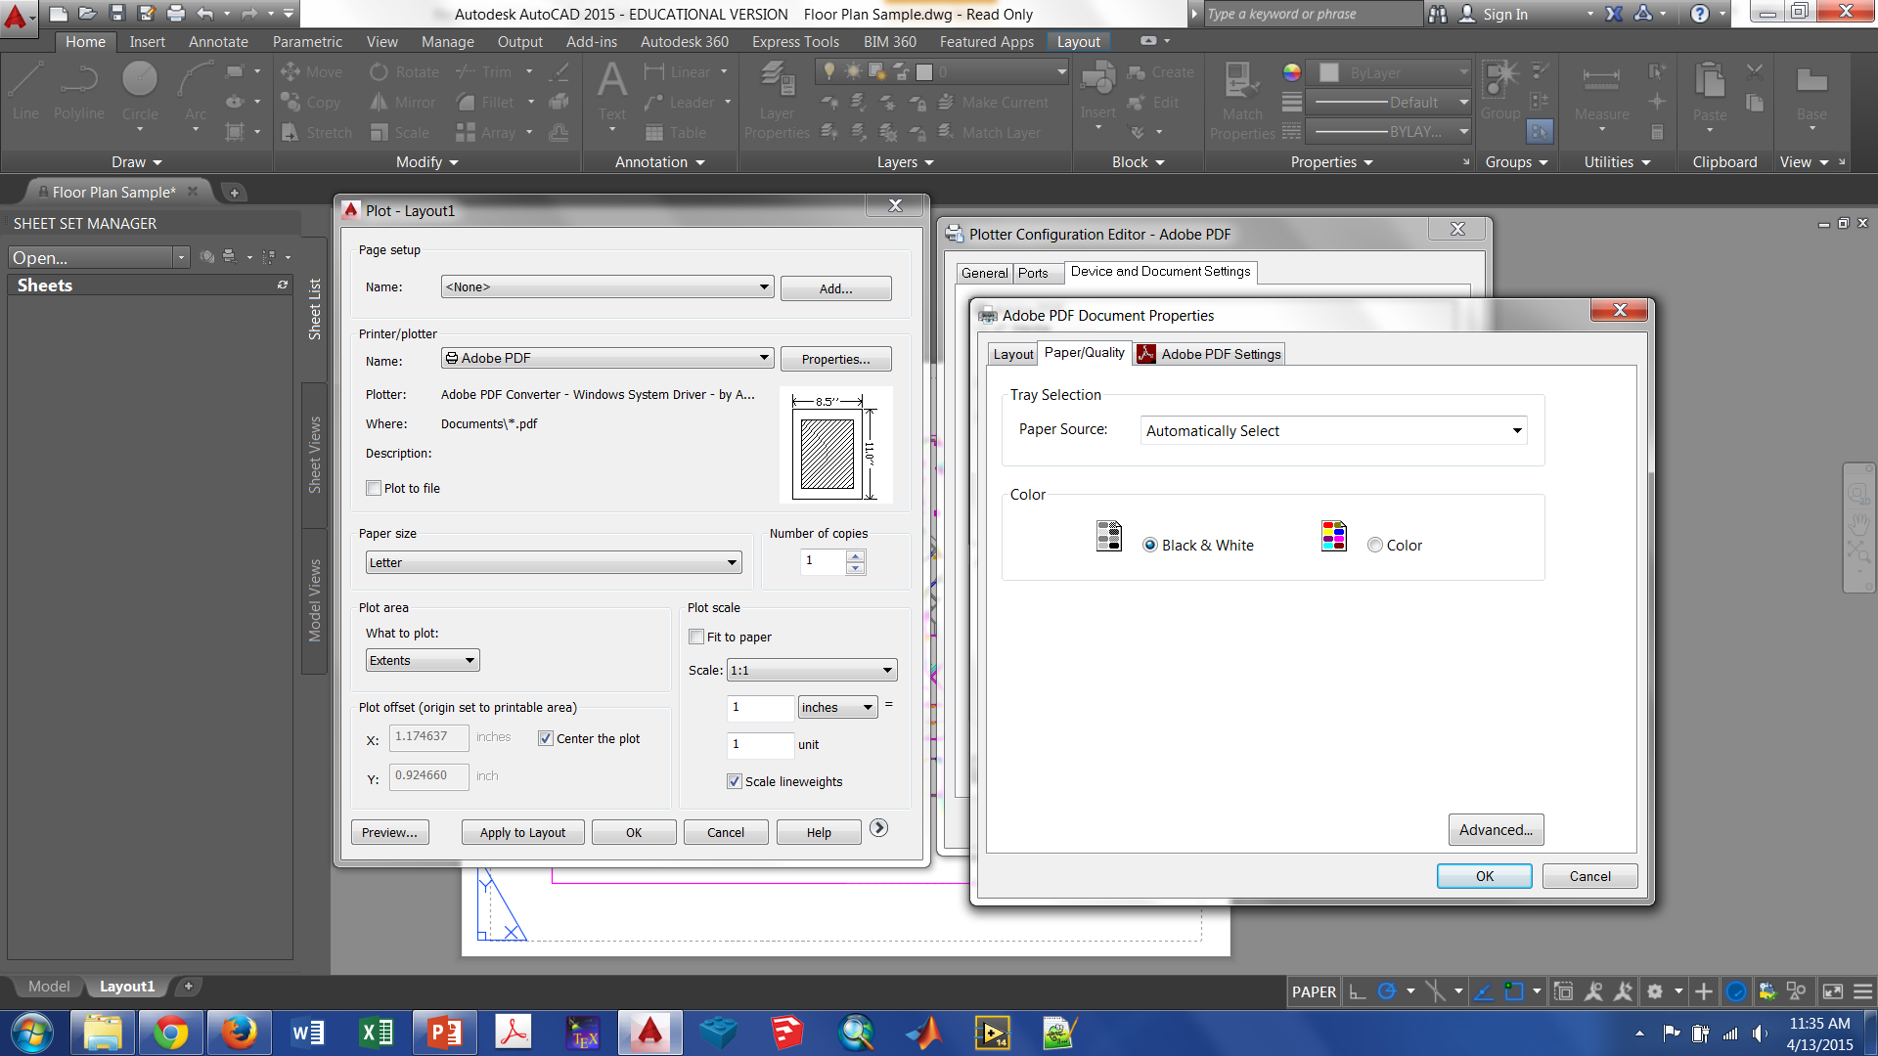
INSERTING CAD DRAWINGS
Figure 6: Colorized AutoCAD Plotting
10
Notes:
This image shows a visual representation of the process described on the last slide.

Slide 11
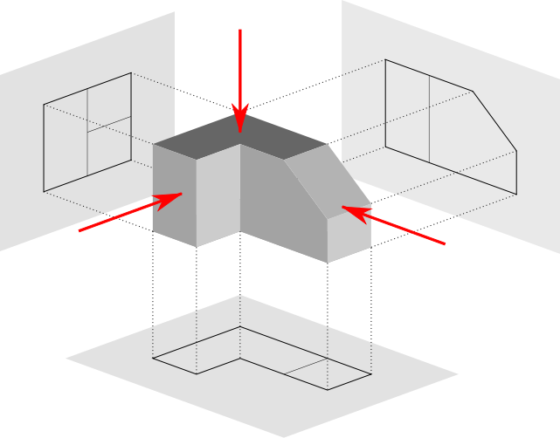
IMAGE VIEWS
Figure 7: Image Viewpoints
11
Notes:
When creating presentations we have the challenge of accurately showing 3D objects, such as ones created in CAD software, on a 2D screen. To do this, we use four different image views. **Ask students if they can name them (Answers on next slide)**

Slide 12
IMAGE VIEWS
Top
Detailed Side
Front
Isometric
Figure 8: Labeled image viewpoints
12
Notes:
The four image views/elevations that should be shown are a top view (aka birds-eye view), front elevation, the most detailed side and anisometric view. We are currently looking at the isometric view of this image which shows the other 3 elevations of interest.

Slide 13
PRESENTATION TIPS SUMMARY
Style
With text, less is more
Think content first
Cohesive & consistent
Meaningful images
You are the storyteller
Motivation
Important concepts
Organize transitions
Clarity
13
Notes:
We’ve talked a lot about presentations by now. Here is a summary to wrap up the big ideas. Use style tips to engage your audience. Think about how you’ll transition from topic to topic in advance. Use a storytelling technique to provide the best presentation. Be sure to include the motivation behind the experiment/project and important foundational concepts.

Slide 14

CATME
Comprehensive Assessment of
Team Member Effectiveness

Slide 15
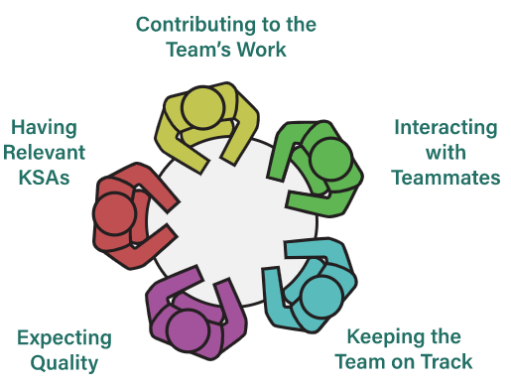
Why Do I Participate CATME?
Peer assessment on team dynamics
Monitor your performance on five dimensions
Understand how to be a better team member
Identify any potential interpersonal conflicts
Intervention from professor at early stage
Possible individual penalty based on evaluation
Figure 9: CATME Five Team Dimensions
15
Notes:
KSAs = knowledge skills and abilities

Slide 16
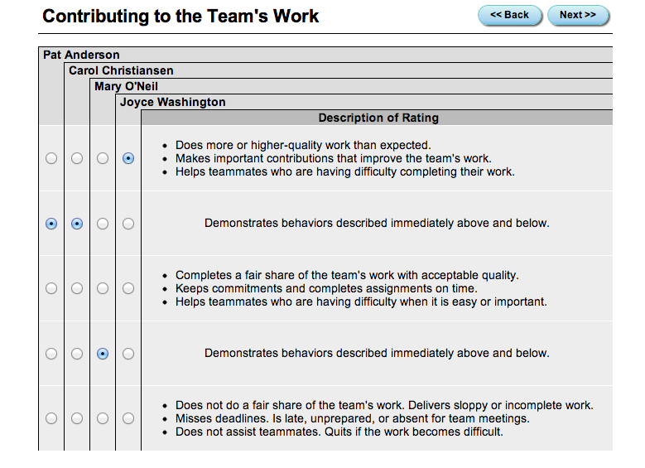
What Do I Need To Do?
Account will be automatically generated
You’ll receive an email once teams are formed
Rater Practice due Recitation 5 (Milestone 1)
Peer Evaluation I due Recitation 7 (Milestone 2)
Peer Evaluation II due Recitation 10 (Milestone 3)
Peer Evaluation III
due after Final Pres & Submission
Figure 10: CATME Interface
16

Slide 17
Contributing to the Team’s Work
Helps team achieve its goals or objectives by completing tasks assigned to the team
Does more or high-quality work than expected.
Makes important contributions that improve the team’s work.
Helps teammates who are having difficulty completing their work.
Completes a fair share of the team’s work with acceptable quality.
Keeps commitments and completes assignments on time.
Helps teammates who are having difficulty when it is easy or important.
Does not do a fair share of the team’s work. Delivers sloppy or incomplete work.
Misses deadlines. Is late, unprepared, or absent for team meetings.
Does not assist teammates. Quits if the work becomes difficult.
5
3
1
17

Slide 18
Interacting with Teammates
Provides positive interactions within the team that contribute to a supportive environment
Makes sure teammates stay informed and understand each other.
Provides encouragement or enthusiasm to the team.
Asks teammates for feedback and uses their suggestions to improve.
Listens to teammates and respects their contributions.
Communicates clearly.
Shares information with teammates.
Participates fully in team activities.
Interrupts, ignores, bosses, or makes fun of teammates.
Complains, makes excuses, or does not interact with teammates.
Is defensive. Will not accept help or advice from teammates.
5
3
1
18

Slide 19
Keeping the Team on Track
Monitors team’s progress and ensures that the team is meeting necessary deadlines
Watches conditions affecting the team and monitors the team’s progress.
Makes sure that teammates are making appropriate progress.
Notices changes that influence the team’s success.
Knows what everyone on the team should be doing and notices problems.
Is unaware of whether the team is meeting its goals.
Does not pay attention to teammates’ progress.
Avoids discussing team problems, even when they are obvious.
5
3
1
19

Slide 20
Expecting Quality
Reviews team’s work and products to ensure they are meeting standards
Motivates the team to do excellent work.
Cares that the team does outstanding work, even if there is no additional reward.
Wants the team to perform well enough to earn all available rewards.
Believes that the team can fully meet its responsibilities.
Satisfied even if the team does not meet assigned standards.
Wants the team to avoid work, even if it hurts the team.
Doubts that the team can meet its requirements.
5
3
1
20

Slide 21
Having Relevant KSAs
(Knowledge, Skills, and Abilities)
Possessing necessary competencies (knowledge, skills, and abilities) to help the team achieve its goals
Demonstrates the knowledge, skills, and abilities to do excellent work.
Acquires new knowledge or skills to improve the team’s performance.
Able to perform the role of any team member if necessary.
Acquires knowledge or skills as needed to meet requirements.
Able to perform some of the tasks normally done by other team members.
Missing basic qualifications needed to be a member of the team.
Unable or unwilling to develop knowledge or skills to contribute to the team.
Unable to perform any of the duties of other team members.
5
3
1
21

Slide 22
How To Write
Peer-to-Peer Comments*
Peer-to-Peer comments can be viewed by professor & team members
Practice reflecting on and incorporating feedback
Be respectful
Be real
There is no delete
Be trustworthy
Comment only on teammates’ behaviors
Your comments should be yours alone
* Courtesy of Purdue CATME team
22

Slide 23
Writing Effective
Peer-to-Peer Comments*
Balanced: Include both strengths and weaknesses
Respectful: Avoid negative language, set a positive tone
Implementable: Suggest ways which peers could immediately improve
Constructive: Not just identifying problems, offer solutions
Specific: Give detailed examples
* Courtesy of Purdue CATME team
23

Slide 24
Sample Peer-to-Peer Comments
Bad examples (Too generic): | Good examples:
A does not really understand what is going on. | A could be more involved in the team activities. For example, A always misses the weekly team meeting. Also, A never gives any input/feedback to team discussions. I wish A would be more engaging and share with us their thoughts.
B is very helpful and contributes a lot to the team. | B is a valuable member of the team. B helps with organizing weekly team meetings and volunteers to take meeting notes. I think of B as the team leader. B keeps everyone on track. B has a very sound understanding of Arduino coding.
24

Slide 25
QUESTIONS?

