Slide 1
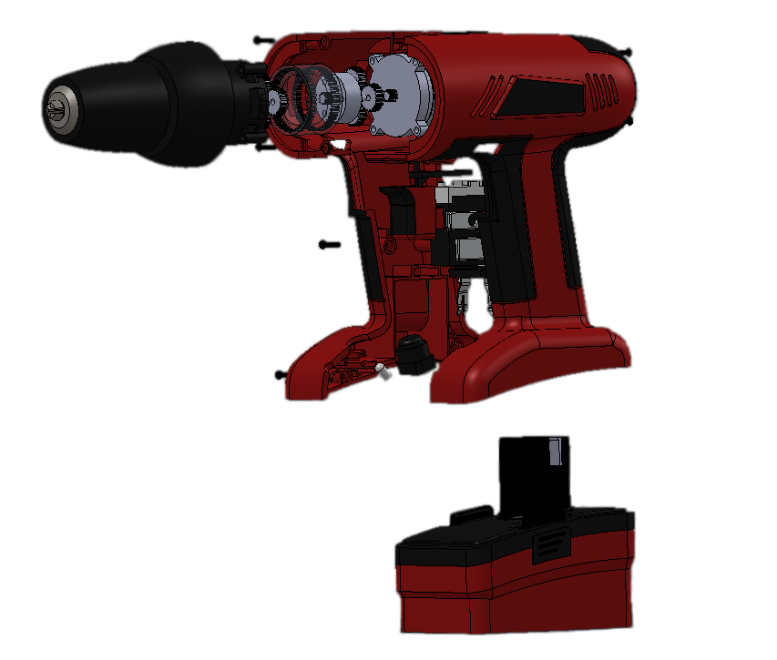
Virtual Product Dissection

Slide 2
Overview
Objectives
Background
Materials
Procedure
Report & Presentation
Closing

Slide 3
Objectives
To evaluate the functional design of an existing product to apply to the ideation of a new product
To develop and design an idea for a water toy to be used by children ages 4 - 6

Slide 4
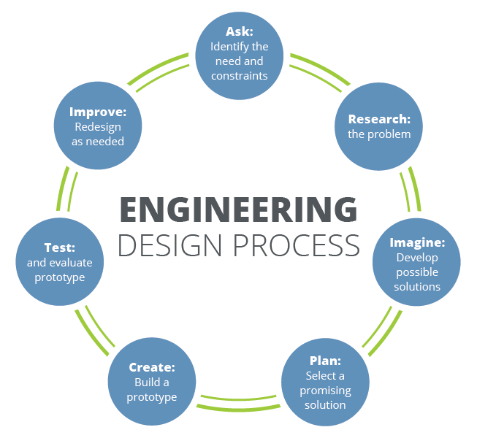
Background
Idea generation occurs during the conceptualization phase of the engineering design process

Slide 5
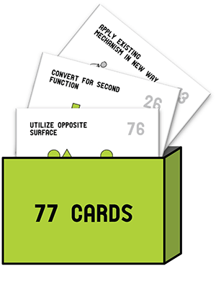
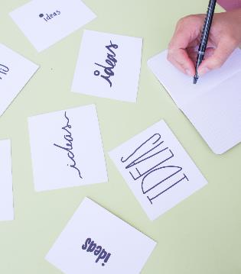
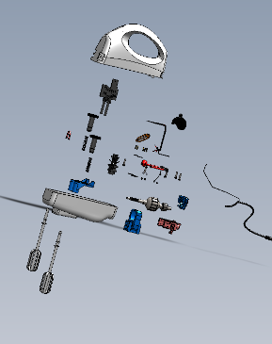
Background
Idea generation methods are aimed at fostering creativity
Substitute
Combine
Adapt
Modify
Put to another use
Eliminate
Reverse
Design Heuristics
Brainstorming
Product Dissection
Scamper

Slide 6
Background
Rules of Brainstorming:
No (self) judgement
Encourage wild ideas
Stay focused on the topic
Be visual
Go for quantity (9 or more)
Combine and improve ideas

Slide 7
Materials
SolidWorks eDrawings
Product dissection files
Virtual product dissection handout
Any materials needed for hypothetical design of a water toy

Slide 8
Procedure – Part 1
Creativity (10 minutes): Let us exercise our “creative muscles” to get into the creative spirit
Alternative Uses Test:
Think of as many uses as possible for a paper clip. Winner gets a prize!

Slide 9
Procedure – Part 2
First Idea Generation Session (10 minutes): You have 10 minutes to produce ideas for a new water toy
Your design task is to design an innovative water toy for use by kids ages 4-6. The toy must be safe to use and fun.

Slide 10
Procedure – Product Dissection Overview

Slide 11
Procedure – Part 3
Product Dissection Activity (20 minutes): Determine which products each team member will dissect
www.manual.eg.poly.edu/Virtual_Product_Dissection
Select “View Models”
Pick products – different for each team member
Download eDrawings file

Slide 12
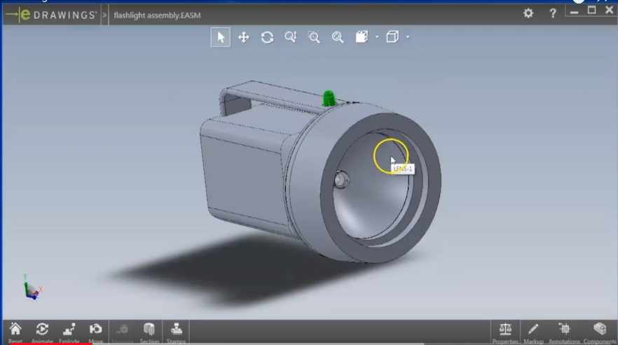
Procedure – Part 3
You have 20 minutes to complete your dissection
View manipulation
Object Dissection
Component list
2 min tutorial
https://www.youtube.com/watch?v=mANf4dnBCno&feature=youtu.be

Slide 13
Procedure – Part 4
Second Idea Generation Session (10 minutes): You have 10 minutes to produce ideas for a new water toy
Your design task is to design an innovative water toy for use by kids ages 4-6. The toy must be safe to use and fun.
Remember to look back at the application opportunities that you identified during the product dissection activity and apply them in your new ideas.

Slide 14
Procedure – Reflection
Share your ideas with your teammates and think about the following questions (5 minutes):
In what way did the product dissection activity help you develop ideas?
Did the product you dissected impact the ideas you developed?
Do you think it is useful to dissect different products when working in a group?

Slide 15
Report
Individual lab report
Title page
Discussion topics in the manual
Include pictures
Due at 11:59pm the night before your next lab

Slide 16
Presentation
There is NO team presentation for Lab 1

Slide 17
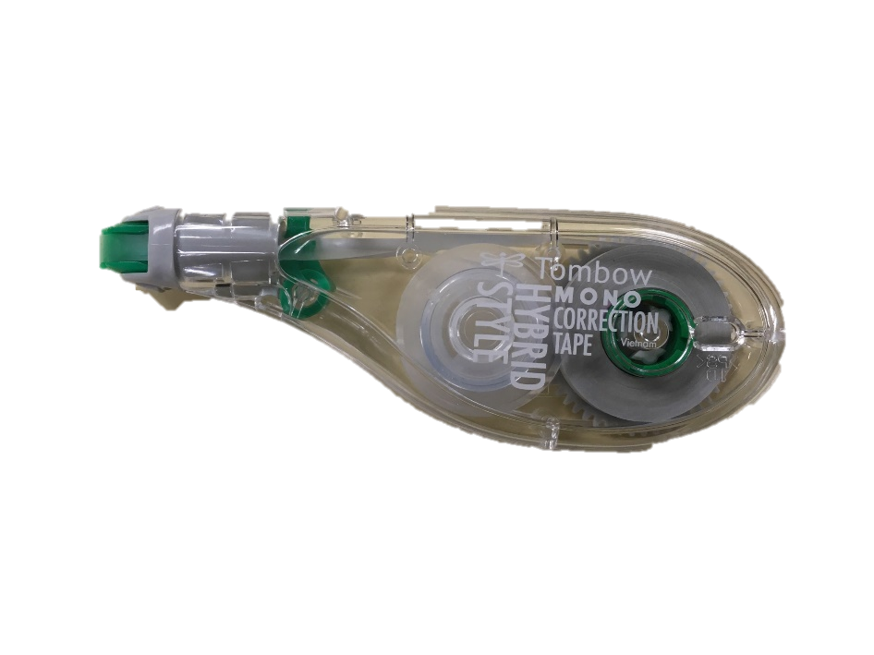
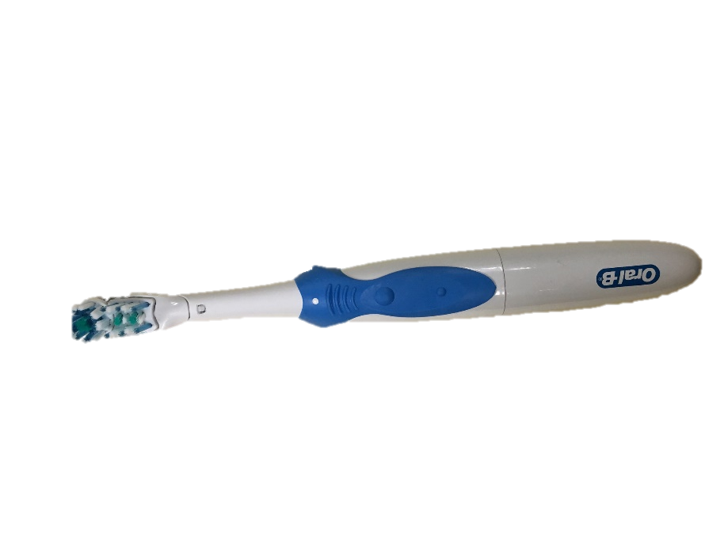
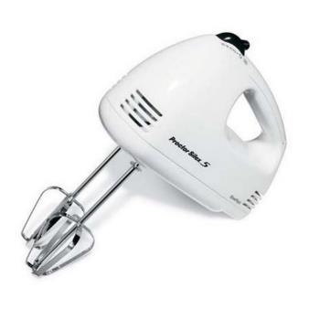
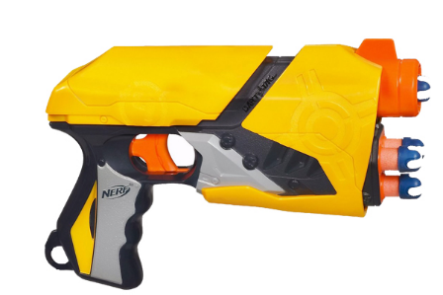
Closing
Think about this:
In what ways did the product dissection activity help you develop ideas?
Designers should limit interactions with physical examples in the early stages of design to mitigate fixation.
Did the product you dissected impact the ideas you developed?

Slide 18
Virtual Product Dissection
QUESTIONS?

