Slide 1
EG1003: Introduction to Engineering and Design
Software for Engineers

Slide 2
Overview
Objectives
Materials
Background
Procedure
Report
Closing

Slide 3
Objective
Familiarization with relevant software
Explore Microsoft software tools
Word
Excel

Slide 4
Software Tasks
Microsoft Word Copy generic document Personalize copied version Record information | Microsoft Excel Replicate table of values Create computed values column Plot graph based on tabulated data Embed excel into other documents

Slide 5
Background Information
Word
For lab reports, proposals, documents
Excel
For tables, charts/graphs, data analysis

Slide 6
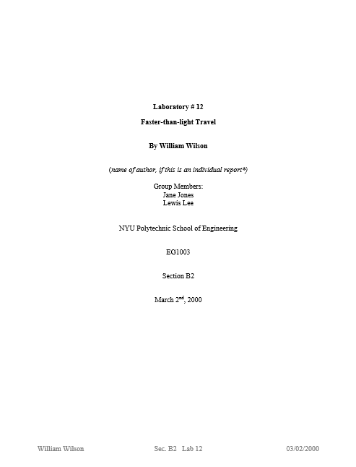
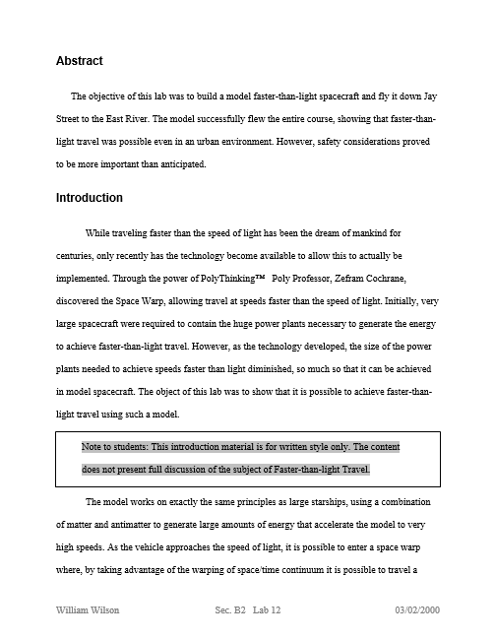
Example: MS Word

Slide 7
Example: MS Excel

Slide 8
Procedure: MS Word
Copy generic document
Information includes name, address, schedule, etc.
Manual has exact specifications
Edit document to include your information
Save original and updated files for submittal and presentation

Slide 9
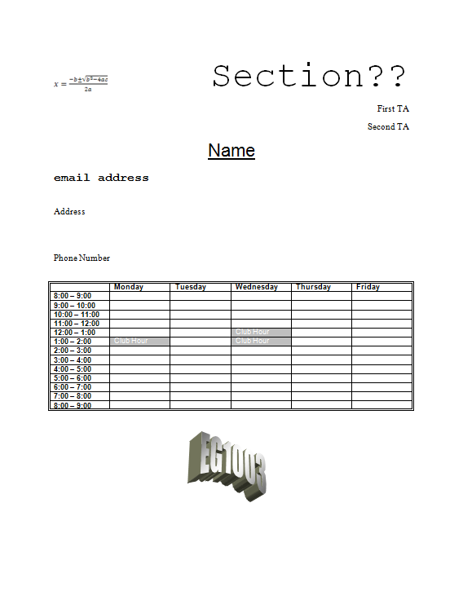
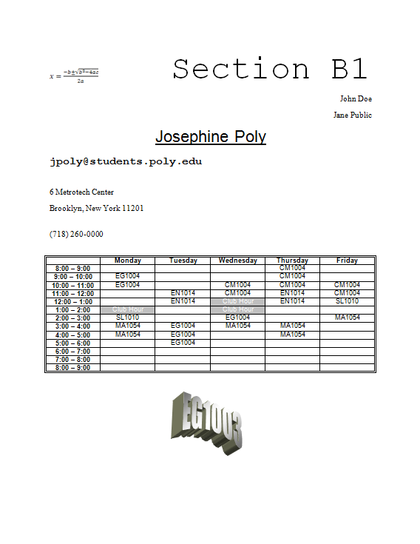
Procedure: MS Word

Slide 10
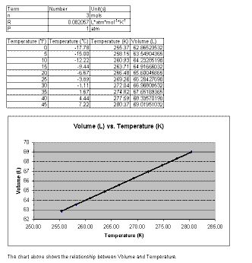
Procedure: MS Excel
Create 2 tables based on Charles’ Law
Temperature data values are provided by TAs
Using Charles’ Law, calculate volumes at specified temperatures
Plot volume vs. temperature based on generated tables

Slide 11
Assignment: Written Report
Independent report (one report per student)
Standard lab report submission
Submit online (eg.poly.edu) before midnight of day of Lab #2
One Word Document Containing:
Title Page (MS Word: name, partner, lab title, etc.)
Generic Schedule
Personalized Schedule
Mousetrap competition report
Excel File: Two tables & graph

Slide 12
Closing
Each team member must use software
Submit all work electronically by 11:59pm before Lab #2
Work together with your partner
TA is always available for assistance
Mousetrap Car Competition
Following MS Office Exercise

