Slide 1
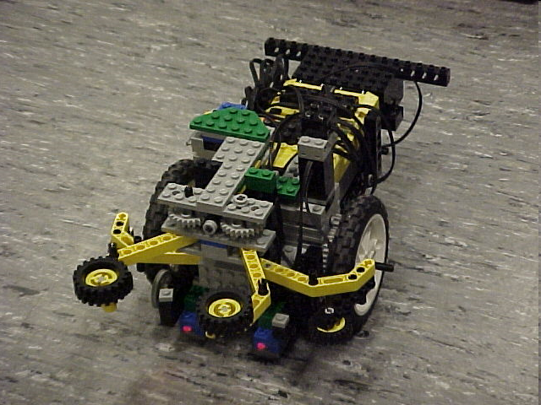
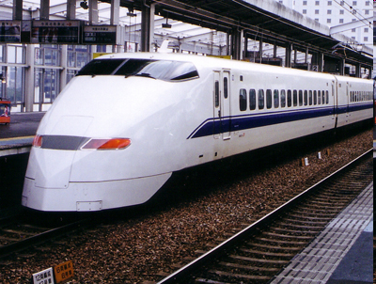
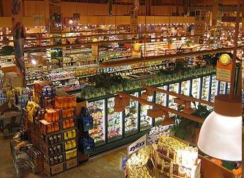
Semester-Long Design Project

Slide 2
Project Introduction
Project duration: 10 weeks
Teams of 2-3 people
Projects to choose from:
  Supermarket
  Train Guidance System
  Robot (seven types)

Slide 3
Project Grading
Item | % of Grade
Benchmarks and Commissioning | 50%
Final Presentation | 50%
NOTE: The SLDP counts toward 30% of your course final grade!

Slide 4

Project Grading
Benchmarks:
  Completion of a specified portion
  of the project
  2 Benchmarks throughout semester
  Refer to schedule for due dates
  Penalties for not completing on time

Slide 5
Project Grading
Commissioning:
  Completion of all required tasks
  Last phase of project
  Refer to syllabus for due dates
  Failure to commission will result
  in penalties (Partial Commissioning)

Slide 6

Project Grading
Project Submission:
  Hand in Technical and Managerial related documents
  Must be received in order to obtain SLDP grade (30%)
  Any missing items will result in penalties
  Refer to syllabus for deadline
  Refer to Submission Guidelines
  Must hand in folder before due date for credit!

Slide 7
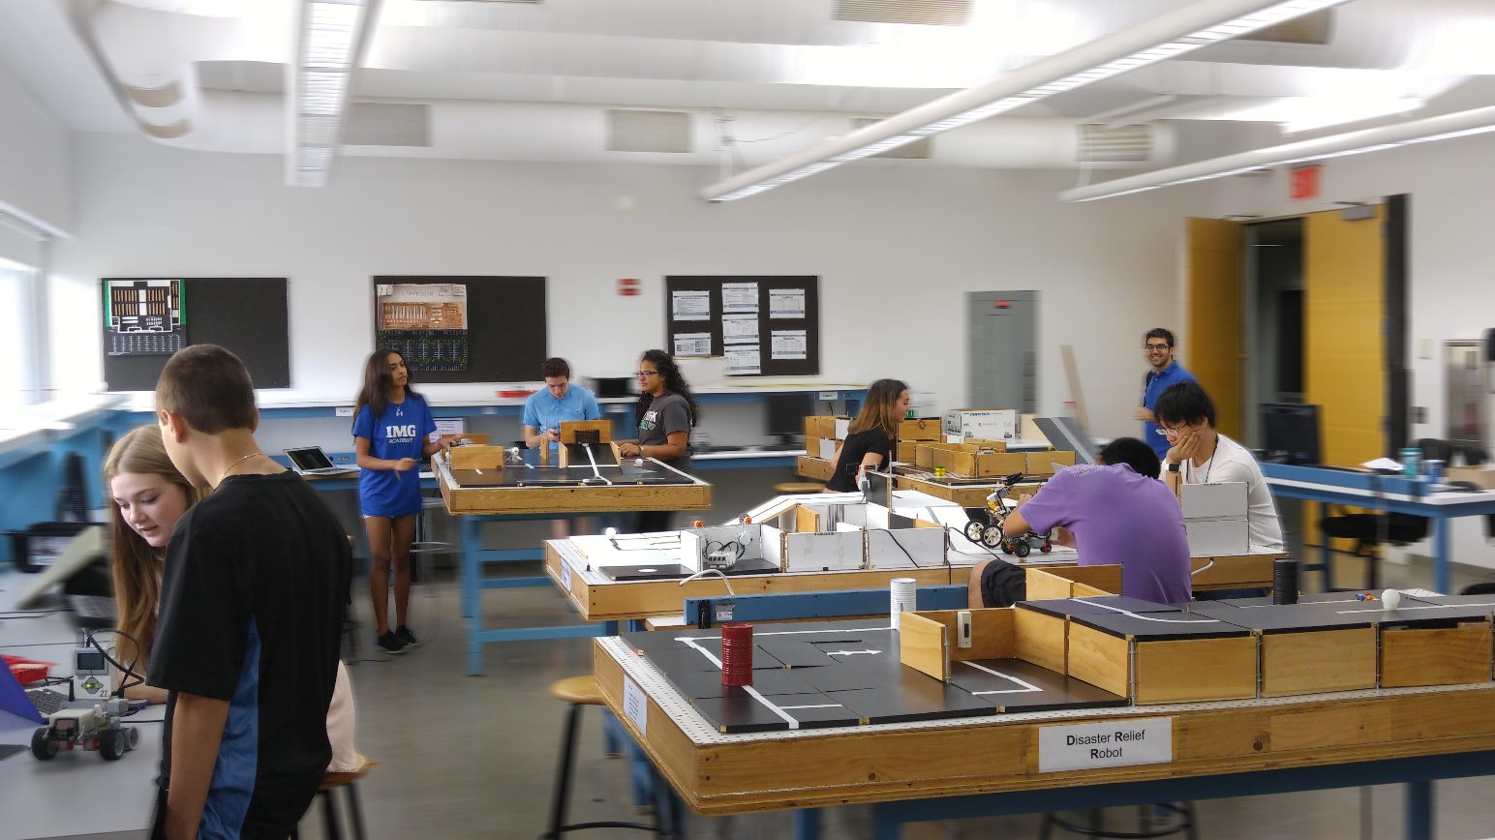
SLDP Options
Seven Robot Variants
Supermarket Logistics System
Digital Logic Train Guidance System

Slide 8
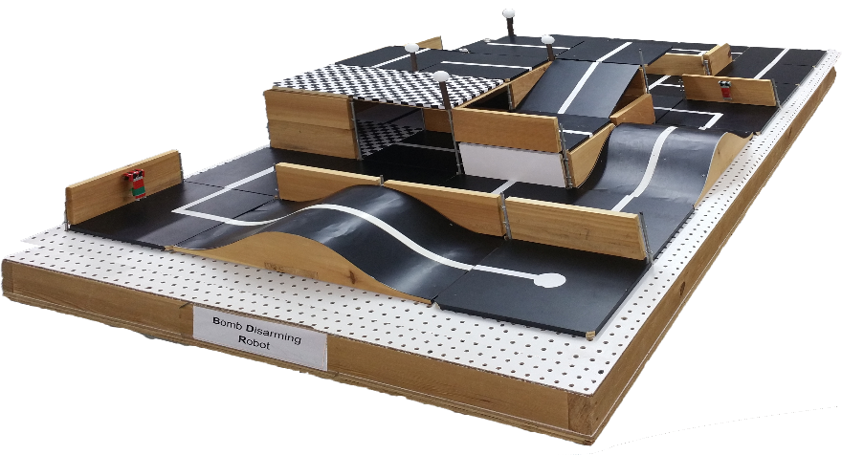
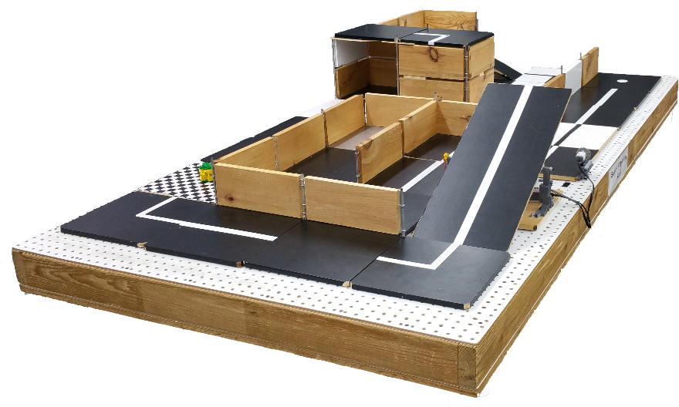
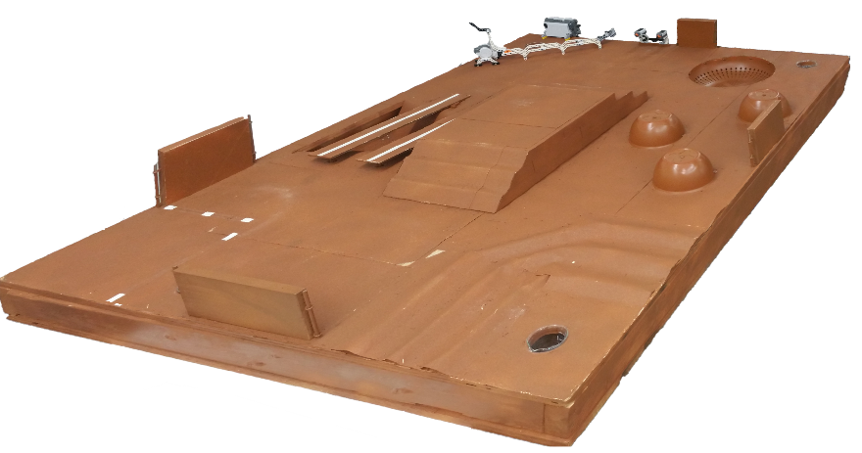
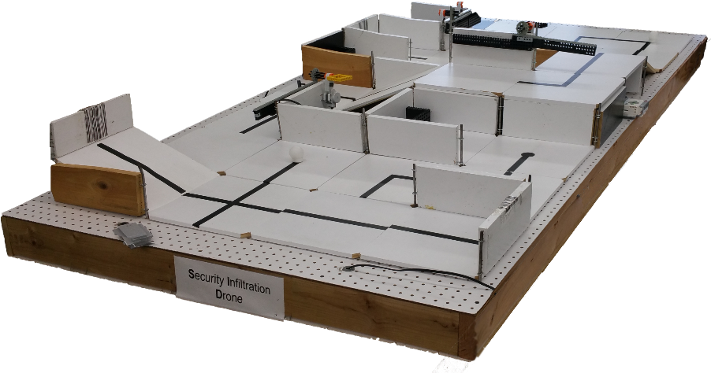
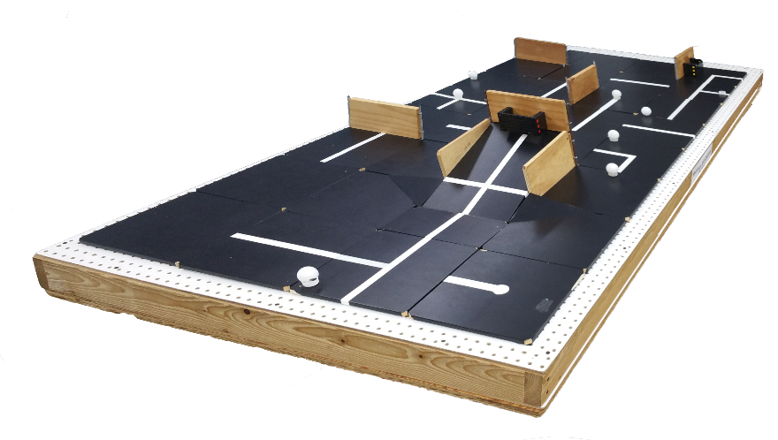
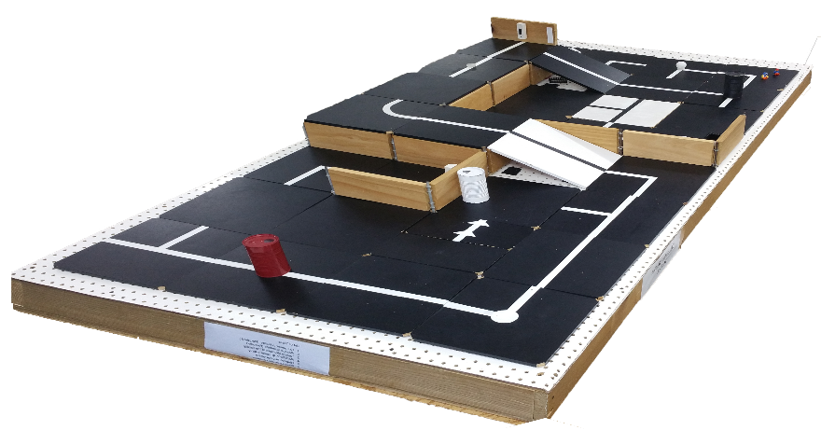
SLDP Options
Robot Variants

Slide 9
SLDP Options
Mars Rover Robot (MRR)
Retrieve and analyze water salinity readings
to determine in life can exist on Mars
Collect two different readings of water
sources with the Vernier salinity sensor
Return to the space shuttle at the landing
site once both readings are taken

Slide 10
SLDP Options
Mars Rover Robot (MRR)
Extra Credit:
Obtain a third water source reading
and return it to the space shuttle
Robot travels down into and over the crater
Robot travels up the step side of the hill

Slide 11
SLDP Options
Search & Recovery Robot (SRR)
Retrieve lost space module from moon
and return safely
Robot must move autonomously over
a pre-selected route
Retrieve power supply module and return to space shuttle
The robot must fit in a start area that is 25cm x 25cm

Slide 12
SLDP Options
Search and Recovery Robot (SRR)
Extra Credit:
Retrieves modules and returns them
to the space shuttle

Slide 13
SLDP Options
Bomb Disarming Robot (BDR)
Day and night courses
Robot must be able to autonomously
navigate the obstacle course provided
Disarm the bomb while avoiding any decoy bombs
Robot must fit in a start area that is 25cm x 25cm
Maximum height is 20cm

Slide 14
SLDP Options
Bomb Disarming Robot (BDR)
Extra Credit:
Disable and retrieve triangulation
device(s)

Slide 15
SLDP Options
Security Infiltration Drone (SID)
Open gates using barcode scanners
to infiltrate enemy headquarters
Solve the barcode puzzle
Robot must fit in a start area that
is 25cm x 25cm

Slide 16
SLDP Options
Security Infiltration Drone (SID)
Extra Credit:
Retrieve data canisters (with a
robotic arm) and bring them to
extraction point

Slide 17
SLDP Options
Retrieval & Delivery System (RDS)
Retrieve fuel cells
Deliver them to three different hospitals
Hospitals consume power at different
levels of efficiency
Deliver a total of at least 200 hours of battery life
The robot must fit in a start area that is 25cm x 25cm

Slide 18
SLDP Options
Retrieval & Delivery System (RDS)
Extra Credit:
Additional points rewarded for
additional fuel cells accumulated
past the 200-hour requirement

Slide 19
SLDP Options
Disaster Relief Robot (DRR)
After tragedy strikes, clean the affect area,
rescue workers, and remove hazardous waste
Robot must perform at least five of the
six tasks
Must return back to base in 5 minutes or less
The robot must fit in a start area that is 25cm x 25cm

Slide 20
SLDP Options
Disaster Relief Robot (DRR)
Extra Credit:
Complete all six tasks
Retrieve extra fuel cells
Activate a second power cutoff station

Slide 21
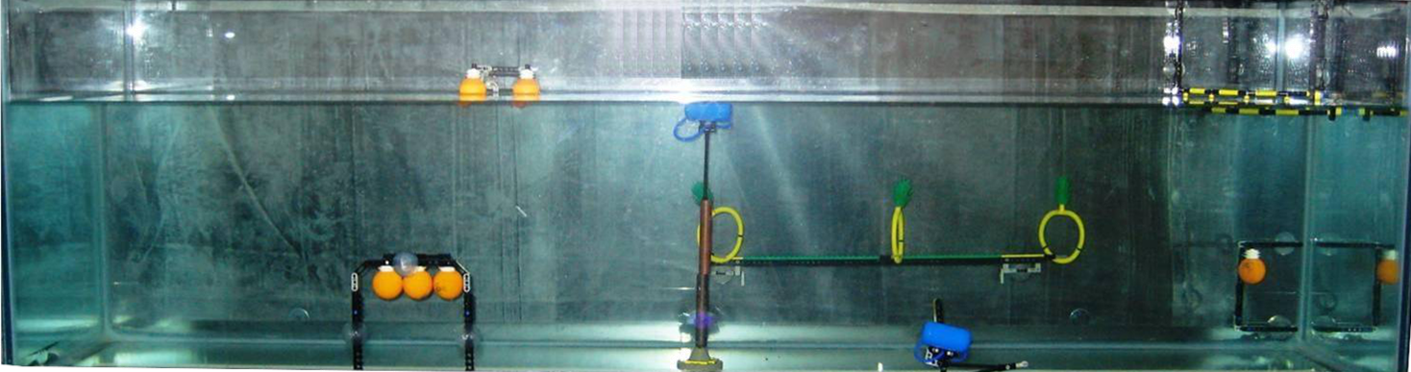
SLDP Options
Autonomous Underwater Vehicle (AUV)
Construct a robot that functions underwater
Perform tasks for a total
of 100 points
AUV must fit into a
1’ x 1’ x 1’ box
Must use waterproofed sensors and case
Oil spill task

Slide 22
SLDP Options
Autonomous Underwater Vehicle (AUV)
Marine Plant Samples
  5 points per plant released
  10 points per plant recovered
Data Canisters: 10 points each
Oceanographic Sensor:
20 points
Seismic Reading: 10 points
Oil spill task: 40 points

Slide 23
SLDP Options
Autonomous Underwater Vehicle (AUV)
Extra Credit:
Rover design (stays underwater): 5 points
Skimmer design (skims water surface): 10 points
Hybrid design (floats underwater, changes elevation): 15 points

Slide 24
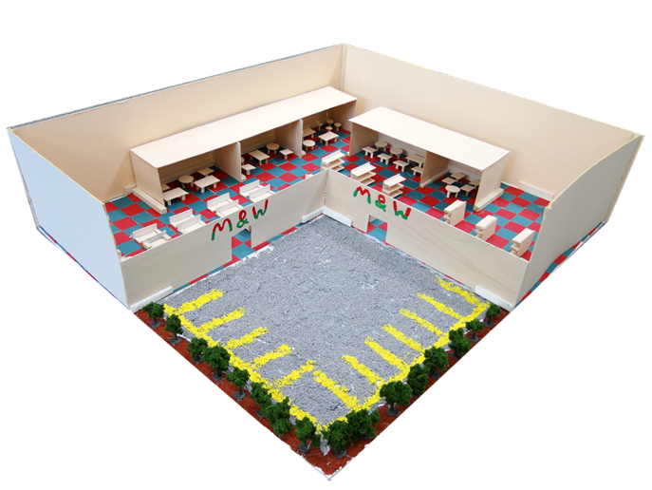
SLDP Options
Supermarket Logistics System (SLS)
Design a customer-friendly supermarket with AutoCAD
Design for a 400’ x 400’ lot
Create scaled 3D model (actual or CAD)
Create security, lighting, and temperature
systems for store using LabVIEW
Calculate building and maintenance costs

Slide 25
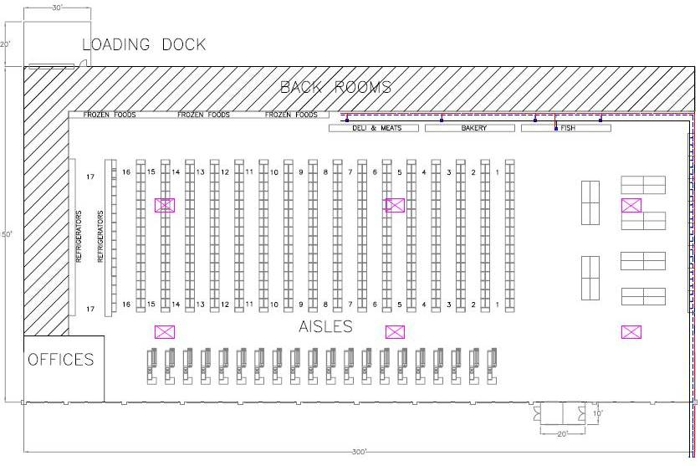

SLDP Options
Supermarket Logistics System (SLS)
Extra Credit:
Incorporate LEED certification into
the design of supermarket

Slide 26
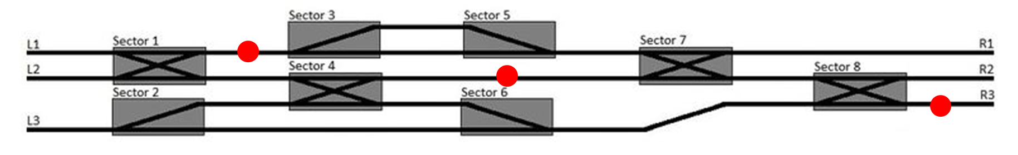
SLDP Options
Railroad Train Guidance System (RTGS)
Design a logic system to avoid obstacles by selecting an optimal path
Guide train from one end of the track to the other
Avoid collisions with other trains and obstructions

Slide 27
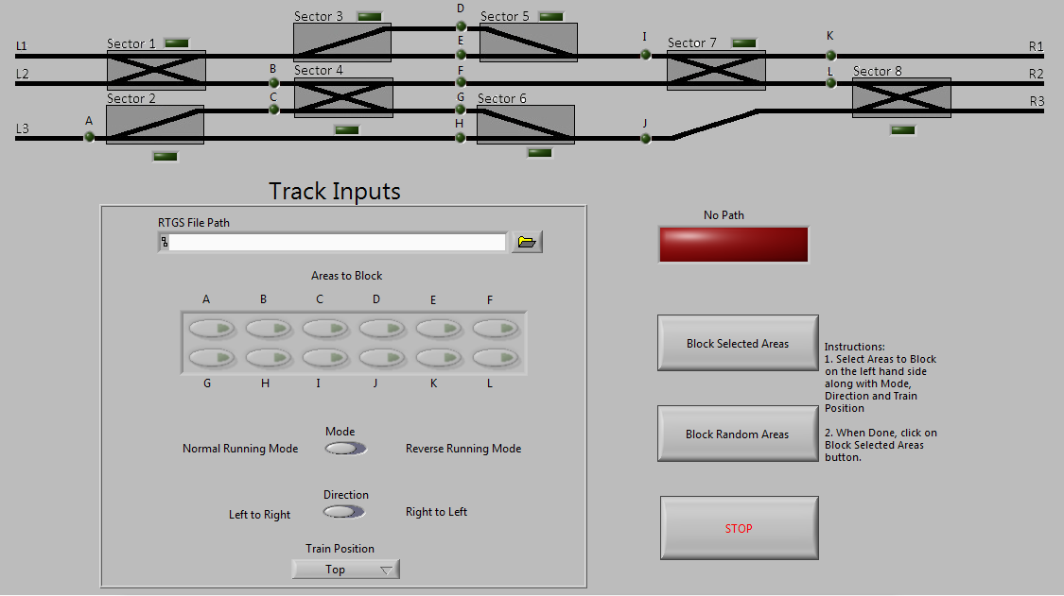
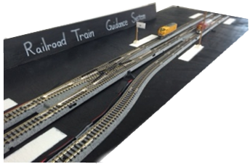
SLDP Options
Railroad Train Guidance System (RTGS)
Implement digital logic program using LabVIEW to control the train track

Slide 28
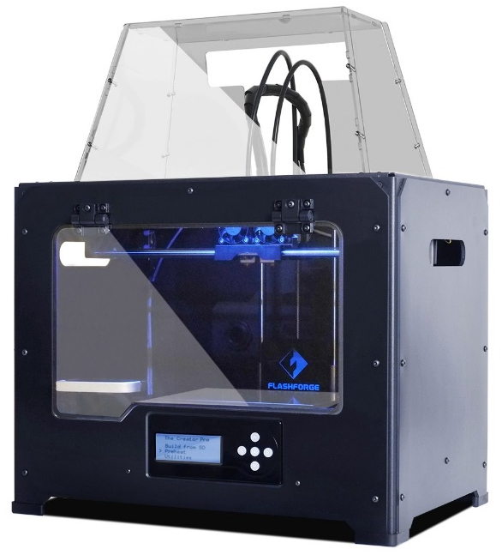
3D Printing Extra Credit
Design your own SLDP team logo
  Due by Milestone 2 Presentations
Be creative with your design (2 pts EC)
  Your design will need approval by a 3D printing TA
  Can’t be text like Lab 1
  Multiple colors are available: purple, black, white,
  yellow, red, green, pink, light blue, blue, clear
  More info on 3D Printing Extra Credit page on lab manual

Slide 29
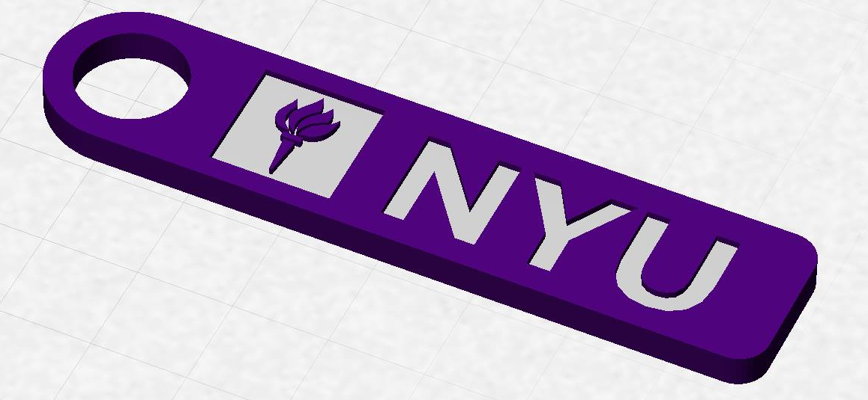
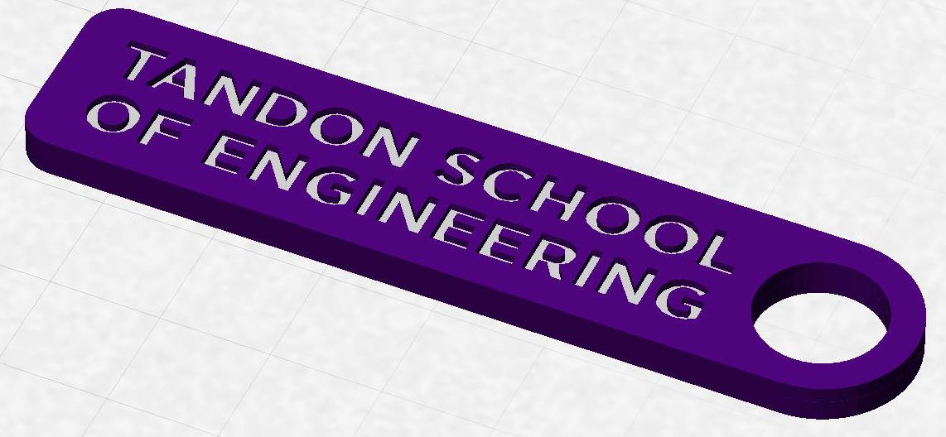
3D Printing Extra Credit
Constraints:
  Maximum weight of 15 grams
  Must be two colors
  No copyrighted logos
  Must be attached to robot or worn
  as pin during Final Presentation
  Must be done before any advanced printing

Slide 30
3D Printing Extra Credit ADVANCED
An experimental opportunity to create a prototype of a custom,
3D-printed robot part or terrain modification (4 pts EC)
Constraints:
  Must complete logo first
  Due by Milestone 2 Presentations
  YOU MUST HAVE A CONTINGENCY PLAN if the piece does not
  work or cannot be printed
  For full list of constraints see the 3D Printing Extra Credit page on lab manual
You may also print parts at the MakerSpace, or you can receive one-on-one instruction in the EG Prototyping Lab (Rogers Hall 223)

Slide 31
3D Printing Extra Credit Submission
Submit your design at eg.poly.edu under the
3D Printing Submission tab
  Your first submission is due by Milestone 2
  Your design must be a .thing or .stl file
  After your submission has been received you will be contacted by a TA

Slide 32
Closing
Refer to manual.eg.poly.edu for details
Think about which project interests you
Brainstorm ideas
Speak with professors and TAs regarding projects

Slide 33

Semester-Long Design Project
QUESTIONS?

