Slide 1

PROCESSES & WATER FILTERS (VIRTUAL)
EG1003 | LAB 8

Slide 2
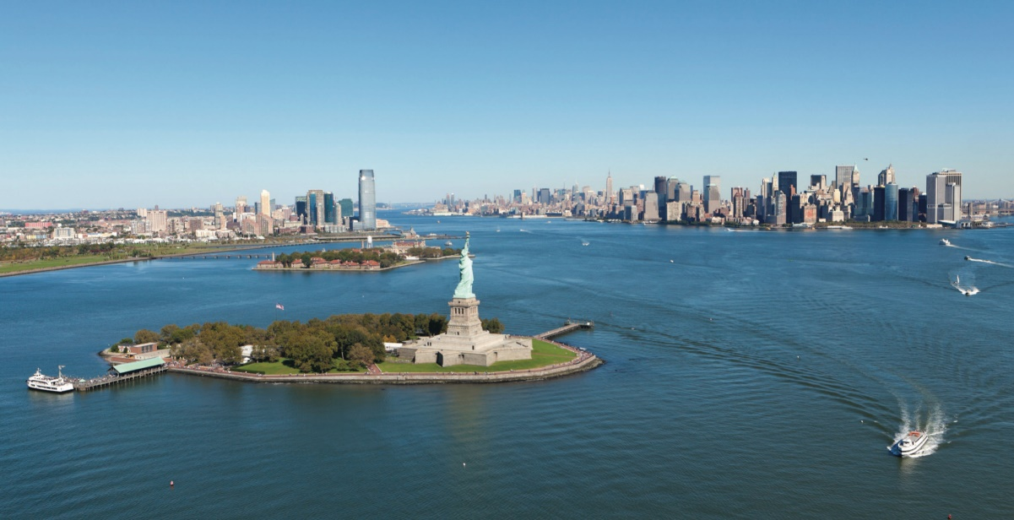
OVERVIEW
Objective
Background Information
Materials
Procedure
Assignment
Closing
Figure 1: Hudson River Courtesy of Hudson River Foundations
1

Slide 3
OBJECTIVE
To understand the processes behind a water treatment system
To design an efficient water filter
To design a process flow diagram of an industrial-scale water filter
2

Slide 4
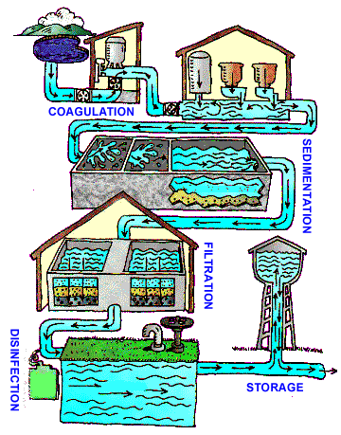
BACKGROUND INFORMATION
Water treatment system:
Coagulation & flocculation – addition of chemicals to create flocs
Sedimentation – flocs settle to bottom
Filtration – physical removal of flocs
Disinfection – kills bacteria, viruses, and parasites
Storage – store in water tank
Figure 2: Water Treatment System
Courtesy of the CDC
3

Slide 5
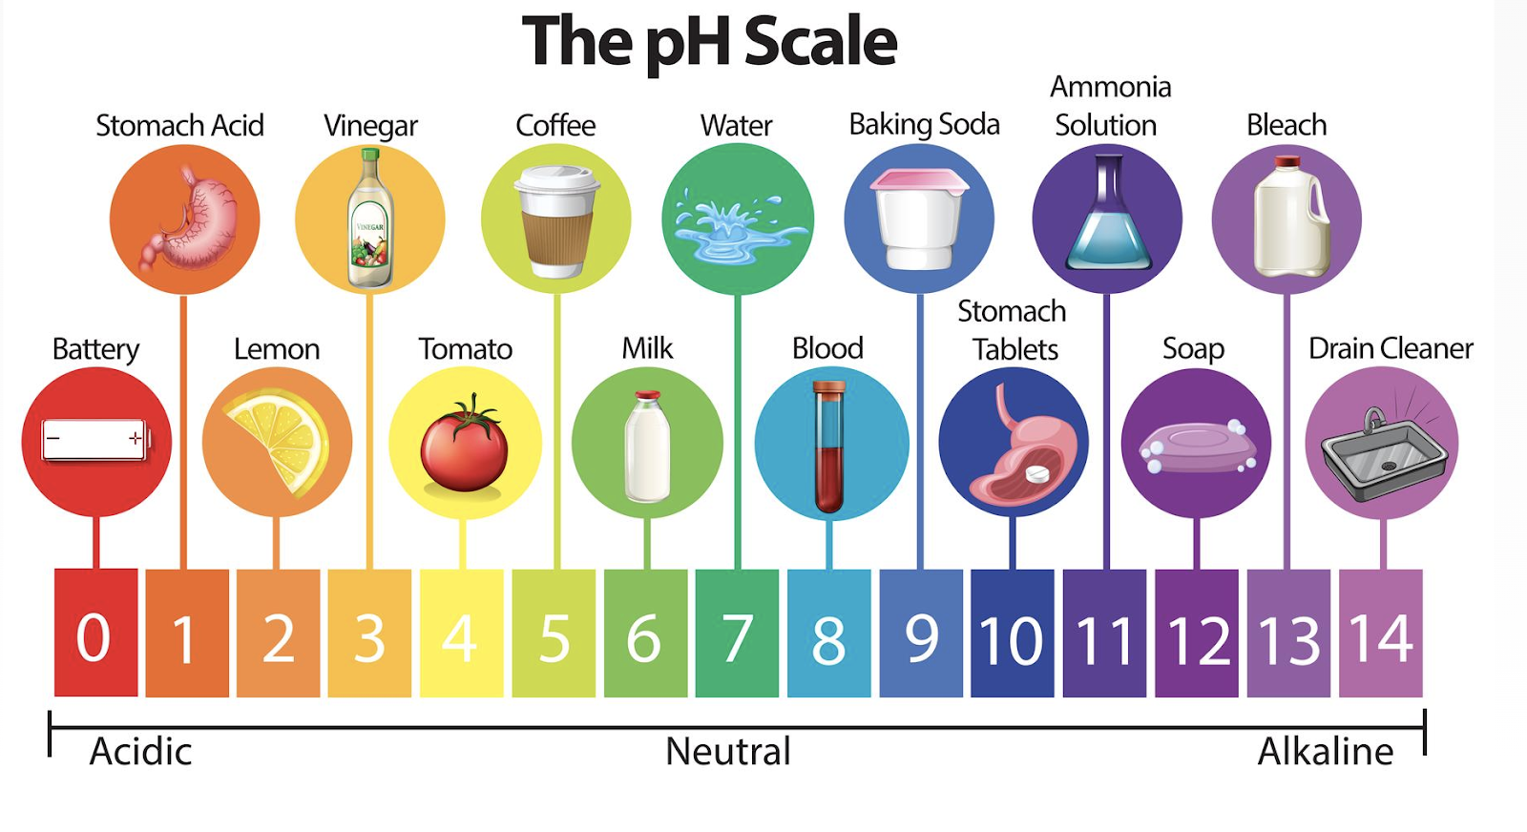
BACKGROUND INFORMATION
pH – measure of acidity and alkalinity
  Logarithmic scale of concentration of hydrogen ions
  Below 7 is acidic, 7 is neutral,
  over 7 is basic (alkaline)
  Ideal pH for drinking water is
  6.5 – 8.5
Figure 3: Examples of pH Courtesy of Vecteezy
4

Slide 6
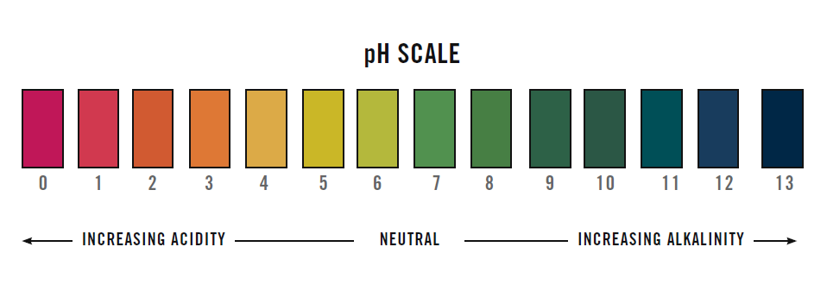
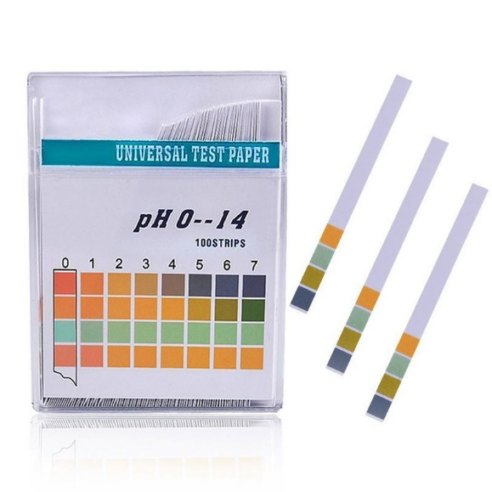
BACKGROUND INFORMATION
pH strip – strip of filter paper that changes color based on pH
Figure 4: pH Scale (Left) and pH Strips (Right) Courtesy of Bradford Derustit
5

Slide 7
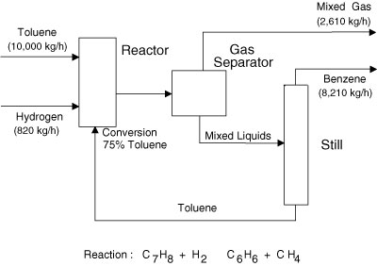
BACKGROUND INFORMATION
Process flow diagram (PFD) – relays information about a process design
  Process vessel & equipment
  Process and utility lines
  Full energy and material balance
  Composition of every stream
  Bypass and recycle streams
Figure 5: Simple PFD Courtesy of InformIT
6

Slide 8
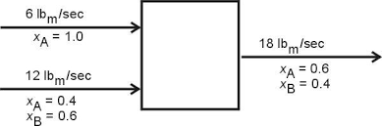
BACKGROUND INFORMATION
Mass balance – the conservation of mass applied to a process
  Whatever comes in must come out
  Input + Generation =
  Output + Consumption
Figure 6: Simple Mass Balance Courtesy of NYU
7

Slide 9
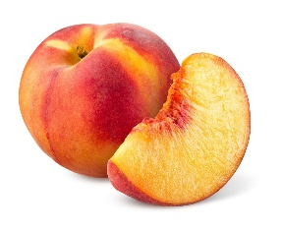
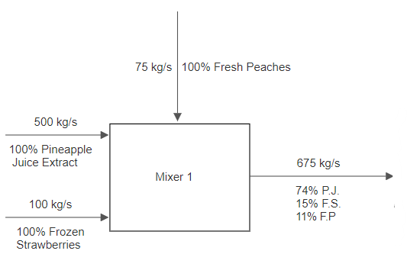
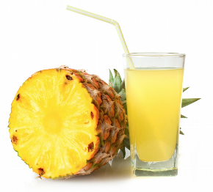
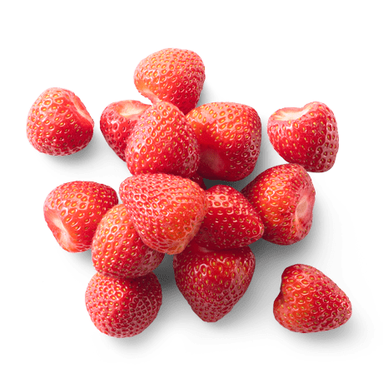
BACKGROUND INFORMATION
Example process:
Three streams enter a mixer:
  500 kg/s pineapple juice
  100 kg/s frozen strawberries
  75 kg/s fresh peaches
Figure 7: First Process Unit Example
8

Slide 10
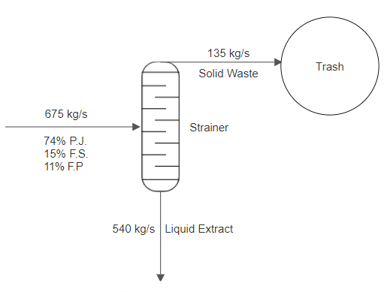
BACKGROUND INFORMATION
Next, product stream enters a strainer:
  20% exits as solid and goes into the trash
  80% exits as liquid extract
Figure 8: Second Process Unit Example
9

Slide 11
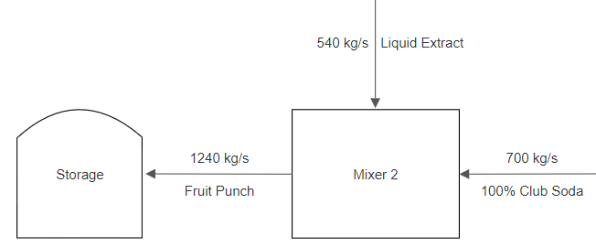
BACKGROUND INFORMATION
Lastly, liquid extract enters another mixer with another stream:
  700 kg/s club soda
  Product stream then enters storage unit
Figure 9: Third Process Unit Example
10

Slide 12
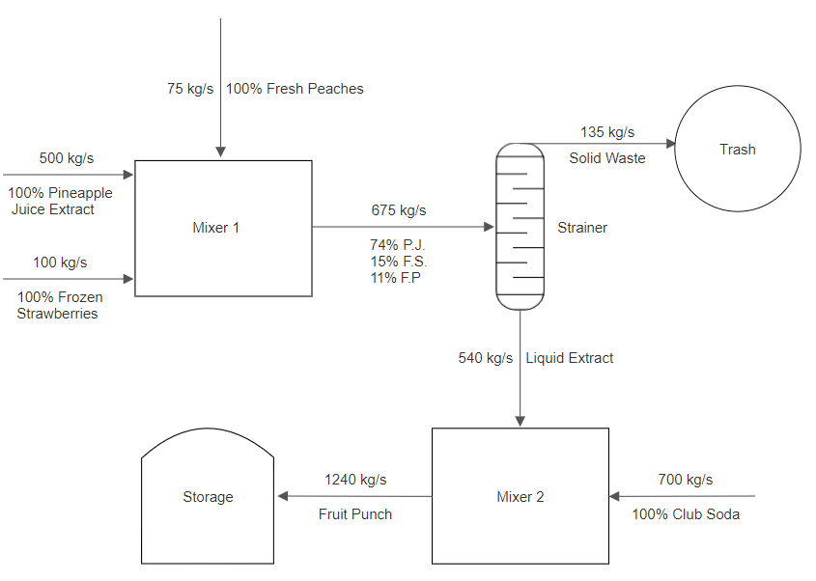
BACKGROUND INFORMATION
Combine all the parts to make the complete PFD
Figure 10: Complete Process Flow Diagram Example
11

Slide 13
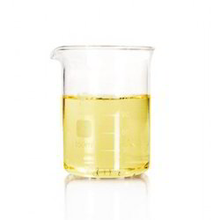
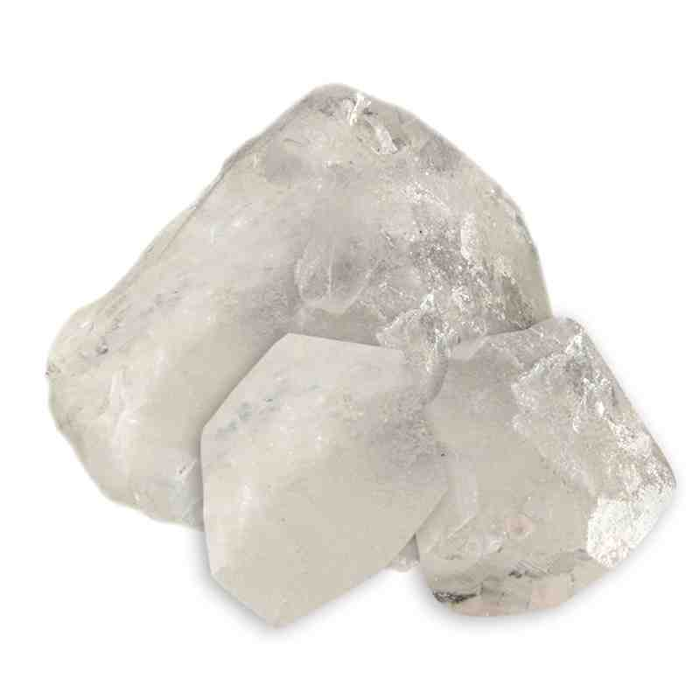
MATERIALS
Computer with internet access
Materials for in-person lab:
  pH strips
  Contaminated water
  Beaker
  Scale
  Alum
  Sodium bicarbonate
  Glass stirring rod
12

Slide 14
PROCEDURE
Part 1: Balance the pH of the contaminated solution
  Watch the virtual simulation here
Part 2: Design and test three water filters
  Watch the virtual simulation here
  Record data on Excel datasheet
Part 3: Design a process flow diagram based on the best water filter design
13

Slide 15
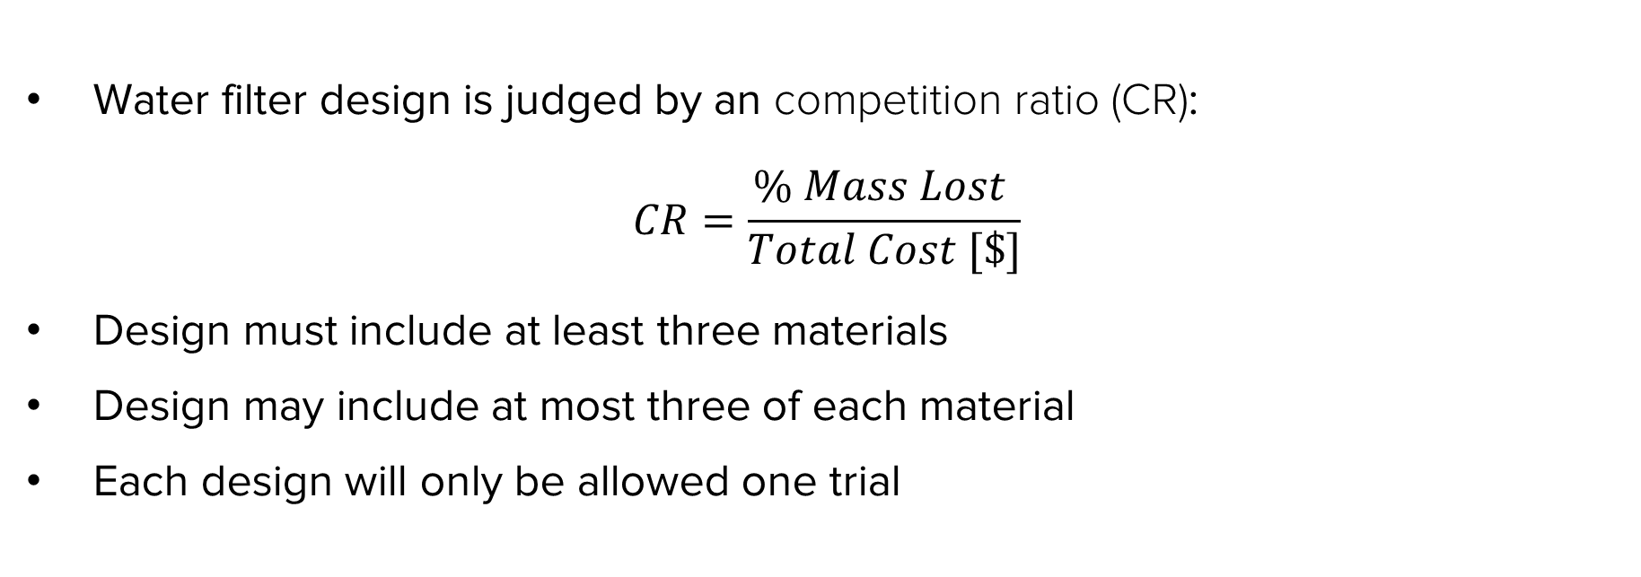
DESIGN CONSIDERATIONS
Water filter design is judged by an competition ratio (CR):
$$CR=\frac{\% Mass Lost }{Total Cost [\$]}$$
Design must include at least three materials
Design may include at most three of each material
Each design will only be allowed one trial
14

Slide 16
DESIGN CONSIDERATIONS
Table 1: Cost List for Water Filter Design
Material | Unit | Cost Per Unit
Gravel | 1 scoop | $0.25
Sand | 1 scoop | $1.00
Activated Carbon | 1 scoop | $0.50
15

Slide 17
ASSIGNMENT
Team lab report:
  Answer discussion questions in manual
  Include pictures of water filter designs
  Include Excel datasheet with results
  Include picture of complete process flow diagram
  Due at 11:59 PM the night before Lab 9
Team presentation:
  Address discussion points in manual
  Include cost of water filter designs
16

Slide 18
CLOSING
Record all data in Excel datasheet
Take pictures/screenshots of the filter designs, contaminated water, filtered water, and process flow diagram
Submit all work electronically
17

Slide 19
QUESTIONS?

