Slide 1

PROCESSES &
WATER FILTERS
EG1003 | LAB 8

Slide 2
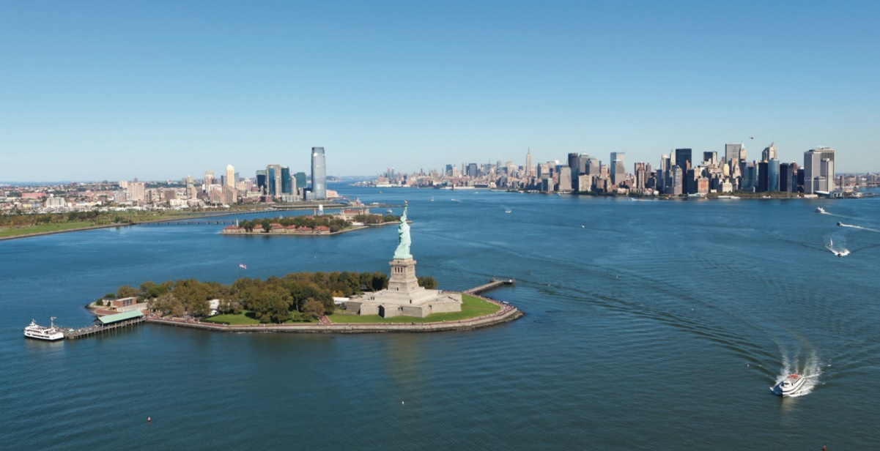
OVERVIEW
Objective
Background Information
Materials
Procedure
Assignment
Closing
Figure 1: Hudson River Courtesy of Hudson River Foundations
1

Slide 3
OBJECTIVE
To understand the processes behind a water treatment system
To design and assemble an efficient water filter
To design a process flow diagram of an industrial-scale water filter
2

Slide 4
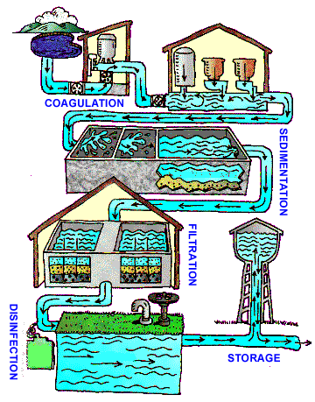
BACKGROUND INFORMATION
Water treatment system:
Coagulation & flocculation – addition of chemicals to create flocs
Sedimentation – flocs settle to bottom
Filtration – physical removal of flocs
Disinfection – kills bacteria, viruses, and parasites
Storage – store in water tank
Figure 2: Water Treatment System
Courtesy of the CDC
3

Slide 5
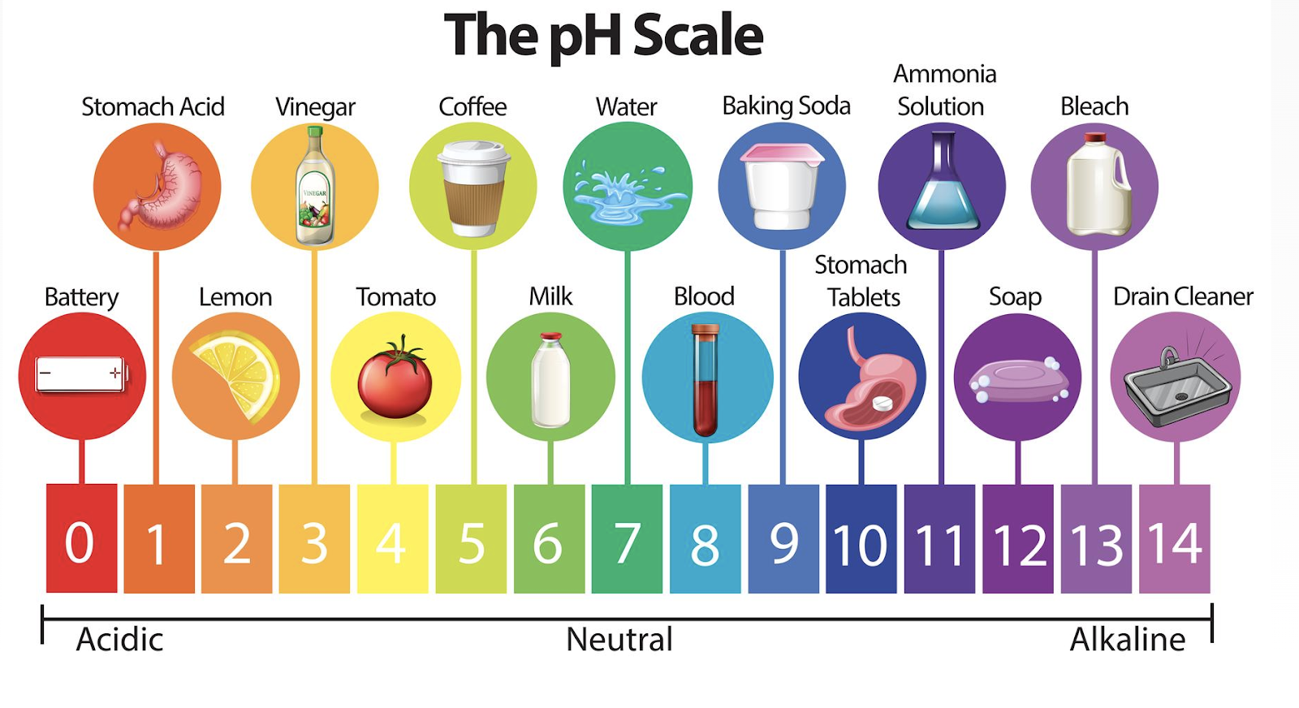
BACKGROUND INFORMATION
pH – measure of acidity and alkalinity
  Logarithmic scale of concentration of hydrogen ions
  Below 7 is acidic, 7 is neutral,
  over 7 is basic (alkaline)
  Ideal pH for drinking water is
  6.5 – 8.5
Figure 3: Examples of pH Courtesy of Vecteezy
4

Slide 6
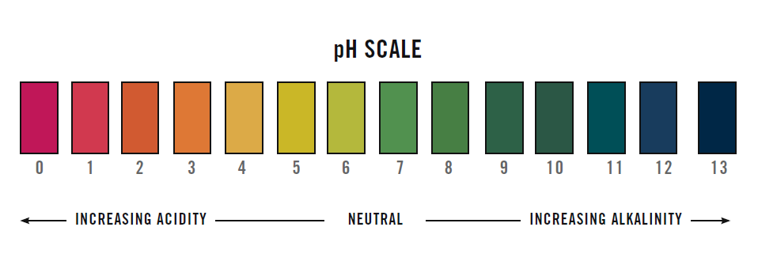
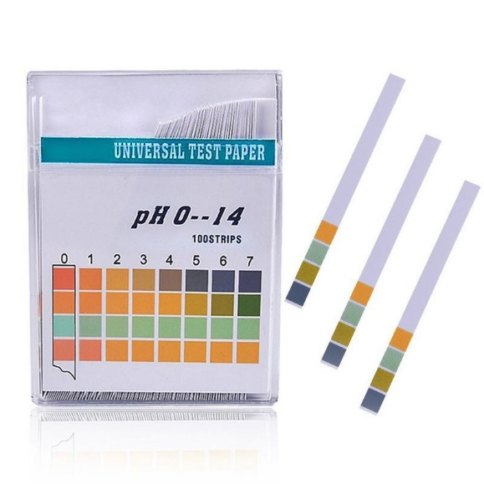
BACKGROUND INFORMATION
pH strip – strip of filter paper that changes color based on pH
Figure 4: pH Scale (Left) and pH Strips (Right) Courtesy of Bradford Derustit
5

Slide 7
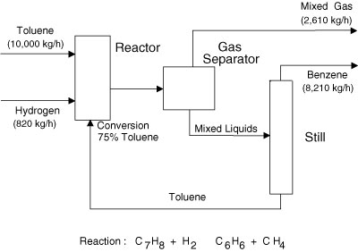
BACKGROUND INFORMATION
Process flow diagram (PFD) – relays information about a process design
  Process vessel & equipment
  Process and utility lines
  Full energy and material balance
  Composition of every stream
  Bypass and recycle streams
Figure 5: Simple PFD Courtesy of InformIT
6

Slide 8
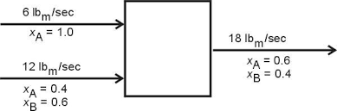
BACKGROUND INFORMATION
Mass balance – the conservation of mass applied to a process
  Whatever comes in must come out
  Input + Generation =
  Output + Consumption
Figure 6: Simple Mass Balance Courtesy of NYU
7

Slide 9
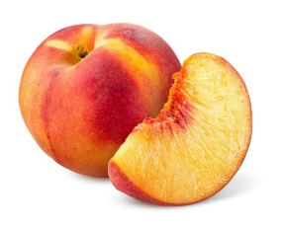
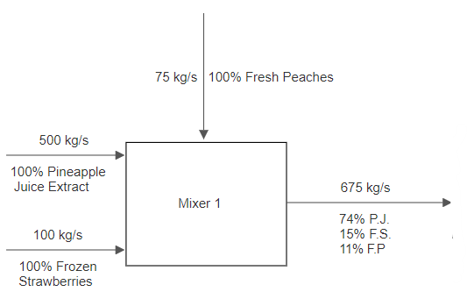
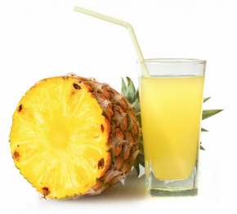
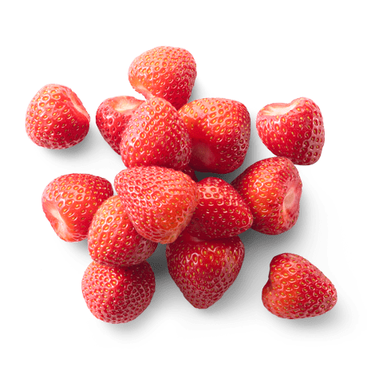
BACKGROUND INFORMATION
Example process:
Three streams enter a mixer:
  500 kg/s pineapple juice
  100 kg/s frozen strawberries
  75 kg/s fresh peaches
Figure 7: First Process Unit Example
8

Slide 10
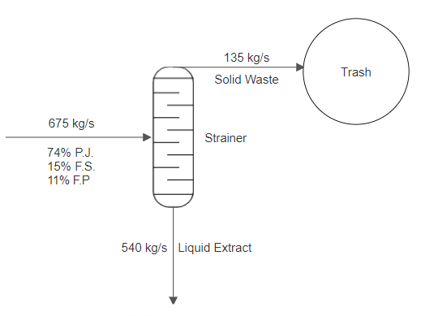
BACKGROUND INFORMATION
Next, product stream enters a strainer:
  20% exits as solid and goes into the trash
  80% exits as liquid extract
Figure 8: Second Process Unit Example
9

Slide 11
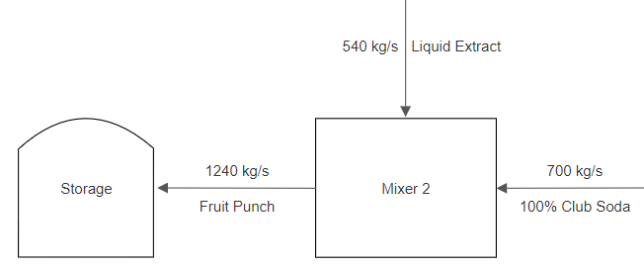
BACKGROUND INFORMATION
Lastly, liquid extract enters another mixer with another stream:
  700 kg/s club soda
  Product stream then enters storage unit
Figure 9: Third Process Unit Example
10

Slide 12
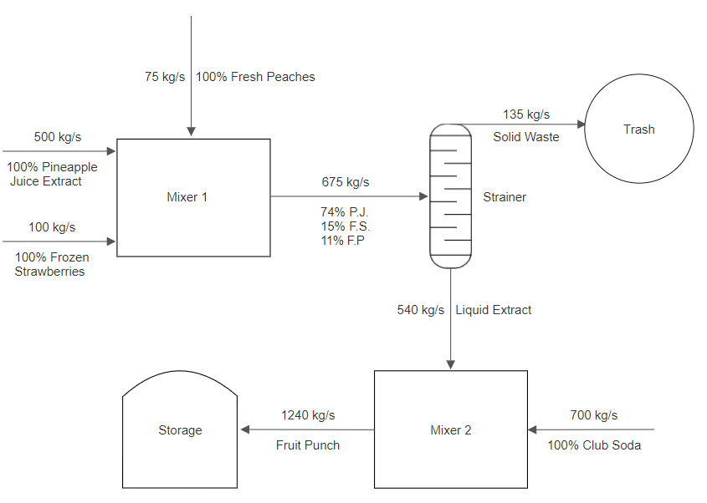
BACKGROUND INFORMATION
Combine all the parts to make the complete PFD
Figure 10: Complete Process Flow Diagram Example
11

Slide 13
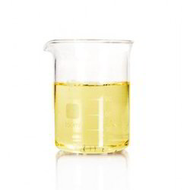
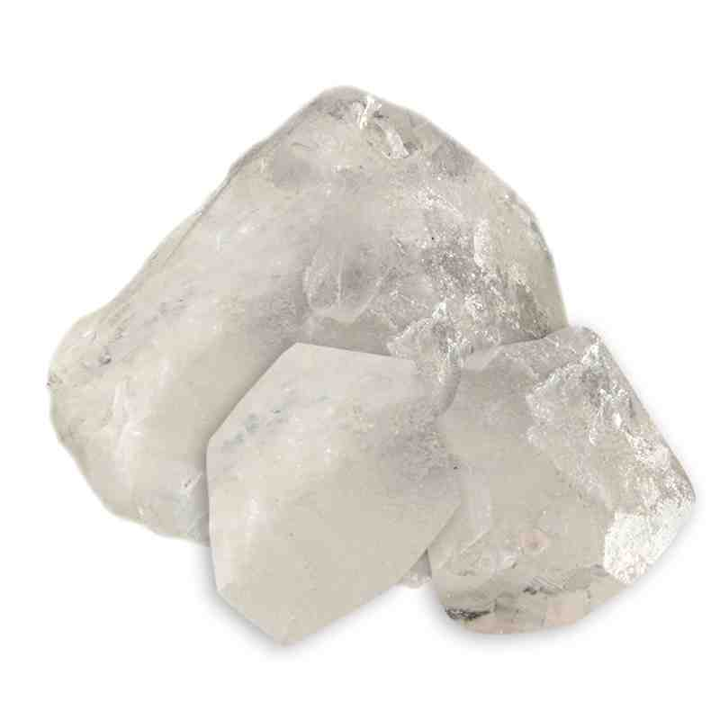
MATERIALS
Lab PC
pH strips
Contaminated water
Beaker
Funnel
Erlenmeyer flask
Scale
Alum
Sodium bicarbonate
Glass stirring rod
Gravel
Sand
Activated carbon
12

Slide 14
PROCEDURE
Part 1: Balance the pH of the contaminated solution
Part 2: Design and test assembled water filter
  Record data on Excel datasheet
Part 3: Design a process flow diagram based on the water filter design
13

Slide 15
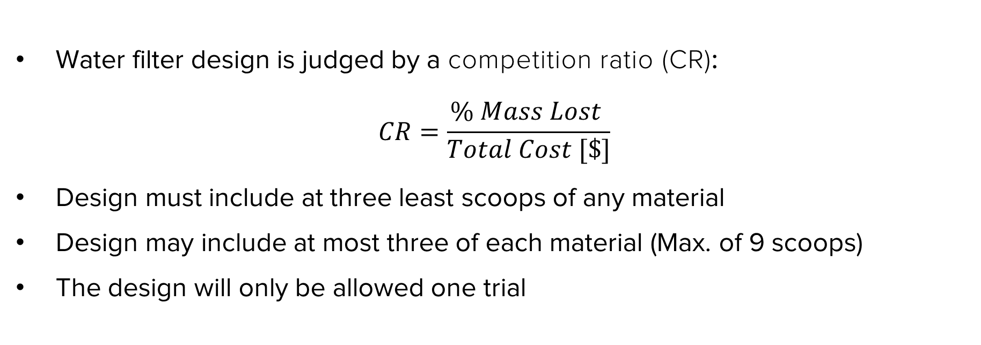
DESIGN CONSIDERATIONS
Water filter design is judged by a competition ratio (CR):
$$CR=\frac{\% Mass Lost }{Total Cost [\$]}$$
Design must include at three least scoops of any material
Design may include at most three of each material (Max. of 9 scoops)
The design will only be allowed one trial
14

Slide 16
DESIGN CONSIDERATIONS
Table 1: Cost List for Water Filter Design
Material | Unit | Cost Per Unit
Gravel | 1 scoop | $0.25
Sand | 1 scoop | $1.00
Activated Carbon | 1 scoop | $0.50
15

Slide 17
ASSIGNMENT
Team lab report:
  Answer discussion questions in manual
  Include pictures of water filter design & assembled water filter
  Include Excel datasheet with results
  Include picture of complete process flow diagram
  Due at 11:59 PM the night before Lab 9
Team presentation:
  Address discussion points in manual
  Include cost of water filter designs
16

Slide 18
CLOSING
Record all data in Excel datasheet
Take pictures of the filter design, assembled water filter, contaminated water, filtered water, and process flow diagram
Submit all work electronically
Clean up workstations
Return all unused materials to the TA
17

Slide 19
QUESTIONS?

