Slide 1

RECITATION 6
EG1003

Slide 2
AGENDA
Ethics in Engineering
1

Slide 3
What ethical & social issues will arise with the increase in use of autonomous vehicles?
DISCUSSION QUESTION
2
Notes:
**Give students time to discuss this question in groups and/or have a larger group discussion**

Slide 4
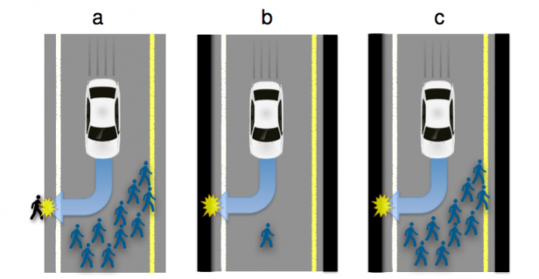
ETHICS OF AUTONOMOUS VEHICLES
Who decides the value of human lives?
Figure 1: Traffic situations with inevitable harm
3
Notes:
Option A has two outcomes: the car can continue straight on course and kill several pedestrians or swerve and kill one passer-by
Option B has two outcomes: the car can continue straight on course and kill one passer-by or swerve and kill its passenger
Option C has two outcomes: the car can continue straight on course and kill several pedestrians or swerve and kill its passenger
There are not objective, correct answers to each of these situations. Autonomous technology cannot make its own ethical decisions, the engineers who program and design the technology do.

Slide 5
What ethical & social issues arose from pulse oximeters used for COVID-19 patients that were found have a higher error rate for black people?
DISCUSSION QUESTION
https://www.ncbi.nlm.nih.gov/search/research-news/12312/
4
Notes:
**Give students time to discuss this question in groups and/or have a larger group discussion**

Slide 6
ETHICS SUMMARY
Technology & engineering design raise ethical & social questions
Your technical perspective and voice will be important
You must work with policy-makers, business leaders, and the public
National Society of Professional Engineers Code of Ethics (https://www.nspe.org/resources/ethics/code-ethics)
  Fundamental Canons
  Rules of Practice
  Professional Obligations
5
Notes:
Absences must be excused through the office of student affairs or you will not be able to complete makeup labs, receive a grade for your report or presentations. Communication is key!
Attendance at lecture adds up over time, make it a priority to attend every lecture.
If your lab absence is excused/in the process of being excused, you may request a makeup lab through the EG website.
Plagiarism is not a small slip up. It is a very major offense. Remember that for most courses, including this one, software are used to detect plagiarism.
Stay on top of your deadlines- this is a tough way to loose points since you are doing the work anyway, just do it on time.
Grow from mistakes you’ve made on presentations and lab reports by reviewing feedback from your TAs, Professors and Writing Consultants. As the semester goes on, you will be penalized for repeatedly making the same mistakes

Slide 7
QUESTIONS?

Slide 8
PRESENTATION ACTIVITY
Following each presentation, all teams discuss and share one effective aspect and one improvement for the group that just presented
7

