Slide 1

COMPUTER-AIDED DESIGN COMPETITION
LAB 2
EG 1004 Introduction to Engineering & Design

Slide 2

OVERVIEW
Objective
Background Information
Materials
Procedure
Competition Rules
IDBE Implementation
Assignment
Closing
Figure 1: Fusion 360 Courtesy of AppRecs

Slide 3
OBJECTIVE
Use CAD software, Fusion 360, to modify a design
Analyze and modify a poorly-designed part in Fusion 360
Enter the modified part in a competition against other redesigns
Notes:
Tandon Areas of Excellence
Sustainability
Urban
Telecommunications & IT
Health
Artificial Intelligence
Professional Skills & Tandon Resources
MakerSpace & RAD
Teamwork & Vertically Integrated Projects
Career Services
Project Management & Technical Writing
World Trade Center Construction

Slide 4
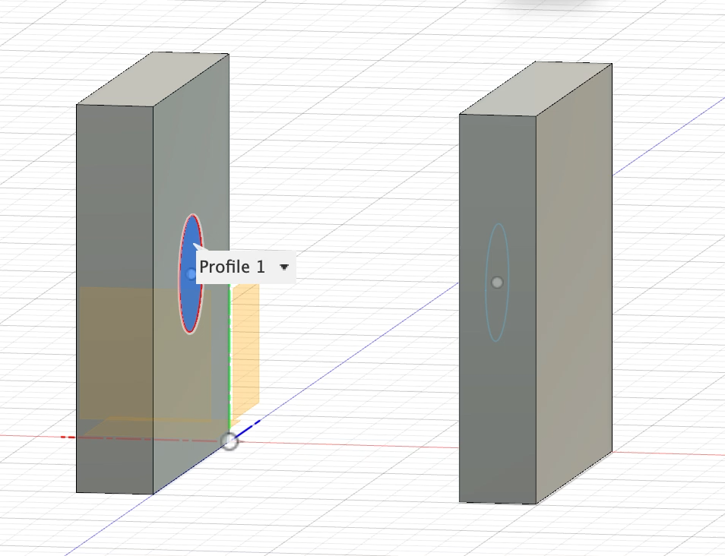
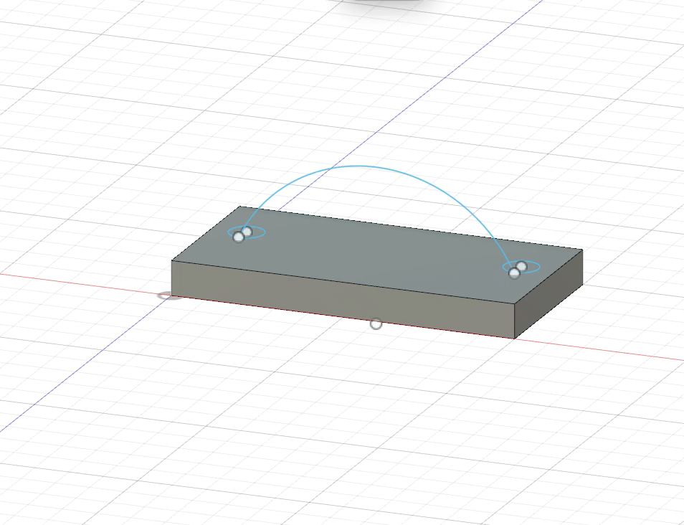
BACKGROUND INFORMATION
Loft
Sweep
  Creates a 3D extrusion to connect two profiles
  Creates a 3D model of a surface (profile) along a specific path
Notes:
The video has NO AUDIO, so make sure to walk through and narrate what is happening. The first thing they do here is a loft, and then a sweep.

Slide 5
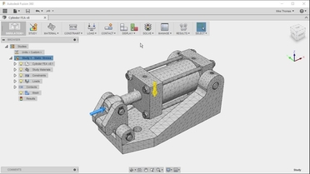
BACKGROUND INFORMATION
Simulation workspace
Used to run structural analysis on model under real-world conditions
Define the constraints (boundary conditions) on the model
Apply a load to simulate real-world force
Generate a mesh, an array of polygons making up the body of the model
Figure 2: Fusion 360 mesh courtesy of O’Reilly

Slide 6
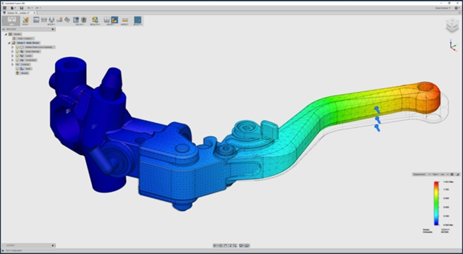
BACKGROUND INFORMATION
Simulation workspace
  Run simulation to obtain safety factor, a value used to describe how much stronger a system is than the expected load
  Can determine if an object is ready to sustain real-world loads or needs to be remodified
Figure 3: Fusion 360 simulation courtesy of Engineering.com

Slide 7
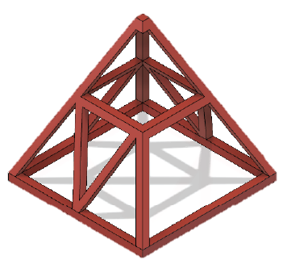
MATERIALS
A lab PC
Fusion 360
Predesigned part files (download
directly from the manual)
Figure 4: Truss Pyramid

Slide 8
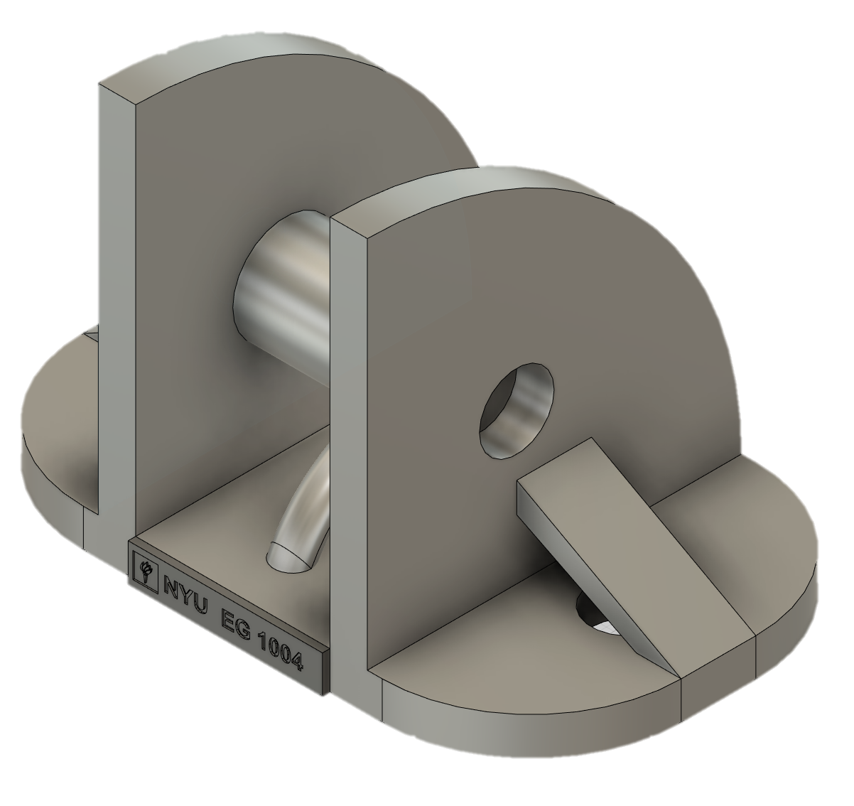
PROCEDURE
Part 1: Set up the File
Part 2: Learning Exercise
  Simultaneous activity with TAs
Figure 5: Redesigned Part

Slide 9
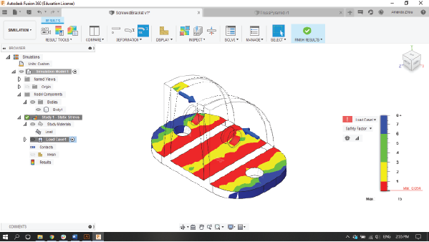
PROCEDURE
Part 3: CAD Competition
  Find the load, material, and
  constraints on the model
  Run a static stress simulation
  Review the initial factor of safety
  Modify the model in the Design workspace within the limits of the competition rules
  Rerun simulations and remodify until
  the part has safety factor of at least 3
  Save and store the F3D file for later use
Figure 6: Fusion 360 mesh courtesy of O’Reilly

Slide 10
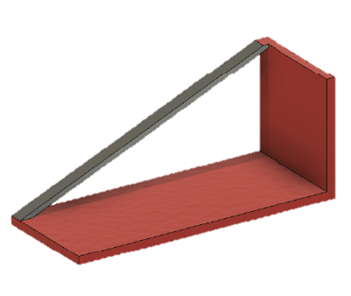
COMPETITION RULES
Redesigned part must be less than double the initial volume
Redesigned part must have a safety factor of at least 3
Cannot alter the applied loads or constraints
Cannot remove the areas highlighted in red on the model
Can only use aluminum, steel, copper, or lead
Figure 7: Wire
Supported Shelf

Slide 11
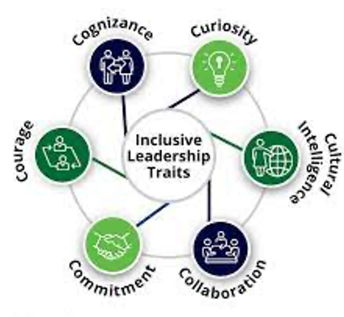
IDBE IMPLEMENTATION
Inclusive Leadership
  Effective and inclusive leaders work to identify their peers’ strengths and support their weaknesses
  Our social identities play an important role in how we lead and the ways we can relate to others
Conflict Resolution
  How do you approach an interpersonal conflict?
  What expectations do you have for your team members? Are these realistic expectations?
  How can we make our emotions and the emotions of others heard?
Figure 8: Inclusive Leadership from Deloitte

Slide 12
ASSIGNMENT
Individual lab report:
  Answer discussion questions in manual
  Learning Exercise section need not be discussed
  Include screenshots of at least two simulations
  Due at 11:59 PM the night before Lab 3
Team presentation:
  Address discussion points in manual
  Learning Exercise section need not be discussed
  Include drawings (top, front, most detailed side, isometric) of
  unmodified and modified part
  Due at 11:59 PM the night before Recitation 3
Notes:
Tandon Areas of Excellence
Sustainability
Urban
Telecommunications & IT
Health
Artificial Intelligence
Professional Skills & Tandon Resources
MakerSpace & RAD
Teamwork & Vertically Integrated Projects
Career Services
Project Management & Technical Writing
World Trade Center Construction

Slide 13
ASSIGNMENT
Individual Lab Report
  Answer discussion questions in manual
  Learning Exercise section need not be discussed
  Include screenshots of at least two simulations
  Due at 11:59 PM the night before Lab 3
Team Presentation
  Address discussion points in manual
  Learning Exercise section need not be discussed
  Include drawings (top, front, most detailed side, isometric) of
  unmodified and modified part
  Due at 11:59 PM the night before Recitation 3
Notes:
Alternate slide conifguration

Slide 14
LAB REPORT REMINDER
CONTRIBUTION STATEMENTS
Paragraph at the end of Conclusion
Discuss the parts of the lab that you completed
State the importance of these parts to the overall experiment
Refer to the Sample Lab Report manual page under Writing Resources
Notes:
The paragraph needs to be added to the end of every conclusion. This does NOT apply to lab 3 lab reports. This applies to Lab 4 lab report and all the other lab reports after that. Ask them to refer to the Sample Lab Report page available on the manual under Writing Resources if they are confused. The paragraph is a part of the conclusion so it does not need a separate title.

Slide 15
LAB REPORT REMINDER
Contribution Statements
Paragraph at the end of Conclusion
Discuss the parts of the lab that you completed
State the importance of these parts to the overall experiment
Refer to the Sample Lab Report manual page under Writing Resources
Notes:
The paragraph needs to be added to the end of every conclusion. This does NOT apply to lab 3 lab reports. This applies to Lab 4 lab report and all the other lab reports after that. Ask them to refer to the Sample Lab Report page available on the manual under Writing Resources if they are confused. The paragraph is a part of the conclusion so it does not need a separate title.

Slide 16
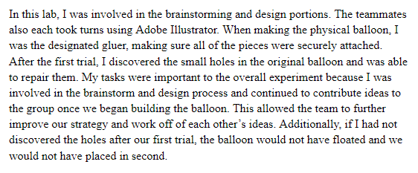
LAB REPORT REMINDER
EXAMPLE
Notes:
This example is also in the sample lab report manual page.

Slide 17
LAB REPORT REMINDER
EXAMPLE
Notes:
This example is also in the sample lab report manual page.

Slide 18
CLOSING
Have all original data signed by a TA
Submit all work electronically
Take screenshots of mechanical part before and after modification
Notes:
Tandon Areas of Excellence
Sustainability
Urban
Telecommunications & IT
Health
Artificial Intelligence
Professional Skills & Tandon Resources
MakerSpace & RAD
Teamwork & Vertically Integrated Projects
Career Services
Project Management & Technical Writing
World Trade Center Construction

Slide 19
QUESTIONS?

