Slide 1

RECITATION 3
EG1003

Slide 2
AGENDA
Technical Presentation Practice
1

Slide 3
TECHNICAL PRESENTATION PRACTICE
Notes:
During recitation you have the opportunity to watch your peers present. It is important that you are able to take feedback from the TA and the professor for all presentations--Not just your own. During our first recitation we went over how to give a lab presentation. This is time to practice.

Slide 4
COMMON PRESENTATION ERRORS
Know your audience
Assume the audience has some basic scientific background
Pretend there are not multiple groups
Formatting
Use bullet points
Do NOT use sentences
Style
Utilize figures and diagrams vs text on the slide
Slides and presentation should be cohesive
3

Slide 5
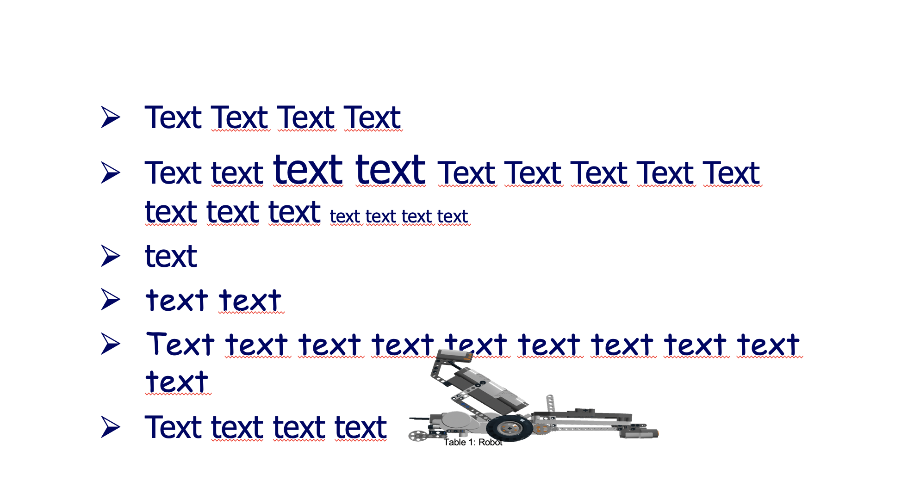
POWERPOINT LAYOUT
Figure 1: Bad slide example
4
Notes:
**Ask students to raise their hand and comment on what is wrong with this slide OR if possible, put students in groups and give them one minute to come up with answers to this question- have each group share one or two improvements to be made. Ask students what is positive with the slide ** Some negative answers: inconsistent font, stretched image, tiny caption, image is labeled as a table, inconsistent capitalization, inconsistent text size, images overlapping text, missing title, too many lines of text.. etc

Slide 6
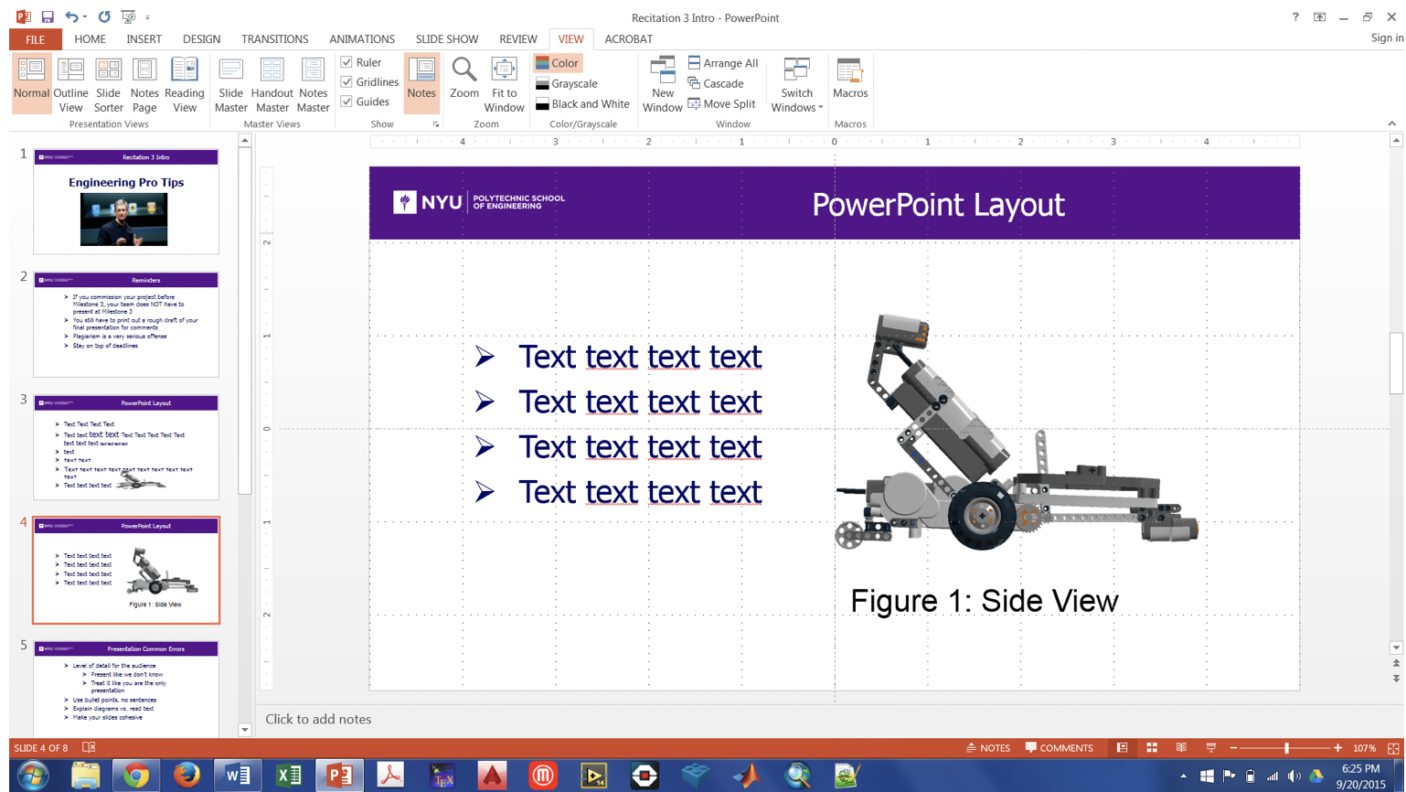
POWERPOINT LAYOUT
Figure2: Layout tools screenshot
5
Notes:
To help with positioning and layout, utilize the gridline, guide and ruler tools nested under the ‘View’ table on the tool bar.

Slide 7
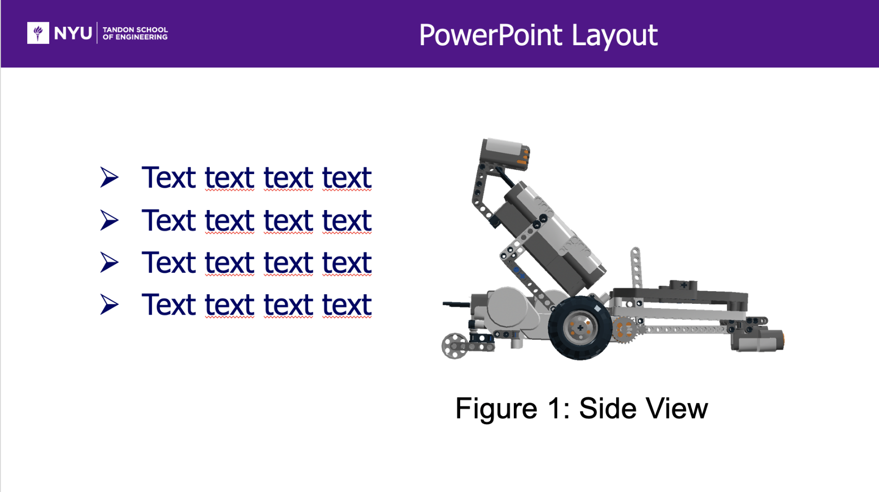
POWERPOINT LAYOUT
Figure 3: Improved slide
6
Notes:
Here’s a visual of the cleaned-up slide.

Slide 8
INSERTING TABLES
Keep source formatting
  Excel: ‘Copy as Picture’ vs ‘Copy’
Remove unnecessary gridlines
  Excel: Page Layout > Uncheck ‘View Gridlines’
Figure 4: Proper table format example
7
Notes:
It is a good idea to use Excel to create tables to display your data since Excel has more advanced functionality than creating a table in PowerPoint. To ensure any stylistic changes are carried over between Excel and PowerPoint, when you copy and paste use the ‘Copy as Picture’ option from the drop down menu next to the ’copy’ icon. If you don’t do this the cell sizes, fonts, coloring and gridlines may change between applications. On the example above you may notice that there are cell gridlines that are not shown in order to deliver the data more clearly. To do this, uncheck the ‘View Gridlines option on the ‘Page Layout’ tab. After you’ve done this, you can create gridlines where you want them.

Slide 9
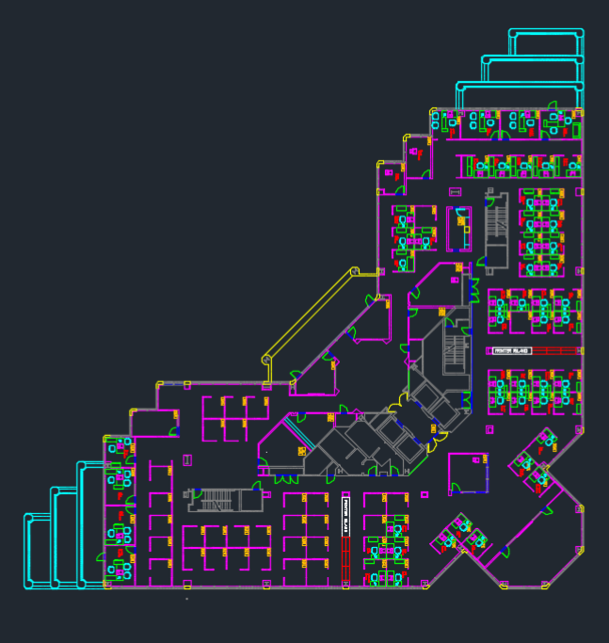
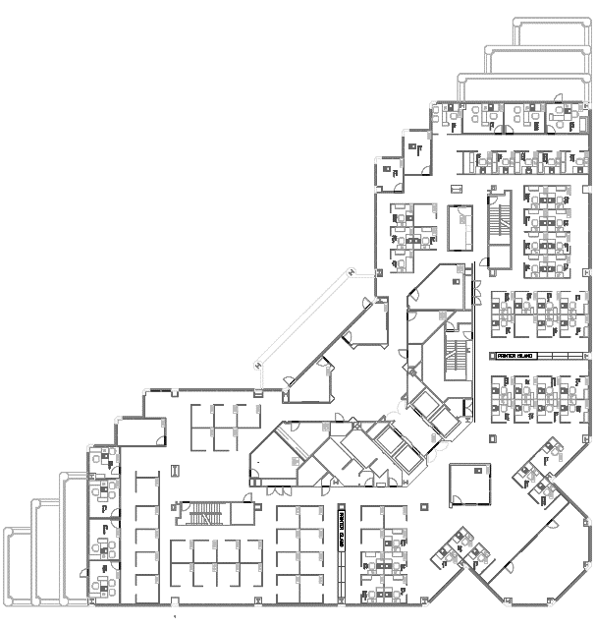
INSERTING CAD DRAWINGS
AutoCAD Colorized Images
Define layers (plumbing, electrical, walls, etc.) in 2D
Detail Distinctions
Print> Properties> Paper/Quality> Color
Figures 5 & 6: Plain and colorized CAD drawings
8
Notes:
Besides being more exciting to look at, a color-coded image of a CAD layout can help the presenter easily display different features and layers of the sketch in one image instead of multiple. To do this, press the printer icon at the top of the window and select the ‘Properties’ button. A visual how-to is shown on the next slide.

Slide 10
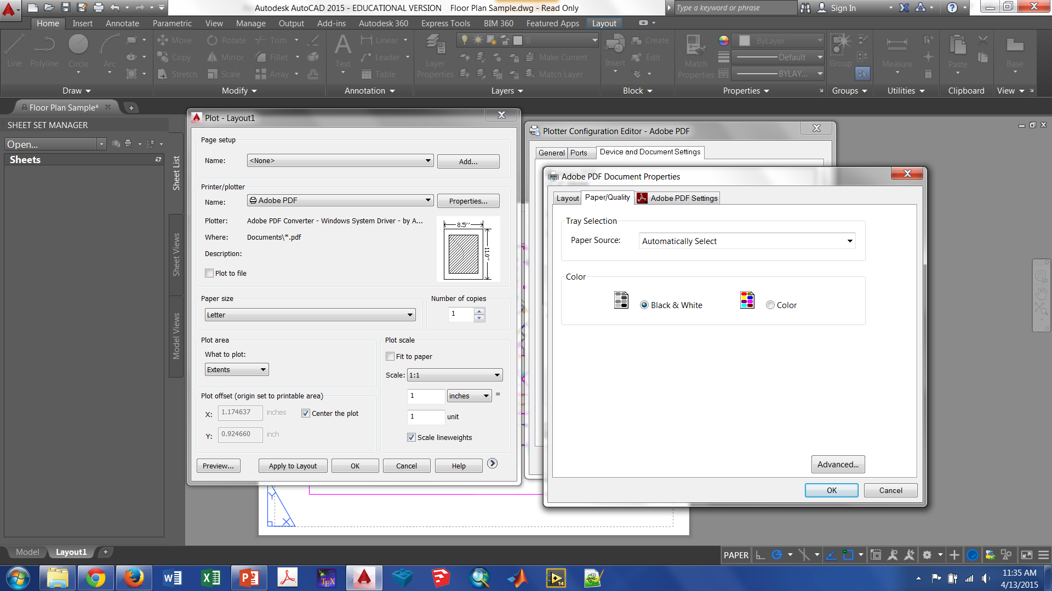
INSERTING CAD DRAWINGS
Figure 7: Colorized AutoCAD Plotting
9
Notes:
This image shows a visual representation of the process described on the last slide.

Slide 11
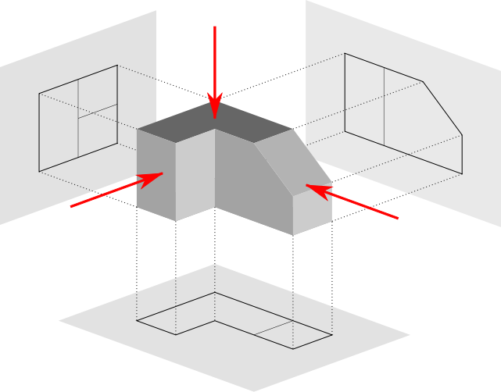
IMAGE VIEWS
Figure 8: Image Viewpoints
10
Notes:
When creating presentations we have the challenge of accurately showing 3D objects, such as ones created in CAD software, on a 2D screen. To do this, we use four different image views. **Ask students if they can name them (Answers on next slide)**

Slide 12
IMAGE VIEWS
Top
Detailed Side
Front
Isometric
Figure 9: Labeled image viewpoints
11
Notes:
The four image views/elevations that should be shown are a top view (aka birds-eye view), front elevation, the most detailed side and anisometric view. We are currently looking at the isometric view of this image which shows the other 3 elevations of interest.

Slide 13
PRESENTATION TIPS SUMMARY
Style
With text, less is almost always more
Think content first
Cohesive and consistent presentation
Meaningful images
Plan topic transitions
You are the storyteller
Organize presentation
Clarity
Motivation
Important concepts
12
Notes:
We’ve talked a lot about presentations by now. Here is a summary to wrap up the big ideas. Use style tips to engage your audience. Think about how you’ll transition from topic to topic in advance. Use a storytelling technique to provide the best presentation. Be sure to include the motivation behind the experiment/project and important foundational concepts.

Slide 14
QUESTIONS?

Slide 15
QUESTIONS?

Slide 16
LAB REPORT UPDATE
INDIVIDUAL REFLECTIONS
Paragraph at the end of Conclusion
Discuss the parts of the lab that you completed
State the importance of these parts to the overall experiment
Needs to be implemented beginning with Lab 4 lab report
  Lab 4, Lab 5, Lab 7, Lab 8, Lab 10 & Lab 11 lab reports
Refer to the Sample Lab Report manual page under Writing Resources
14
Notes:
The paragraph needs to be added to the end of every conclusion. This does NOT apply to lab 3 lab reports. This applies to Lab 4 lab report and all the other lab reports after that. Ask them to refer to the Sample Lab Report page available on the manual under Writing Resources if they are confused. The paragraph is a part of the conclusion so it does not need a separate title.

Slide 17
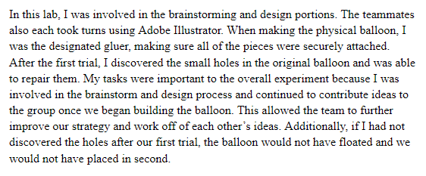
LAB REPORT UPDATE
EXAMPLE
15
Notes:
This example is also in the sample lab report manual page.

