Slide 1
CREATING A LINKEDIN PROFILE
EG1004 | RECITATION 3

Slide 2

WHY LINKEDIN?
Supplements resume and cover letter
It’s where most jobs are posted
Companies search & find you!
Professional network
  Recruiters!
  Colleagues
  Recommenders & Endorsers
  Organizations & companies

Slide 3

PROFILE STRENGTH
Progress bar
  Complete profile = stronger profile
  Add profile sections similar to a resume
Profile basics
  Headshot wearing professional attire
  Simple background
  Use search keywords from job postings
  Highlight major/position & university/company

Slide 4
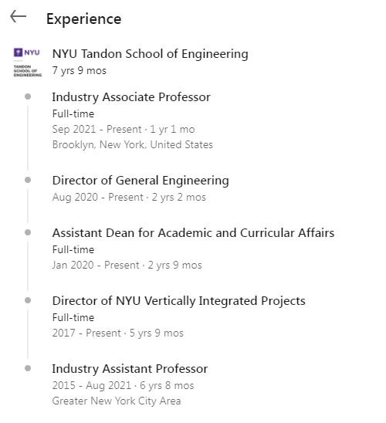
PROFILE STRENGTH
Background photo adds personality
About / Summary
  Like cover letter to a resume
  Expand on headline
Add work and education experience
Media
  Link out to external media
  Resume, ePortfolio, videos of your work

Slide 5
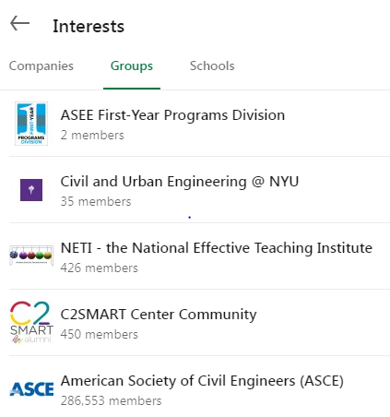
ASSIGNMENT
Create a LinkedIn Profile
Add a professional picture
Update your about me section
Add new education & work experiences
Follow one organization
Submit URL to EG website

Slide 6

RESOURCES
EG1004 Student Manual:
  Writing Consultants will meet with you 1:1 during recitation to answer questions
  EG1004 Writing Style Guide
  Sample Lab Report
  Writing Consultant Lab Report Rubric
Writing Center:
  Schedule an appointment: nyupoly.mywconline.com
  Location: 2 MTC, 9th Floor
  NYU Writing Center Website & Peer Tutor Program
6

Slide 7
QUESTIONS?

