Slide 1

INTRODUCTION TO DIGITAL LOGIC
EG1004 | LAB 5

Slide 2

OVERVIEW
Objective
Background Information
Materials
Procedure
Assignment
Closing
Figure 1: Semiconductor Courtesy of Scoop.it
1

Slide 3
OBJECTIVE
To design a combinational logic circuit for a given problem statement
To build and test the circuit on a breadboard
2

Slide 4
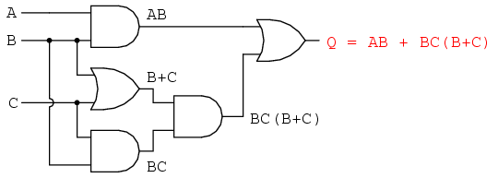
BACKGROUND INFORMATION
Digital logic:
  Conceptual language behind modern computer systems
  Two values of true and false (1 and 0) that lead to complicated decisions
Truth table – shows all the possible input combinations and their associated outputs (example on next slide)
Figure 2: Boolean Circuit Courtesy of
All About Circuits
3

Slide 5
BACKGROUND INFORMATION
Think of this example
An ATM has three options:
  Print statement
  Withdraw money
  Deposit money
The ATM will charge a fee when:
  Money is withdrawn
  A statement is printed without depositing money
Table 1: Truth Table for ATM Example
Inputs |  |  | Output
P (Print) | W (Withdraw) | D (Deposit) | C (Charge)
0 | 0 | 0 | 0
0 | 0 | 1 | 0
0 | 1 | 0 | 1
0 | 1 | 1 | 1
1 | 0 | 0 | 1
1 | 0 | 1 | 0
1 | 1 | 0 | 1
1 | 1 | 1 | 1
4

Slide 6
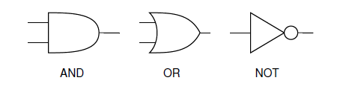
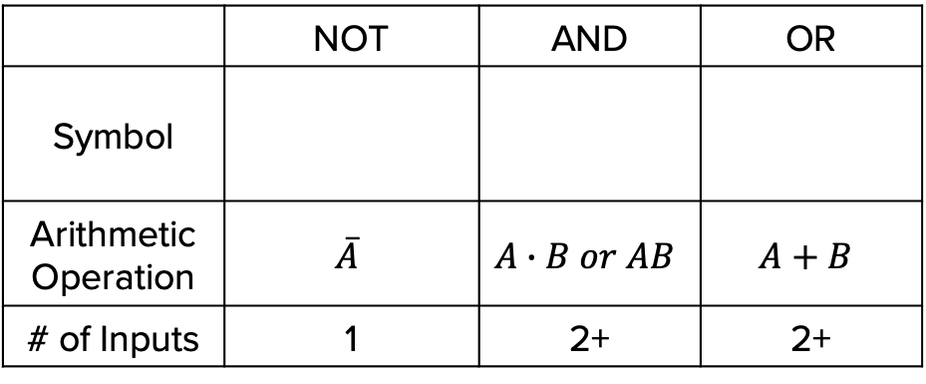
BACKGROUND INFORMATION
Logic gates:
  NOT gate – inverts the input
  AND gate – both inputs must be true for the output to be true
  OR gate – if either input is true the output will be true
Table 2: Logic Gates
 | NOT | AND | OR
Symbol
Arithmetic Operation | $$\overline{A}$$ | $$A∙B or AB$$ | $$A+B$$
# of Inputs | 1 | 2+ | 2+
5

Slide 7
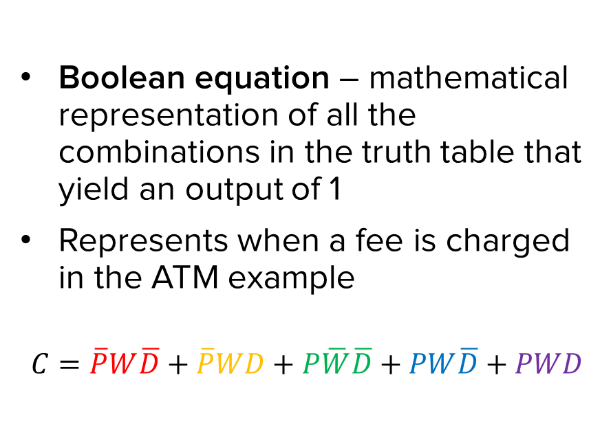
BACKGROUND INFORMATION
Table 3: Truth Table for ATM Example with True Combinations
Boolean equation – mathematical representation of all the combinations in the truth table that yield an output of 1
Represents when a fee is charged in the ATM example
$$C=\overline{P}W\overline{D}+\overline{P}WD+P\overline{W}\overline{D}+PW\overline{D}+PWD$$
Inputs |  |  | Output
P (Print) | W (Withdraw) | D (Deposit) | C (Charge)
0 | 0 | 0 | 0
0 | 0 | 1 | 0
0 | 1 | 0 | 1
0 | 1 | 1 | 1
1 | 0 | 0 | 1
1 | 0 | 1 | 0
1 | 1 | 0 | 1
1 | 1 | 1 | 1
6

Slide 8
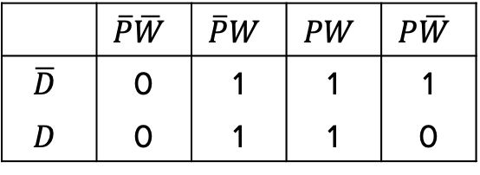
BACKGROUND INFORMATION
Karnaugh map (K-map) – two-dimensional representation that shows the common characteristics of the inputs
Only one value can change at a time between adjacent rows and columns
$$C=\overline{P}W\overline{D}+\overline{P}WD+P\overline{W}\overline{D}+PW\overline{D}+PWD$$
Table 4: K-map for ATM Example
 | $$\overline{P}\overline{W}$$ | $$\overline{P}W$$ | $$PW$$ | $$P\overline{W}$$
$$\overline{D}$$ | 0 | 1 | 1 | 1
$$D$$ | 0 | 1 | 1 | 0
7

Slide 9
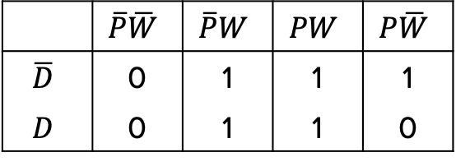

BACKGROUND INFORMATION
Simplified Boolean equation – mathematical representation of true values in the K-map
  Box together 1s in the K-map
  Number of cells in a box must be a
  power of 2 (1, 2, 4, 8, etc.)
  Look for the biggest boxes first
  Boxes can overlap
Simplified equation is determined by constant variable(s) in each box
Table 5: Simplified Boolean Equation
for ATM example
 | $$\overline{P}\overline{W}$$ | $$\overline{P}W$$ | $$PW$$ | $$P\overline{W}$$
$$\overline{D}$$ | 0 | 1 | 1 | 1
$$D$$ | 0 | 1 | 1 | 0
$$C=W+P\overline{D}$$
8

Slide 10

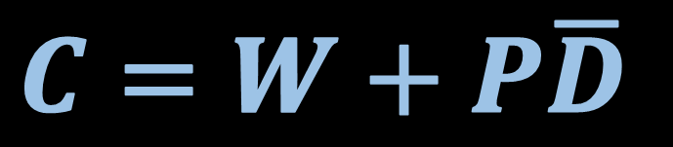




BACKGROUND INFORMATION
Combinational logic circuit – graphical representation of the simplified Boolean equation
$$W$$
OR
$$P$$
$$C=W+P\overline{D}$$
AND
$$D$$
NOT
$$P\overline{D}$$
$$\overline{D}$$
Figure 3: Combinational Logic Circuit for ATM Example
9

Slide 11
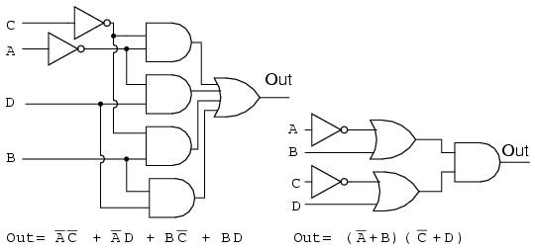
BACKGROUND INFORMATION
Minimization of Boolean functions
  K-map used to simplify complex Boolean equations
  Reduces complexity of logic circuit
  Would increase efficiency and decrease cost in implementation
Figure 4: Complex Logic Circuit (Left) vs.
Simplified Logic Circuit (Right)
10

Slide 12
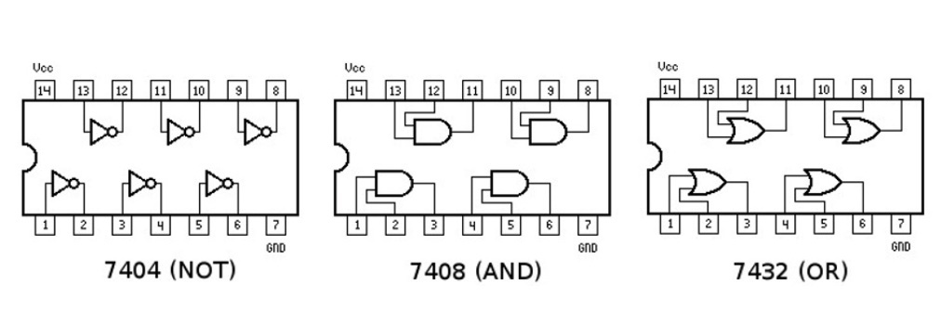
BACKGROUND INFORMATION
Integrated Circuits (ICs) – chips that consist of small assemblies of electronic components
Logic Gate ICs consist of logic gates that can be used to prototype combinational logic circuits on a breadboard
Figure 5: Diagram of NOT/AND/OR IC Chips
11

Slide 13
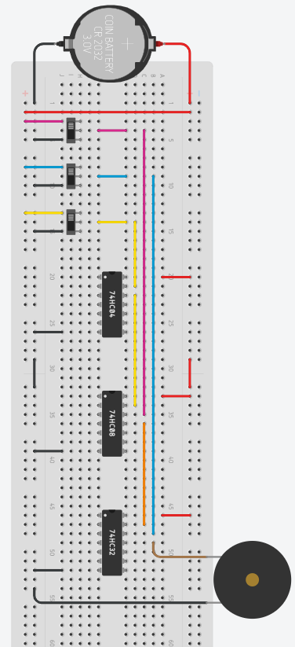



BACKGROUND INFORMATION
$$\overline{\text{D}}$$
$$\text{P}\overline{\text{D}}$$
$$\text{W}\text{+ }\text{P}\overline{\text{D}}$$
Print (P)
Withdraw (W)
Deposit (D)
Figure 6: Diagram of the example ATM circuit
12

Slide 14
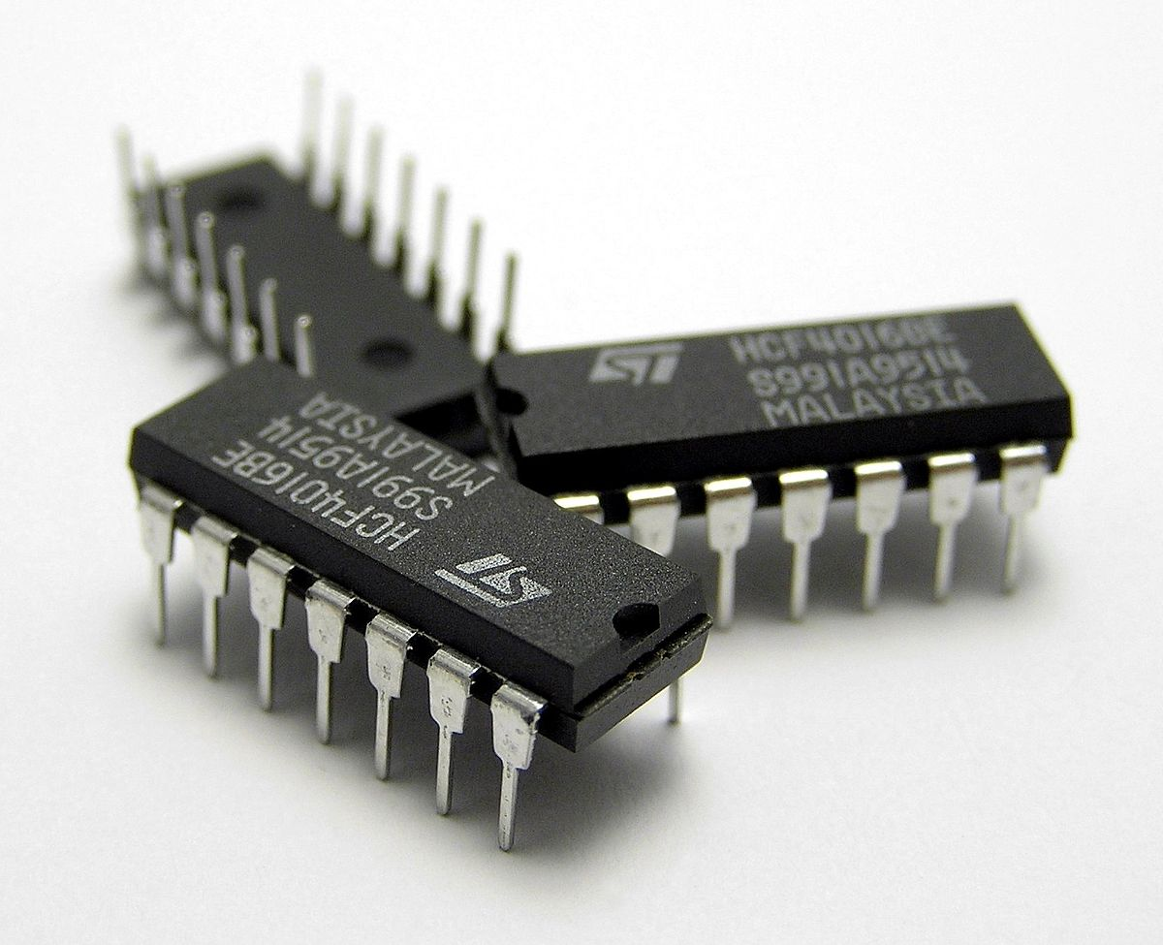
MATERIALS
A 7432 IC (4 dual-input OR gates)
A 7408 IC (4 dual-input AND gates)
A 7404 IC (6 single-input NOT gates)
Breadboard
5V Battery Case
LED
220 Ω Resistor
Slide Switches
Wires
Figure 7: Integrated circuit (IC) chips
courtesy of Wikipedia
13

Slide 15
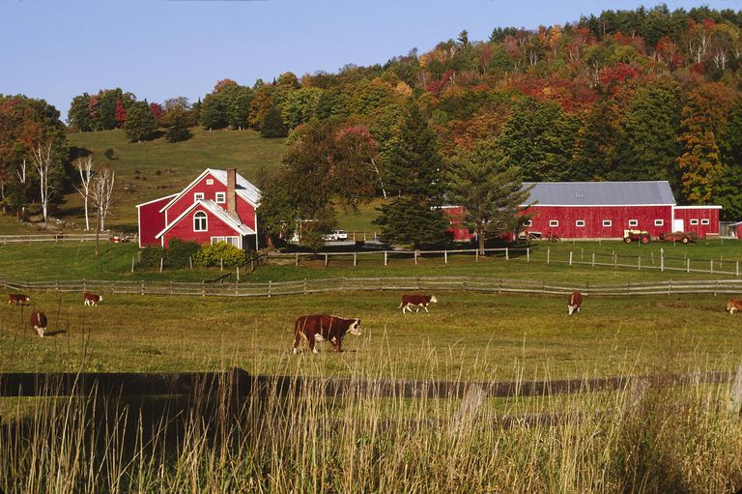
PROBLEM STATEMENT
Farmer Georgi has a hen on his 350-acre farm that produces high-quality eggs
To protect the hen from a fox who has been wandering around the farm and his corn, he needs an alarm system
Figure 8: Farmer Georgi’s Farm
Courtesy of ThoughtCo
14

Slide 16
PROBLEM STATEMENT
Farmer Georgi has two barns
  Think of Barn A as “0” and Barn B as “1” in the truth table
A fox, hen, and corn can be in either barn at anytime
Design an alarm system that will sound when:
  The fox and hen are in the same barn
  The hen and corn are in the same barn
15

Slide 17
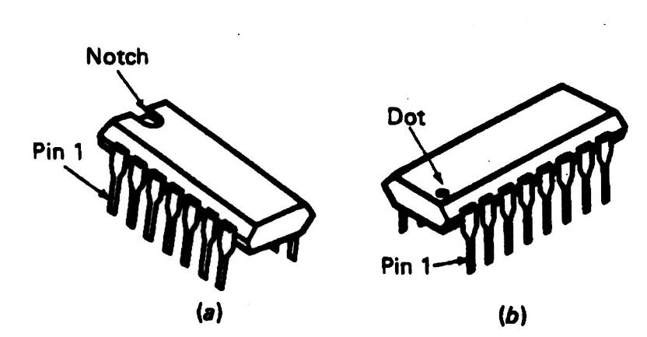
PROCEDURE
Part I: Formulate the Simplified Boolean Equation
Build a truth table for the alarm system
Create a Boolean equation
Build a K-map
Create a simplified Boolean equation
Draw a combinational logic circuit
  Add a light bulb to represent the alarm
Figure 9: IC Chip
16

Slide 18
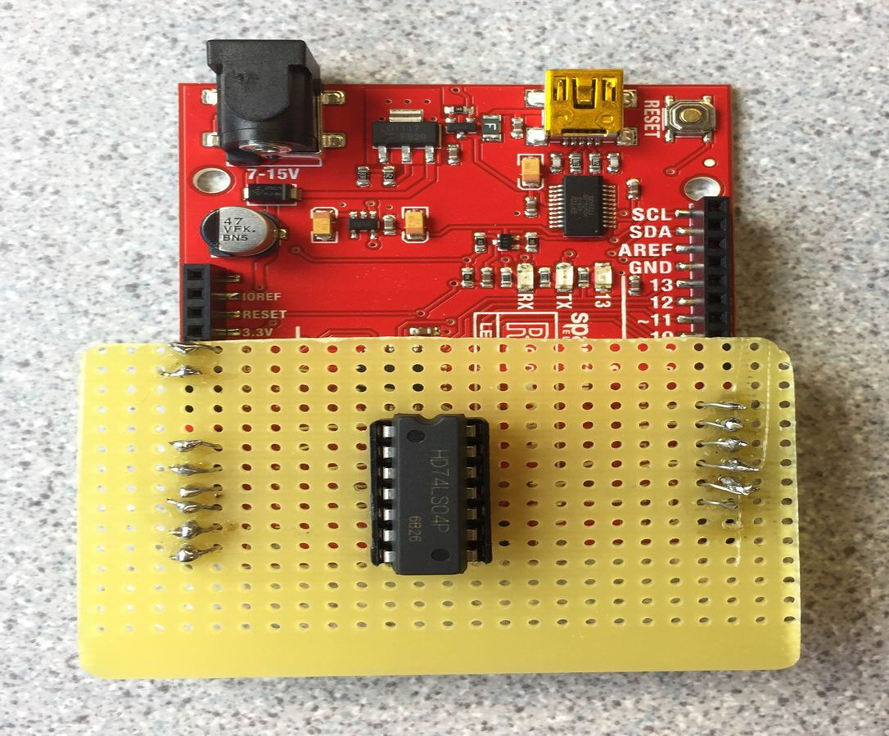
PROCEDURE
Part II: Test the IC Chips
Use the Arduino board setup by the TAs to test the NOT/OR/AND IC chips
The Arduino program will determine if the IC chips are functional or not
Orient the IC chips properly
Figure 10: IC chip tester
17

Slide 19
PROCEDURE
Part III: Build the Combinational Logic Circuit
Build and test the logic circuit on a breadboard
  Wire the combinational logic circuit using the IC chips
  Power (+5V) and ground the IC chips
  Orient the IC chips properly
Figure 11: Diagram of NOT/AND/OR IC Chips
18

Slide 20
ASSIGNMENT
Individual lab report:
  Answer discussion questions in manual
  Explain how k-maps help simplify the circuitry
  Include the truth table, both Boolean equations, and k-map
  Include pictures of the completed logic circuit
  Due at 11:59 PM the night before Lab 6
Team presentation:
  Address discussion points in manual
  Include pictures of the completed logic circuit
19

Slide 21
CLOSING
Take pictures of the completed logic circuit
Clean up workstations
Return all unused materials to the TA
20

Slide 22
QUESTIONS?

