Slide 1
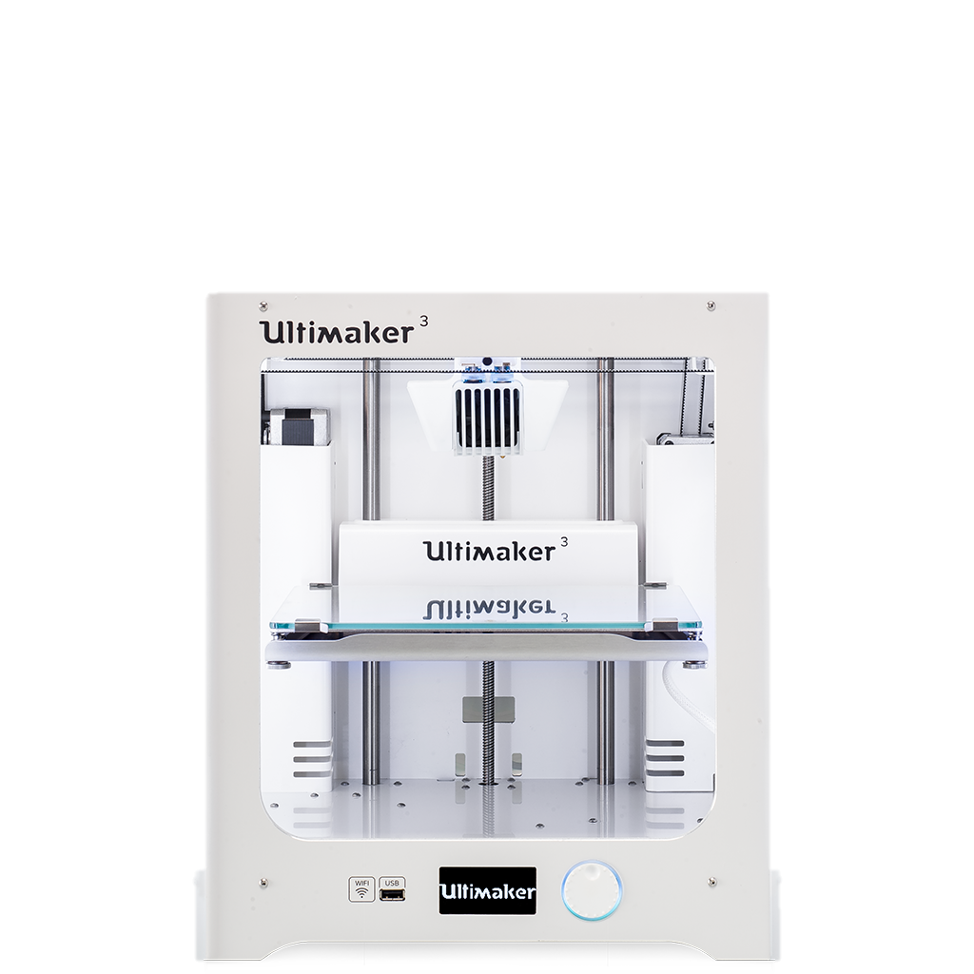
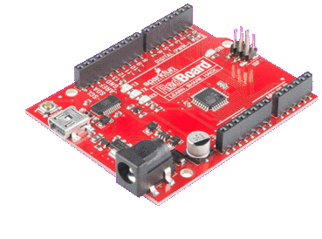
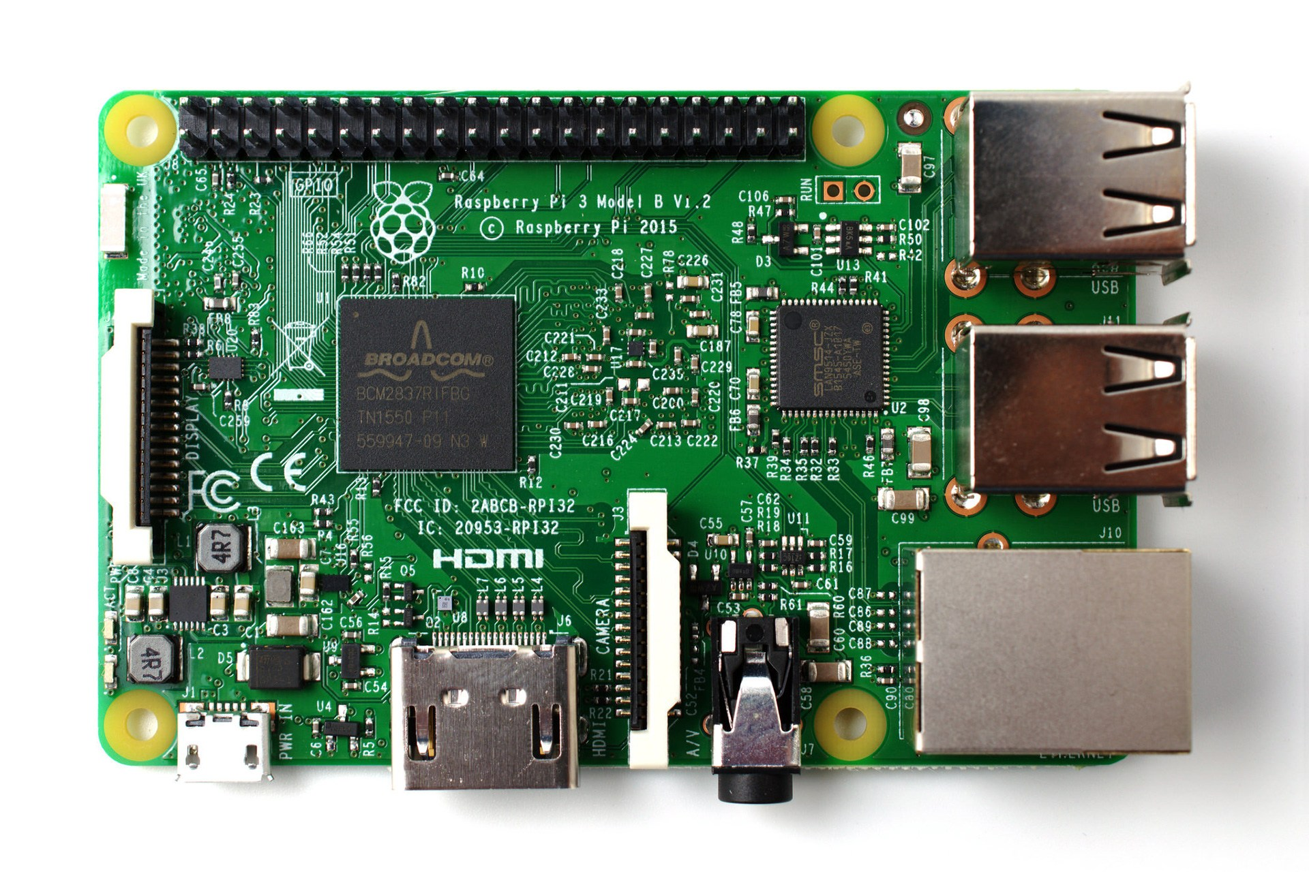
EG1003: Introduction to Engineering and Design
Semester-Long Design Project

Slide 2
Project Introduction
Project duration: 10 weeks
Teams of 3 or 4 people
Projects are open-ended
Any problem
Solve with technology
Novel invention
Technical innovation
Entrepreneurial design

Slide 3
Project Grading
Item | % of Grade
Benchmarks and Commissioning | 50%
Final Presentation | 50%
NOTE: The SLDP counts toward 30% of your course final grade!

Slide 4

Project Grading
Milestones
  Milestone 1 is proposal
  Presentations updating progress
  Technical project management
  Benchmarks
  Physical prototype and pivots
  2 customer interviews
  Penalties for not completing on time

Slide 5

Project Grading
Commissioning
  Completion of a final prototype
  6 interviews in total
  All technical documents must be finished
Project Submission
  Hand in technical and managerial related documents
  Must be received in order to obtain SLDP Grade (30%)
  Any missing items will result in penalties
  Refer to syllabus for deadline

Slide 6
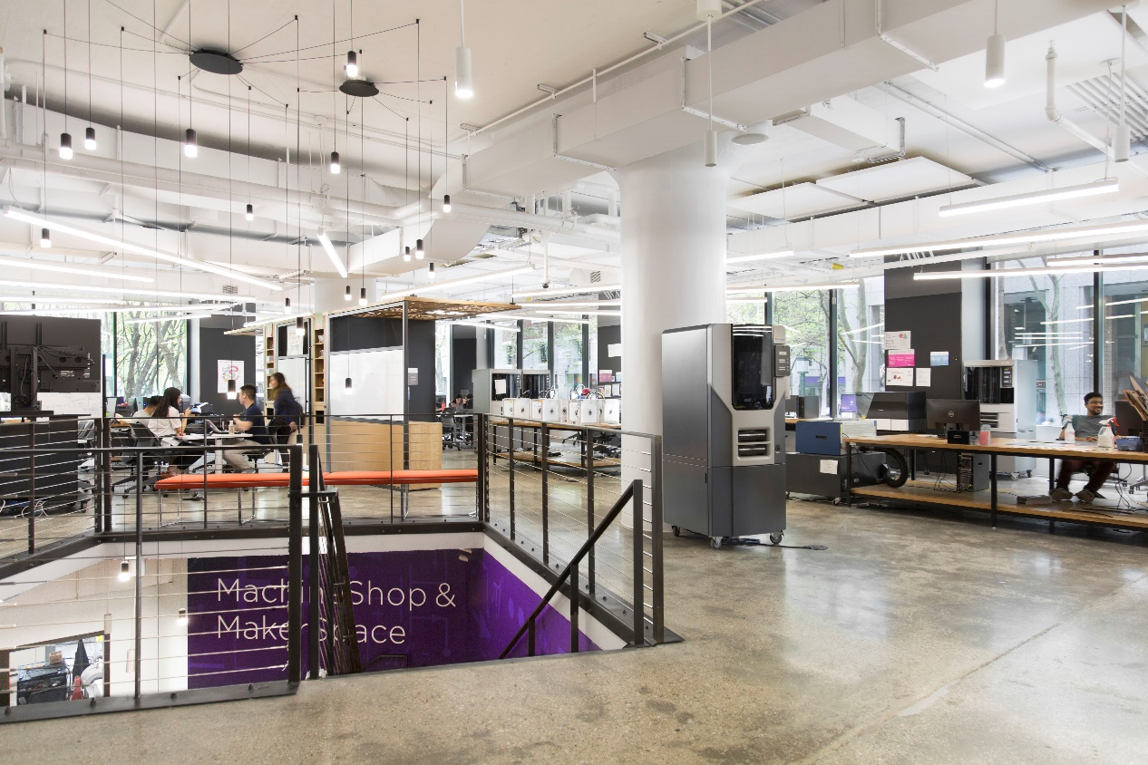
SLDP Options
Open-Ended
Multidisciplinary
Problem Spotting
Physical Prototype

Slide 7
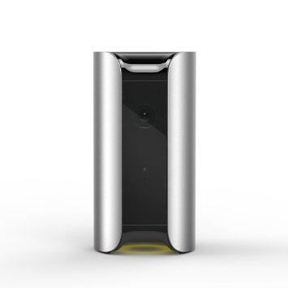
SLDP Options
Invention, Innovation, and Entrepreneurship (i²e)
Must be a physical prototype
Requires some programming
Requires an algorithm with at least two signal inputs (sensors) and one output, or a design of corresponding difficulty
Requires 3D printed elements

Slide 8
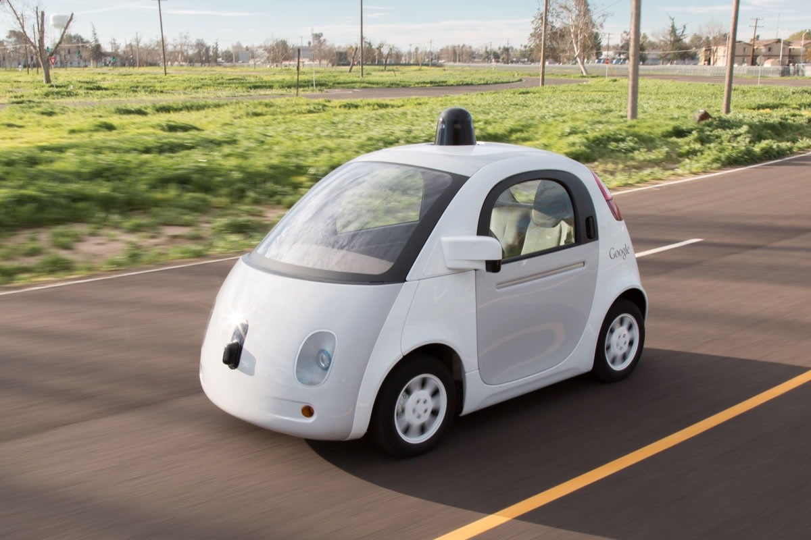
SLDP Requirements
Invention, Innovation, and Entrepreneurship (i²e)
Must be multidisciplinary (combines mechanical, civil, electrical, computer, computer science, and chemical)
Could be a smart device, sensor, robotic part, lab equipment, measurement tool
Or any innovative idea you have

Slide 9
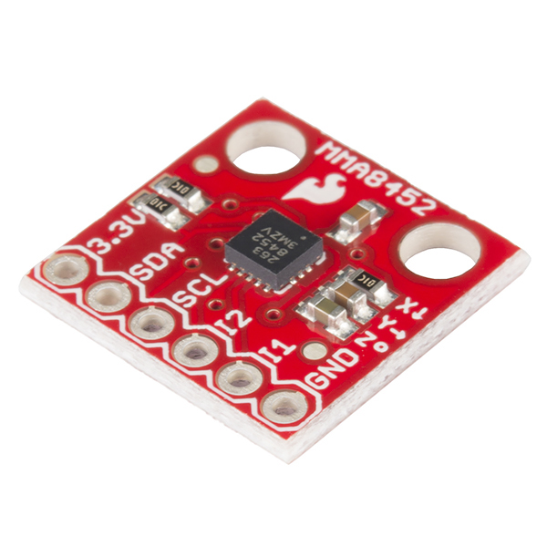
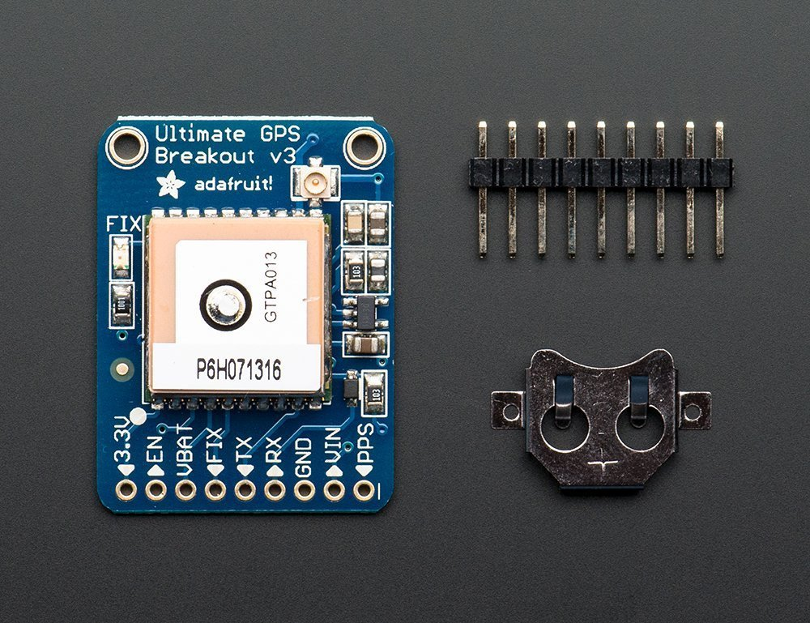
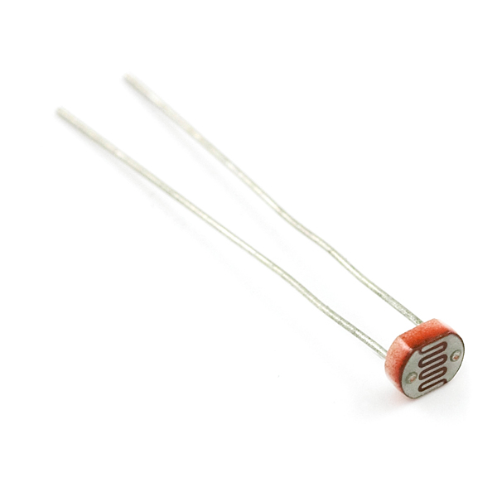
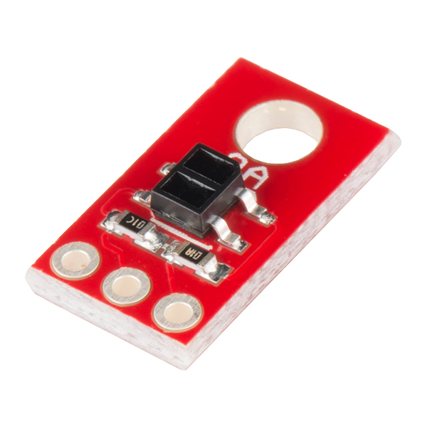
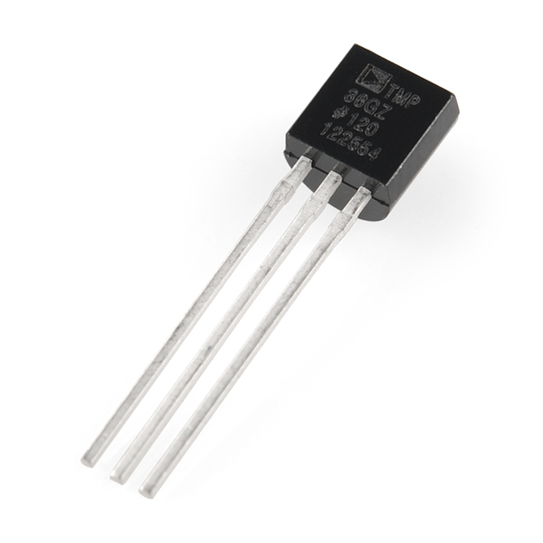
SLDP Materials
Invention, Innovation, and Entrepreneurship (i²e)
Arduino, Raspberry Pi
3D printer filament
Input
  Light sensors, flex sensors, temperature sensors, IR sensors, GPS, accelerometers
Output
  LED, Display Panel, Computer, Phone
Breadboards, wires, and switches

Slide 10
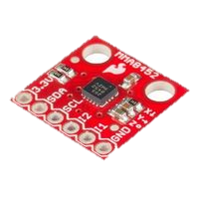
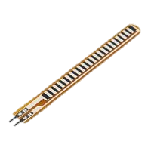
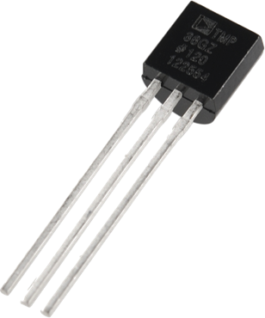
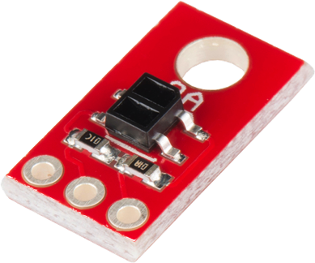
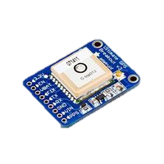
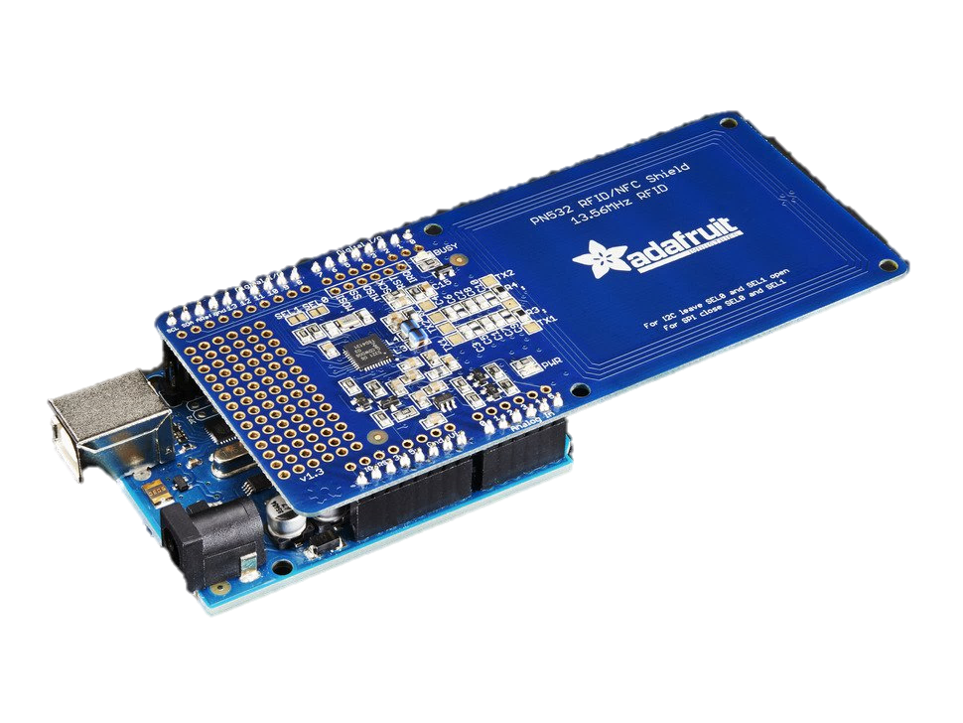
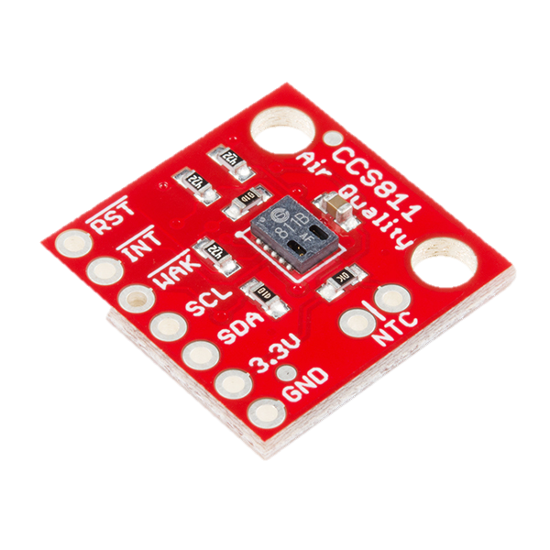
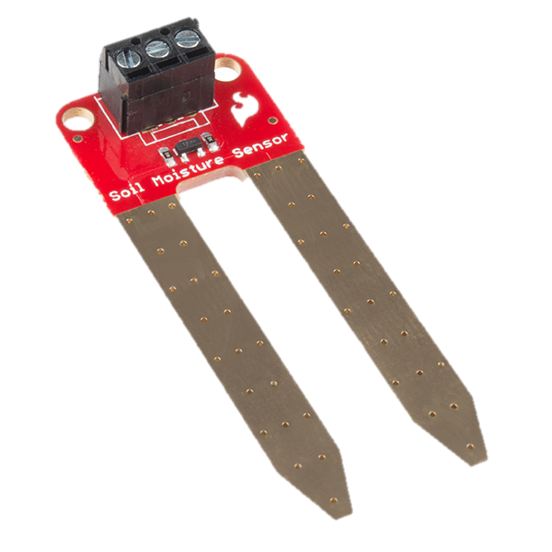
Arduino Sensor Kit
Accelerometer
Temperature
Flex Sensor
Line Following
GPS
RFID
Air Quality
Moisture

Slide 11
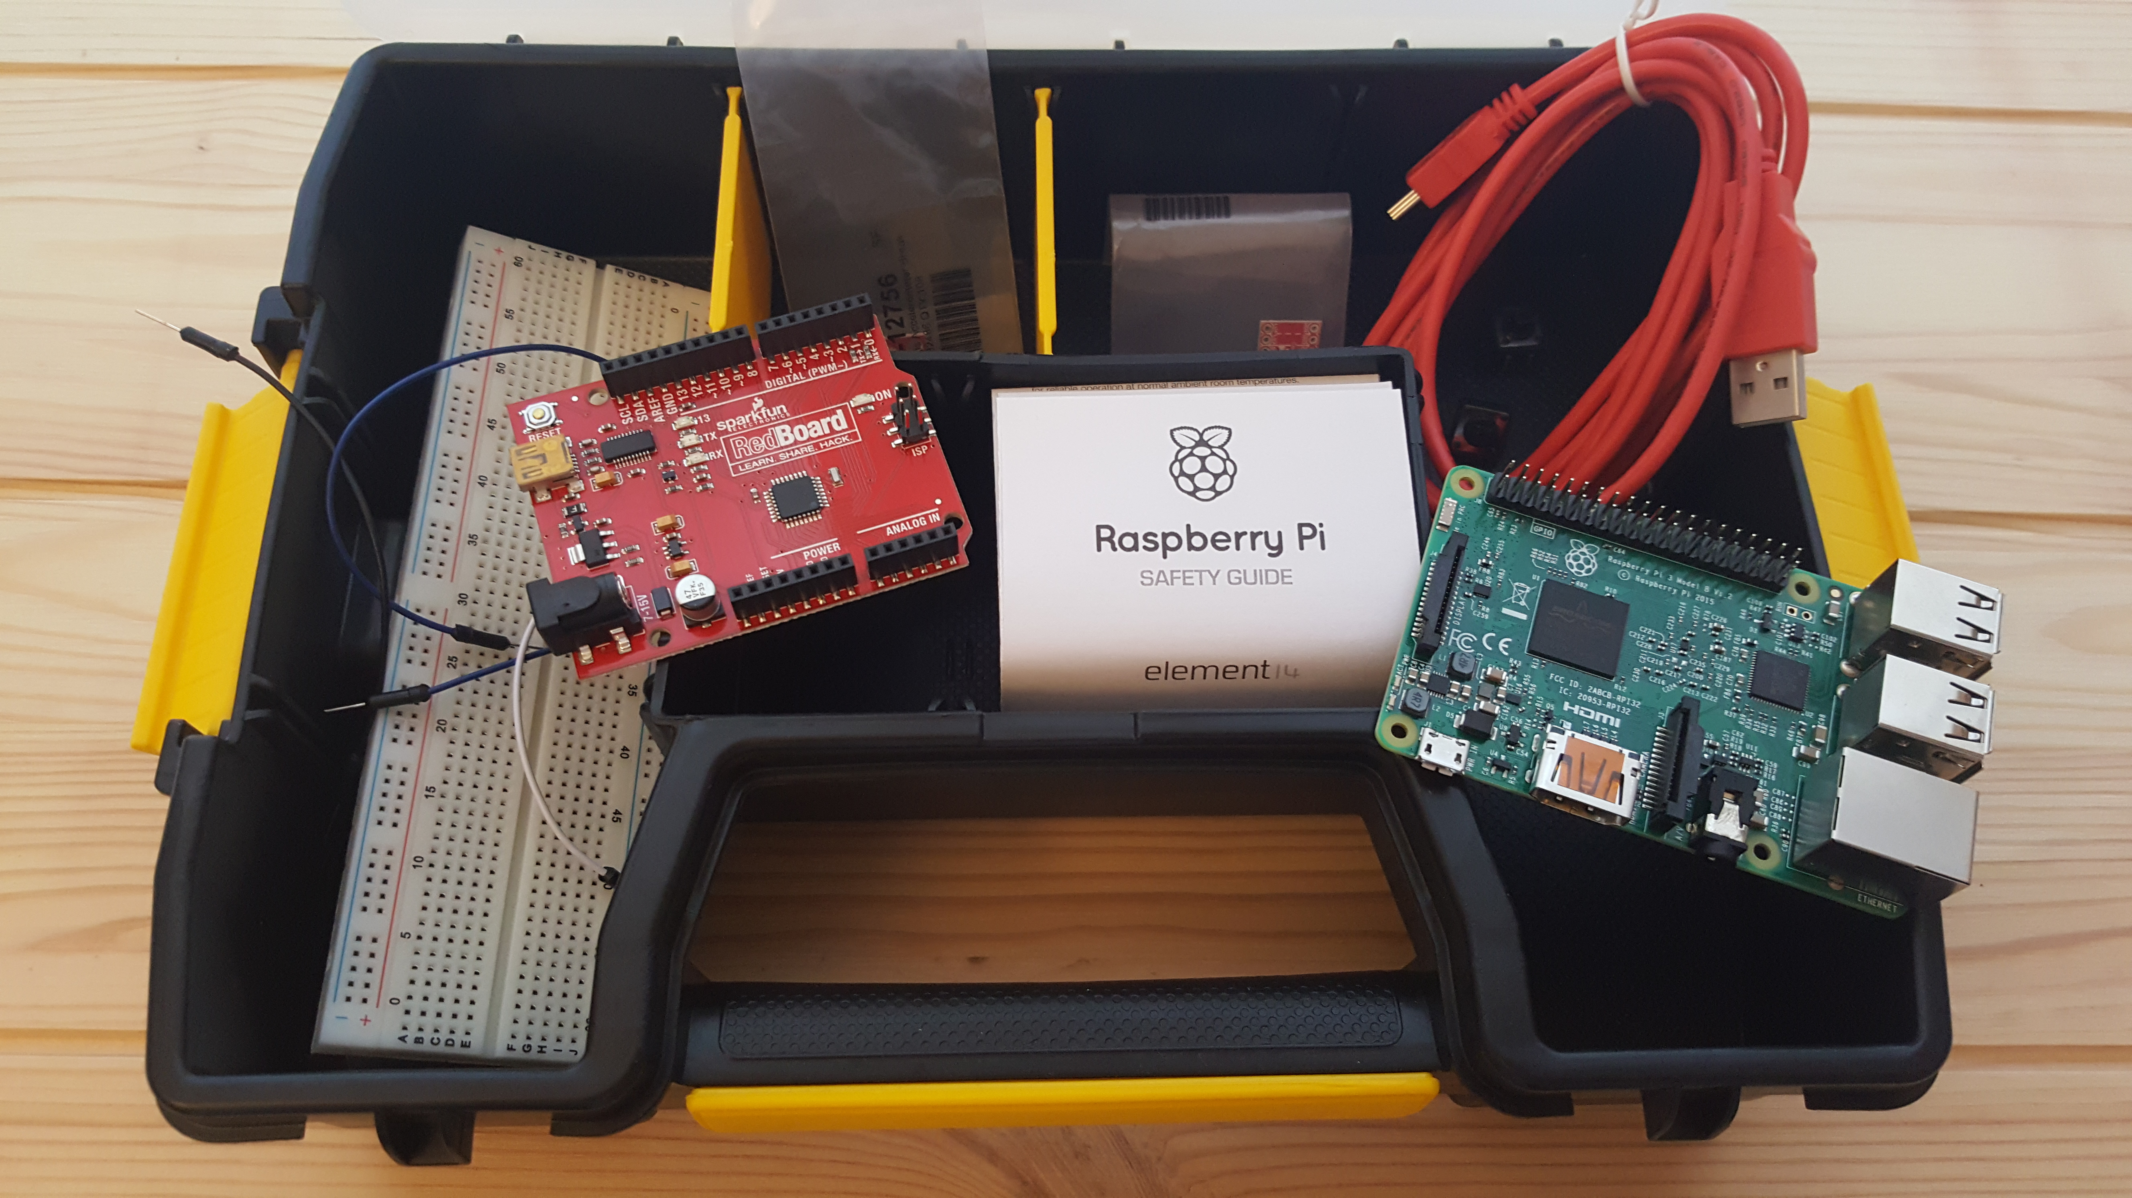
Prototyping Kit

Slide 12
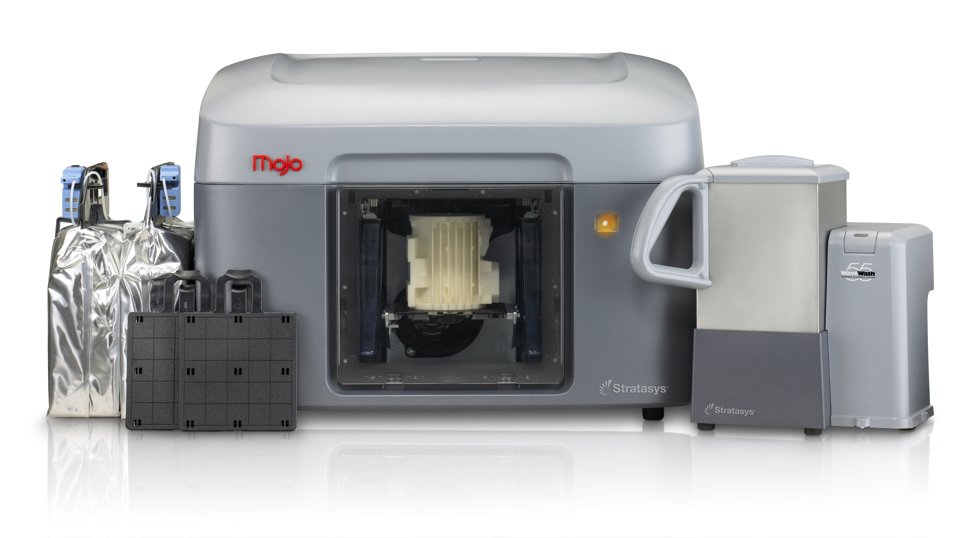
SLDP Support
Invention, Innovation, and Entrepreneurship (i²e)
NYU MakerSpace
EG Prototyping Lab
Senior mentors
In class training on brainstorming, the engineering design process, and consumer-focused prototyping

Slide 13

SLDP Inspiration
Invention, Innovation, and Entrepreneurship (i²e)
Internet of Things
Maker Movement
NYU Tandon School of Engineering Research Areas (Bio, Info, Urban)
Grand Challenges for Engineering

Slide 14
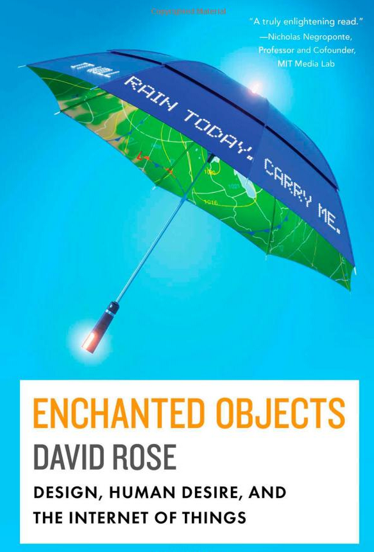
Internet of Things
Rose, D. (2014). Enchanted Objects: Design, Human Desire, and the Internet of Things. Simon and Schuster.

Slide 15
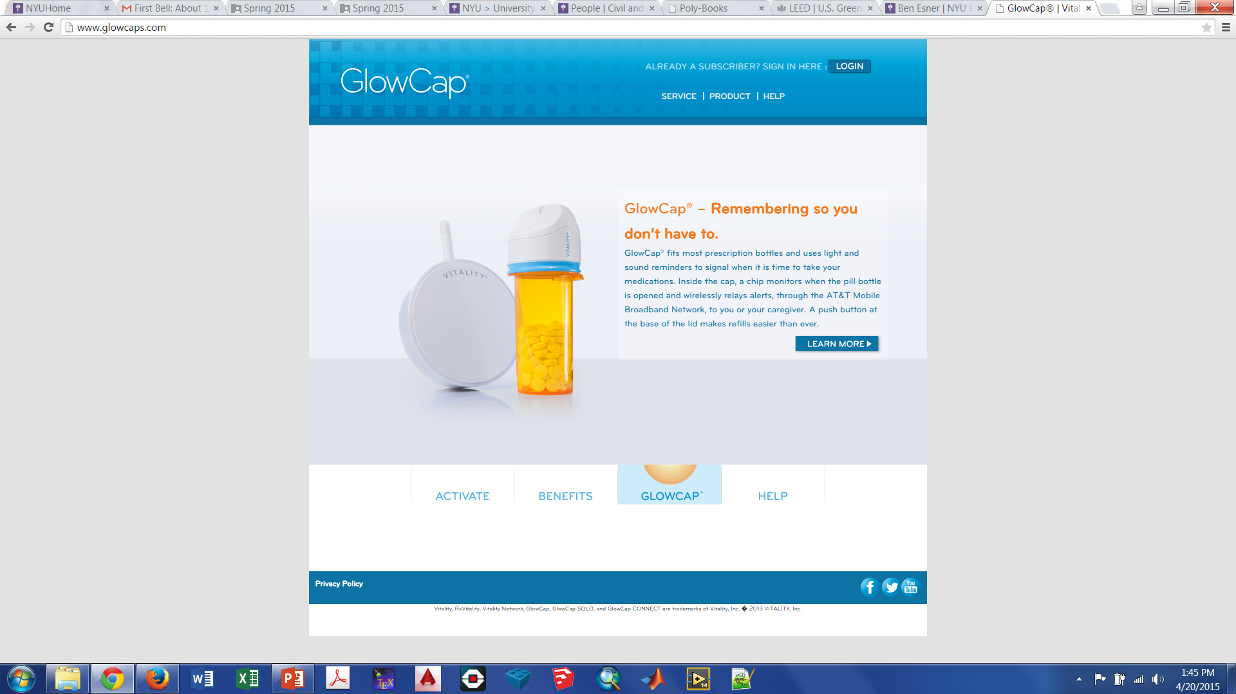
Internet of Things
Terminal World
Prosthetics
Animism
Enchanted Objects

Slide 16
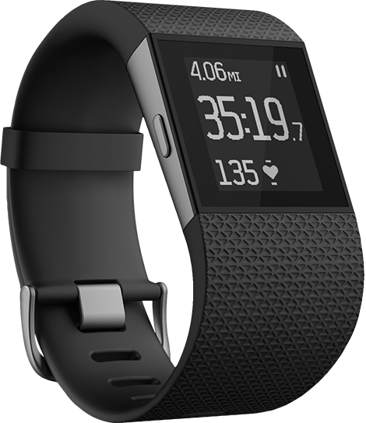
Maker Movement
To know all
To connect with others
Safety
Health
Travel
Creativity

Slide 17
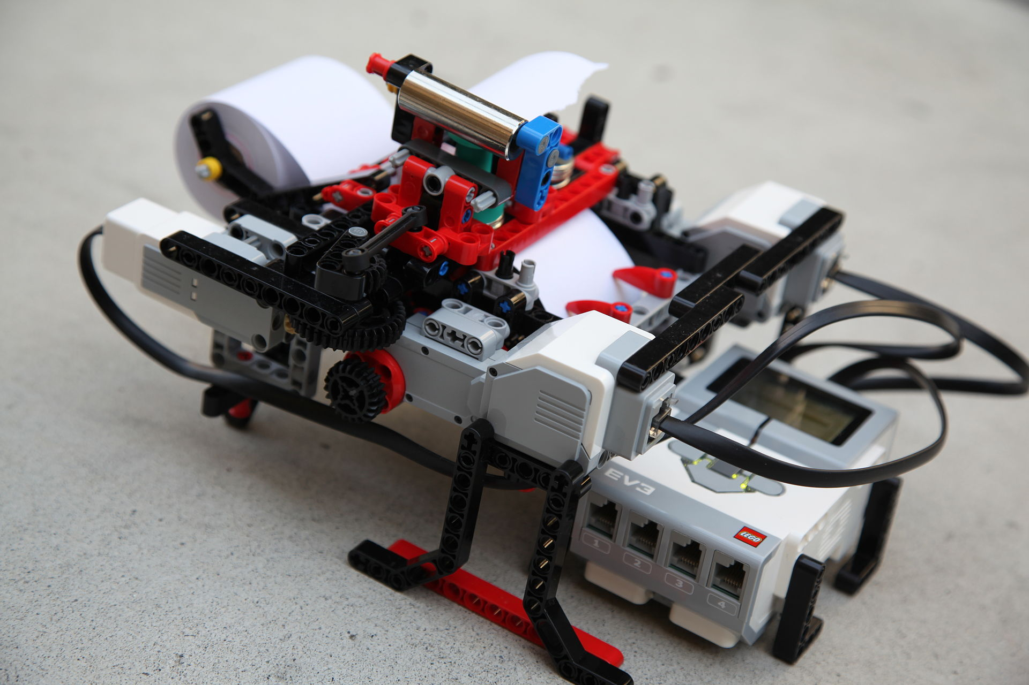
Maker Movement
Glanceabilty
Gestureability
Affordability
Wearability
Indestructability
Usability
Lovability
Braigo - Braille Printer with Lego Mindstorms EV3

Slide 18

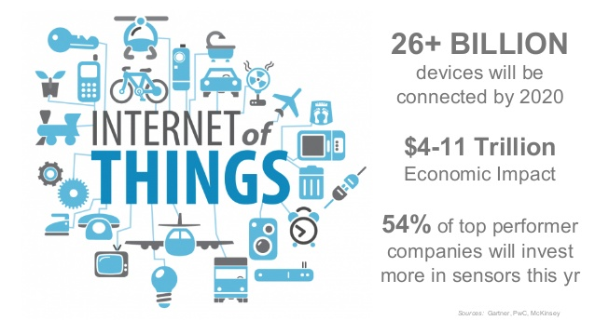
Maker Movement and IoT
Prototyping technology, designing sensors, analyzing data

Slide 19
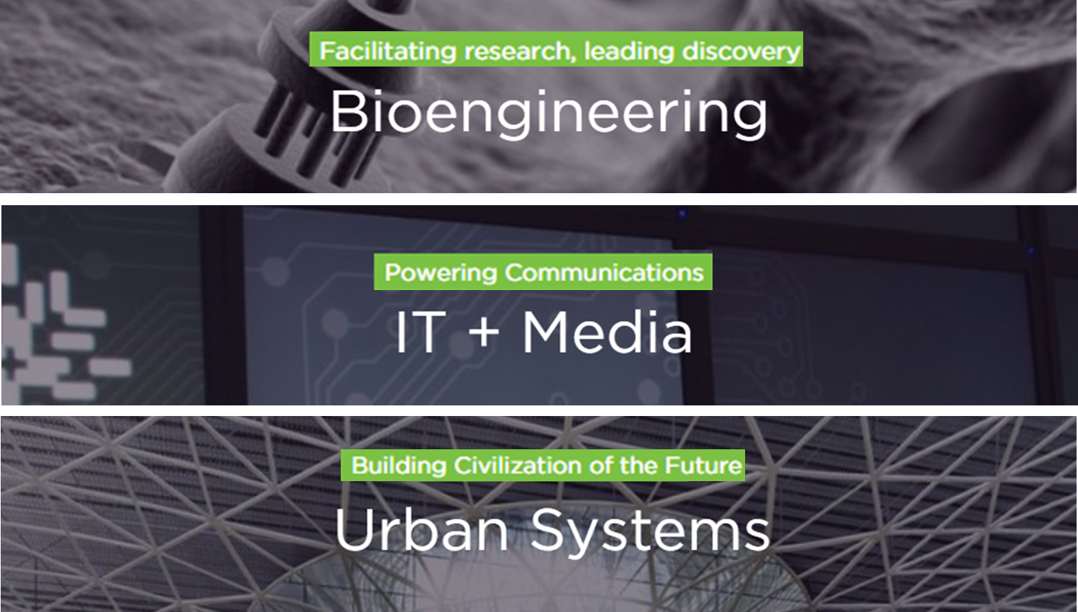
NYU Tandon Research Focuses

Slide 20
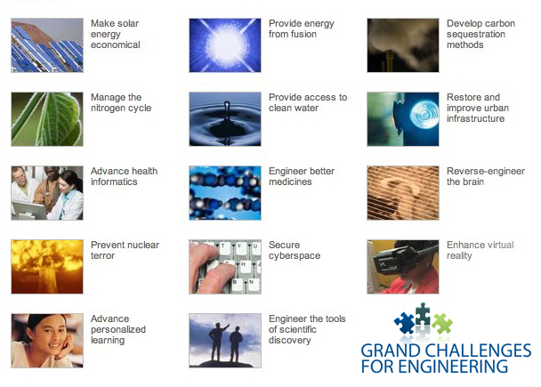
NAE Engineering Grand Challenges

Slide 21
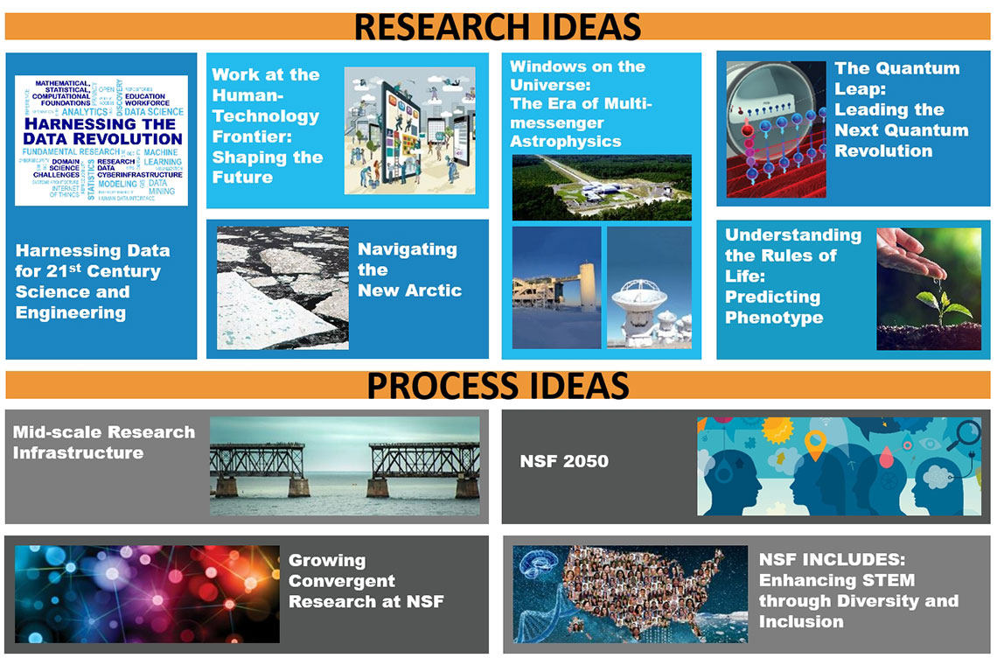

NSF Ten Big Ideas
2050

Slide 22
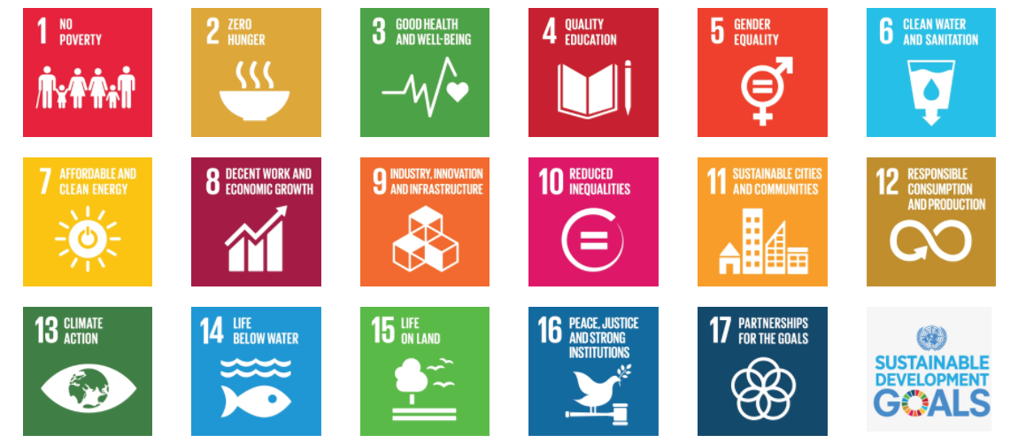
UN Sustainable Development Challenges

Slide 23
Emerging Engineering Topics
Batteries Connected buildings Prosthetics Augmented reality Shared electric autonomous vehicles 5G/LoRa | Wearable technology Ingestible technology Additive manufacturing Health monitoring SpaceX/Blue Origin Machine Learning Artificial Intelligence

Slide 24



i²e
Game changers
I-Corps
InnoVention
Prototyping Fund
NYU Technology Venture Competition
http://entrepreneur.nyu.edu/funding-competitions/

Slide 25
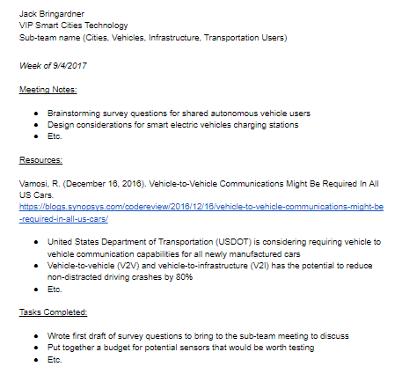
Project Documentation
Project notebook
Google Doc
  Code
  Drawings
  Design canvas
  Testing

Slide 26
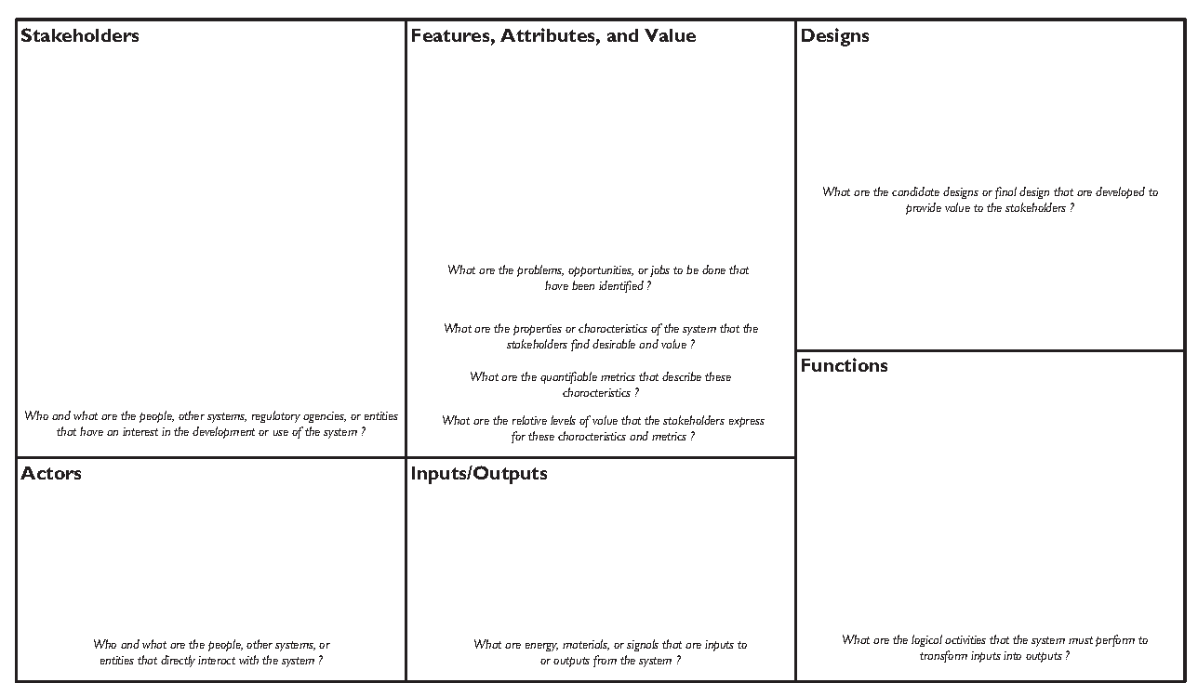
Design Canvas
Documentation of your design

Slide 27
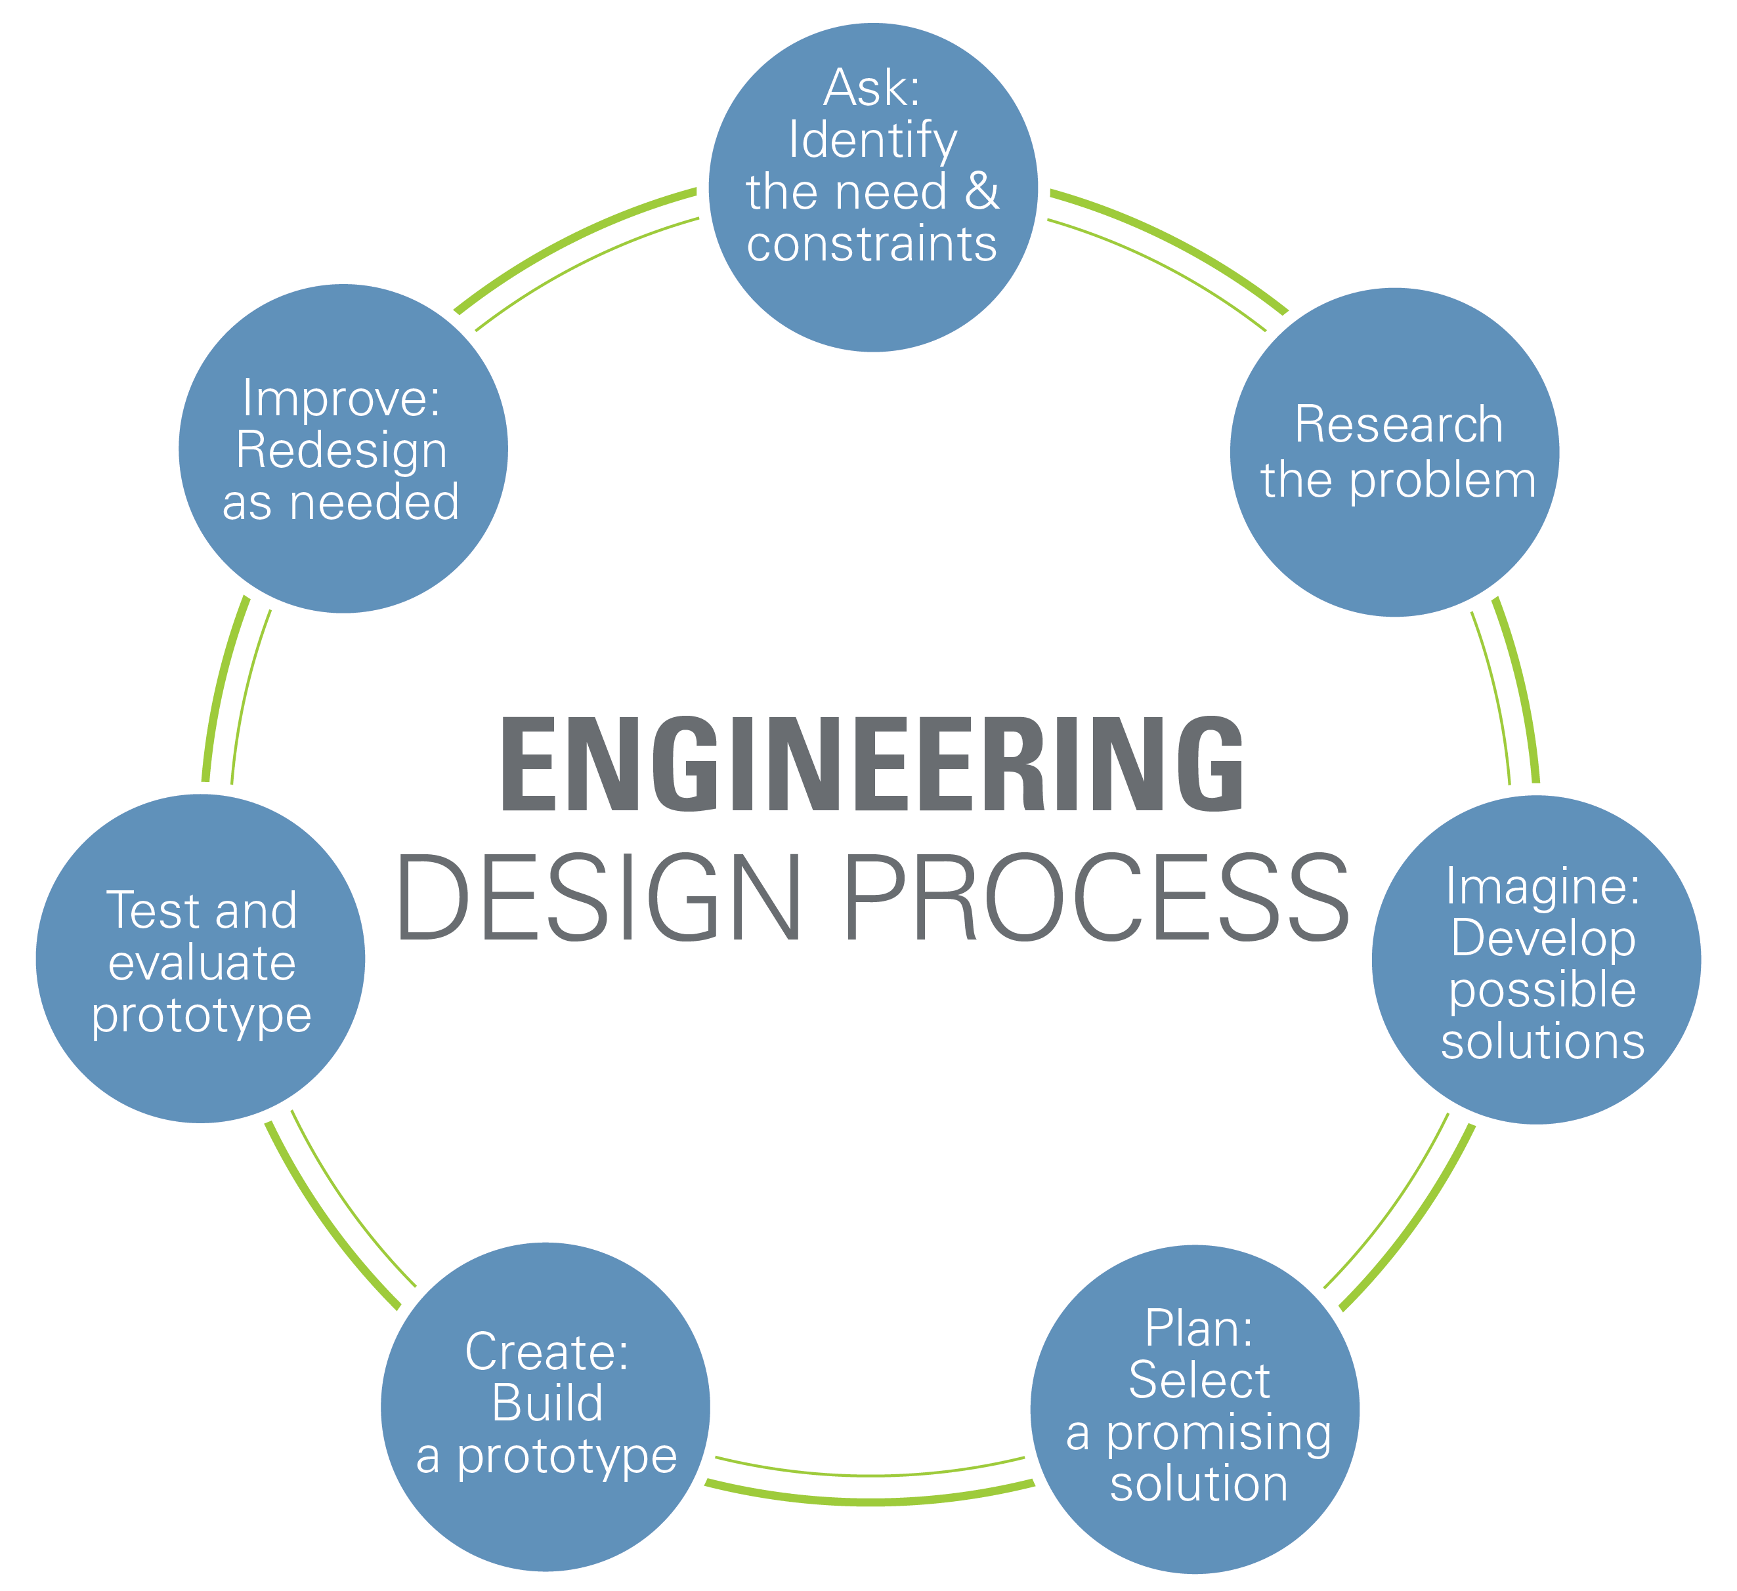
Engineering Design Process

Slide 28
Closing
Refer to manual.eg.poly.edu for details
Think about which topics interests you
Brainstorm ideas
Speak with professors and TAs regarding projects

