Slide 1

RECITATION 10
EG1004

Slide 2
AGENDA
Career Building
Activity: Elevator Pitches
1

Slide 3
CAREER BUILDING

Slide 4
TOP PAYING MAJORS
1. Computer Science
Median Base Salary: $70,000
Popular Entry-Level Jobs:
Software Engineer, Systems Engineer, Web Developer
2. Electrical Engineering
Median Base Salary: $68,438
Popular Entry-Level Jobs:
Electrical Engineer, Systems Engineer, Software Developer
3. Mechanical Engineering
Median Base Salary: $68,000
Popular Entry-Level Jobs:
Mechanical Engineer, Design Engineer, Project Engineer
4. Chemical Engineering
Median Base Salary: $65,000
Popular Entry-Level Jobs:
Chemical Engineer, Process Engineer, Project Engineer
5. Industrial Engineering
Median Base Salary: $64,381
Popular Entry-Level Jobs:
Industrial Engineer, Quality Engineer, Production Planner
6. Information Technology
Median Base Salary: $64,008
Popular Entry-Level Jobs:
Programmer Analyst, Technical Support, Systems Engineer
7. Civil Engineering
Median Base Salary: $61,500
Popular Entry-Level Jobs:
Civil Engineer, Structural Engineer, Field Engineer
8. Statistics
Median Base Salary: $60,000
Popular Entry-Level Jobs:
Data Analyst, Statistician, Data Scientist
9. Nursing
Median Base Salary: $58,928
Popular Entry-Level Jobs:
Registered Nurse, Licensed Vocational Nurse, Case Manager
10. Management Information Systems
Median Base Salary: $58,000
Popular Entry-Level Jobs:
Network Administrator, Help Desk Analyst, Business Analyst
Learn More
3
Notes:
According to an article written by GlassDoor in 2018.

Slide 5

HOW TO GET A JOB
Tandon Career Services
  Tandon Career Fair
  Tandon Resources
The Wasserman Center | Brooklyn
  NYU Handshake
LinkedIn, Glassdoor
Figure 1: Wasserman Center location -- Wunsch Hall in MetroTech courtyard
4

Slide 6
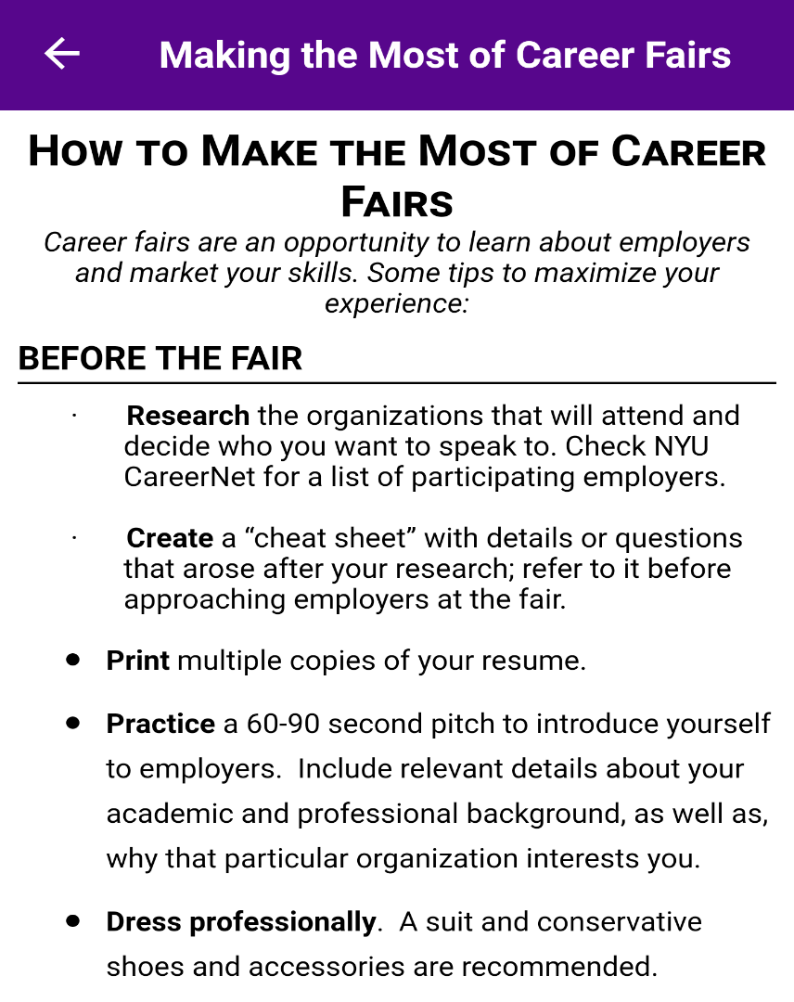


TANDON CAREER FAIR
Figures 2 & 3: Tandon Career Fair logo and tips
5

Slide 7
TYPES OF COMPANIES
Public
  Government – city, state, federal, and international
Private
  Consultant – design, analysis, modeling
  Contractor – construction & manufacturing
  Research & development: products, software
  Managerial, sales, non-profits
  Tech leaders & tech startup
Figure 4: Public vs private graphic courtesy of
EDUCBA
6

Slide 8
TYPES OF JOBS
Internships, Co-Ops
  Your number 1 priority!
Teaching Assistant
  EG 1004 Intro to Engineering
  MakerSpace
  Other Tandon courses
  K-12 summer STEM programs
Research Assistant
  Undergraduate Summer Research
  5 to 10 hours per week during semester
Future Labs Intern
  12 hours per week, 3 credits
7

Slide 9
RESUME BUILDING
Include examples that set you apart
Focus on your
  Work ethic and being detail oriented
  Networking and professional societies
Keep it concise (ONE PAGE )
Sections
  Education, Experience, Skills, Awards, Activities
8

Slide 10
PROFESSIONAL EMAILS
Opening Salutations – “Dear Ms. Williams,”
Put your name in the subject (and everywhere)
  Doe, Jane Application
Your email should be firstname.lastname@nyu.edu
Proofread
  Complete sentences & proper grammar
  Do not add email address until you proofread
Closing Salutations – “Thank you for your consideration,”
Attachment names
  Use your name: Doe, Jane Resume.pdf
Always Reply All on Emails!
Link to change NYU email alias
9

Slide 11
ACTIVITY

Slide 12
ACTIVITY
DEVELOP AN ELEVATOR PITCH
Imagine you are talking to a recruiter from your favorite company at a career fair & use your EG 1004 project to sell yourself.
11
Notes:
**Give the partners several minutes to complete the activity. Ask one or two members to share if desired.**

Slide 13
QUESTIONS?

