Slide 1
LAZ & MRR WORKSHOP
EG1004 | LAB 4A

Slide 2
OVERVIEW
Objective
Background Information
Materials
Procedure
Assignment
Closing
Figure 1: VEX Robotics Logo Courtesy of VEX Robotics
1

Slide 3
OBJECTIVE
Program a small VEX robot to navigate a mini-course
Become familiar with the Arduino VEX library
Understand when and how to use a gyro sensor
2

Slide 4
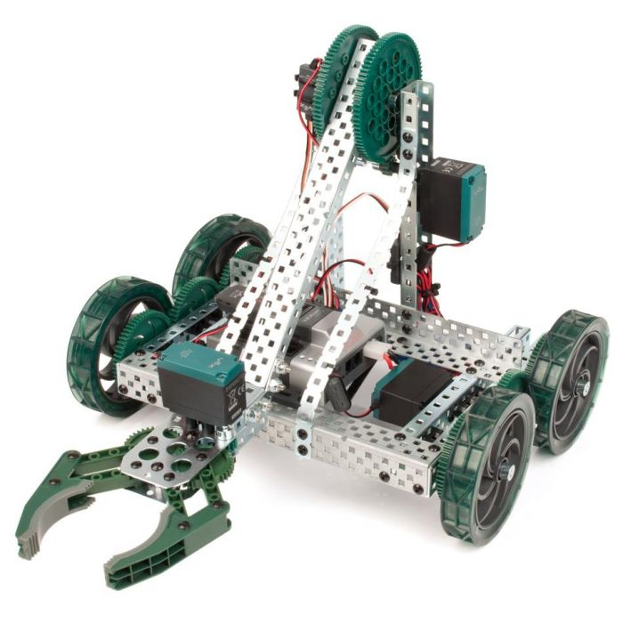
BACKGROUND INFORMATION
VEX Robotics
Used for LAZ and MRR projects
Educational robotic system
Microcontroller, motor shield, motors, battery, gyro sensor
Figure 2: VEX Clawbot Courtesy of Robot Mesh
3

Slide 5
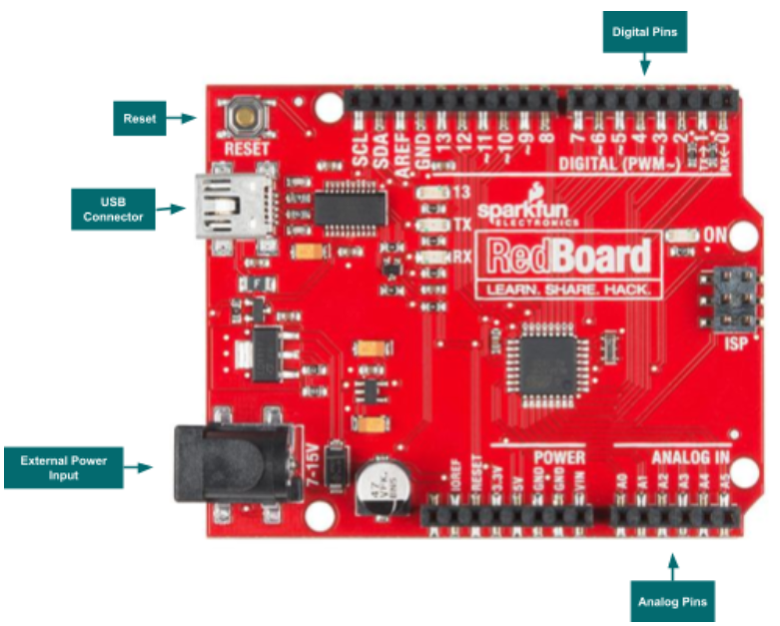
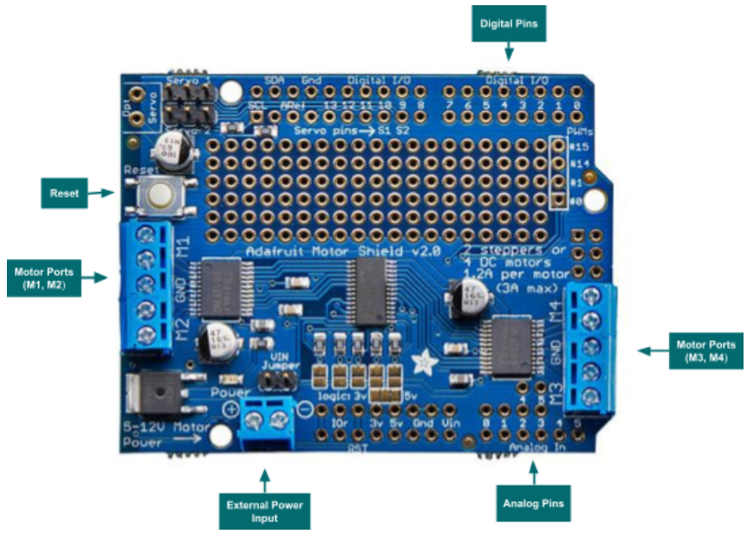
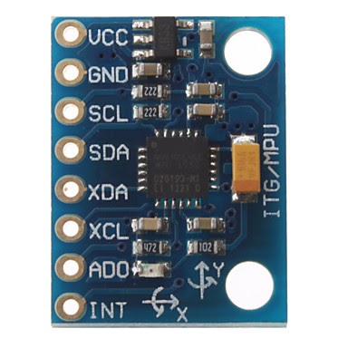
BACKGROUND INFORMATION
Figure 3: Arduino Microcontroller Layout
Figure 4: Arduino Motor Shield Layout
Figure 5: Gyro Sensor
4

Slide 6
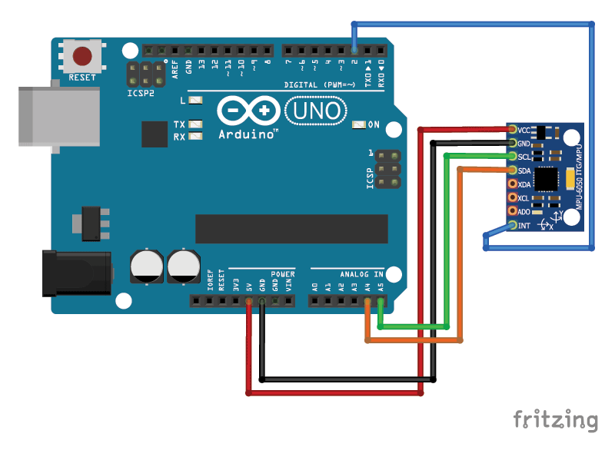
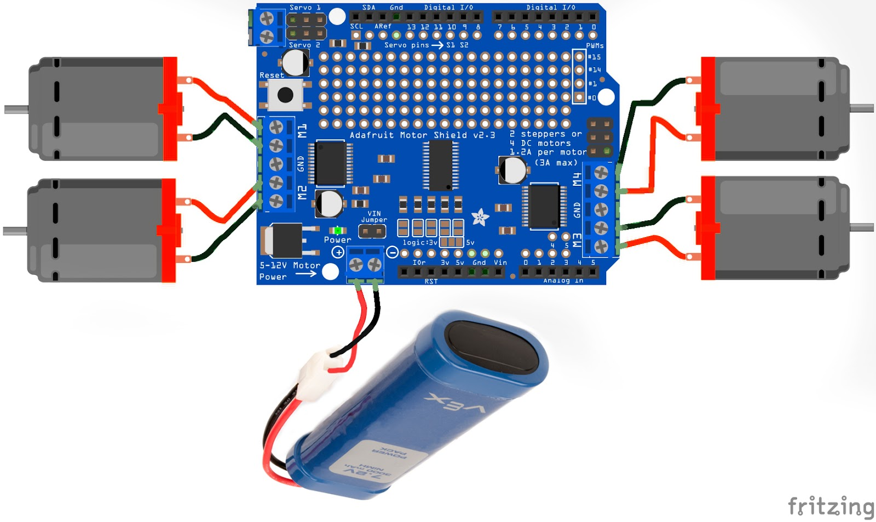
BACKGROUND INFORMATION
Figure 6: Motors and Battery Wiring
Figure 7: Gyro Wiring
5

Slide 7
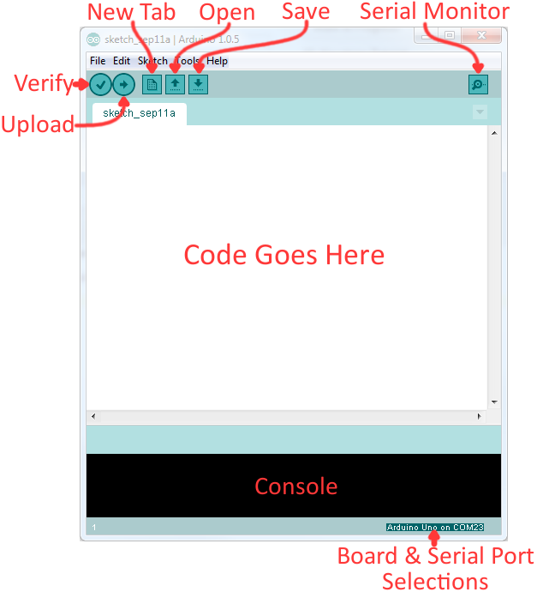
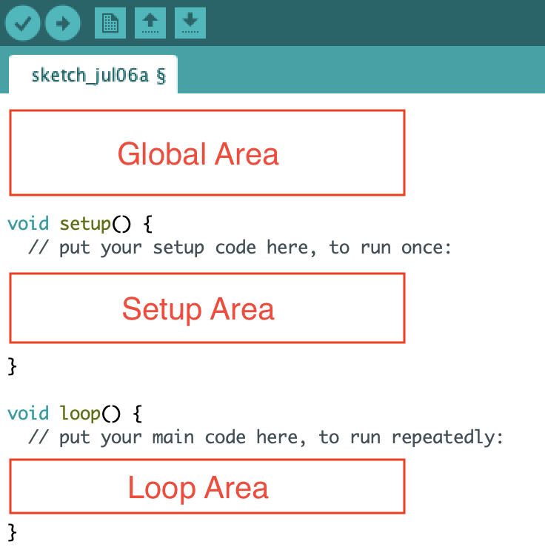
BACKGROUND INFORMATION
Arduino IDE – program to edit, compile, and upload code to the Arduino board
Code written in the Arduino programming language (based on C/C++)
VEX Library
Figure 8: Arduino IDE
6

Slide 8
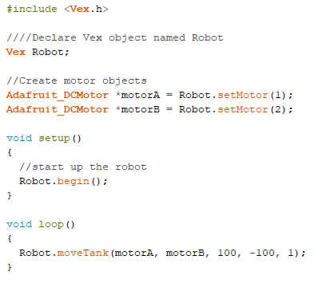
BACKGROUND INFORMATION
Order of Code:
Import VEX Library
Declare Object(s)
Objects in the VEX Library include
Vex Object
Motor Objects
Sensor Objects
Call object functions to program the VEX Robot
Each object type has different programmable functions that relate to their physical functions.
Example: Robot.moveTank()
1
2
3
Figure 9: Example of Code in Arduino
7

Slide 9
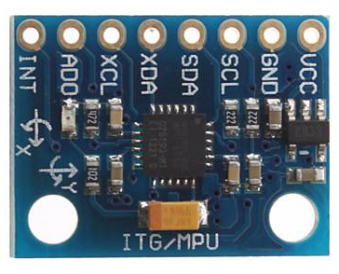
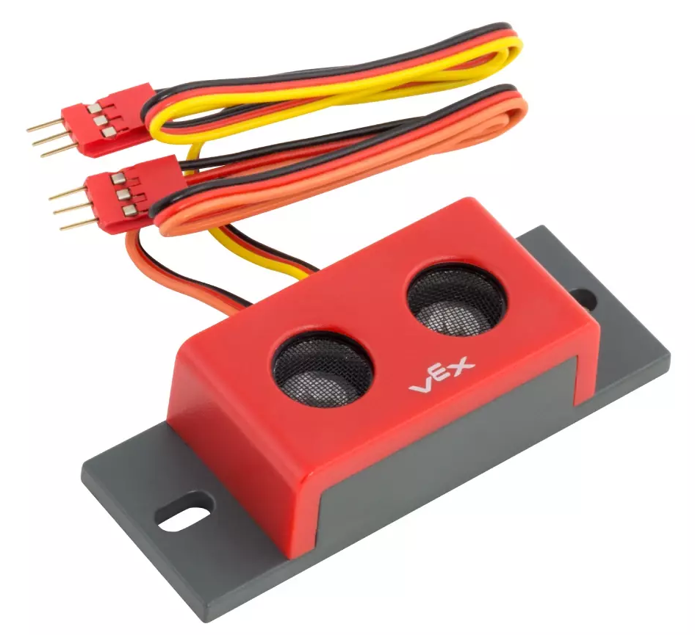
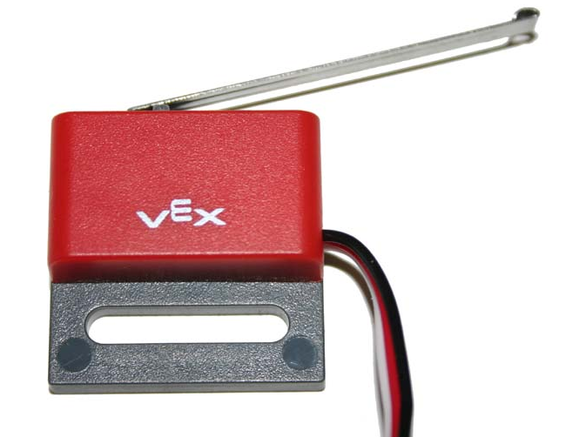
BACKGROUND INFORMATION
Sensor | Description | Picture
Gyro | Tracks the angle that the robot is turning or positioned at.
Ultrasonic | Determines how far the robot is from an obstacle. (returns the total distance)
Touch | Determines whether the robot is pressing against and obstacle or edge of the course.
IRObstacle | Detects if there are obstacles in the robot’s path. (returns HIGH if there’s an obstacle and LOW if there isn’t)
8

Slide 10
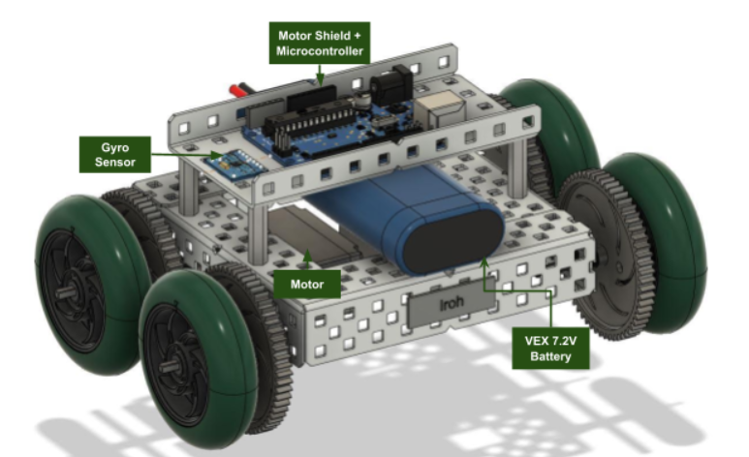
MATERIALS
A lab PC
Pre-built mini VEX robot
Mini VEX Course
Gyro Sensor
Arduino
Figure 10: Mini VEX robot
9

Slide 11
PROCEDURE
Part 1: Importing the Library
Download and import the VEX Library into Arduino
Part 2: Setting up the VEX Robot Object
Coding the robot to move forward
Traverse tiles 1-4
Part 3: Setting up the Gyro Sensor Object
Use gyro sensor to turn the robot
Traverse tiles 4-5
Extra: Complete the Entire Course
Traverse tiles 5-8
Figure 11: Mini VEX Robot
10

Slide 12
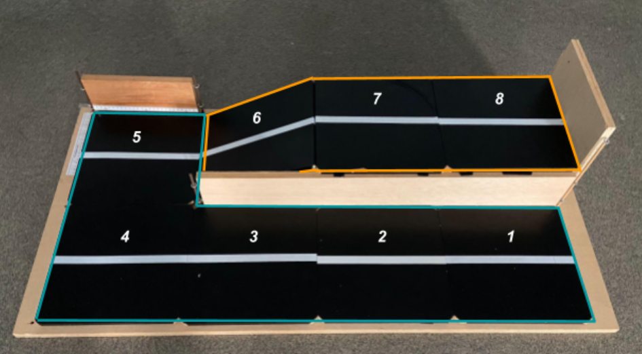
PROCEDURE
Figure 12: Mini VEX Course
11

Slide 13
ASSIGNMENT
No lab report
No team presentation
12

Slide 14
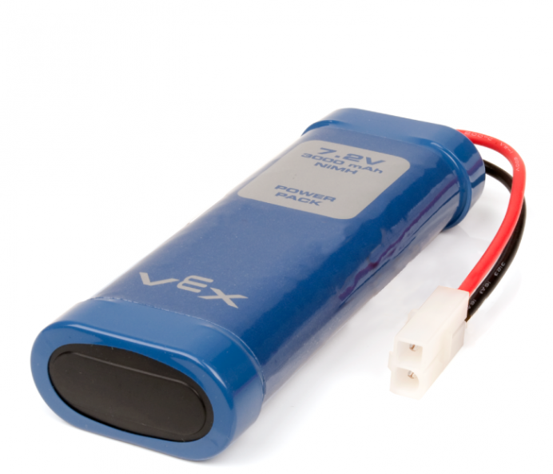
CLOSING
Ask TAs for help if needed
Only finish the entire course if time allows
Be careful not to go full power
Do not let any two exposed wires touch
Do not unplug the gyros or remove the motor shield
Disconnect the VEX battery when not in use
Figure 13: VEX Battery Courtesy of VEX Robotics
13

Slide 15
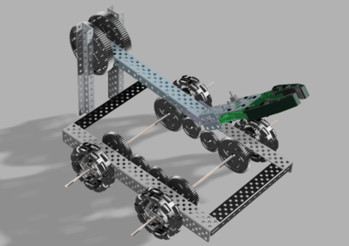
NEXT STEPS
Design and build the chassis of the robot
Design and build the claw (LAZ only)
Run test trials for sensor calibration
Draft the Preliminary Design Investigation (PDI) Report
Create a preliminary CAD drawing of the robot using Fusion 360
Begin working on the Milestone 1 Presentation
Figure 14: VEX LAZ Robot
14

