Slide 1
Computer-Aided Design (CAD) Competition

Slide 2
Overview
Objectives
Background
Materials
Procedure
Report/Presentation
Closing

Slide 3
Objectives
Understand the simulation capabilities of Fusion 360, a common computer-aided design (CAD) software
Use the basics of modeling techniques in Revit
Develop product evaluation and minimal design skills

Slide 4
What is Fusion 360?
Fusion 360 is a cloud-based computer-aided design software
Allows engineers to make precisely scaled drawings that are turned into 3D models to visualize concepts or functionality
Runs tests to imitate real-world situations
Almost identical to SolidWorks and a major upgrade from Inventor in terms of accessibility and ease of use

Slide 5
What is Autodesk Revit?
Revit is a building modeling software for architects and engineers
Allows users to design buildings and other architectural structures in 3D while allowing for 2D drafting elements
Can be used to track stages of a building’s lifecycle, from creation to demolition

Slide 6
Background Information
Simulation in Fusion 360 – Static Stress
Simulates the linear responses to a force being applied to an object based on the material, constraints, and points of application
Analyzes the deformation, stress, and safety factor in a model from structural loads and constraints
Can determine whether an object is ready to sustain real-world loads or needs to be remodified
The resultant safety factor is the measure of how much load a object can sustain before permanent deformation or fracture

Slide 7
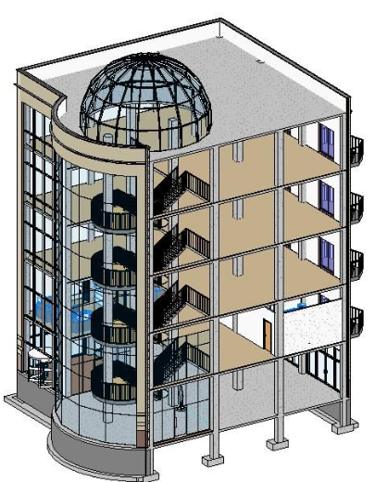
Background Information
3D Modeling in Revit
Used for creating homes, buildings, and structural support systems
Used to create floor, plumbing, and electric plans, as well as heating, ventilation, and air conditioning plans (HVAC)
Capable of viewing models in three dimensions and walking through the structure floor by floor

Slide 8
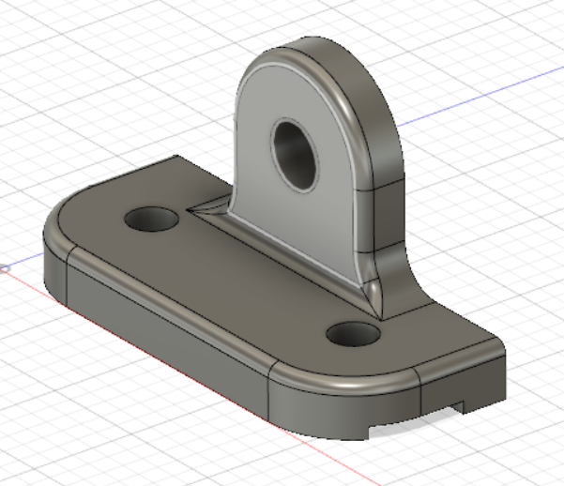
Materials
Computer
Fusion 360
Autodesk Revit
Predesigned parts

Slide 9
Procedure – Fusion 360
Determine the location, magnitude, and direction of the force, as well as material and location of constraints
Run a stress test on the predesigned part given to you
Review factor of safety and location of fracture, then use Fusion 360 to add the modifications onto the model without changing the main base
Rerun tests and remodify until part has safety factor of at least 3

Slide 10
CAD Competition
$CR=\frac{Final Safety Factor}{Final Volume}−\frac{Initial Safety Factor}{Initial Volume}$
Redesigned part must be less than double the initial volume
Safety factor must be at least 3
Cannot alter the applied forces, fixed point constraints, and areas highlighted in red on model

Slide 11
Revit Problem Statement
Create a 350 – 400 square foot apartment for residents/college students
Contains one of each: bathroom, bed, kitchen, table, desk
Must have sufficient lighting (at least 1 window)
A floor plan layout of the entire apartment
An electrical and plumbing plan for the bathroom

Slide 12
Procedure – Revit
Sketch out the apartment based on the problem statement
Create the floor plan on Revit
Insert all required furniture and appliances
Create electrical plan on the same Revit file
Create plumbing plan on separate mechanical template

Slide 13
Report/Presentation
Submit all files as a zip file before end of lab
Scan lab notes
Individual lab report
No lab presentation, instead Milestone 1 presentation

Slide 14
Closing
Have all lab notes signed by TA
Each team member should have turn using software
Save all files
Submit all work electronically
Return all unused materials to TA

Slide 15
CAD Competition
QUESTIONS?

