Slide 1

INTRODUCTION TO THE SEMESTER LONG DESIGN PROJECT (SLDP)
EG1004 | RECITATION 2

Slide 2
AGENDA
Project Introduction
Project Grading
SLDP Options
Additional Information
Questions
1

Slide 3
PROJECT INTRODUCTION
10
Week Project
Four Project Types:
Housing & Innovation in Revit (HIR)
Rapid Assembly & Design (RAD)
Mars Rover Robot (MRR)
Lunar Agricultural Zone (LAZ)
2-4
Team Members
2

Slide 4
PROJECT GRADING
Item | Percentage of Grade
Benchmarks & Commissioning | 50%
Final Presentation | 50%
The SLDP is 30% of your total course grade!
3

Slide 5
PROJECT GRADING
Benchmarks
Two benchmarks
Completion of certain portions of project
Due dates on schedule on eg.poly.edu
Penalties for late completion
Extra credit for early completion
Benchmark
B
Benchmark
A
Benchmark A
Benchmark B
4

Slide 6
PROJECT GRADING
Commissioning
Completion of all tasks
Due date on schedule on eg.poly.edu
Can partially commission if unable to complete all tasks on time
Submission
Submission of all SLDP material
Due on same date as commissioning
Can submit early for extra credit
Benchmark A
Benchmark B
Commissioning
Submission
5

Slide 7
ENGINEERING NOTEBOOK
Use your engineering notebook as an outline & repository for milestone & final presentations and your Final Design Report!
Required Contents for an Effective Notebook
Meeting notes, ideas, brainstorming, tasks, roles, and deadlines
Technical notes, design drawings, and software code
Screenshots or pictures of your design
Record & briefly describe references (e.g. SparkFun sensor guide)
Updates to cost or project schedule
Plans for the future and to-do lists
Design artifacts: design thinking, design canvas, and design pitch
6

Slide 8
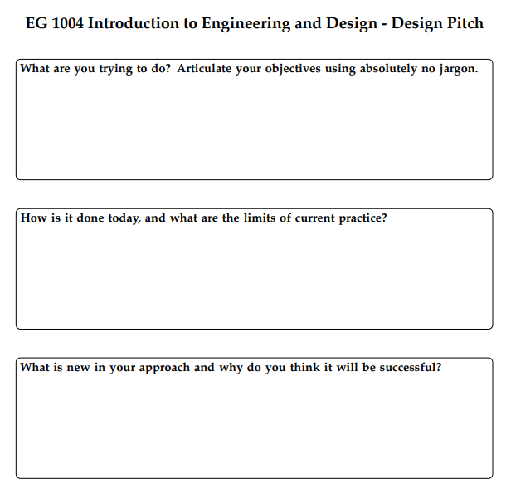
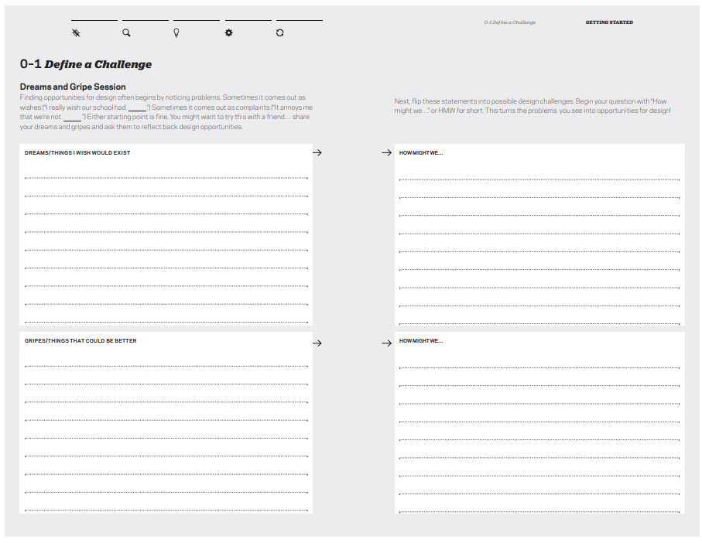
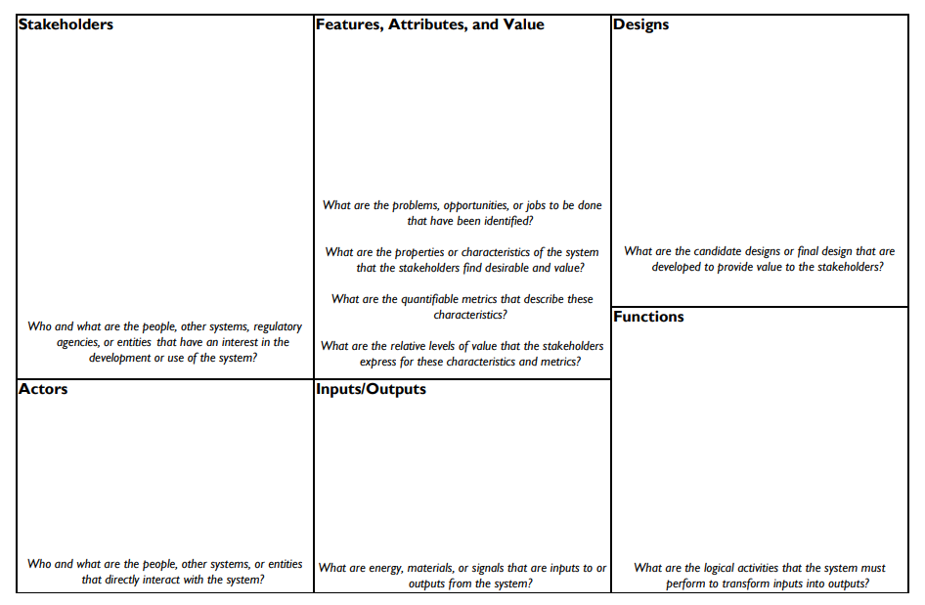
MILESTONE CHECKPOINTS
You will complete these exercises in recitation with professors input!
Milestone 1: Design Thinking
Milestone 2: Design Canvas
Milestone 3: Design Pitch
7

Slide 9
SLDP Team Google Drive
Your team must create a Drive folder for your team by Milestone 1 and share it with your professors & TAs!
All files you create for your SLDP must be in this Drive folder:
Engineering notebook
CAD files
Code
Circuit diagrams
Progress pictures
Product videos
Presentations
Budget spreadsheets
Microsoft Project schedules
Preliminary Design Investigation
Final Design Report
8

Slide 10

SLDP OPTIONS
Rapid Assembly & Design (RAD)
Identify a problem or address a proposed problem
Develop a solution
Manufacture a proof of concept
  $100 budget
  Additional resources: RAD Mentor, EG workshops, MakerSpace machines
Engineering notebook
Figure 3: SpeakSign RAD Project
9

Slide 11
SLDP OPTIONS
Benchmark A
Benchmark B
Commissioning
Preliminary Design Investigation
Updated CAD model
Final assembled CAD model
Initial CAD model
Circuit & wiring diagrams
Final integrated Arduino code
New iteration physical prototype
Initial physical prototype
Rapid Assembly & Design (RAD)
Extra Credit
Additional functionalities as determined by RAD Mentor
10

Slide 12

SLDP OPTIONS
Mars Rover Robot (MRR)
Collect rock sample and bring it back to the start point
Traverse Olympus Mons to obtain a photo
Engineering notebook
Figure 4: Labeled View of the MRR course
11

Slide 13
SLDP OPTIONS
Benchmark A
Benchmark B
Commissioning
Preliminary Design Investigation
Robot reaches highest point in the mountain
Robot collects rock sample
Robot reaches the first rock sample
Robot drops rock sample at start tile
Robot must come to a complete stop at the peak
Mars Rover Robot (MRR)
Extra Credit
Return to start or climb the secondary platform
12

Slide 14
SLDP OPTIONS
Lunar Agricultural Zone (LAZ)
Locate and collect all the plants in the Lunar Agricultural zone
Traverse course
  Pick up and deposit three different samples to designated site
Engineering notebook
Figure 5: Labeled View of the Lunar Agricultural Zone
13

Slide 15
SLDP OPTIONS
Benchmark A
Benchmark B
Commissioning
Preliminary Design Investigation
Collect Plant A and place it on the start tile
Collect and deposit first rock sample in the correct location and reach second sample
Collect & deposit first sample in the correct location
Meet all robot specifications
Lunar Agriculture Zone (LAZ)
Extra Credit
Collect Plant B or C and placing them on their respective drop sites
14

Slide 16
RAD & VEX APPLICATIONS
VEX & RAD application assigned after you form SLDP groups
Both forms are due by September 20 at 11:59 PM EST.
To apply for RAD: Please fill out this form
  EG 1004 inspiration guide for project ideas
  You need to attend an Open Lab ideation session
To apply for VEX (either MRR or LAZ): Please fill out this form
15

Slide 17
SLDP OPTIONS
Housing & Innovation in Revit (HIR)
Create 3D Revit model of campus extension to NYU Tandon
Include plumbing & electrical plans
Obtain LEED Gold certification
Engineering notebook
Figure 1: 181 Mercer Street Building Courtesy of NYU
16

Slide 18
SLDP OPTIONS
Benchmark A
Benchmark B
Commissioning
Preliminary Design Investigation
All classroom spaces
Floor plans for all floors (six minimum) and front elevation
One 20 person-classroom
One 40 person-classroom
Facility of choice
Electrical & plumbing plans for dorm
LEED Gold and implementation plan
Model of building
One recreational space
Housing & Innovation in Revit (HIR)
Extra Credit
LEED Platinum certification
17

Slide 19
ADDITIONAL INFORMATION
Which projects interest you?
Refer to manual.eg.poly.edu for full project information
  3D printing requirements for each project are stated in the manual
Speak with Professors and TAs for information regarding projects
18

Slide 20
QUESTIONS?

