Slide 1

INTRODUCTION TO THE SEMESTER-LONG DESIGN PROJECTS (SLDPs)
EG1003 | RECITATION 1

Slide 2
AGENDA
Project Introduction
Project Grading
SLDP Options
3D Printing
Closing
Questions
1

Slide 3
PROJECT INTRODUCTION
10
Week Project
Four Project Types:
Autonomous robot obstacle course
Housing & Innovation in Revit (HIR)
Biomedical Device (BMD)
Rapid Assembly & Design (RAD)
2-4
Team Members
2

Slide 4
PROJECT GRADING
Item | Percentage of Grade
Benchmarks & Commissioning | 50%
Final Presentation | 50%
The SLDP is 30% of your total course grade!
3

Slide 5
PROJECT GRADING
Benchmark
B
Benchmark
A
Benchmark A
Benchmarks
Two benchmarks
Completion of certain portions of project
Due dates on schedule on eg.poly.edu
Penalties for late completion
Extra credit for early completion
Benchmark B
4

Slide 6
PROJECT GRADING
Benchmark A
Benchmark B
Commissioning
Submission
Commissioning
Completion of all tasks
Due date on schedule on eg.poly.edu
Can partially commission if unable to complete all tasks on time
Submission
Submission of all SLDP material
Due on same date as commissioning
Can submit early for extra credit
5

Slide 7
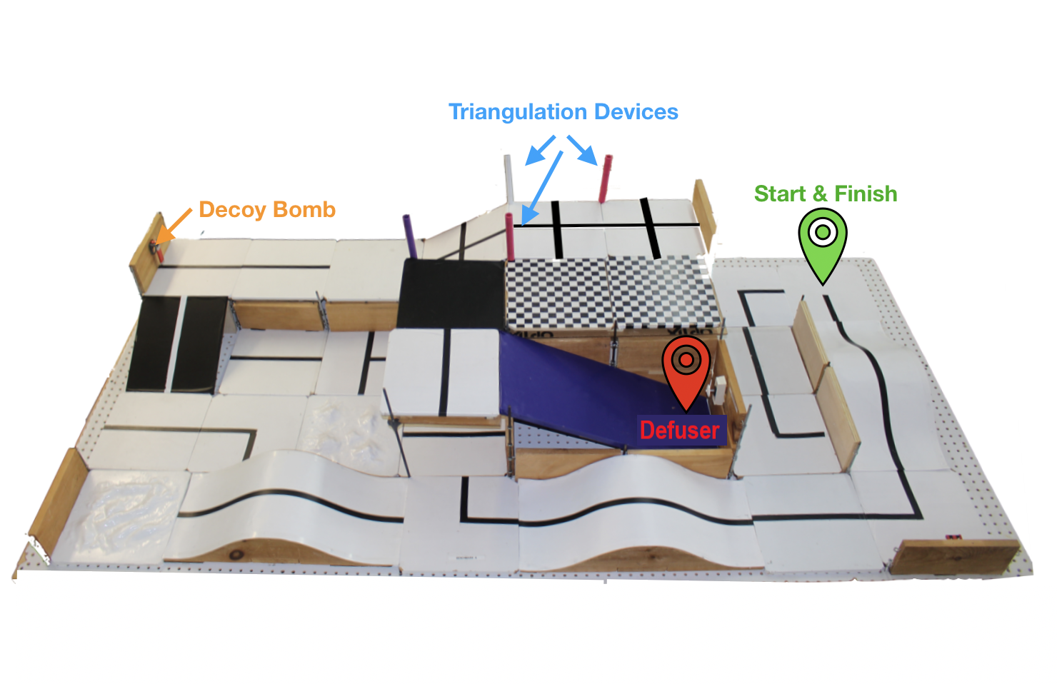
SLDP OPTIONS
Autonomous Robot Courses
Bomb Disarming Robot (BDR)
Disable bomb & return to start
Avoid decoy bombs
Allowed
Jump off levels
Climb walls
Prohibited
Arms
Slingshots
Projectiles
Figure 1: BDR Course Configuration
6

Slide 8
SLDP OPTIONS
Autonomous Robot Courses
Benchmark A
Benchmark B
Commissioning
Pass two hills
Defuse bomb
Return to start
Bomb Disarming Robot (BDR)
Extra Credit
Disable/retrieve triangulation devices
7

Slide 9
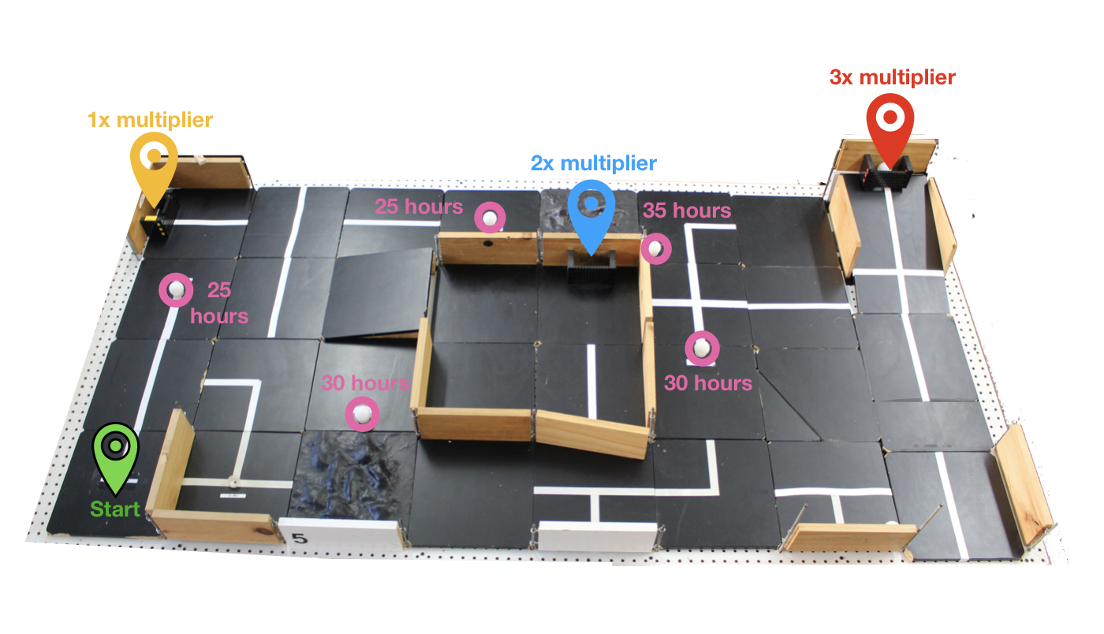
SLDP OPTIONS
Autonomous Robot Courses
Retrieval & Delivery System (RDS)
Retrieve & deliver fuel cells
for hospitals
Hospitals vary in energy efficiency worth a certain multiplier value
Deliver 200 hours of energy to hospitals
Figure 2: RDS Course Configuration
8

Slide 10
SLDP OPTIONS
Autonomous Robot Courses
Benchmark A
Benchmark B
Commissioning
Deliver 50 hours
Deliver 125 hours
Deliver 200 hours
Retrieval & Delivery System (RDS)
Extra Credit
Extra Credit
Deliver additional fuel cells to hospital
Dependent on number of cells
9

Slide 11
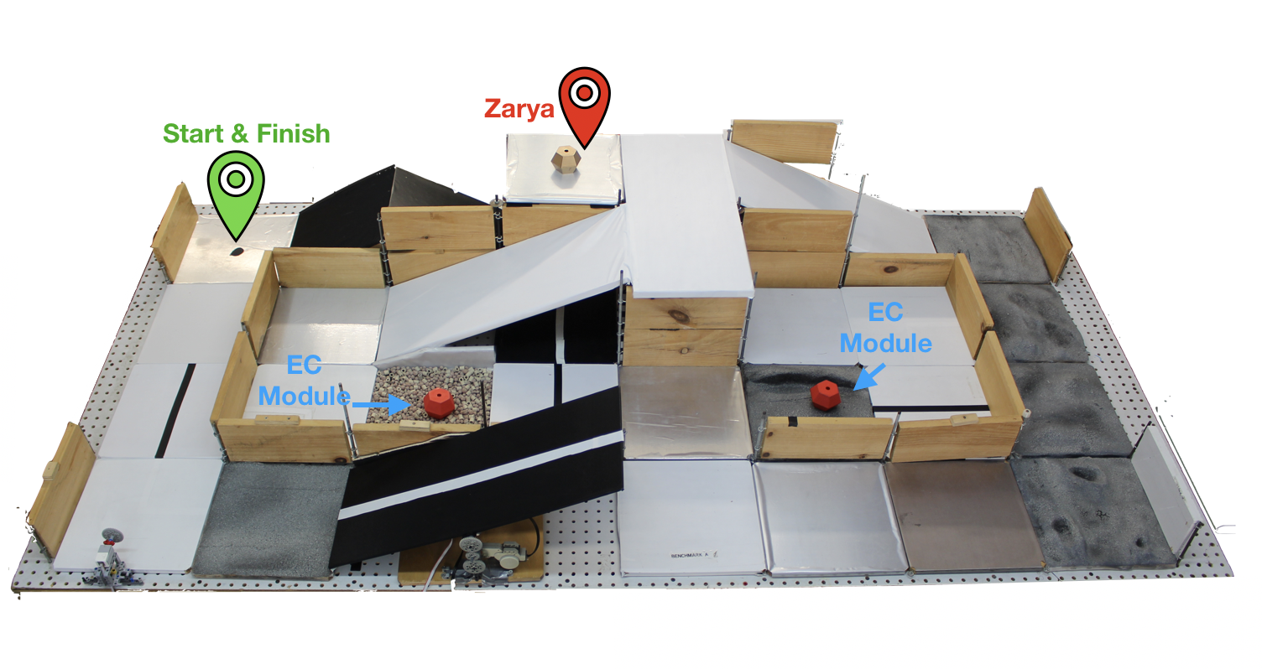
SLDP OPTIONS
Autonomous Robot Courses
Search & Recovery Robot (SRR)
Retrieve lost space module
Zarya & return to start
Traverse ramp and rocky roads
Figure 3: SRR Course Configuration
10

Slide 12
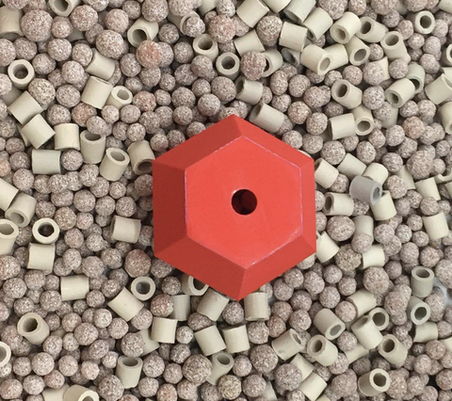
SLDP OPTIONS
Autonomous Robot Courses
Benchmark A
Benchmark B
Commissioning
Traverse solar panel hill
Retrieve Zarya
Return to start with Zarya
Search & Recovery Robot (SRR)
Extra Credit
Retrieve extra credit modules
Traverse moondust
11

Slide 13
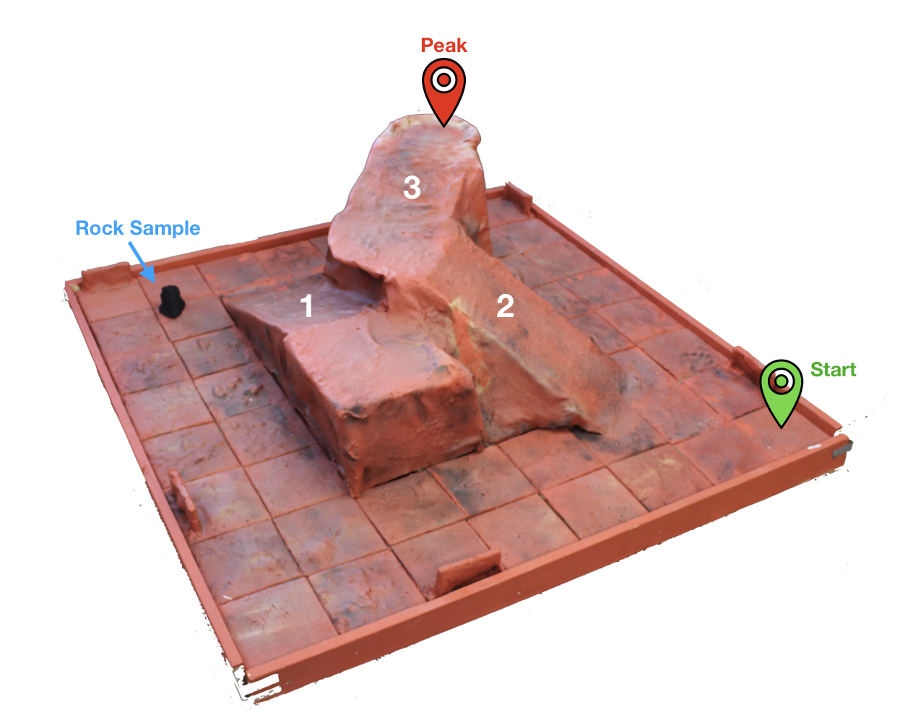
SLDP OPTIONS
Autonomous Robot Courses
VEX Mars Rover Robot (MRR)
Collect rock sample
Traverse Olympus Mons to
obtain photograph
Prohibited:
Jumping
Projectiles
Flammable materials
Figure 4: MRR Course Configuration
12

Slide 14
SLDP OPTIONS
Autonomous Robot Courses
Benchmark A
Benchmark B
Commissioning
Physical assembly
Transport rock sample to start
Climb the peak
Motor wiring
Collect rock sample
Mars Rover Robot (MRR)
Extra Credit
Return to start site after summiting
Climb Ramp 1
13

Slide 15
SLDP OPTIONS
Housing & Innovation in Revit (HIR)
Create 3D Revit model of campus extension to NYU Tandon
Include plumbing & electrical plans
3D print of floorplan
Reach LEED Gold standard
Figure 5: 181 Mercer Street Building Courtesy of NYU
14

Slide 16
SLDP OPTIONS
Benchmark A
Benchmark B
Commissioning
One recreational space
All classroom spaces
Floor plans for all floors (six minimum) and front elevation
One 20 person-classroom
One 40 person-classroom
Facility of choice
Electrical & plumbing plans for dorm
LEED Gold and implementation plan
Housing & Innovation in Revit (HIR)
Extra Credit
LEED Platinum certification
Extra 3D prints
15

Slide 17
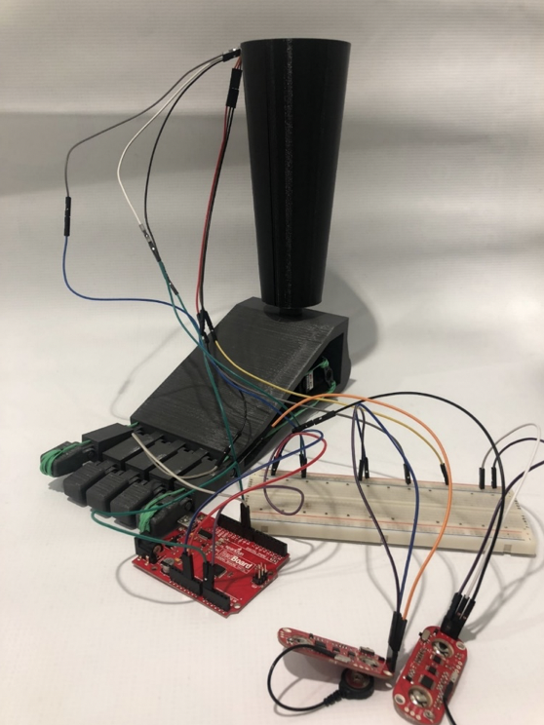
SLDP OPTIONS
Biomedical Device (BMD)
Create an autonomous prosthetic limb or wearable device
Complete one extra task listed in the manual
Utilize a machining method
Create a 1:1 scale model
Figure 6: Prosthetic Foot BMD Project
16

Slide 18
SLDP OPTIONS
Benchmark A
Benchmark B
Commissioning
Determine device choice
Updated CAD model
Incorporated sensors
Initial CAD model
One functioning sensor with code
Machining method
All parts manufactured
Complete one extra task
Functional device
Biomedical Device (BMD)
Extra Credit
Complete additional extra tasks
3D printed component
17

Slide 19
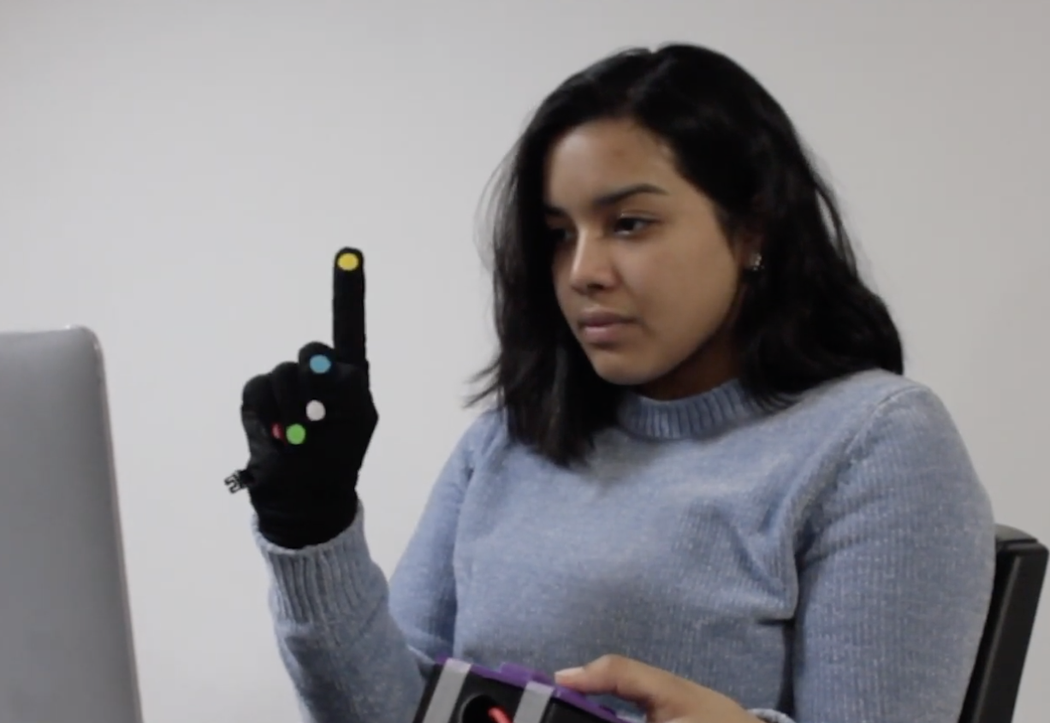
SLDP OPTIONS
Rapid Assembly & Design (RAD)
Identify a problem or address a proposed problem
Develop a solution
Manufacture a proof of concept
$100 budget
Additional resources: EG1003 workshops, Open Lab, MakerSpace
Figure 7: SpeakSign RAD Project
18

Slide 20
SLDP OPTIONS
Benchmark A
Benchmark B
Commissioning
Initial coding or wiring
Some functions completed
Fully functional proof of concept
Initial physical prototype
Design & Feasibility Report (DFR)
New prototype iteration
Final Design Report (FDR)
Rapid Assembly & Design (RAD)
Extra Credit
Additional functionalities as determined by RAD Mentor
3D printed components
19

Slide 21
3D PRINTING
Project | Mandatory | Extra Credit
Autonomous Robot Projects | 1 color logo | 2 color logo Course modification Robot part
Housing & Innovation in Revit | 1 color logo 1 printed floor plan | 2 color logo Up to 2 additional floor plans
Rapid Assembly & Design | Determined by RAD Mentor | 2 color logo Determined by RAD Mentor
Biomedical Device | 1 color logo | 2 color logo
Deadline for initial submission of extra credit prints is Milestone 2
20

Slide 22
3-D PRINTING
Benchmark A
Benchmark B
Final required print(s) approved
Commissioning
Print(s) completed
Initial required print(s) submission due
Prints must be creative and unique
  Logo cannot be simple geometric shape with text
Completing extra credit 3D print exempts logo requirement
Always have a contingency plan for course modification & robot part prints
Visit EG1003 Protolab for help
More info on the 3D Printing Guide on the Student Manual
21

Slide 23
CLOSING
Which projects interest you?
Refer to manual.eg.poly.edu for full project information
Speak with Professors and TAs for information regarding projects
22

Slide 24
QUESTIONS?

