Slide 1
PROTOTYPING WITH MICROCONTROLLERS, SENSORS & MATERIALS (VIRTUAL)
EG1003 | LAB 3

Slide 2
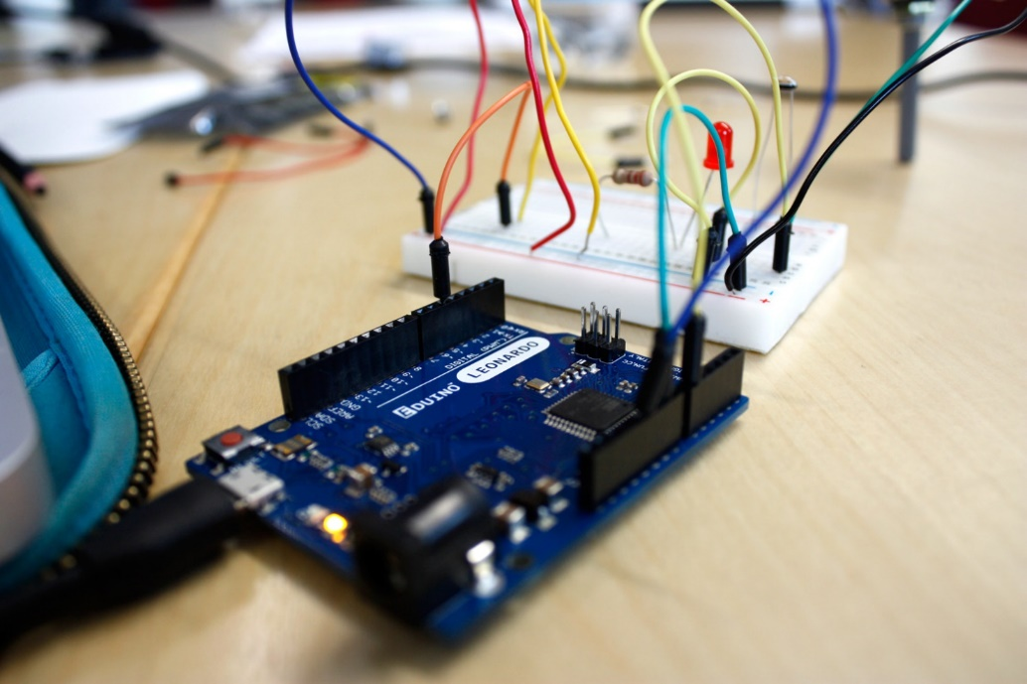
OVERVIEW
Objective
Background Information
Materials
Procedure
Assignment
Closing
Figure 1: Prototyping with Arduino Board
1

Slide 3
OBJECTIVE
Utilize electrical components, an Arduino board, and the Arduino IDE virtually in TinkerCAD to:
Control an LED with a button
Build a TMP 36 temperature sensing circuit
To design a device to slow the rate of heat loss
Enter the device into a competition to obtain the lowest minimal design ratio
2

Slide 4
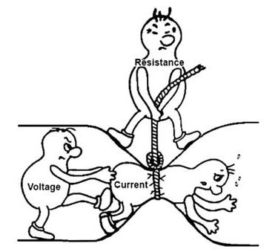
BACKGROUND INFORMATION
Prototyping – process of designing and building an early model of a product
Electricity – the movement of electrons
Current [A] – flow of electrons
Voltage [V] – difference in charge
Resistance [Ω] – opposition to current
Ohm’s Law: V = IR
Figure 2: Ohm’s Law Courtesy of Instructables
3

Slide 5
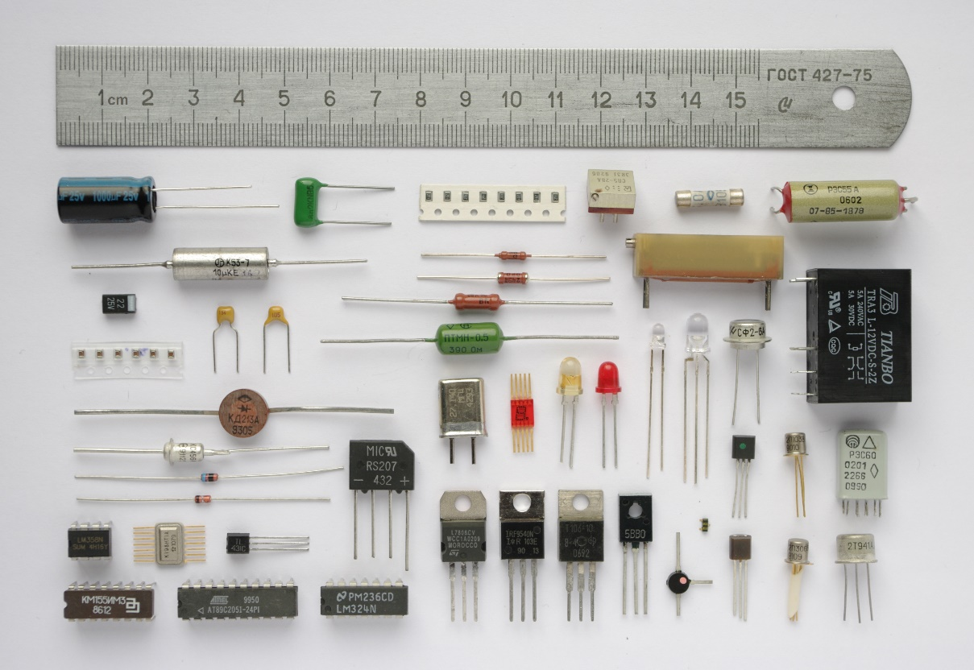
BACKGROUND INFORMATION
Common electrical components:
Breadboards
DC voltage sources
Resistors
Push-buttons and switches
Diodes and transistors
Light emitting diodes
Figure 3: Electrical Components Courtesy of Wikipedia
4

Slide 6
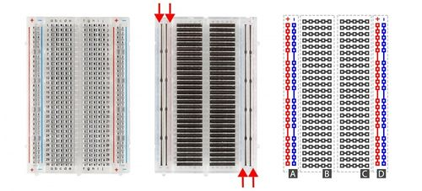
BACKGROUND INFORMATION
Breadboards
Small boards used for circuit prototyping
Allow temporary connection between circuit components
Power rails connected vertically (Sections A & D)
Non-colored rows connected horizontally (Sections B & C)
Figure 4: Breadboard Diagram
5

Slide 7
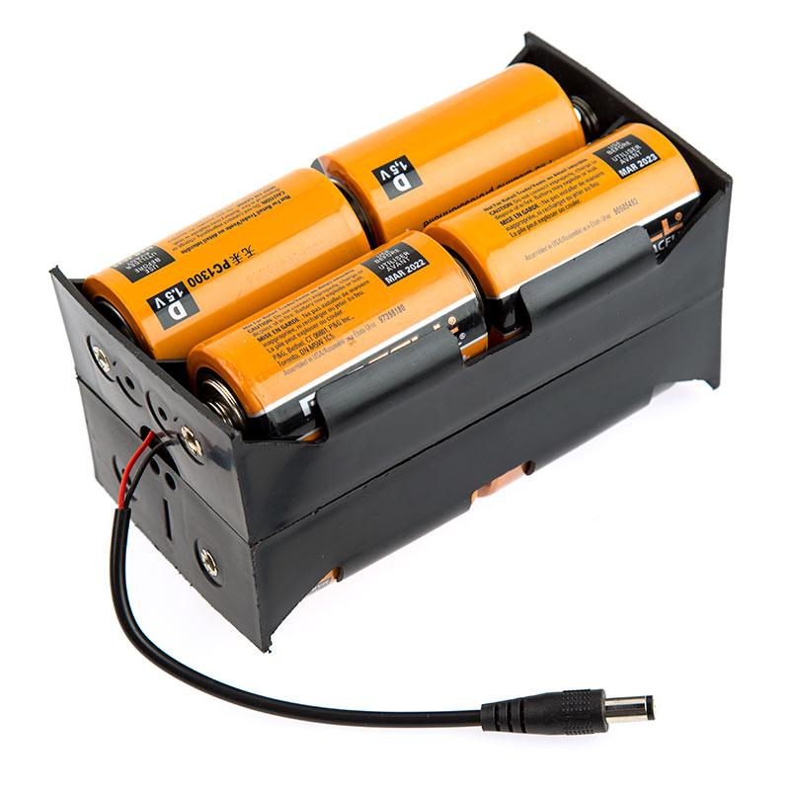
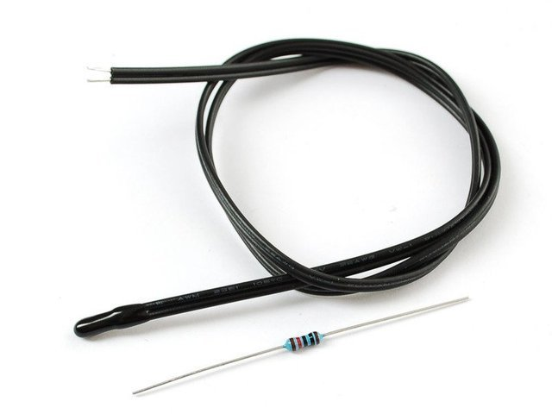
BACKGROUND INFORMATION
DC voltage sources – power circuits with voltage difference
Resistors – reduce the current flowing through a circuit
Color-coded to indicate resistance value
Thermistor – thermal resistor used to measure temperature
Figure 5: DC Voltage Source (Left), Thermistor (Top Right), and Resistor (Bottom Right)
6

Slide 8
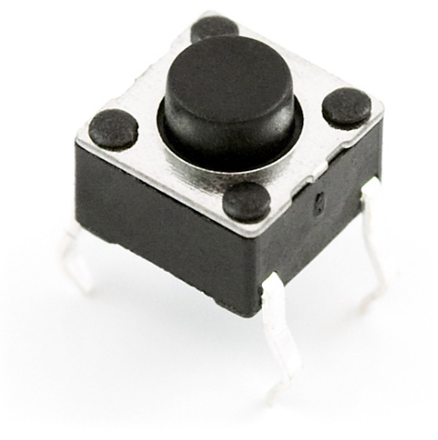
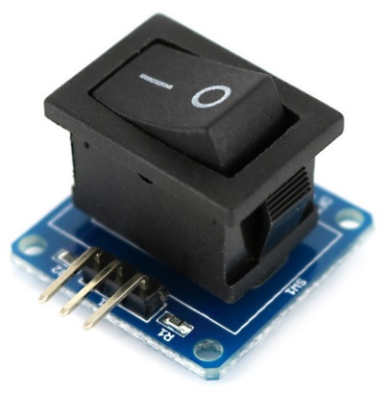
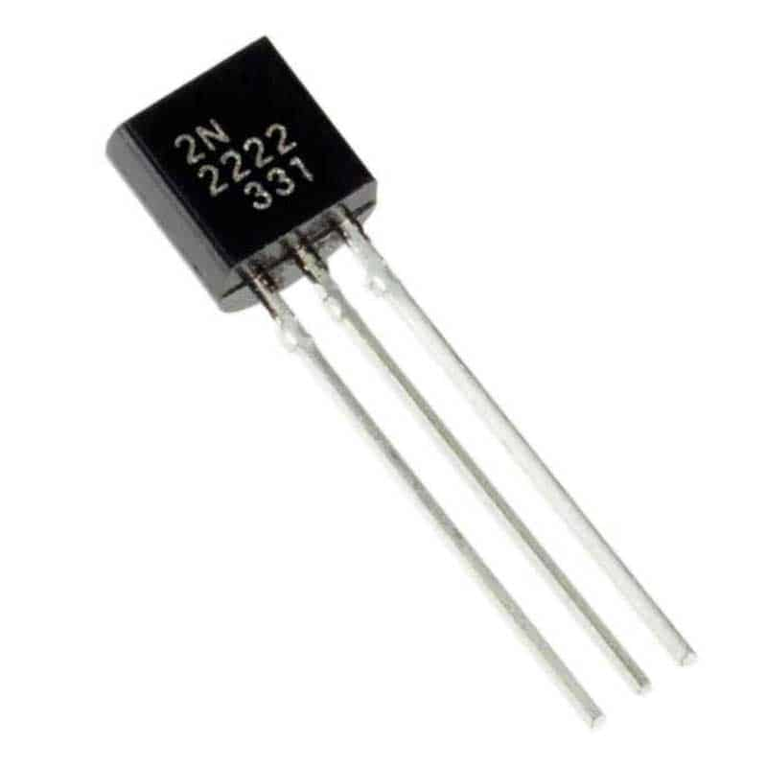
BACKGROUND INFORMATION
Push-buttons and switches – interrupt or divert current
Diodes and transistors – allow current to pass in only one direction
Light emitting diodes (LEDs) – diodes that use low voltage and current
Figure 6: Push-Button (Top Left), Switch (Top Right), LED (Bottom Left), and Transistor (Bottom Right)
7

Slide 9
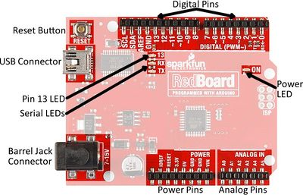
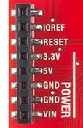
BACKGROUND INFORMATION
Microcontroller – inexpensive, programmable computer
3.3V – typically used to power low-voltage sensors
5V – most common power pin used to power circuits
GND – ground pin (0 V)
VIN – voltage-in can be used to power the board using a battery
Figure 7: Arduino RedBoard
8

Slide 10
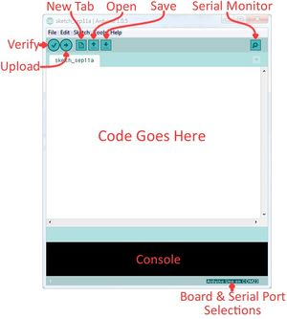
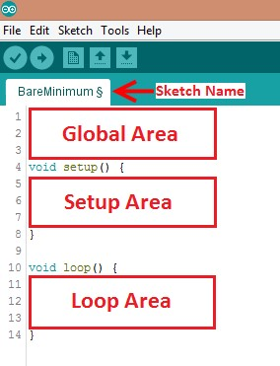
BACKGROUND INFORMATION
Arduino IDE – program to edit, compile, and upload code to the Arduino board
Code written in the Arduino programming language (based on C/C++)
In-program on TinkerCAD
9
Figure 8: Arduino IDE

Slide 11
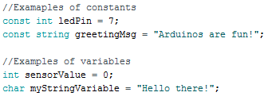
BACKGROUND INFORMATION
Datatypes – different kinds of data values
e.g. int, double, char
Operators – perform operations on variables and constants
e.g. +, =, ==, <=
Variables and constants – hold data according to datatype
Figure 9: Examples of Constants and Variables
10

Slide 12
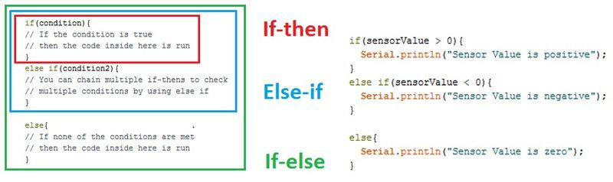
BACKGROUND INFORMATION
Conditional statements – run code enclosed by curly brackets when condition is met
Figure 10: Conditional Statements
11

Slide 13
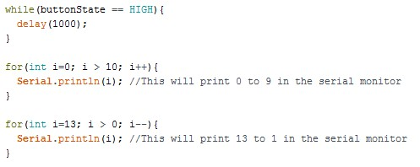
BACKGROUND INFORMATION
Loops – runs section of code repeatedly
While loops – runs code until the end condition is met
For loops – runs code for a specific number of times
Figure 11: While and For Loops
12

Slide 14
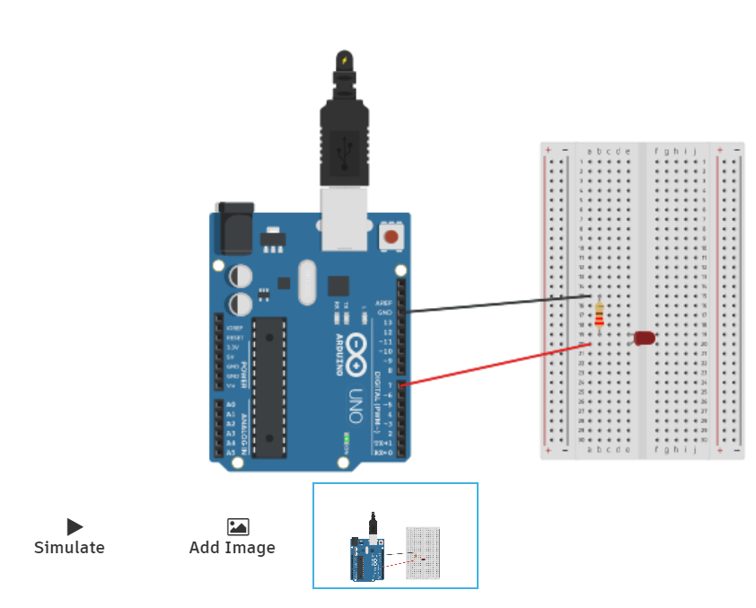
BACKGROUND INFORMATION
Tinkercad
www.tinkercad.com
Log-in with Autodesk account
Cloud-based 3D modeling software
Used to create CAD models, simulate circuitry, and code virtually
Figure 12: Example TinkerCAD Template
13

Slide 15
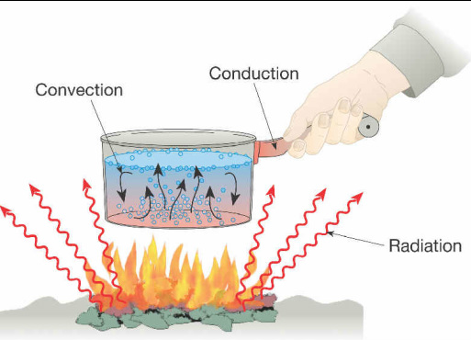
BACKGROUND INFORMATION
Heat – form of energy
Heat transfer – process of thermal energy moving from one body to another
Conduction – through solids
Convection – within a fluid medium (liquid or gas)
Radiation – emitted energy in all directions with or without a medium
Figure 13: Modes of Heat Transfer Courtesy of Mr. Oey’s Science Classes
14

Slide 16
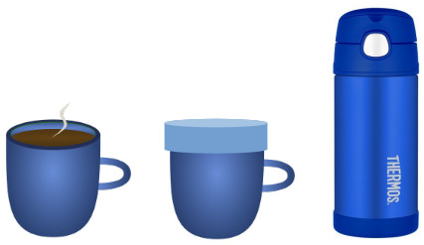
BACKGROUND INFORMATION
Thermodynamic system – defined area in the Universe separated by a boundary
Open – transfers mass and heat
Closed – only transfers heat
Isolated – cannot transfer mass or heat
Figure 14: Open (Left), Closed (Center), and Isolated (Right) Systems Courtesy of x-engineer.org
15

Slide 17
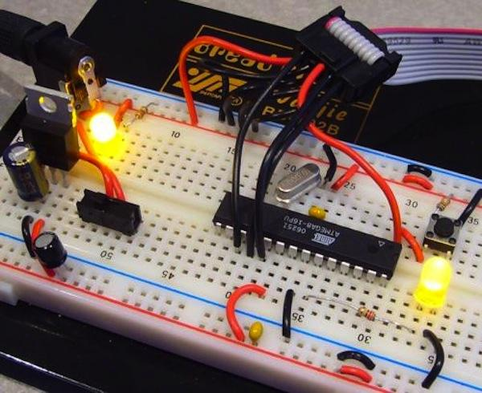
MATERIALS
Parts in Tinkercad:
Arduino UNO microcontroller
Tinkercad Code block with Arduino IDE
Breadboard
Wires
220 Ω resistor
10 kΩ resistor
LED
Push-button
TMP 36 sensor
Figure 15: Prototyping with Breadboard Courtesy of SparkFun
16

Slide 18
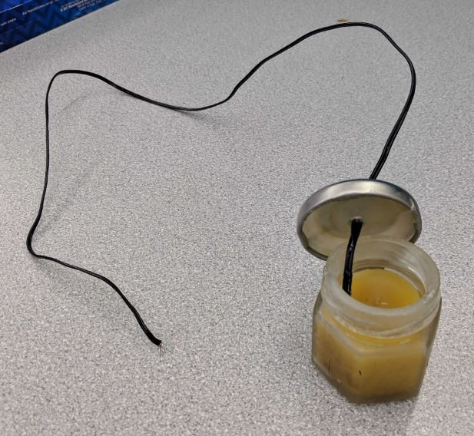
PROCEDURE
Part 1: Build an LED and button circuit in Tinkercad
Part 2: Thermal insulation device data analysis
Goal is to slow heat loss from a heated jar of beeswax
Build circuit and add code for TMP 36 sensor in Tinkercad to measure temperature of beeswax
Design a thermal insulating device (to be built and tested by TAs)
Perform data analysis for the data recorded from testing
Figure 16: Jar of Beeswax with Thermistor
17

Slide 19
PROCEDURE
The TA will build and test the designs for the competition
The goal of the device is to have the lowest minimal design ratio (MDR):
Insulating capacity (IC) is the change in temperature over time of the beeswax
Cost is the total cost of the insulating device
T_{R} is the room temperature (obtain from TA)
T_{F} is the final temperature of the beeswax (obtain from data)
18

Slide 20
PROCEDURE
Material | Unit | Cost Per Unit
Large foam cup | 1 | $0.50
Small foam cup | 1 | $0.25
Lid | 1 | $0.25
Sand | 1 cup | $0.40
Pack of clay | 1 bag | $0.20
Wool fabric | 2 pieces | $0.10
Styrofoam pieces | 5 pieces | $0.05
Tape | 1 ft | $0.10
Cotton balls | 3 balls | $0.05
Aluminum foil |  | $0.30
Table 1: Material Costs for Thermal Insulation Device Competition
19

Slide 21
ASSIGNMENT
Individual lab report:
Answer discussion questions in manual
Include original graph (temperature vs. time) of insulating device
Provide minimal design ratio calculation
Provide price list and design improvements
Due at 11:59 PM the night before Lab 4
Team presentation:
Address discussion points in manual
Describe the design of the insulating device
21

Slide 22
CLOSING
Submit all work electronically
Take screenshots of the virtual circuitry and temperature vs. time graph
22

Slide 23
CLOSING
In preparation for the next virtual lab, download this software ahead of time:
eDrawings Viewer
23

Slide 24
QUESTIONS?

