Slide 1
VIRTUAL PRODUCT DISSECTION
EG1003 | LAB 4A

Slide 2
OVERVIEW
Objective
Background Information
Materials
Procedure
Assignment
Closing
1

Slide 3
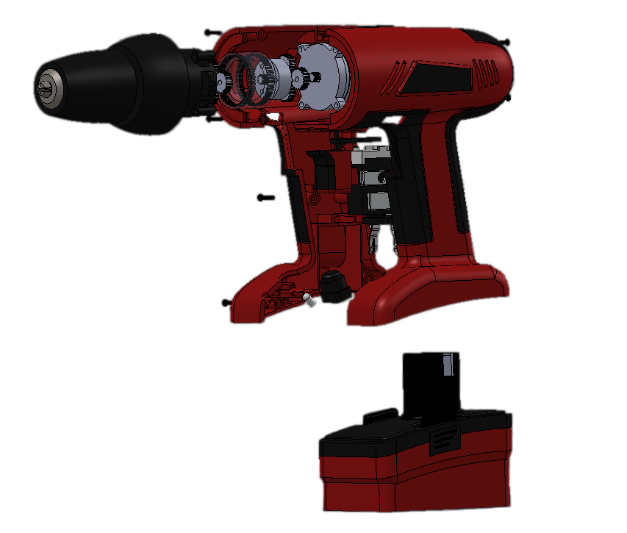
OBJECTIVE
To evaluate the functional design of an existing product to apply to the ideation of a new product
To develop and design an idea for a water toy to be used by children ages 4 – 6
Figure 1: Product Dissection of Cordless Drill
2

Slide 4
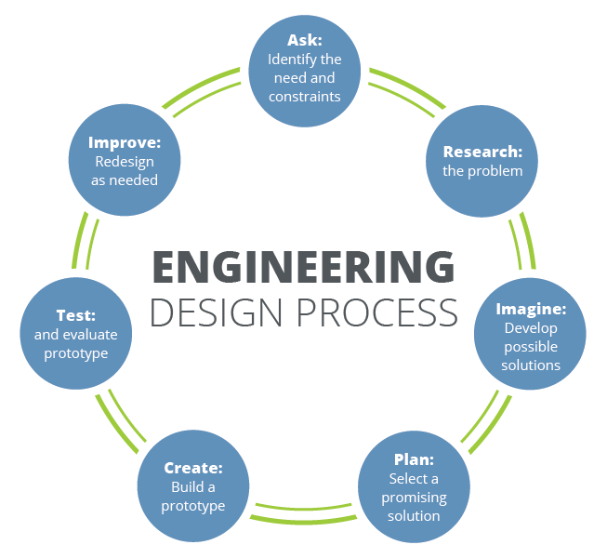
BACKGROUND INFORMATION
Engineering design process
Systematic approach to designing a new product
Idea generation occurs during the “Imagine” phase
Design fixation – having preconceived notions of an initial idea and the inability to think of alternatives
Reverse engineering – process of reproducing a product by examination of the product’s components and functions
Figure 2: Engineering Design Process Courtesy of Teach Engineering
3

Slide 5
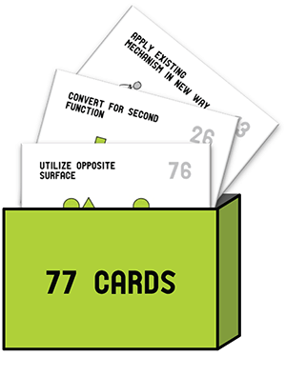
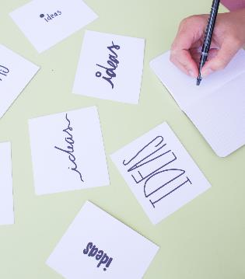
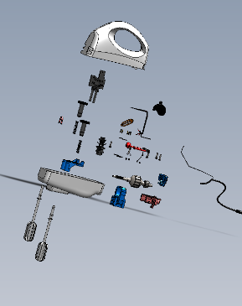
BACKGROUND INFORMATION
Design fixation can be overcome with these idea generation methods:
Substitute
Combine
Adapt
Modify
Put to another use
Eliminate
Reverse
Design Heuristics
Brainstorming
Product Dissection
Scamper
Figure 3: Idea Generation Methods
4

Slide 6
BACKGROUND INFORMATION
No (self) judgement
Encourage wild ideas
Stay focused on the topic
Be visual
Go for quantity (9 or more)
Combine and improve ideas
Figure 4: Rules for Brainstorming
5

Slide 7
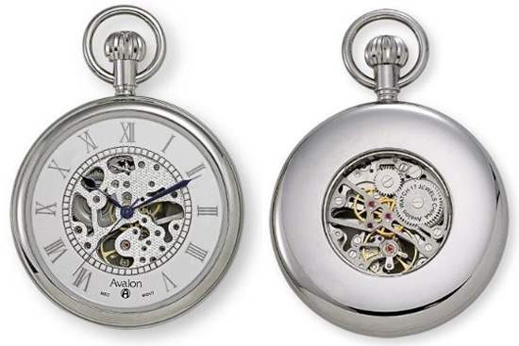
BACKGROUND INFORMATION
Product dissection – systematic disassembly of products
Power supply/energy source – how is power supplied?
Primary motion – how is mechanical motion achieved?
Energy flow – how is power transferred to create motion?
Form and outer body – how do users interact with outer components?
Example: Pocket watch
Power supply – battery and compressed spring
Primary motion – gear train drives clock hands
Energy flow – spring gets wound and mechanical energy powers watch
Form – winding crown, cover, case body
Figure 5: Pocket Watch Courtesy of Retro Thing
6

Slide 8
MATERIALS
SolidWorks eDrawings
Product dissection files
Virtual product dissection handout
Any materials needed for hypothetical design of a water toy
7

Slide 9
PROCEDURE
Part 1: Creativity (10 minutes)
Get in groups and take out paper and a pencil
Write down as many alternative ways as possible to use a paperclip (2 minutes)
Count the number of ideas generated as a group
Identify the greatest number of ideas generated – winner gets a prize!
Figure 6: Paperclip
8

Slide 10
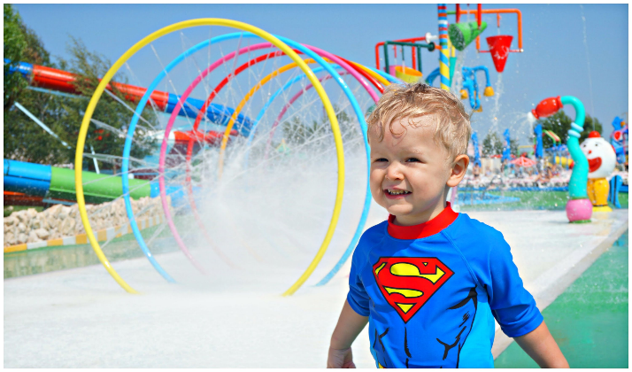
PROCEDURE
Part 2: First Idea Generation Session (5 minutes)
Work individually
List down all ideas for a water toy for use by children ages 4 – 6
Focus on a fun toy rather than a safe toy
Figure 7: Child at Water Park Courtesy of BabyCouture
9

Slide 11
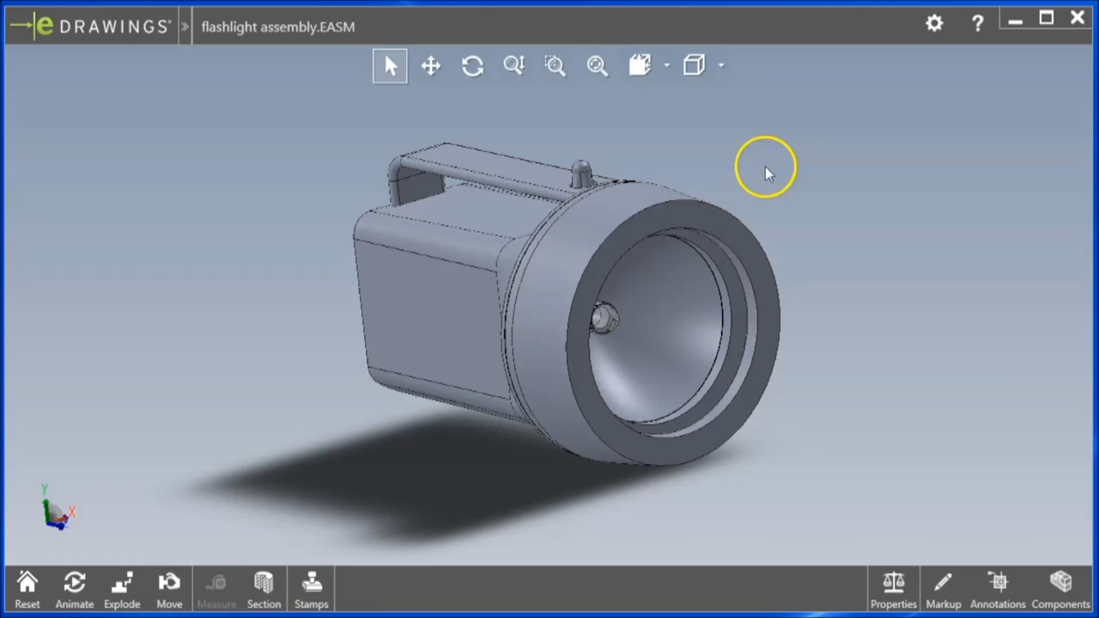
PROCEDURE
Part 3: Product Dissection Overview (2 minutes)
Figure 8: SolidWorks eDrawings Tutorial Courtesy of Elizabeth Starkey
10

Slide 12
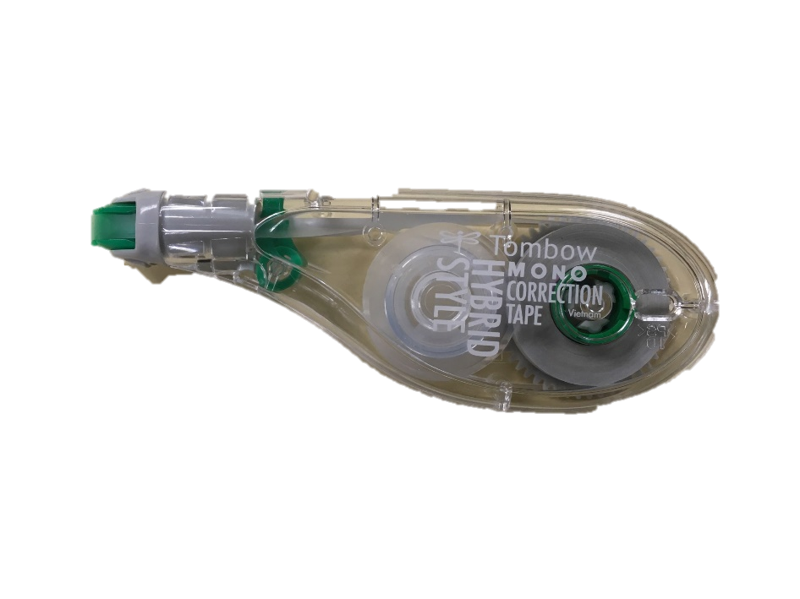
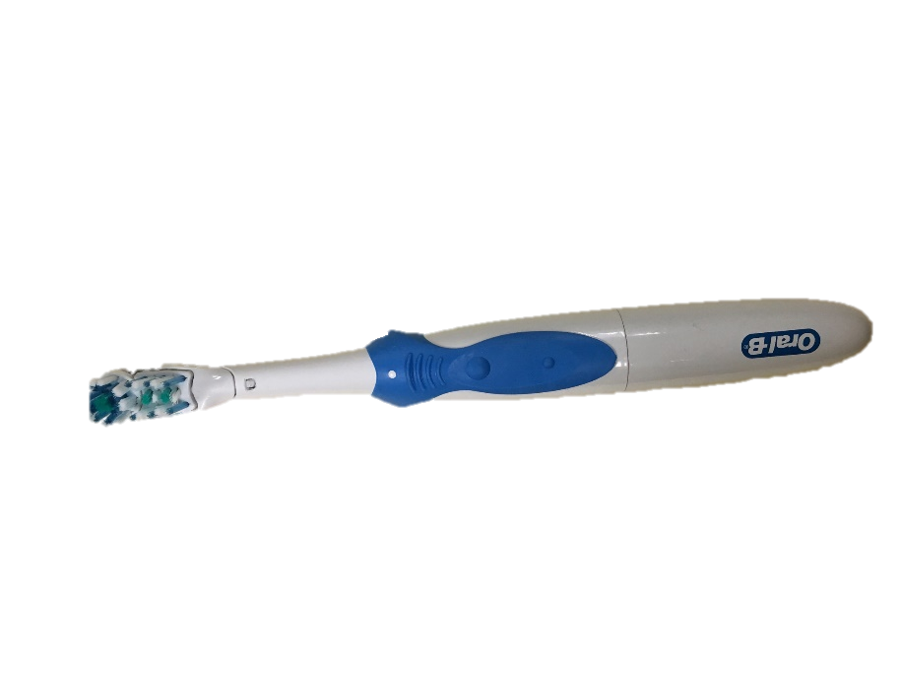
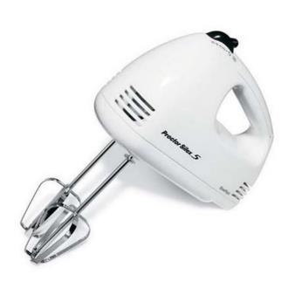
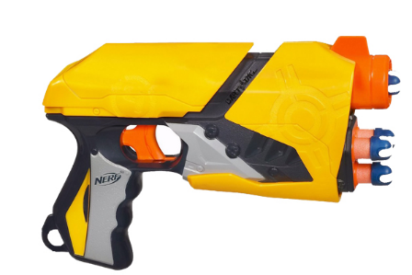
PROCEDURE
Part 4: Product Dissection Activity (20 minutes)
Go to Lab 4A – Virtual Product Dissection
Download products to dissect – different for each team member
Fill out the virtual product dissection handout individually
Figure 9: Products Available for Dissection
11

Slide 13
PROCEDURE
Part 5: Second Idea Generation Session (5 minutes)
Work individually
List down all ideas for a water toy for use by children ages 4 – 6
Focus on a fun and safe toy
Figure 10: Child at Water Park Courtesy of BabyCouture
12

Slide 14
PROCEDURE
Part 6: Reflection
Share your ideas with your teammates and think about the following questions:
In what way did the product dissection activity help you develop ideas?
Did the product you dissected impact the ideas you developed?
Do you think it is useful to dissect different products when working in a group?
13

Slide 15
ASSIGNMENT
Individual lab report:
No lab report for Lab 4
Team presentation:
No presentation for Lab 4A
Milestone 1 Presentation next week
14

Slide 16
CLOSING
Each team member should dissect their own product
Submit all work electronically
Take screenshots
Take pictures of the product dissection handout
Follow detailed lab report format for Lab 4A in student manual
15

Slide 17
CLOSING
Required Pre-Lab Activity for Lab 6:
Complete the online NYU Tandon MakerSpace Safety Orientation training
Requires watching three videos
Covid-19 Policies and Updates
Safety Orientation
Ultimaker
Refer to the Lab 6A manual page for more information
16

Slide 18
QUESTIONS?

