Slide 1

PRODUCT EVALUATION
EG1003 | LAB 3

Slide 2
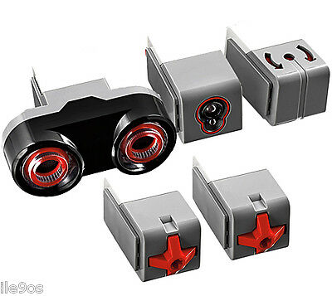
AGENDA
Objective
Background Information
Materials
Procedure
Assignment
Closing
Figure 1: EV3 sensors courtesy of PicClick
1

Slide 3
OBJECTIVE
Create two codes for an EV3 Mindstorms robot, with and without sensors
Test the codes against the EG1003 standards for accuracy and precision
Emphasize the importance of product evaluation
2

Slide 4
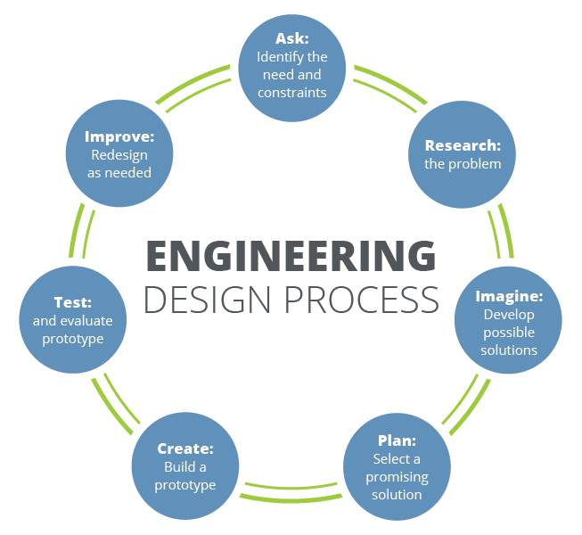
BACKGROUND INFORMATION
Product evaluation occurs during the “test” phase of the engineering design process
  Highly iterative
  Constantly looking for improvements
Tests are performed to a company standard
  If the standard is met, the product is acceptable
  If the standard is not met, the product may be redesigned or withdrawn
Figure 2: Engineering design process
courtesy of Teach Engineering
3

Slide 5
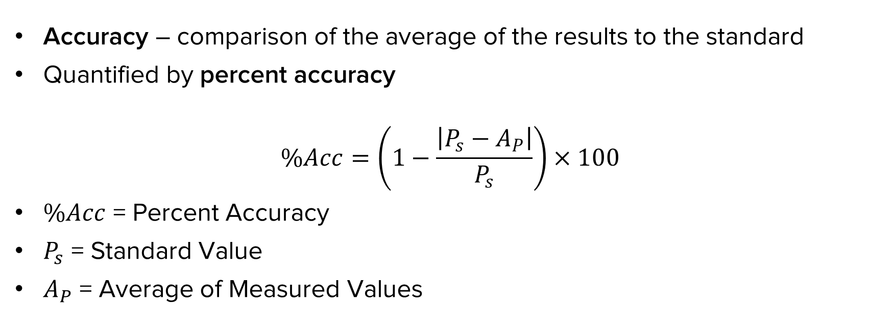
BACKGROUND INFORMATION
Accuracy – comparison of the average of the results to the standard
Quantified by percent accuracy
$$\%Acc=\left(1−\frac{\left|P_{s}−A_{P}\right|}{P_{s}}\right)×100$$
$\%Acc$ = Percent Accuracy
$P_{s}$ = Standard Value
$A_{P}$ = Average of Measured Values
4

Slide 6

BACKGROUND INFORMATION
Precision – repeatability of the results, how close they are to each other
$$\text{±}P=\frac{\left|P_{high}−P_{low}\right|}{2}$$
$P_{high}$ = Highest Data Value
$P_{low}$ = Lowest Data Value
5

Slide 7
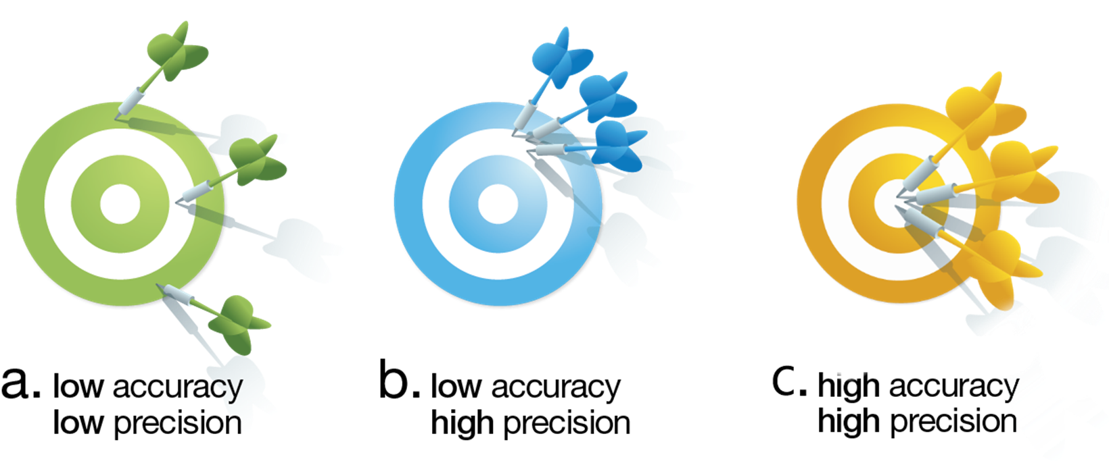
BACKGROUND INFORMATION
Figure 3: Accuracy vs. Precision
6

Slide 8
BACKGROUND INFORMATION
EG1003 Standard
  Distance test: 5 cm
  Angle of deviation test: 360˚
  Obtain within 80% of standard values
Tolerance – the precision standard set by the manufacturer
  Distance test: T = ± 1 cm
  Angle of deviation test: T = ± 10˚
Wall
θ in degrees
Target = 5 cm
Figure 4: Product evaluation test
7

Slide 9
BACKGROUND INFORMATION
Quality improvement - process of analyzing a design and testing it through physical modeling, computer simulation, or mathematical modeling
Does the robot perform to standard?
  If no, what can be done to improve its functionality?
  If yes, what can be done to improve its performance beyond the standard?
8

Slide 10
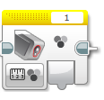

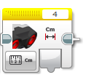
BACKGROUND INFORMATION
Sensor - measures a physical property and records, indicates, or responds to the measured value
Figure 5: Light sensor, gyro sensor, and ultrasonic sensor blocks (left to right) in EV3 Mindstorms
9

Slide 11
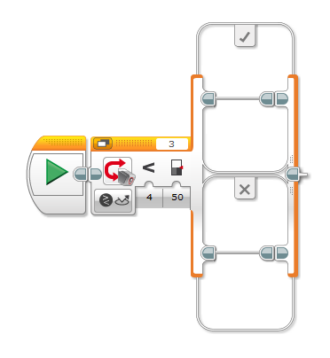
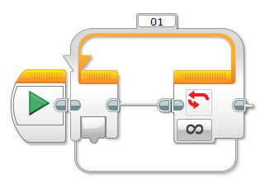
BACKGROUND INFORMATION
Switch – perform certain actions depending on the input
Loop – repeat an action until an end condition is met
Figure 6: Switch block (left) and loop block (right) in EV3 Mindstorms
10

Slide 12
MATERIALS
EV3 Mindstorms kit with robot
Computer with Mindstorms software
Mini-course with accuracy markings
Datasheet
Mindstorms program
11

Slide 13
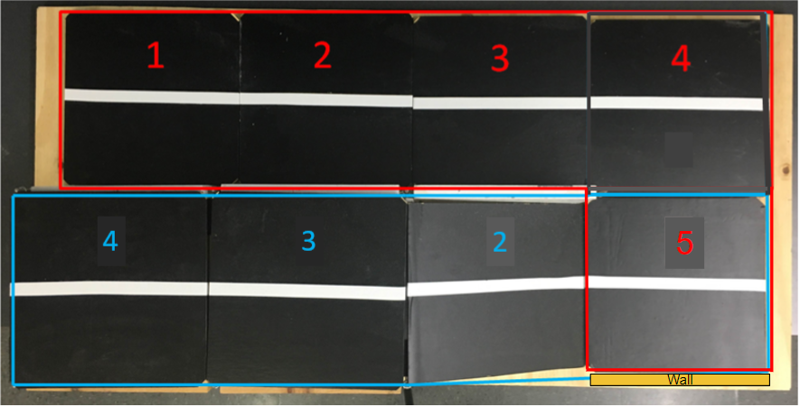
PROCEDURE
Figure 7: Product Evaluation lab mini-course
12

Slide 14
PROCEDURE
Two parts: hardcode and sensors code
  Attempt to achieve within 80% of EG1003 standard values
  Conduct distance and angle of deviation tests
  Fix Mindstorms program
  Run four trials each of Section 1
  Test different values to find optimal setting (power, rotations, etc.)
  Record data in datasheet and take screenshots of code
13

Slide 15
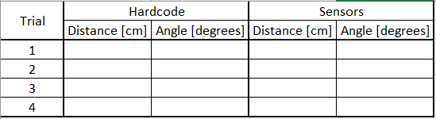
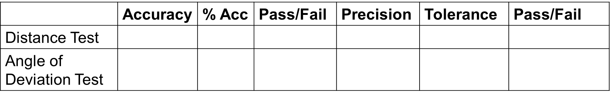
PROCEDURE
Tabulate data into two charts
Table 1: Hardcode and sensors code results
Table 2: Accuracy and precision evaluation
14

Slide 16
PROCEDURE
Extra credit portion
  Robot traverses entire course (Sections 1 and 2)
  Stops within 10 cm of wall
  Awarded extra credit only if robot completes entire course
Figure 8: Product Evaluation lab mini-course
15

Slide 17
ASSIGNMENT
Individual lab report:
  Answer discussion questions in manual
  Include tables from datasheet
  Include screenshots of the code
  Due at 11:59 PM the night before Lab 4
Team presentation:
  Address discussion points in manual
  Include data from trials
  Include screenshots of the code
16

Slide 18
CLOSING
Share tasks – each team member should take a turn building the code
Submit all work electronically
Take pictures
Clean up workstations
Return all unused materials to the TA
17

Slide 19
QUESTIONS?

